Slide 1
Introduction to Client-Side Development - html
Web 3

Slide 2
Client-Side Core
HTML
marked up text that provides the actual content to be displayed
HTML5 provides some new semantic tags
CSS
is a selector {key:value} system that specifies format/visual appearance.
JavaScript
an interpreted OO programming language that runs in the browser
The great power of modern JavaScript is that in can access the contents of a web page (specifically the data structure the browser has constructed to represent that contents, i.e. the DOM) while the page is displaying, and can modify that contents in response to system and user events.

Slide 3
Cross Browser Issues
You might detect problems moving from browser to browser
For example, IE and Firefox have different default padding and margins, so the minute you start using <div> your pages look difference on the two browsers
Acknowledge but ignore
We will use Chrome(latest installed version) for the course
I will be marking assignments in Chrome, so ensure your stuff looks correct in Chrome
Three reasons:
Market dominance
Has sensible defaults
Supports the majority of CSS3 and HTML5 features
Has DevTools

Slide 4
Where did HTML come from?
HTML is a markup language
A way of annotating a document
Allow users to control how text and visual elements will be laid out and displayed
Combining semantic markup with presentation markup is no longer permitted in HTML5
HTML5 is now a living language: that is, it is a language that evolves
not all browsers and all versions support every feature of HTML5

Slide 5
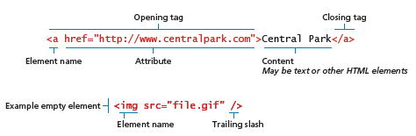
HTML syntax

Slide 6
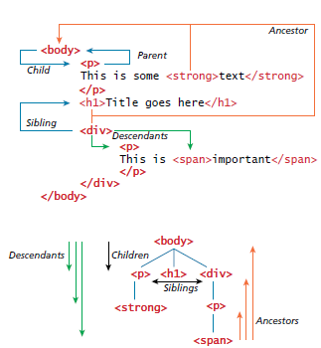
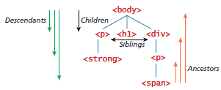
HTML document outline
This way of thinking will become useful when we learn how to use JavaScript to modify the DOM

Slide 7
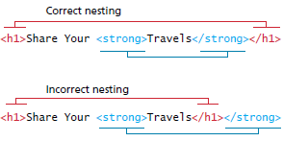
HTML nesting of elements

Slide 8

Semantic markup
HTML documents should not describe how to visually present content
Inline Styling is bad
Presentational tags are bad
HTML documents should describe its contents structural semantics or meaning
Eliminating presentation oriented markup and writing semantic HTML markup has several advantages:
Maintainability
Speed
Accessibility
Search engine optimization

Slide 9
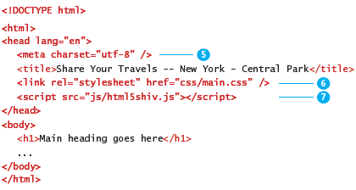
Structure of HTML documents

Slide 10
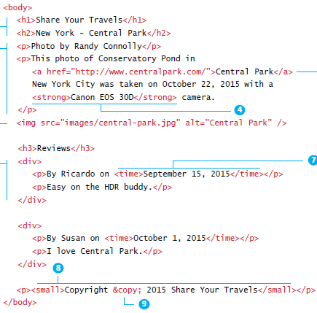

Headings paragraphs and divisions

Slide 11
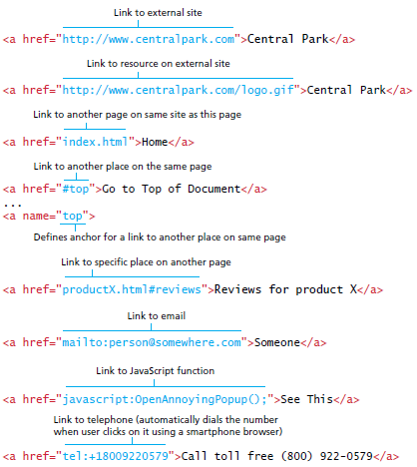
Anchor tags and URL Relative Referencing

Slide 12
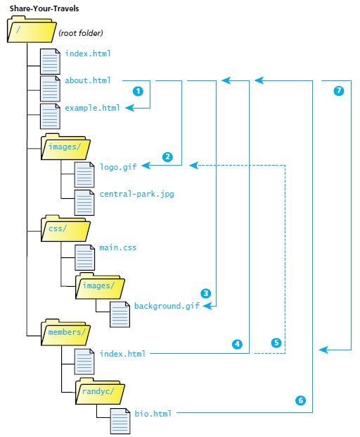
Site directory tree

Slide 13
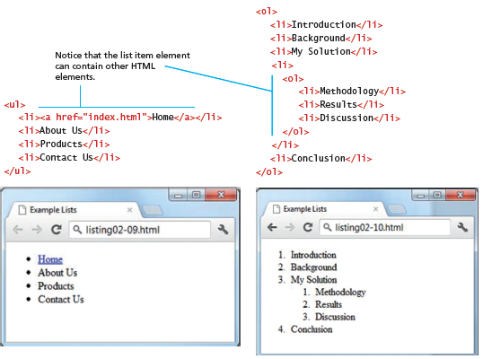
Lists

Slide 14
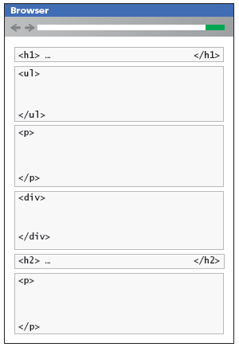
Block level elements

Slide 15

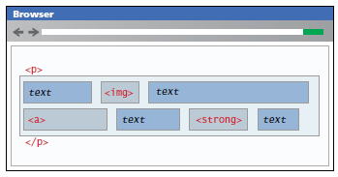
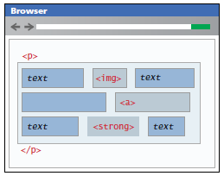
In-line elements

Slide 16
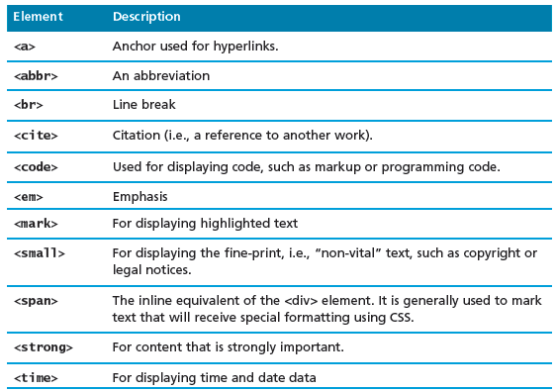
In-line text elements

Slide 17
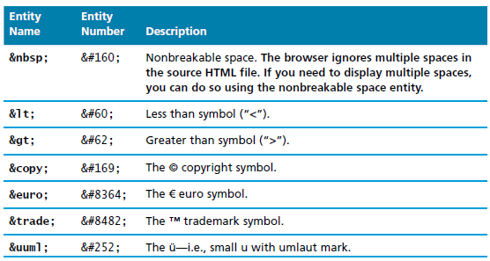
Character entities
Special characters for symbols for which there is no easy way to type them or for symbols which have a reserved meaning in HTML (“<“)

Slide 18
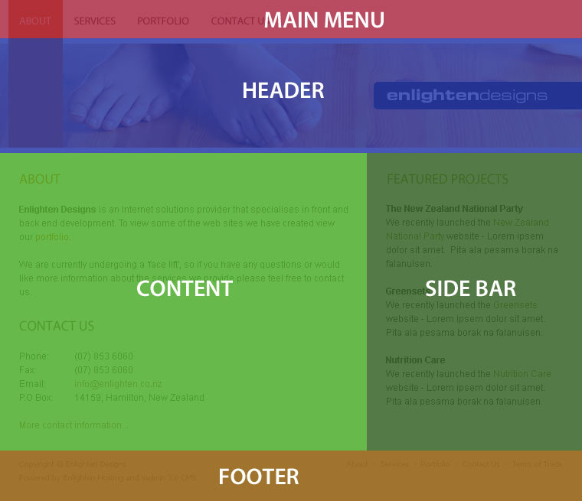
HTML5 semantic structure elements
Beyond <div>

Slide 19
HTML 5
We all use div to separate our documents into chunks. Pragmatically, we do this so we can position them or apply CSS styles to them
But these chunks usually have distinct *semantic* roles – that’s why they are visually delineated by position or style
They are sections, or sidebars, or footers or whatever; these names are often reflected in the id’s that we give the divs
These semantic roles are important. Logically they express the semantic structure of the information on the page; pragmatically, web crawlers or TTS readers can use semantic information to better process and analyse the HTML

Slide 20
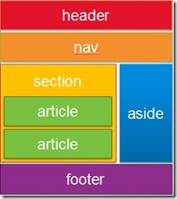
HTML5 semantic structure elements
Beyond <div>
Here are some of the new tags
Each defines a block element (i.e. it has padding, margin, etc. like a div does, available for styling)
Use these to describe the logical roles of the chunks in your document
You can still give them id’s if you need to for reaching them from the code behind
article
section
aside
figure
figcaption
header
footer
nav

Slide 21
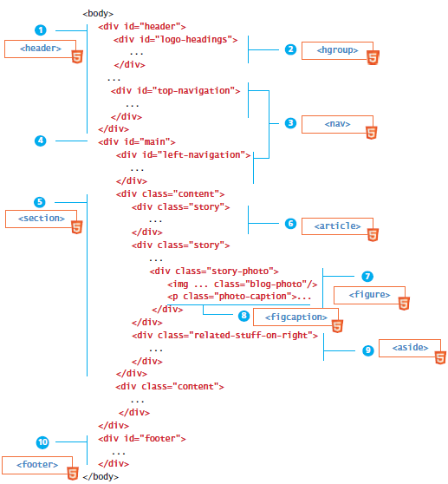
HTML5 semantic structure elements

Slide 22
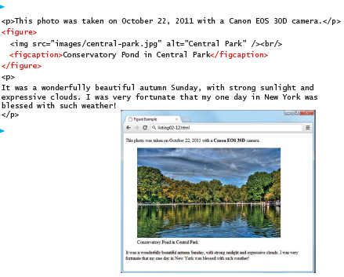
Figures and figure captions

Slide 23
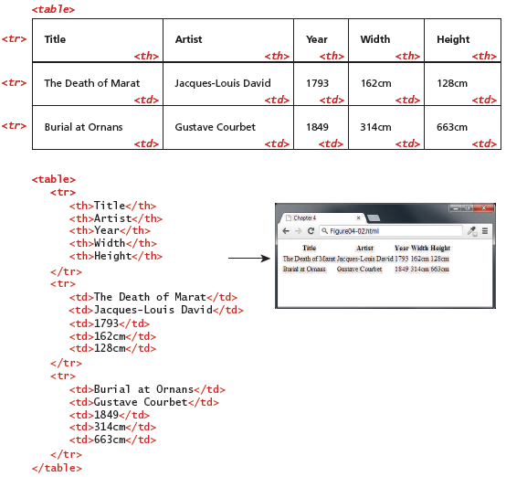
HTML tables

Slide 24
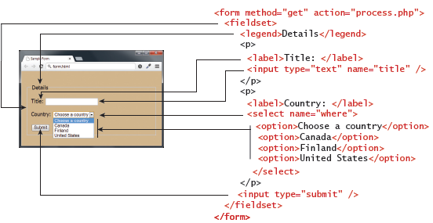
Forms

Slide 25
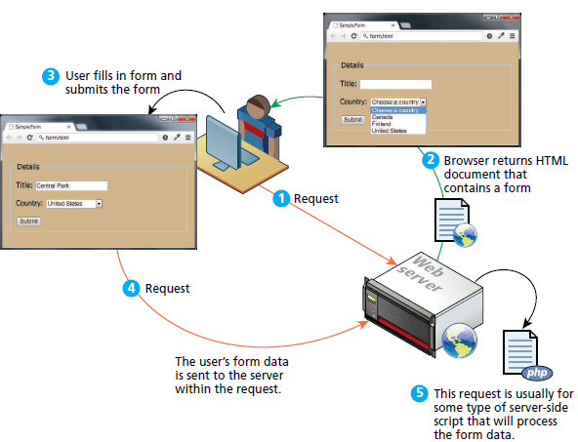
How forms work

Slide 26
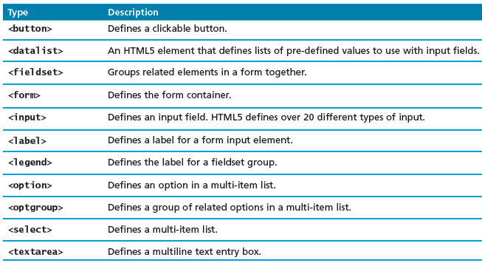
Form related HTML elements

Slide 27
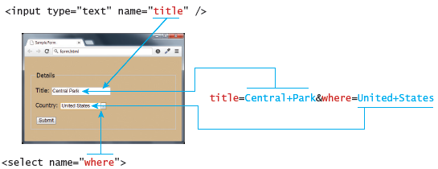
Query string data and its connection to the form elements

Slide 28
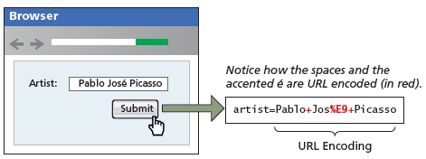
URL encoding

Slide 29
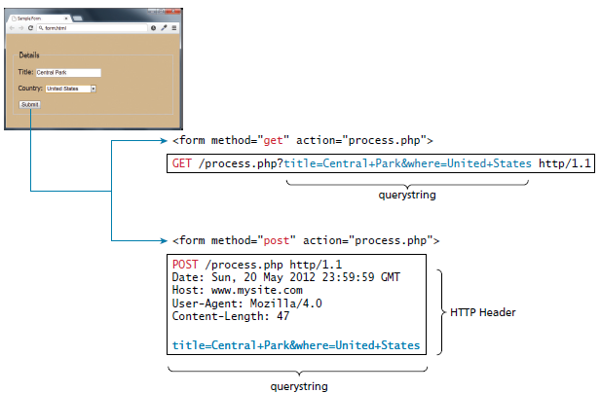
GET versus POST

Slide 30
GET versus POST
GET
Data can be clearly seen in the address bar. This could be:
An advantage during development
A disadvantage in production
Data remains in browsing history and cachet
Could be beneficial to some users
Could be a security risk on public computers
Data can be bookmarked
Limit on the number of characters in the form data returned
POST
Data can contain binary data
Data is hidden from user
Submitted data is not the stored in cache, history or bookmarks

Slide 31
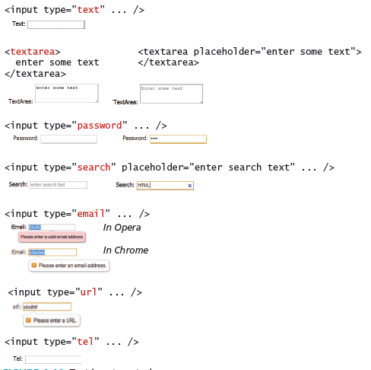
Text input controls

Slide 32
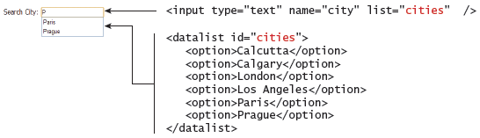
<datalist> element

Slide 33
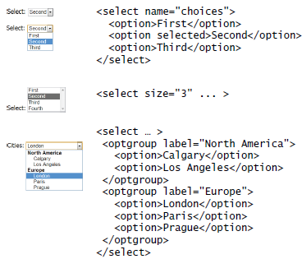
<select> element

Slide 34
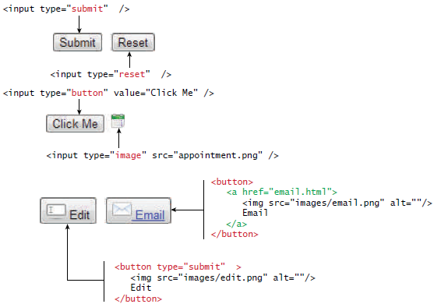
Button elements

Slide 35
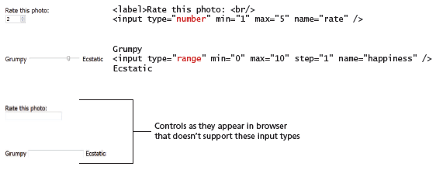
Number and range input controls

Slide 36
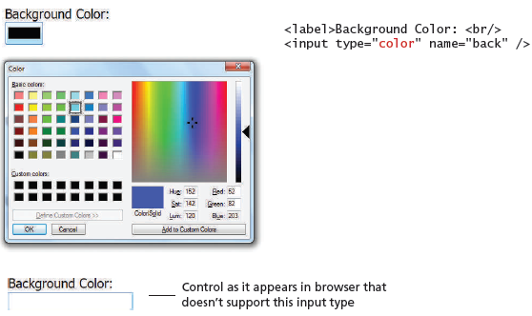
Color input control

Slide 37
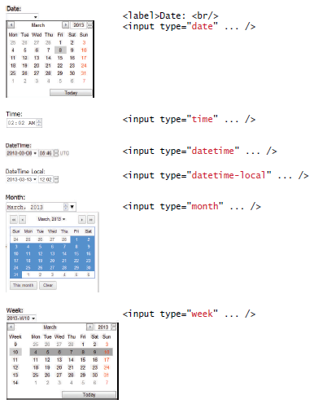
Date and time controls

Slide 38
Practical

