Slide 1
bootstrap
Web 3 2015

Slide 2
The Problem
Website Front-end development can be a painful process
CSS based layouts are difficult to create and maintain and don’t render uniformly across different browsers

Slide 3
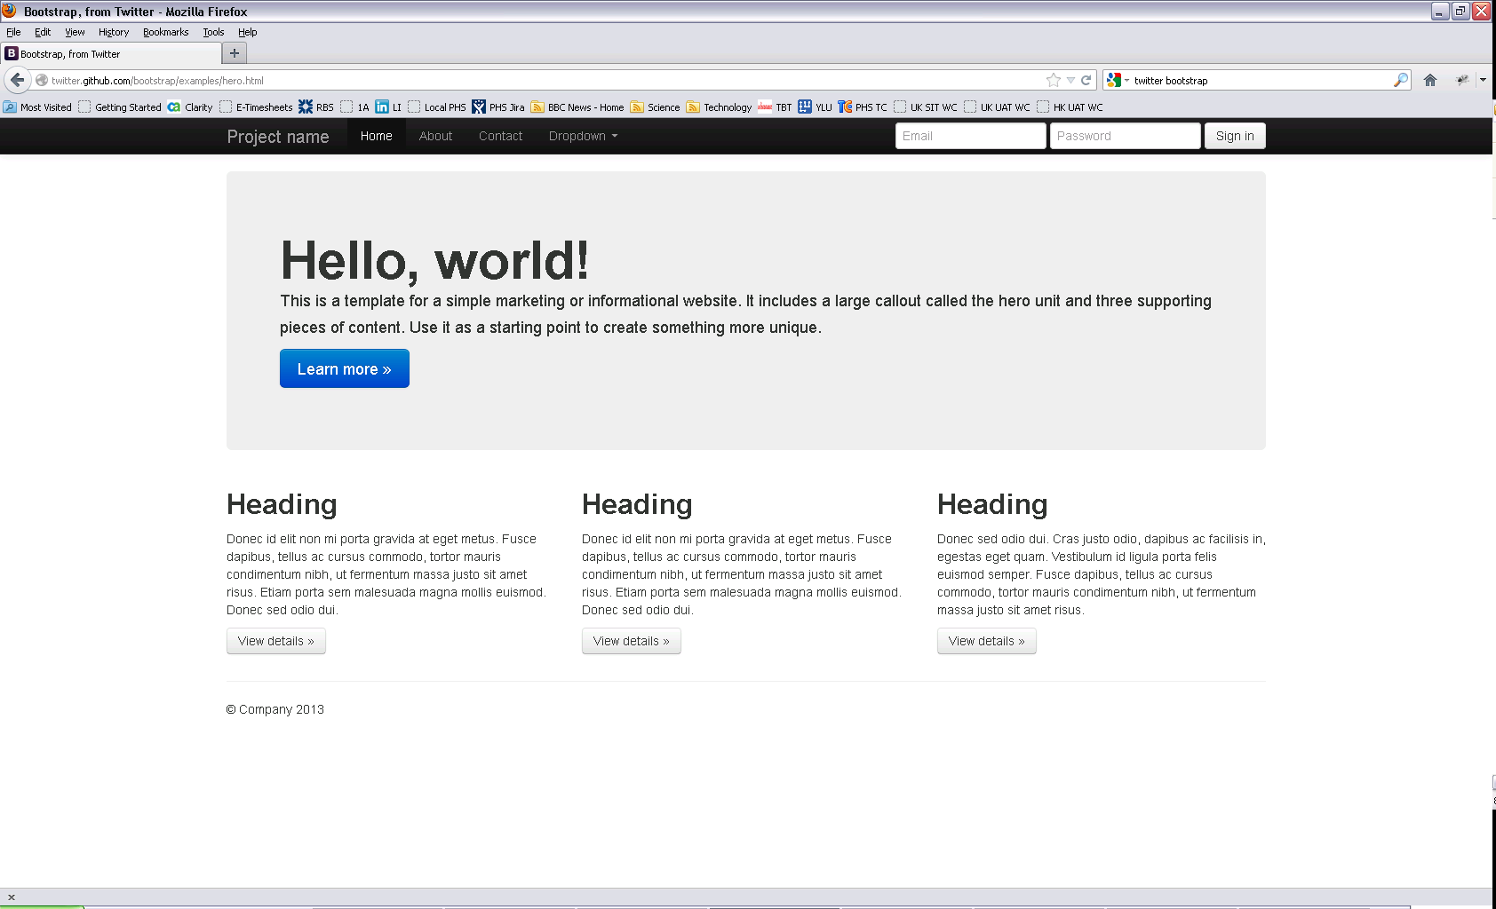
The Solution – Twitter Bootstrap

Slide 4
Twitter Bootstrap
Sleek, intuitive, and powerful mobile first front-end framework for faster and easier web development
Very easy to use and based on latest Web Development Standards for screen and form design
Very lightweight – it can be as little as just one CSS and one JS file
It does things easier and faster
All you have to do is just place the right HTML mark-up at correct place with the correct predefined classes

Slide 5
How it Works
Twitter Bootstrap is largely dependent on a 12 column grid
Suppose you want two large equal divisions inside the body of your index.html
You have to give a specific class name of size 6 to each of div element.
This tells Bootstrap to make two equal divisions that should span six grids on each side
Similar to 960 grid system
Bootstrap has a set of predefined classes for each element
You have to give appropriate classes to each when needed

Slide 6
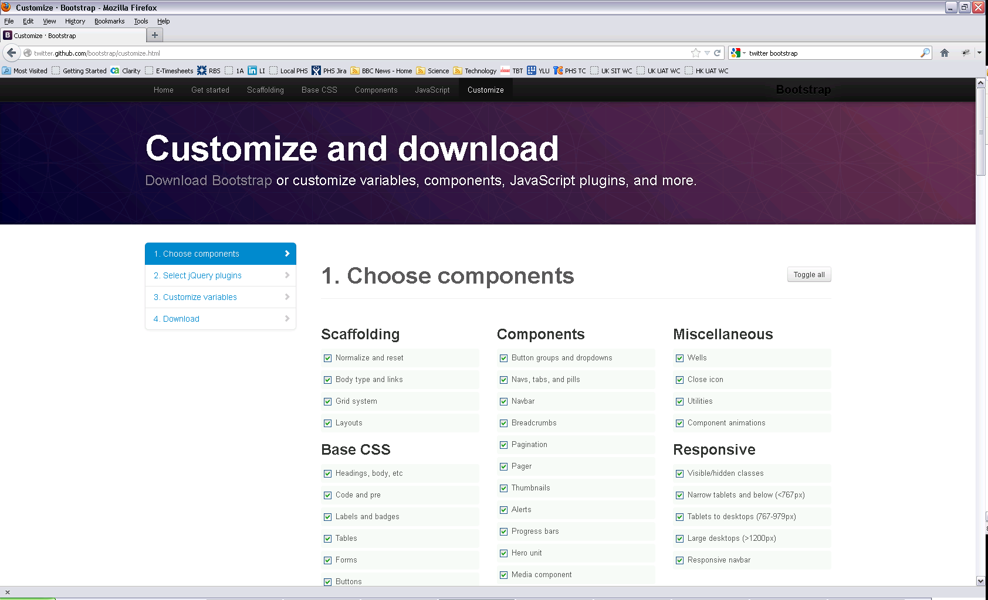
Customise and download

Slide 7
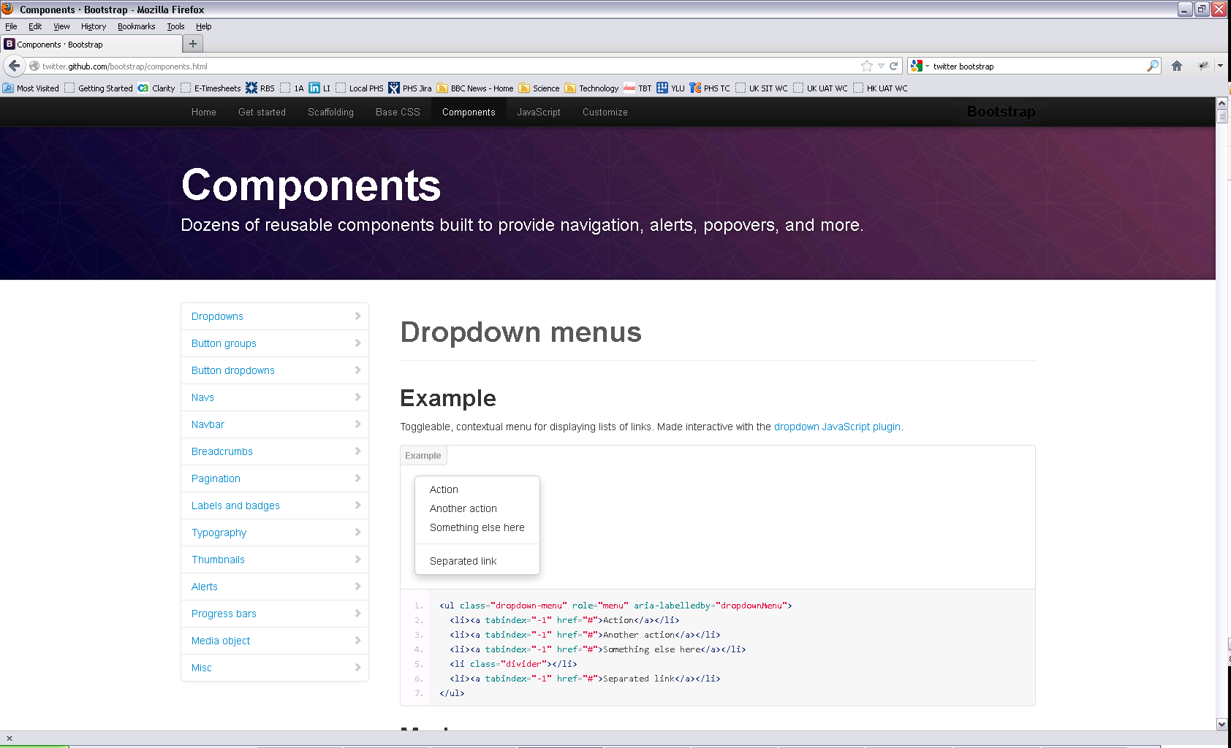
Bootstrap Components

Slide 8
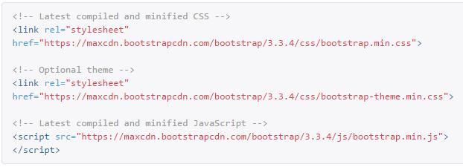
Bootstrap CDN

Slide 9
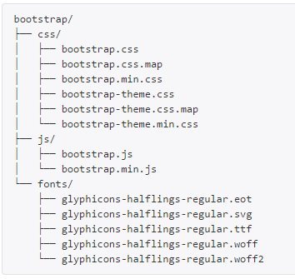
Downloaded Bootstrap

Slide 10
Mobile First
To ensure proper rendering and touch zooming, add the viewport meta tag to your <head> element
You can disable zooming capabilities on mobile devices by adding user-scalable=no to the viewport meta tag
This disables zooming, meaning users are only able to scroll, and results in your site feeling a bit more like a native application

Slide 11
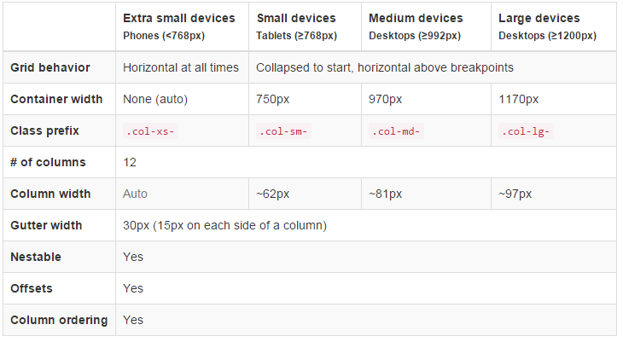
Grid Options

Slide 12
Bootstrap Grid System
12 column grid
Defined through CSS classes
3 key concepts
Containers
rows
columns

Slide 13
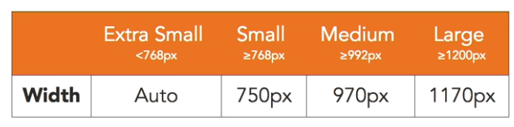
Bootstrap containers
Control layout
Adds padding by default
2 types
Fluid
Fixed-width
Shows a specific size depending on the size of the viewport
Adjusts to media query breakpoints
http://liveweave.com/BCK5Re

Slide 14
Bootstrap rows
Allow you to create horizontal groups of columns
Always need to be placed inside a container
If you use a row container you need to include columns
Gets rid of container padding

Slide 15
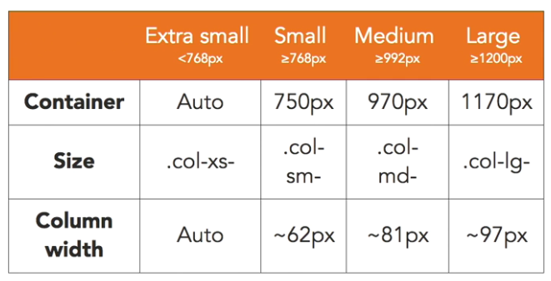
Bootstrap columns
The foundation of any bootstrapp layout
12 columns per row
30px gutters
15px on each side
Use col-SIZE-SPAN
The size specifies at which point the layout stacks
The span specifies how many columns the element wants to take
>12 columns wrap
http://liveweave.com/WKLTs6

Slide 16
Using multiple column classes
http://liveweave.com/eQnMZZ

Slide 17
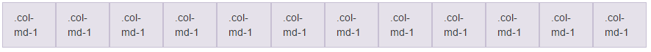
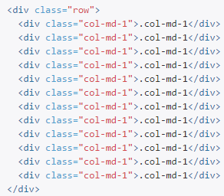
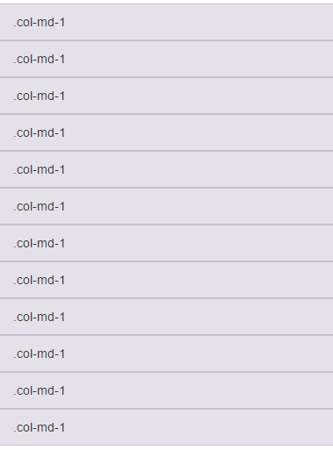
Example: Stacked-to-horizontal

Slide 18
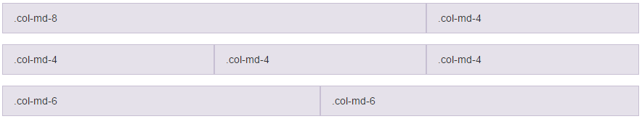
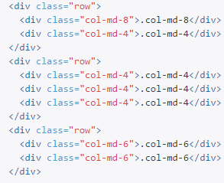
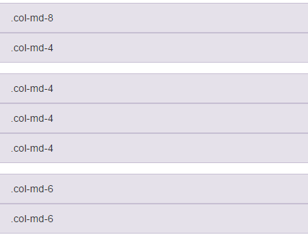
Example: Stacked-to-horizontal

Slide 19
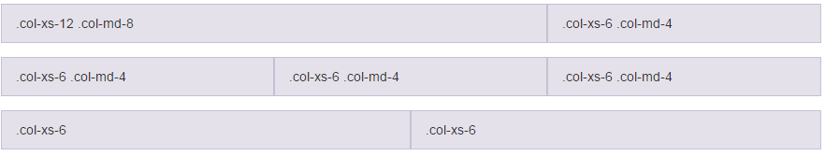
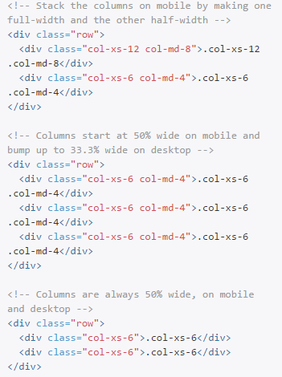
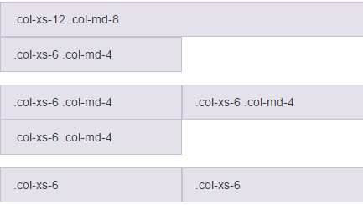
Example

Slide 20
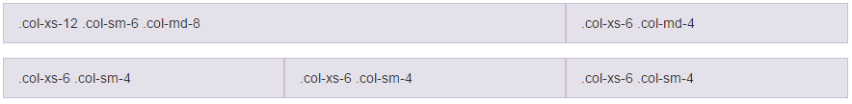
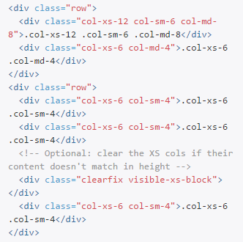
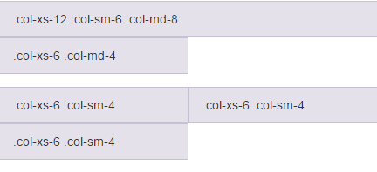
Example

Slide 21
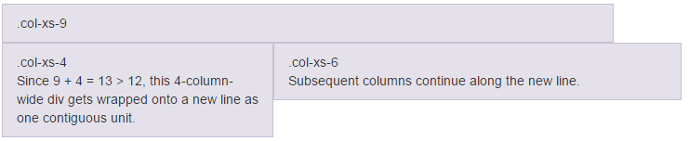
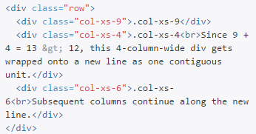
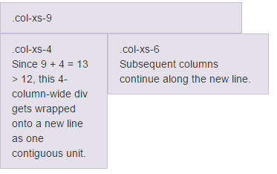
Example: Column wrapping

Slide 22
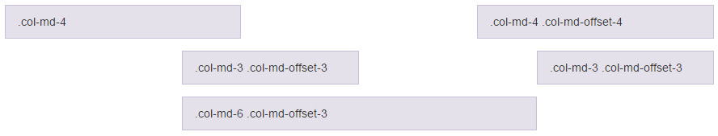
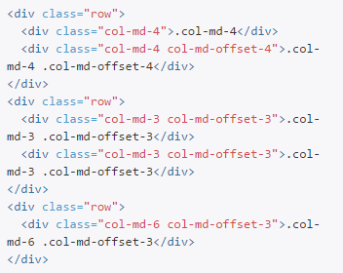
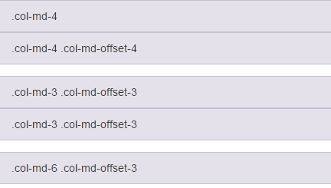
Offsetting columns

Slide 23
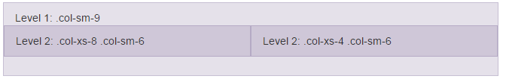
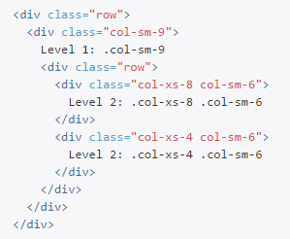
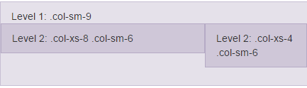
Nesting columns

Slide 24
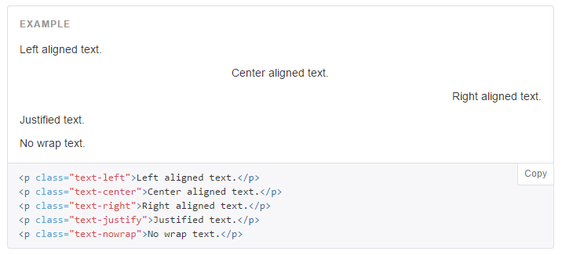
Alignment classes

Slide 25
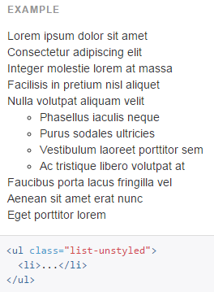
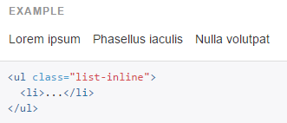
Lists

Slide 26
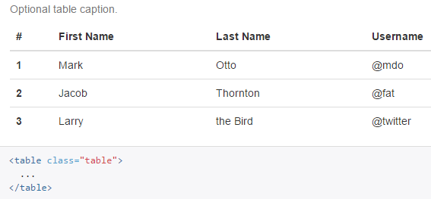
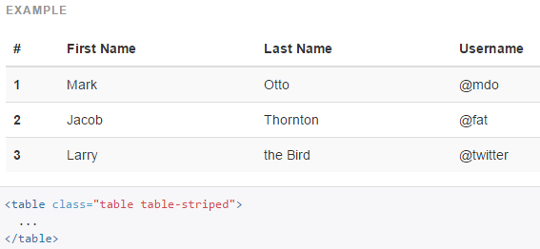
Tables

Slide 27
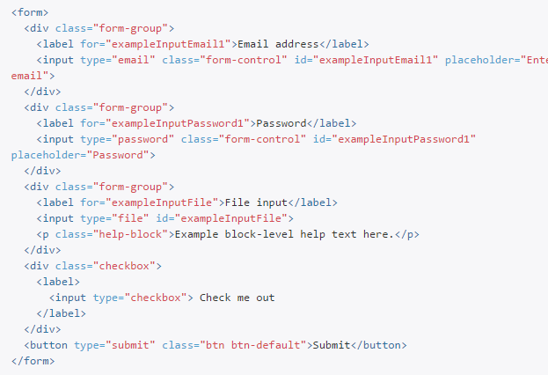
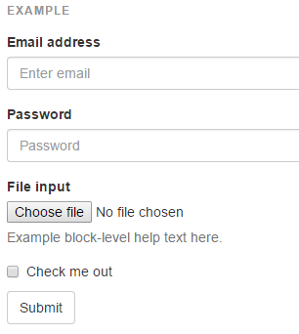
Forms

Slide 28
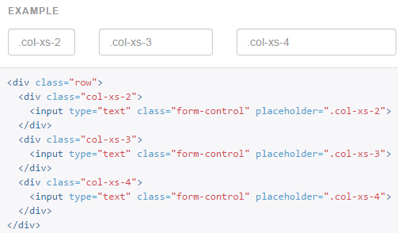
Column sizing

Slide 29
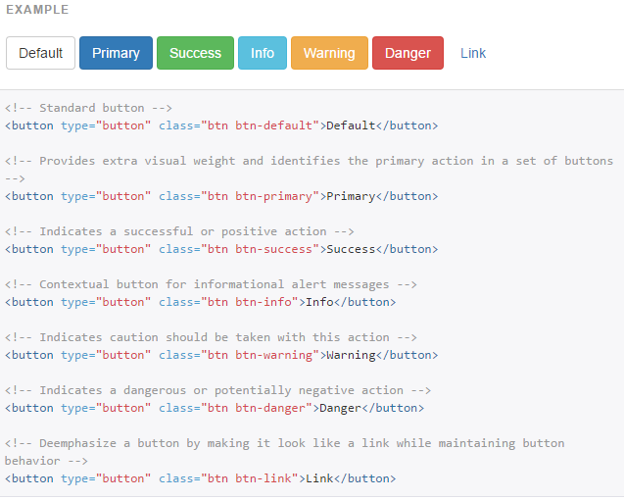
Buttons

Slide 30
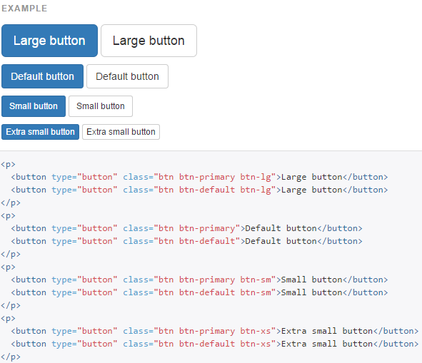
Buttons

Slide 31
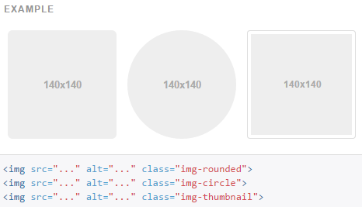
Images

Slide 32
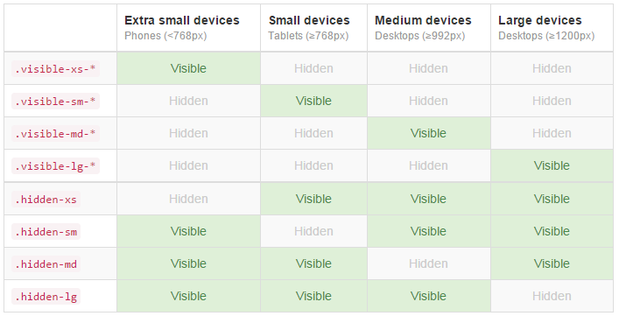
Responsive utilities
Showing and hiding content by device via media query
Use a single or combination of the available classes for toggling content across viewport breakpoints

Slide 33
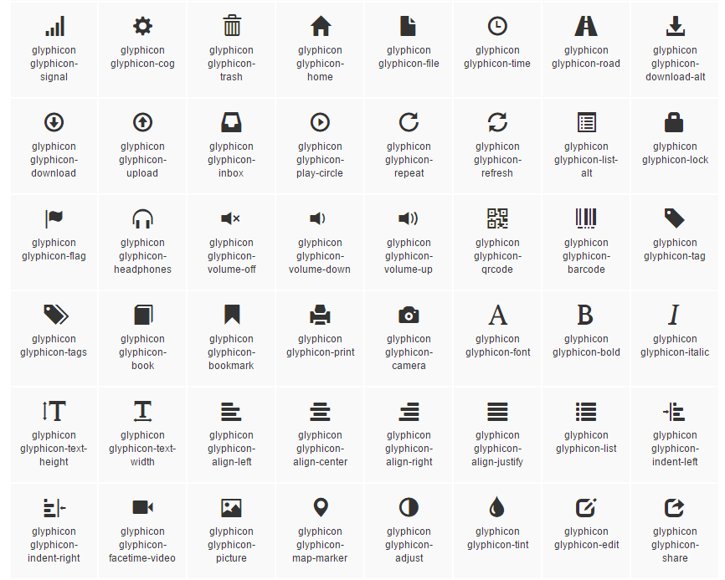
Glyphicons
Includes over 250 glyphs in font format from the Glyphicon Halflings set

Slide 34
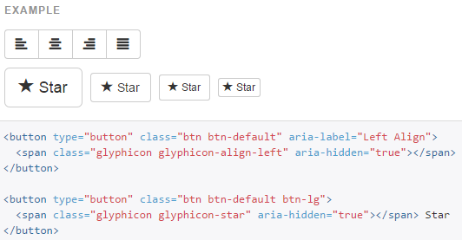
Example

Slide 35
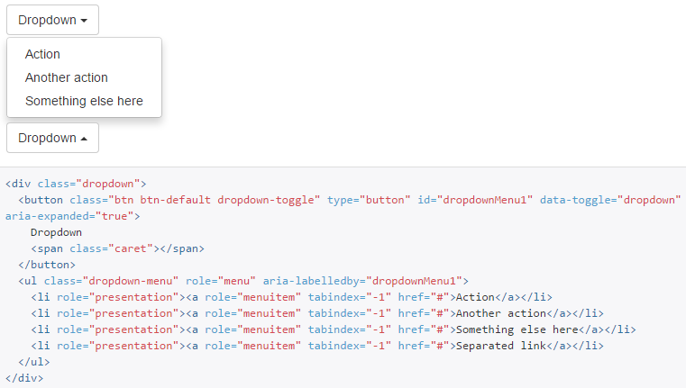
Dropdowns

Slide 36
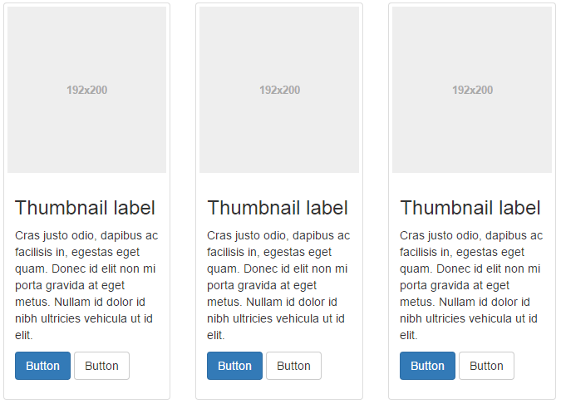
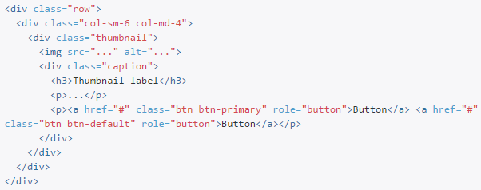
Putting It All Together

