Slide 1
Question: Can we create a psychological profile of each subjects’ behavior based on daily data?
Daily Behavioral
Assessment:
Pop-up notification
D
 | Day 1 | Day 2 | Day 3 | … | Day T
Anxiety | 2 | 1 | 3 | … | 5
Depr. | 2 | 0 | 4 | … | 6
Physical Activity | 10 | 7 | 7 | … | 3
Sleep quality | 10 | 8 | 7 | … | 4
Cognitive Score | 6 | 7 | 3 | … | 7
S
A
C
P

Slide 2
 | Day 1 | Day 2 | Day 3 | … | Day T
Anxiety | 2 | 1 | 3 | …
Depr. | 2 | 0 | 4 | …
Physical Activity | 10 | 7 | 7 | …
Sleep quality | 10 | 8 | 7 | …
Cognitive Score | 6 | 7 | 3 | …
 | Day 1 | Day 2 | Day 3 | … | Day T
Anxiety | 4 | 5 | 6 | …
Depr. | 2 | 0 | 4 | …
Physical Activity | 10 | 7 | 7 | …
Sleep quality | 10 | 8 | 7 | …
Cognitive Score | 6 | 7 | 3 | …
 | Day 1 | Day 2 | Day 3 | … | Day T
Anxiety | 9 | 10 | 8 | … | 6
Depr. | 2 | 0 | 4 | … | 7
Physical Activity | 10 | 7 | 7 | …
Sleep quality | 10 | 8 | 7 | …
Cognitive Score | 6 | 7 | 3 | …
…
…
…
…
 | Day 1 | Day 2 | Day 3 | … | Day T
Anxiety | 6 | 4 | 3 | … | 0
Depr. | 7 | 6 | 2 | … | 1
Physical Activity | 2 | 4 | 6 | … | 9
Sleep quality | 3 | 5 | 7 | … | 8
Cognitive Score | 4 | 7 | 8 | … | 7

Slide 3
 | Day 1 | Day 2 | Day 3 | … | Day T
Anxiety | 2 | 1 | 3 | …
Depr. | 2 | 0 | 4 | …
Physical Activity | 10 | 7 | 7 | …
Sleep quality | 10 | 8 | 7 | …
Cognitive Score | 6 | 7 | 3 | …
 | Day 1 | Day 2 | Day 3 | … | Day T
Anxiety | 4 | 5 | 6 | …
Depr. | 2 | 0 | 4 | …
Physical Activity | 10 | 7 | 7 | …
Sleep quality | 10 | 8 | 7 | …
Cognitive Score | 6 | 7 | 3 | …
 | Day 1 | Day 2 | Day 3 | … | Day T
Anxiety | 9 | 10 | 8 | … | 6
Depr. | 2 | 0 | 4 | … | 7
Physical Activity | 10 | 7 | 7 | …
Sleep quality | 10 | 8 | 7 | …
Cognitive Score | 6 | 7 | 3 | …
…
…
…
…
 | Day 1 | Day 2 | Day 3 | … | Day T
Anxiety | 6 | 4 | 3 | … | 0
Depr. | 7 | 6 | 2 | … | 1
Physical Activity | 2 | 4 | 6 | … | 9
Sleep quality | 3 | 5 | 7 | … | 8
Cognitive Score | 4 | 7 | 8 | … | 7
D
S
A
C
P

Slide 4
 | Day 1 | Day 2 | Day 3 | … | Day T
Anxiety | 2 | 1 | 3 | …
Depr. | 2 | 0 | 4 | …
Physical Activity | 10 | 7 | 7 | …
Sleep quality | 10 | 8 | 7 | …
Cognitive Score | 6 | 7 | 3 | …
 | Day 1 | Day 2 | Day 3 | … | Day T
Anxiety | 4 | 5 | 6 | …
Depr. | 2 | 0 | 4 | …
Physical Activity | 10 | 7 | 7 | …
Sleep quality | 10 | 8 | 7 | …
Cognitive Score | 6 | 7 | 3 | …
 | Day 1 | Day 2 | Day 3 | … | Day T
Anxiety | 9 | 10 | 8 | … | 6
Depr. | 2 | 0 | 4 | … | 7
Physical Activity | 10 | 7 | 7 | …
Sleep quality | 10 | 8 | 7 | …
Cognitive Score | 6 | 7 | 3 | …
…
…
…
…
 | Day 1 | Day 2 | Day 3 | … | Day T
Anxiety | 6 | 4 | 3 | … | 0
Depr. | 7 | 6 | 2 | … | 1
Physical Activity | 2 | 4 | 6 | … | 9
Sleep quality | 3 | 5 | 7 | … | 8
Cognitive Score | 4 | 7 | 8 | … | 7
D
D
D
D
S
S
S
S
…
A
A
A
A
C
C
C
C
P
P
P
P

Slide 5
D
S
A
C
P

Slide 6
…
D
D
D
D
S
S
S
S
…
A
A
A
A
C
C
C
C
C
P
P
P

Slide 7
…
D
D
D
D
S
S
S
S
…
A
A
A
A
C
C
C
C
P
P
P
P
Shared Structure
Gender-moderated Effects
Socioeconomic-Moderated Effects

Slide 8
Socio-Economic
Effect
GNC
Shared Structure
Gender Effect
D
D
D
S
S
=
+
+
S1
A
A
A
C
C
P
P
P
D
D
S
S
S
=
+
+
A
A
S2
C
C
C
P
P
P

Slide 9
D
D
D
D
S
S
S
S
…
A
A
A
A
C
C
C
C
P
P
P
P
D
D
D
D
S
S
S
S
…
A
A
A
A
C
C
C
C
C
P
P
P

Slide 10
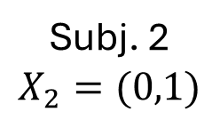
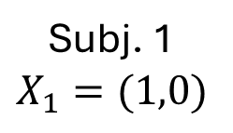
GCN
Shared Structure
Moderator 1
Moderator 2
D
D
D
S
S
=
+
+
Subj. 1
$$X_{1}=(1,0)$$
A
A
A
C
C
P
P
P
D
D
S
S
S
+
+
=
Subj. 2
$$X_{2}=(0,1)$$
A
A
C
C
C
P
P
P

Slide 11
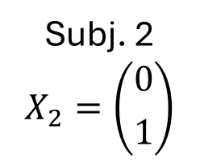
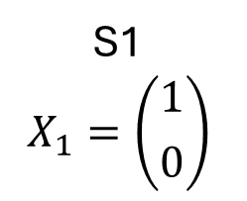
Fully Individual
GNC
Shared Structure
Mod. 1
Mod. 2
D
D
D
D
S1
$$X_{1}=\left({1 \atop 0}\right)$$
S
S
=
+
+
+
A
A
A
C
C
C
P
P
P
D
D
S
S
S
Subj. 2
$$X_{2}=\left({0 \atop 1}\right)$$
=
+
+
+
A
A
A
C
C
C
C
P
P
P
P

Slide 12
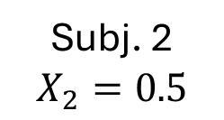
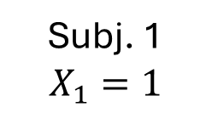
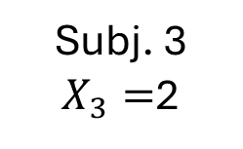
GCN
Shared Structure
Moderated
D
D
D
S
S
Subj. 1
$$X_{1}=1$$
=
+
A
A
A
C
C
P
P
P
D
D
D
S
S
Subj. 2
$$X_{2}=0.5$$
=
+
A
A
A
C
C
P
P
P
D
D
D
D
S
S
Subj. 3
$X_{3}=$2
=
+
A
A
A
A
C
C
P
P
P
P

Slide 13
GCN
Shared Structure
Moderated
Fully Individual
D
D
D
D
S
S
Subj. 1
$$X_{1}=1$$
=
+
+
A
A
A
C
C
C
P
P
P
D
D
D
S
S
Subj. 2
$$X_{2}=0.5$$
=
+
A
A
A
C
C
P
P
P
D
D
D
D
S
S
Subj. 3
$X_{3}=$2
=
+
+
A
A
A
A
A
C
C
C
P
P
P
P
P

