Slide 1
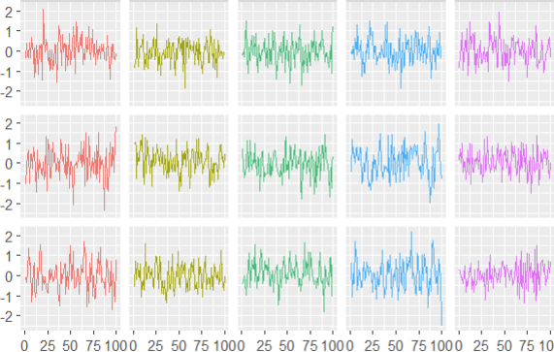
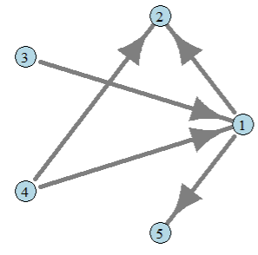
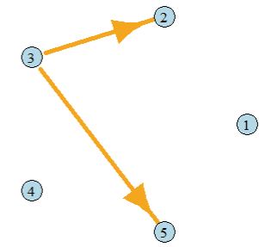
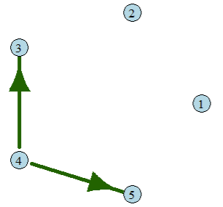
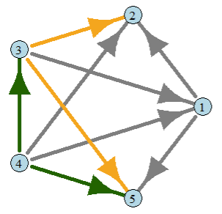
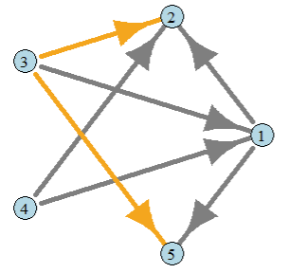
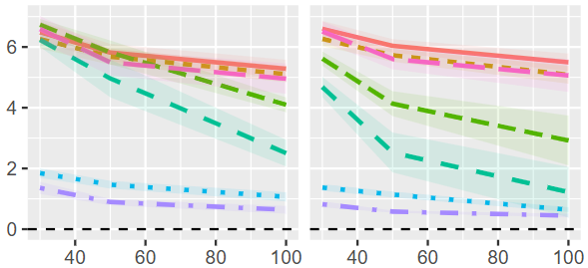


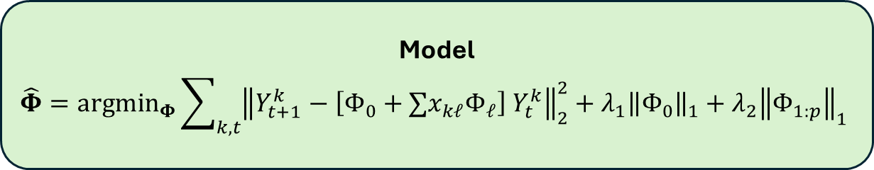







A
B
Sex
M
F
F
Model
$$\hat{Φ}={argmin}_{Φ}\sum_{k, t}{{\left\|Y_{t+1}^{k}−\left[Φ_{0}+∑x_{kℓ}Φ_{ℓ}\right] Y_{t}^{k}\right\|}_{2}^{2}}+λ_{1}{\left\|Φ_{0}\right\|}_{1}+λ_{2}{\left\|Φ_{1:p}\right\|}_{1}$$
S1
S2
S3
C
Socio-Economic
Effects
Gender
Effects
$$⋮$$
Common Network
$$⋮$$
$$⋮$$
$$⋮$$
$$⋮$$
$$⋮$$
S. No. | Soc-Ec | Sex
S1 | High | M
S2 | Low | F
S3 | Middle | F
Soc-Ec
High
Low
High
Sex
M
F
F
$$⋮$$
$$⋮$$
$$⋮$$
D
E
Prediction Error
10 Subjects
20 Subjects
S1
S2
S3
…
Estimation Error
Time points (T)
Covariate-Dependent Network Estimation

Slide 2
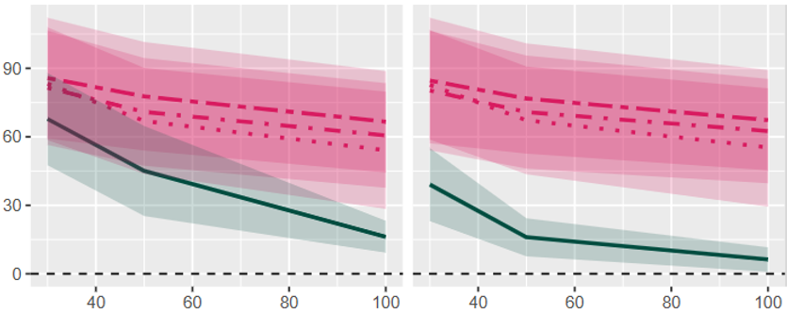


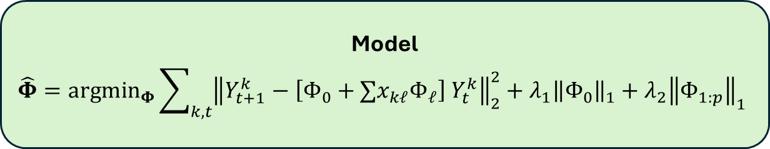







A
B
Sex
M
F
F
Model
$$\hat{Φ}={argmin}_{Φ}\sum_{k, t}{{\left\|Y_{t+1}^{k}−\left[Φ_{0}+∑x_{kℓ}Φ_{ℓ}\right] Y_{t}^{k}\right\|}_{2}^{2}}+λ_{1}{\left\|Φ_{0}\right\|}_{1}+λ_{2}{\left\|Φ_{1:p}\right\|}_{1}$$
S1
S2
S3
C
Socio-Economic
Effects
Gender
Effects
$$⋮$$
Common Network
$$⋮$$
$$⋮$$
$$⋮$$
$$⋮$$
$$⋮$$
S. No. | Soc-Ec | Sex
S1 | High | M
S2 | Low | F
S3 | Middle | F
Soc-Ec
High
Low
High
Sex
M
F
F
$$⋮$$
$$⋮$$
$$⋮$$
D
E
Prediction Error
10 Subjects
20 Subjects
S1
S2
S3
…
Estimation Error
Time points (T)
Covariate-Dependent Network Estimation

Slide 3
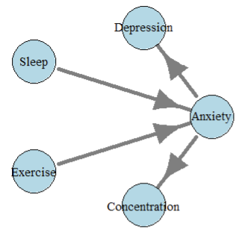
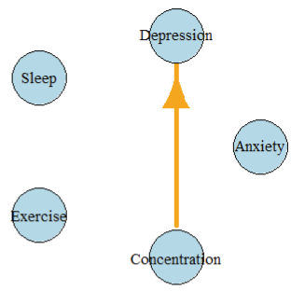
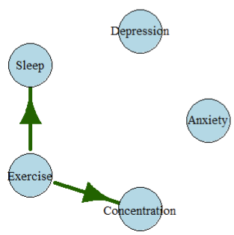
C
Common Network
Socioeconomic Effects
Gender Effects

Slide 4
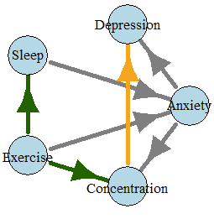
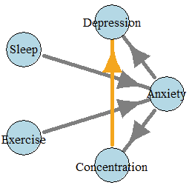
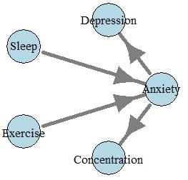




E
Individual Network Estimation
Subject 1
Subject 2
Subject 3
$$⋮$$
Socioeconomic moderated-links
Gender moderated-links
Shared Links

Slide 5
E
Subject 1
Subject 2
Subject 3
$$⋮$$
Shared Links
Socioeconomic moderated-links
Physical Health moderated-links

Slide 6
E
Subject 1
Subject 2
Subject 3
$$⋮$$
Shared Links
Socioeconomic moderated-links
Physical Health moderated-links

Slide 7
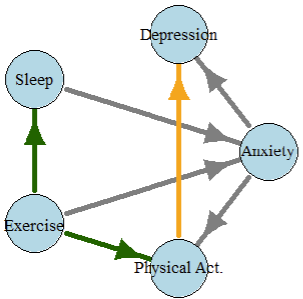
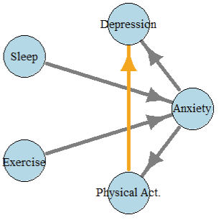
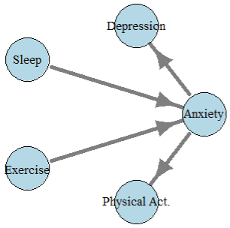
E
Subject 1
Subject 2
Subject 3
Shared Links
Socioeconomic moderated-links
Physical Health moderated-links

