Slide 1
Exploring Design smells for smell-based defect prediction
Instructor: Dr. Ashtiyani
TA: Morteza Zakeri
Students:
Hosein Mohamadian , Hamidreza Sadeghi & Alireza Usef
Fall 2022

Slide 2
Outline
Introduction
Related Work
Problem definition methodology
Evaluation methodology
Results
Threats to validity

Slide 3
Introduction
Machine learning
Features
Design code smells
Training data set
Correlation
Refactoring

Slide 4
Related work
God class
God method
Message chains
Middle man
Speculative Generality
yes
no

Slide 5
Code smell
Ant singleton
Blob
Class Data Should Be Private,
Complex Class
Lazy Class
Long Parameter List
Refused Parent Bequest
Swiss Army Knife

Slide 6
Code smell intensity
God Class
Data Class
Brain Method
Shotgun Surgery
Dispersed Coupling
Message Chains

Slide 7
Problem definition methodology

Slide 8
The defect prediction goal
Machine learning techniques
The training set
Choose meaningful features
The typical approach for classification

Slide 9
Generation of the datasets
Accounting
Training set and a test set
The classification model
Version control systems and issue tracking systems
Design smells

Slide 10
What is code smell?
Traditional Code Smells
Examples for Traditional Code Smells
Shotgun Surgery smell
The Swiss Army Knife

Slide 11
What is Design Code Smells?
Examples for Design Code Smells
Irrelevant class
Lazy class/Freeloader
Small class

Slide 12
The Mini-class
The No responsibility
The Agent classes
Motivation to use Design smells for defect prediction
The example is from the javax.swing package

Slide 13
public interface WindowConstants
{
/** The do-nothing default window close operation. */
public static final int DO_NOTHING_ON_CLOSE = 0;
/** The hide -window default window close operation */
public static final int HIDE_ON_CLOSE = 1;
/** The dispose -window default window close operation. */
public static final int DISPOSE_ON_CLOSE = 2;
/** The exit application default window close operation. */
public static final int EXIT_ON_CLOSE = 3;
}

Slide 14
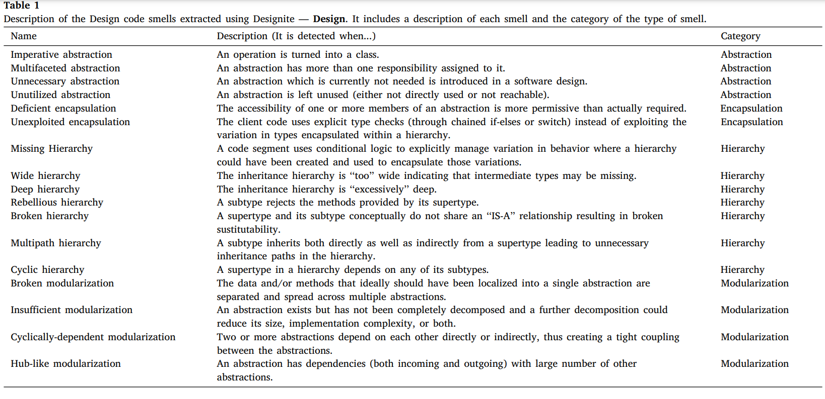

Slide 15
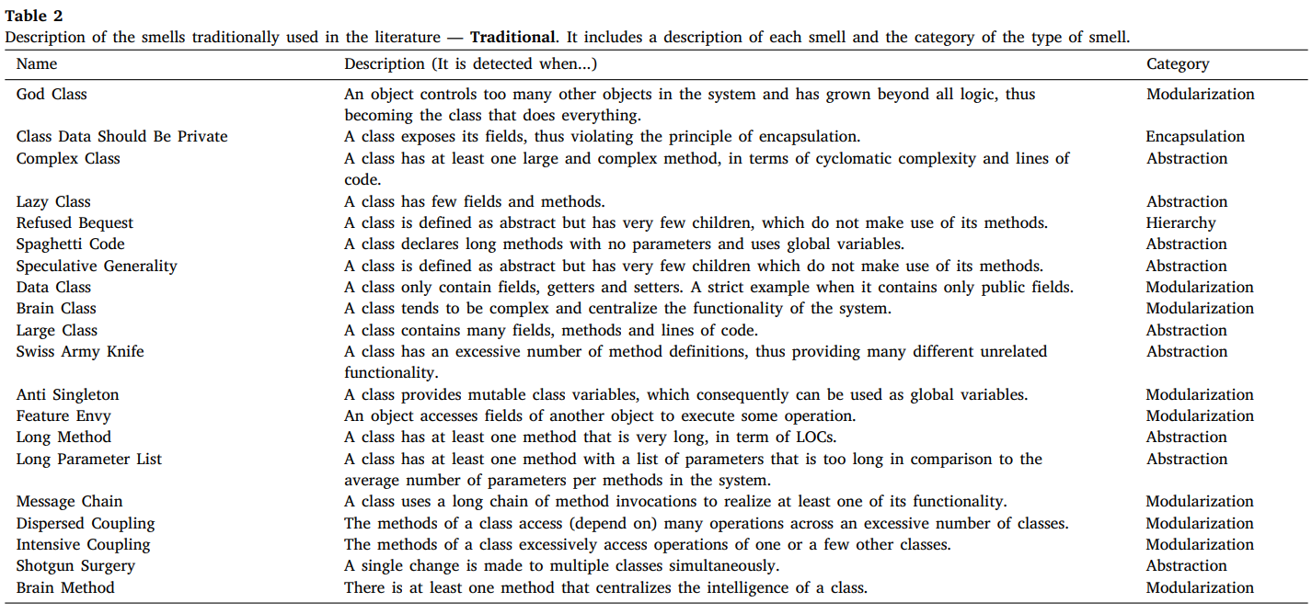

Slide 16
Evaluation methodology

Slide 17
RQ1. Do Design code smells contribute to the performance of defect prediction models trained with Traditional code smells?
RQ2. How do the different categories of Design smells impact the performance of the defect prediction models?
Collecting the data from repositories, including smells, metrics, and defects information
Feature selection
Train classification models
Model Validation

Slide 18
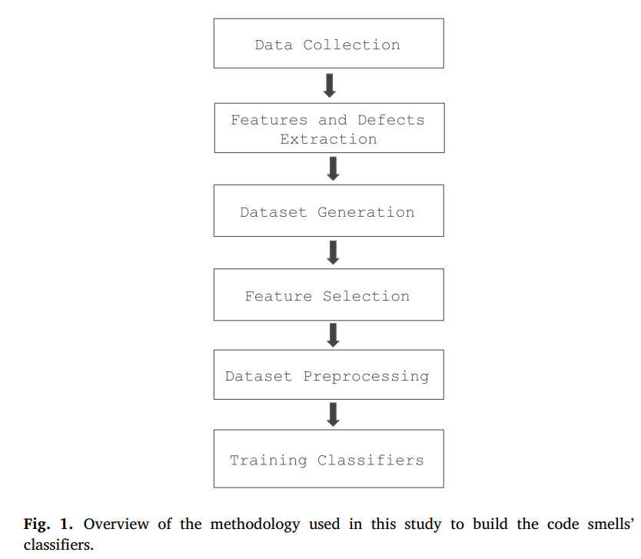

Slide 19
Dataset construction
Generate the datasets required for the classifiers training and testing
Iterating each project’s versions and extracting the defective information
Preprocessed the datasets for training
Handled the missing information, standardized the data, and dealt with data imbalance
Split the data into training and testing datasets

Slide 20
Data Collection
Versions with ratios between 10% and 30% of defects
Concerning authors, number of contributors, number of commits, and release times
Describe each project’s respective information about the project’s age, the number of contributors, and for the training and testing sets, the average number of files, number of commits, and ratio of defects
Collecting features from a high number of versions

Slide 21
Extracting Defects
Variant of the SZZ (Borg et al., 2019) algorithm
Compared to SZZ, our approach only requires locating the bug-fixing commits
The matching between issues and commits was based on a numerical id that identified the issue
JIRA issue tracker
Issue id follows the format ⟨PROJECT⟩ − ⟨NUMBER⟩

Slide 22
Other issue presented by Herbold et al. (2020) was the criterion used to select the files that were fixed. They observed that not all of the files in the change were directly related to the fix, particularly test cases, refactorings, and changes targeting comments in a file
An example of the application of the defects extraction methodology
Our study used the Jira tracker from Apache to collect the defects information and mapped a boolean value for each file asserting whether it is defective or not

Slide 23
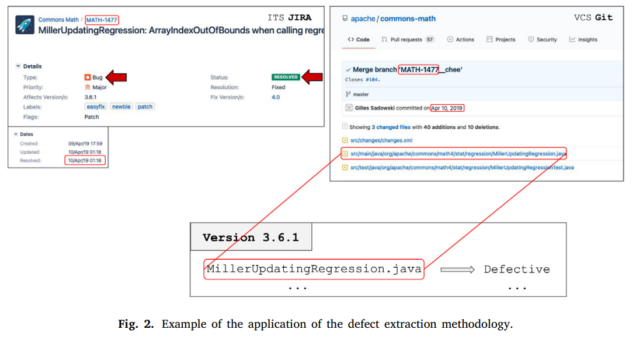

Slide 24
Feature Selection
F1-Score
Dataset Preprocessing
One of the first required operations is to handle missing values; thus, we dropped rows with missing values
In Table 3, we describe the relative frequency (in percentage) of instances, based on whether at least one smell was detected or no smell was detected (not detected), and whether the instance-mapped file is defective or not.

Slide 25
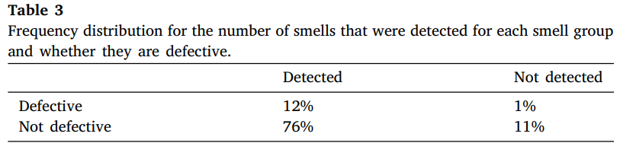

Slide 26
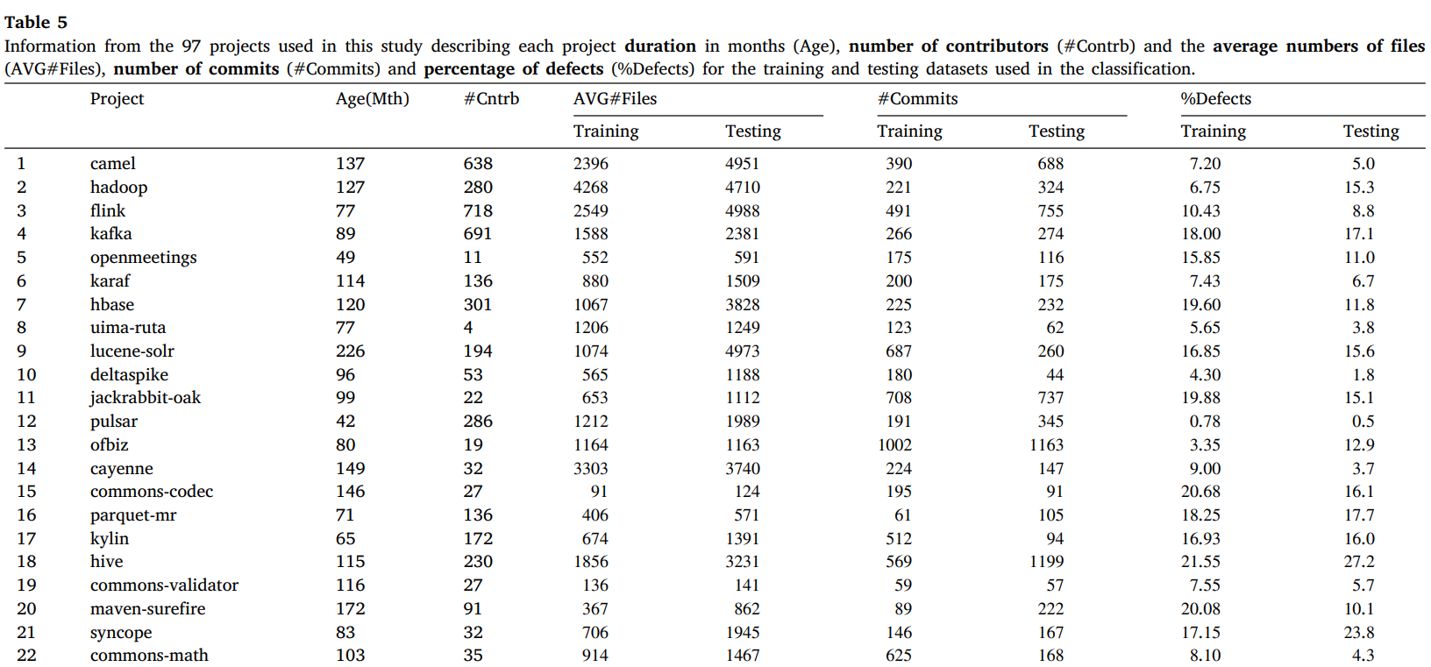

Slide 27
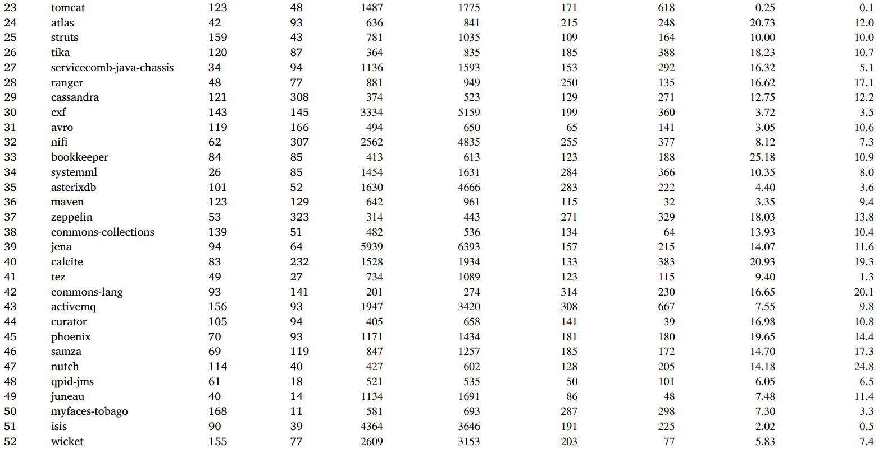

Slide 28
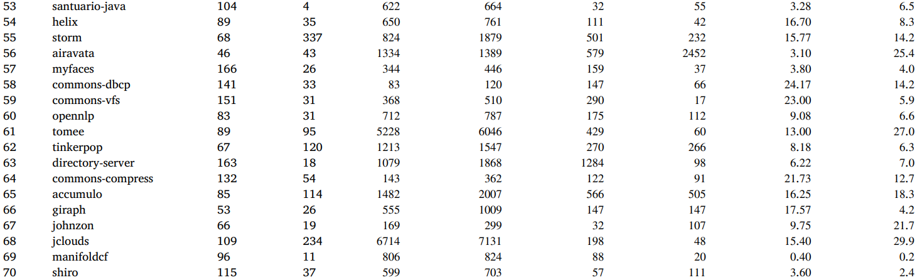

Slide 29
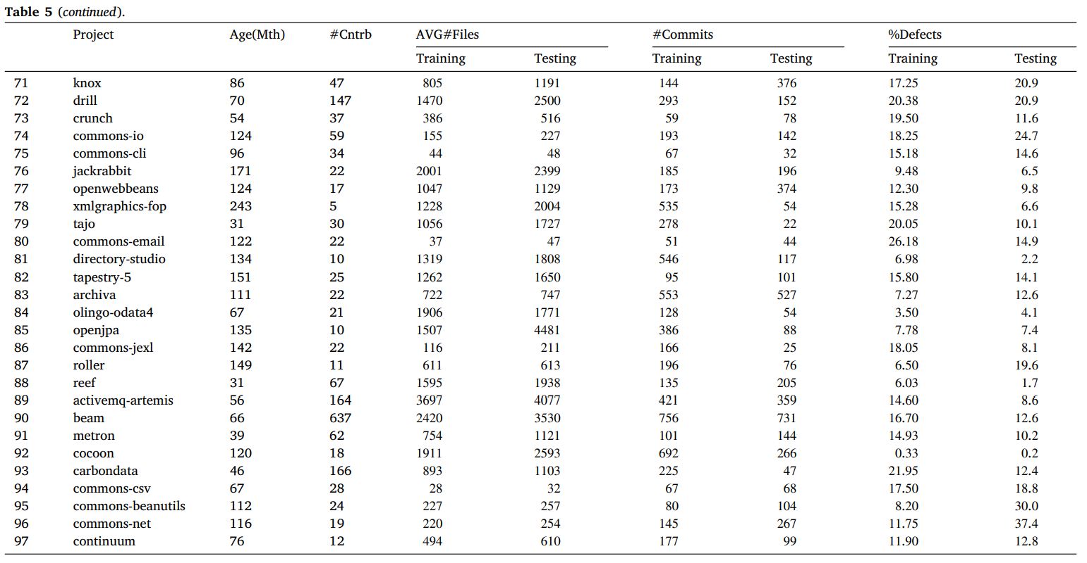

Slide 30
Data analysis and metrics
Precision
Recall
F1- Score
AUC-ROC
Brier Score

Slide 31
TP describes the number of classes containing defects that were correctly predicted as defective
• TN describes the number of non-defective classes that were correctly predicted as non-defective
• FP describes the number of non-defective classes that were incorrectly predicted as defective

Slide 32



Slide 33
Area Under the Curve (AUC)
AUC summarizes the ability of the classifier to discriminate between defective and non-defective classes
As such, the closer it is to 1, the higher the classifier’s skill to discern the classes affected or not by the defect
Score closer to 0.5 describes a classifier with lower accuracy, thus having a classification ability closer to a random classifier.

Slide 34

Brier Score
Score measures the distance between the probabilities predicted by a model and the actual outcome
Where 𝑝𝑐 is the predicted probability by the classifier, and 𝑜𝑐 is the actual outcome for the class
𝑁 is the total number of classes in the dataset
Low Brier Score represents a good classifier performance, while a high score represents a low performance.

Slide 35
Results
RQ1. Do Design code smells contribute to the performance of defect prediction models trained with Traditional code smells?
RQ2. How do the different categories of Design smells impact the performance of the defect prediction models?

Slide 36
RQ1: Performance of defect prediction
Following approaches :
classifier configuration with the highest score from the ten configurations for each project
classifier configuration for all projects and metrics

Slide 37
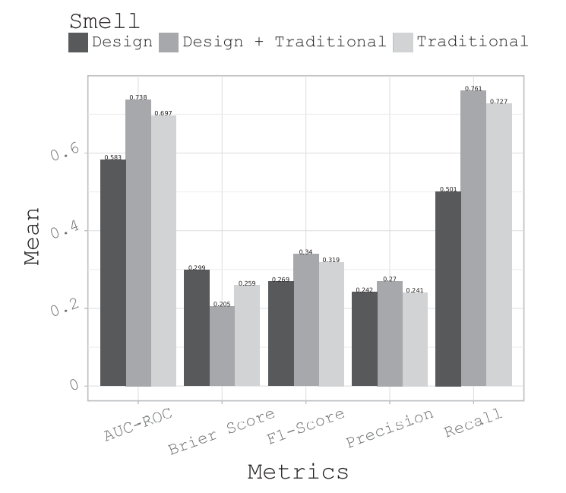
best classifier of each project and metric
improvement on 76 out of 97 projects (78%)
average improvement of 5.65% in the AUC
Between 18.0% and 0.24%

Slide 38
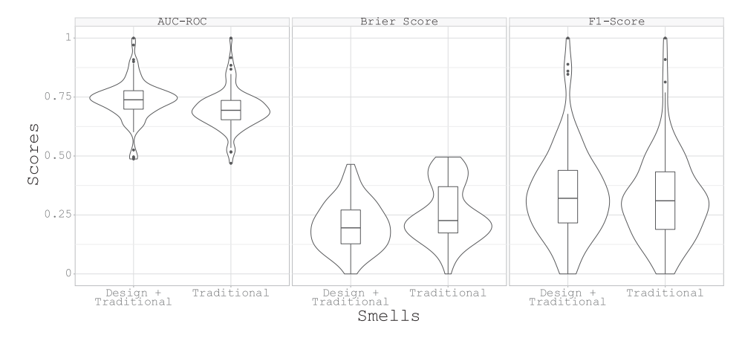
best classifier of each project and metric

Slide 39
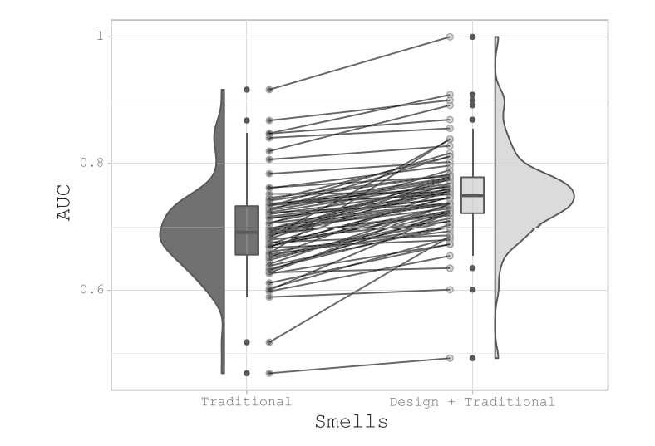
Improvement for each project between Design and Design + Traditional smells.

Slide 40
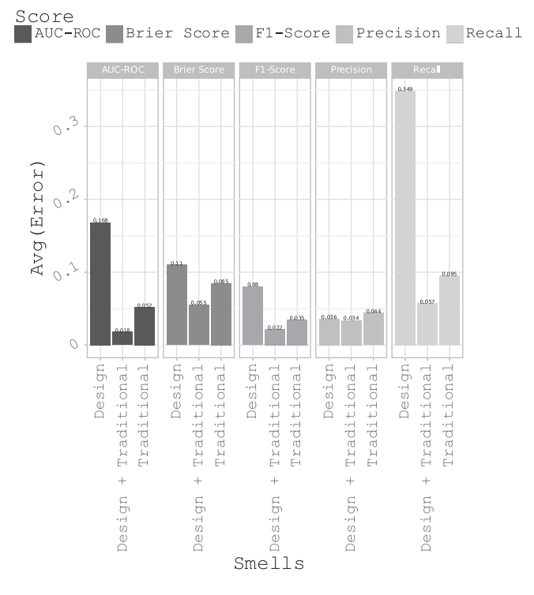
Experiment with the robustness of the model’s performance for each project
Avg of distance from best possible score for a project

Slide 41
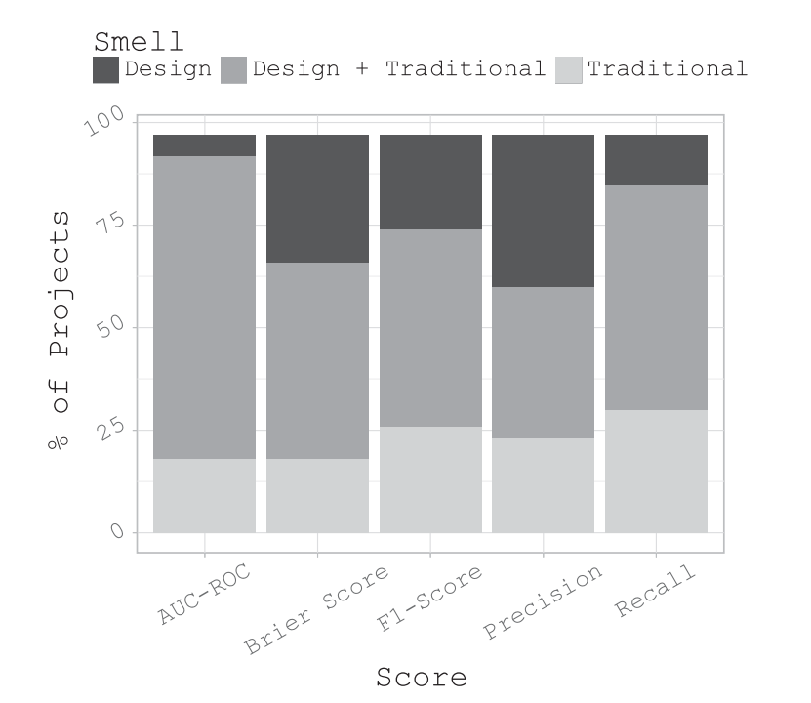
Experiment with the robustness of the model’s performance for each project
Percentage of projects for each class of the smells with the highest performance

Slide 42
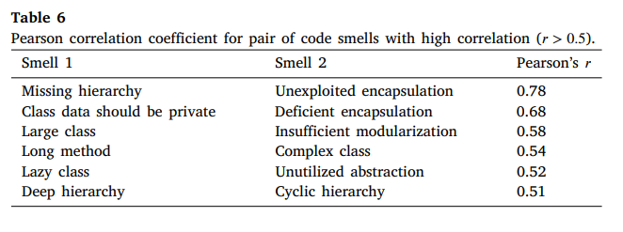
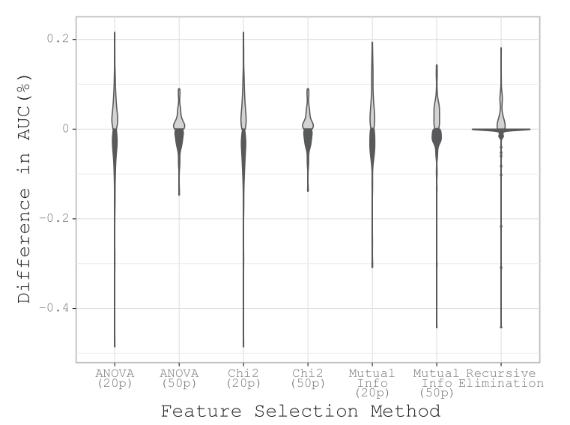
Experiment with the feature selection methods over the different datasets
Delete highly correlated smells
Between 35% and 64% of projects showed an improvement (2.3% and 5.6%).
Gray: distributed representing the improvements over using all the smells

Slide 43
RQ2: Different categories of Design smells
How do the different categories of Design smells impact the performance of the defect prediction models?

Slide 44
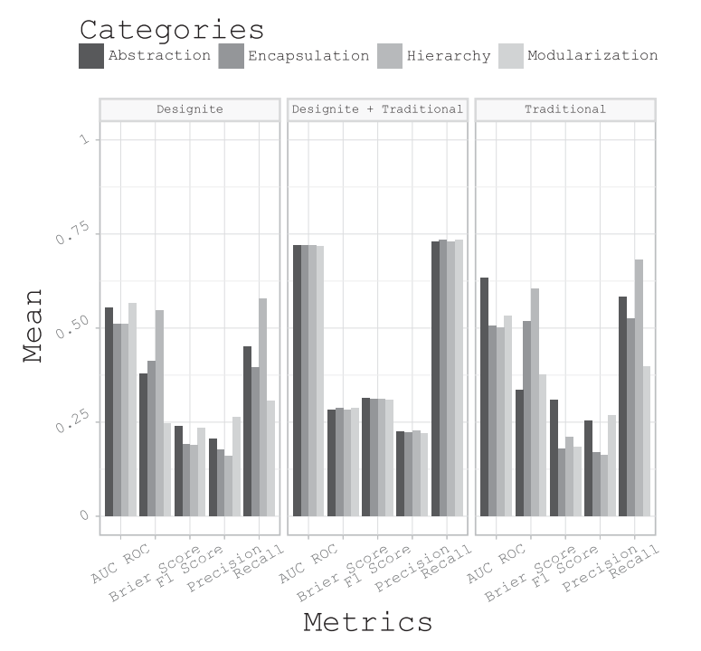
Performances for each category of the design code smells
Percentage of projects for each class of the smells with the highest performance

Slide 45
SUMMERY OF RESULTS
Models trained with D+T smells outperform others.
Improvement on 78% of the projects when adding the Design smells to the Traditional smells.
Applying feature selection to the D+T smells produces models with slightly higher accuracy
In general, for the D+T dataset all categories perform similarly.

Slide 46
Threats to validity
Comparison of Design code smells with the Traditional smells discussed in the literature. We do not compare the performance of defect prediction models trained with other metrics found in the literature, like code metrics or process metrics.
Source projects from Apache written in Java, which is a threat to the generalization of our results.
The use of the Jira as the issue tracking system.
We used the tool provided by the authors that proposed the Design smells.
we used to label the defects raises the possibility for non-defective code to be labeled as defective due to post-release

Slide 47
Conclusion and future work
What we did?
Final results
Future work

Slide 48
References
Link to this paper
Authors
BrunoSotto-Mayor
Amir Elmishali
Meir Kalech
Rui Abreu
DOI:10.1016/j.engappai.2022.105240

Slide 49
Questions?
Thanks for your attention

