Slide 1
EXECUTIVE TECHNOLOGY BRIEFING · SEPTEMBER 2026
The AI Application Landscape
Harnesses, loops, Skills, multi-agent workflows, and post-training — how model intelligence becomes a reliable, persistent, verifiable worker.
Source: AI_Application_Landscape_2026.md — converted to slide format.

Slide 2
AGENDA
Fourteen topics build one connected architecture
1 Executive map
2 Harness engineering
3 Loop engineering
4 AI Skills
5 Jev and decision models
6 Personal computer agents
7 Enterprise model adaptation
8 Post-training & inference-time scaling
9 Unified architecture
10 The larger 2026 landscape
11 Enterprise implications
12 Connection to software projects
13 Practical mental model
14 Sources
AI Application Landscape — 2026 Executive Briefing
1

Slide 3
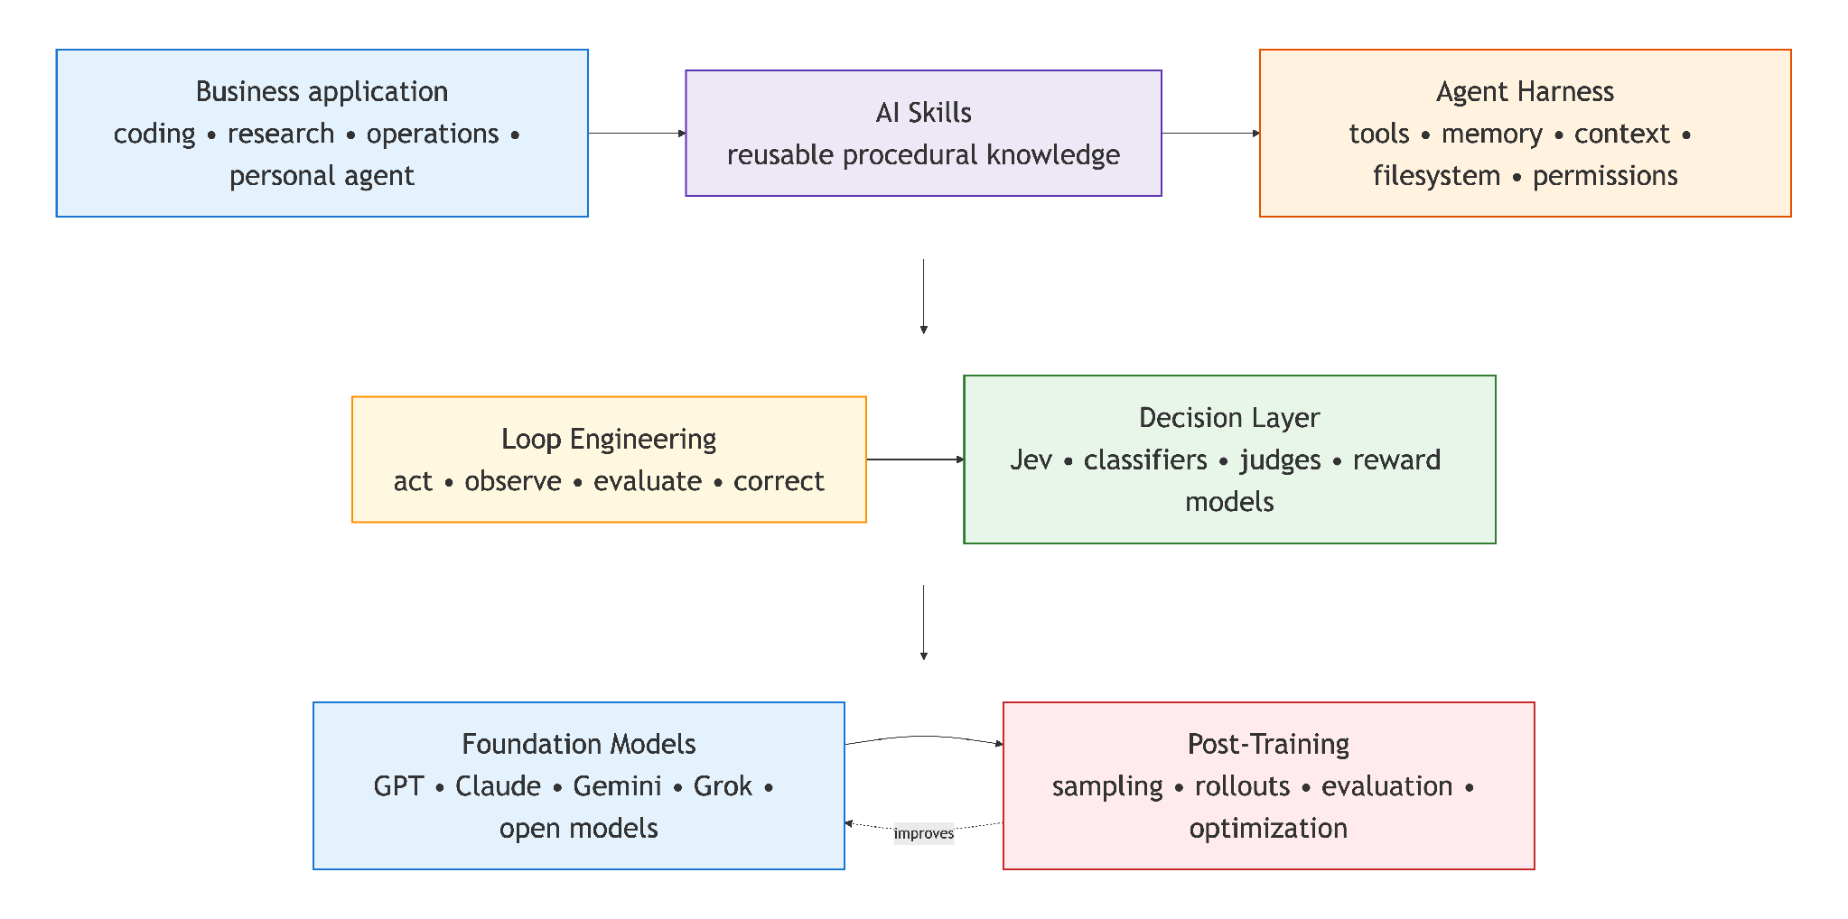
SECTION 1 · EXECUTIVE MAP
AI capability is built in six stacked layers
Takeaway: The industry is moving one level above the model — reliability now depends on the harness, loop, and decision layers wrapped around it.
AI Application Landscape — 2026 Executive Briefing
2

Slide 4
SECTION 1 · EXECUTIVE MAP
Seven engineering disciplines, seven different questions
Discipline | What is being engineered | Primary question
Model | Architecture and weights | How capable is the underlying intelligence?
Context | Information presented to the model | What should the model know right now?
Harness | The execution environment | How can the model reliably perform work?
Loop | Repeated action and feedback | How does the agent recover and continue?
Multi-agent | Coordination across bounded loops | What should be delegated or verified centrally?
Skills | Reusable procedural knowledge | How should this job be performed?
Post-training | Model behavior after pretraining | How can experience improve the model itself?
AI Application Landscape — 2026 Executive Briefing
3

Slide 5
SECTION 2 · HARNESS ENGINEERING
A harness turns model intelligence into reliable, governed work
Agent harness
Context & Memory
Environment & Access
Execution Control
Trust & Oversight
➤ Context management across a task
➤ Persistent or scoped memory
➤ Skills as procedural knowledge
➤ Filesystem / workspace scope
➤ Browser and computer use
➤ Sandboxing and resource limits
➤ Agent-loop control
➤ Subagent delegation
➤ Model routing
➤ Permissions and approval gates
➤ Verification and evaluation
➤ Observability and tracing
AI Application Landscape — 2026 Executive Briefing
4

Slide 6
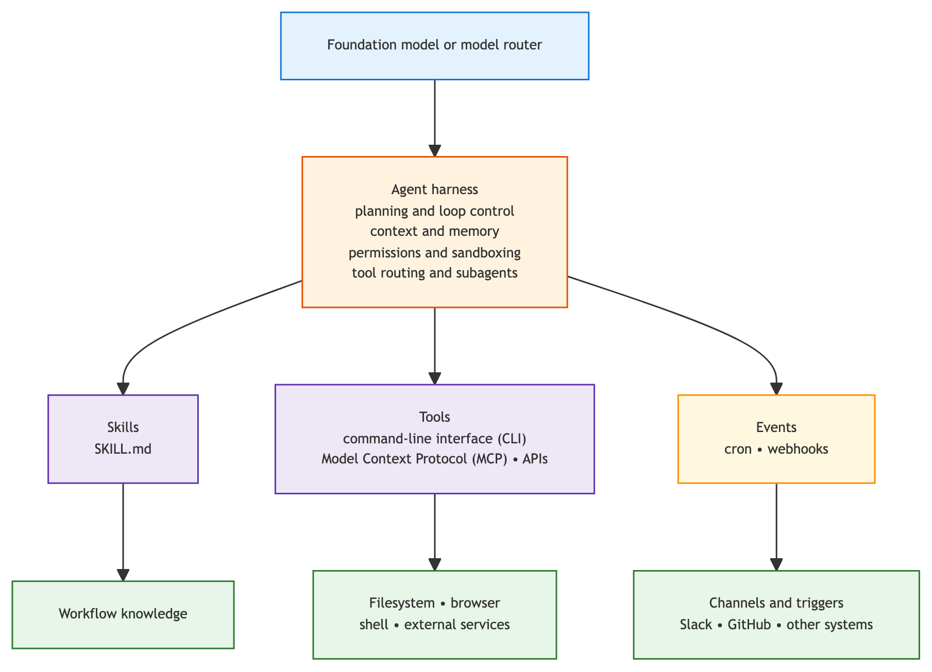
SECTION 2 · HARNESS ENGINEERING
One runtime architecture, configured for different environments
Takeaway: Skills answer how; tools/MCP answer what the agent can access; events answer when work starts.
AI Application Landscape — 2026 Executive Briefing
5

Slide 7
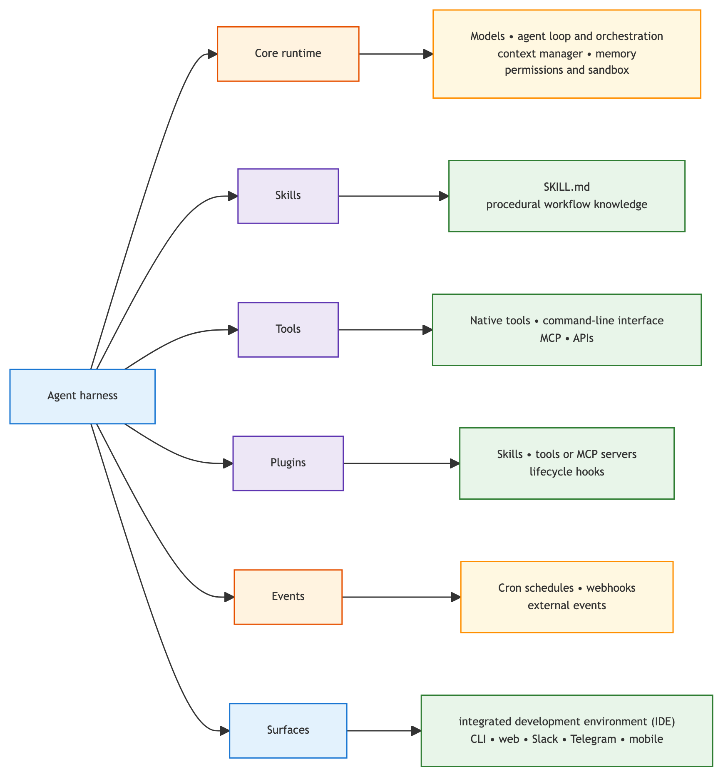
SECTION 2 · HARNESS ENGINEERING
Six concerns compose the modern harness
Takeaway: Core runtime, Skills, Tools, Plugins, Events, and Surfaces are separable — and independently upgradable.
AI Application Landscape — 2026 Executive Briefing
6

Slide 8
SECTION 2 · HARNESS ENGINEERING
“The difference is primarily which parts are emphasized and preconfigured”
Developer Agent
Personal Agent
Enterprise Workflow Agent
Repository-centered
➤ World: repo / dev environment
➤ Emphasis: code, tests, version control
➤ e.g. Cursor, Claude Code, Codex
Life/work-centered
➤ World: broader digital environment
➤ Emphasis: memory, messaging, schedules
➤ e.g. Hermes, OpenClaw
Process-centered
➤ World: bounded organizational process
➤ Emphasis: identity, policy, auditability
➤ e.g. internal regulated-domain agents
AI Application Landscape — 2026 Executive Briefing
7

Slide 9
SECTION 2 · HARNESS ENGINEERING
Type A and Type B increasingly share one architecture
Property | Type A — Personal/general agent | Type B — Software-engineering agent
Primary object | User, role, or continuing task | Repository or engineering task
Default workspace | Many directories, accounts, services | One project / repo / cloud sandbox
Lifetime | Often persistent across sessions | Task-scoped, increasingly persistent
Memory | First-class personal/role memory | Project or task memory
Messaging | Often first-class (Slack, Telegram…) | Secondary, now emerging
Events | Cron, webhooks, inboxes central | Commits, PRs, CI results, schedules
Coding | One capability among many | Primary optimized workflow
Skills | Prominent for personal workflows | Increasingly first-class
Representative products | Hermes, OpenClaw | Cursor, Claude Code, Codex, Antigravity
Installation location, interface, and filesystem breadth are not decisive — one harness can wrap or invoke another.
AI Application Landscape — 2026 Executive Briefing
8

Slide 10
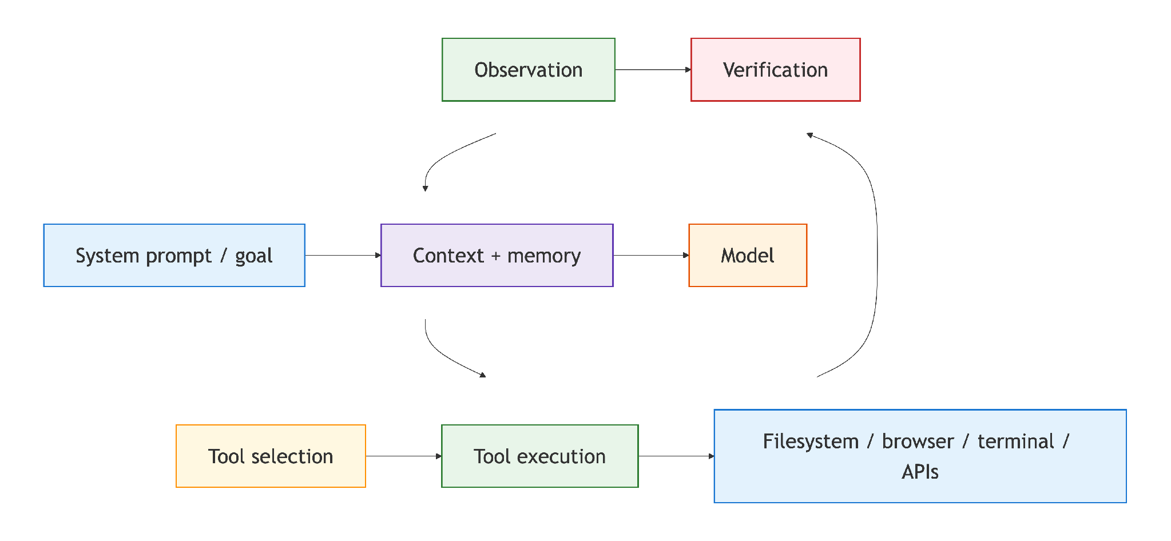
SECTION 2 · HARNESS ENGINEERING
Agent = Model + Harness, running in a loop
Takeaway: LangChain reported major benchmark gains from harness changes alone — with the same underlying model.
AI Application Landscape — 2026 Executive Briefing
9

Slide 11
SECTION 2 · HARNESS ENGINEERING
Harness quality can matter as much as model choice
The multiplier is not just the model
➤ Model capability × harness quality × context quality
➤ × tools × verification × domain knowledge
➤ = useful AI system — not model score alone
Proprietary advantage increasingly lives in
➤ Internal Skills and procedures
➤ Integrations and organizational context
➤ Evaluation datasets and permission systems
➤ Accumulated traces and domain verification
AI Application Landscape — 2026 Executive Briefing
10

Slide 12
SECTION 3 · LOOP ENGINEERING
Four loop types keep agents acting, checking, and improving
Agent Loop
Verification Loop
Event-Driven Loop
Improvement Loop
➤ Repeatedly choose and execute the next action
➤ Check whether output actually satisfies requirements
➤ Resume work when an external event occurs
➤ Analyze traces to improve the harness itself
AI Application Landscape — 2026 Executive Briefing
11

Slide 13
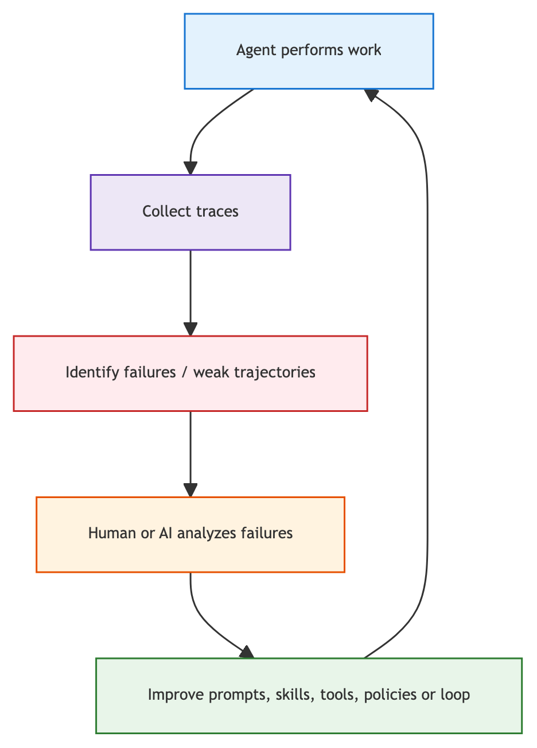
SECTION 3 · LOOP ENGINEERING
Improvement loops upgrade the system, not just the weights
Takeaway: This resembles training — except the organization improves the system around the weights.
AI Application Landscape — 2026 Executive Briefing
12

Slide 14
SECTION 3 · LOOP ENGINEERING
Six coordination patterns for multi-agent workflows
Pattern | Best fit | Main trade-off
① Router → specialist | Request belongs to one clear domain | Simple, but routing errors misdirect the whole task
② Handoff | Specialist should own the interaction | Autonomy, but global context can blur
③ Manager → workers | Lead agent retains control & synthesizes | Strong oversight; manager can bottleneck
④ Parallel fan-out/fan-in | Independent research can run concurrently | Breadth, but duplicate cost rises quickly
⑤ Sequential pipeline | Well-defined extract → validate → approve | Easy to govern; errors propagate upstream
⑥ Peer debate / review | Diverse hypotheses expose uncertainty | Can amplify confident errors without a judge
AI Application Landscape — 2026 Executive Briefing
13

Slide 15
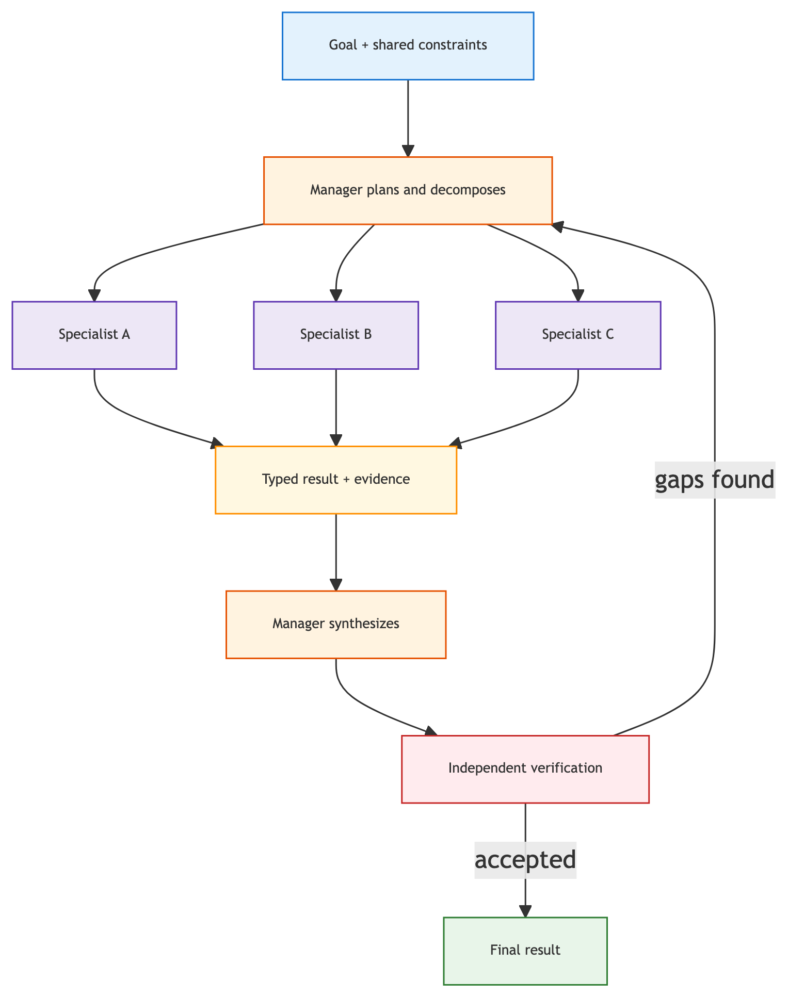
SECTION 3 · LOOP ENGINEERING
Anthropic's production pattern: manager, parallel specialists, verification
Takeaway: Orchestrator-worker fits open-ended research: independently decomposable, then synthesized and verified.
AI Application Landscape — 2026 Executive Briefing
14

Slide 16
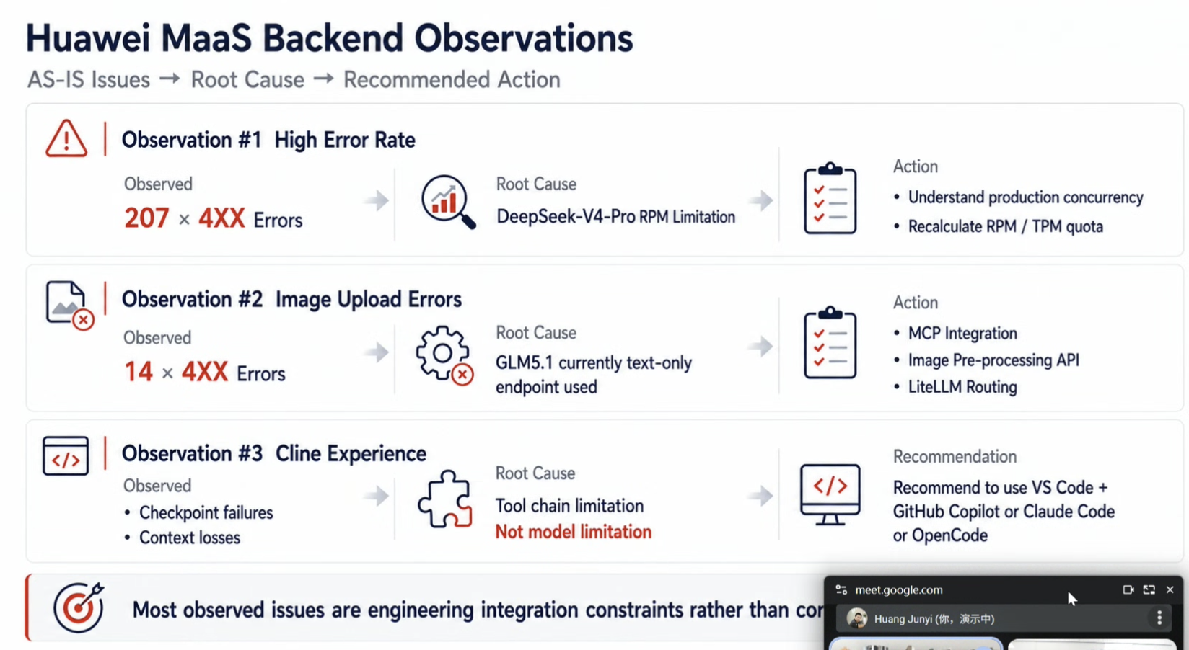

Slide 17
SECTION 3 · LOOP ENGINEERING
Evidence says: match architecture to task shape, not agent count
Use multi-agent when...
➤ Work is meaningfully decomposable
➤ Specialists need distinct tools or policies
➤ Parallel exploration has clear value
➤ Independent review reduces a known risk
2026 research found
➤ Centralized coordination: +80.8% on decomposable tasks
➤ Every architecture tested: −39% to −70% on sequential planning
➤ ~45% capability-saturation threshold (task-specific, not universal)
➤ Centralized verification contains error amplification (4.4× vs 17.2×)
AI Application Landscape — 2026 Executive Briefing
15

Slide 18
SECTION 3 · LOOP ENGINEERING
Eight rules for production multi-agent systems
1. Start with one capable agent — add only for measurable gain
2. Give every agent a narrow, typed contract
3. Keep authoritative state outside chat (durable records/logs)
4. Separate execution from verification
1. Bound fan-out, recursion, tokens, and time
2. Design for partial failure and safe retries
3. Trace the whole graph — routing, calls, costs, outcomes
4. Apply least privilege per agent role
AI Application Landscape — 2026 Executive Briefing
16

Slide 19
SECTION 4 · AI SKILLS
Skills load progressively, not all at once
Agent starts
Task arrives
Skill selected
SKILL.md loads
Assets on demand
Sees only lightweight skill metadata
Agent evaluates which skill applies
Relevant SKILL.md is chosen
Procedure and constraints load into context
Scripts / references load only if needed
Progressive disclosure keeps context lean while procedures stay comprehensive.
AI Application Landscape — 2026 Executive Briefing
17

Slide 20
SECTION 4 · AI SKILLS
Skills are procedural RAG: how to act, not just what to know
Traditional RAG
AI Skills
What should the model know?
➤ Documents, facts, records, knowledge
How should the agent perform this job?
➤ Procedures, scripts, templates, rules, examples
AI Application Landscape — 2026 Executive Briefing
18

Slide 21
SECTION 4 · AI SKILLS
Procedural knowledge becomes versioned organizational IP
A skill package typically contains
➤ SKILL.md — the procedure itself
➤ scripts/ — executable helpers
➤ templates/ and references/ — reusable assets
For software projects, Skills encode
➤ Investigate a production incident
➤ Review Terraform, migrate a database
➤ Deploy to EKS, generate release notes
AI Application Landscape — 2026 Executive Briefing
19

Slide 22
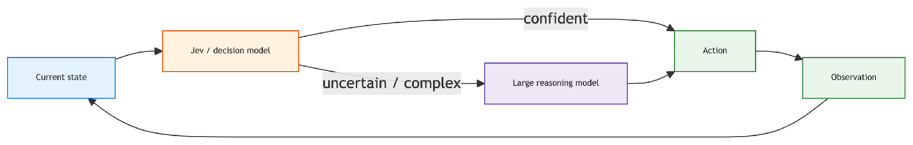
SECTION 5 · JEV & DECISION MODELS
Split thinking from deciding for fast, structured calls
Takeaway: LLMs reason and plan; Jev-like models route, classify, score, and verify — cheaply and fast.
AI Application Landscape — 2026 Executive Briefing
20

Slide 23
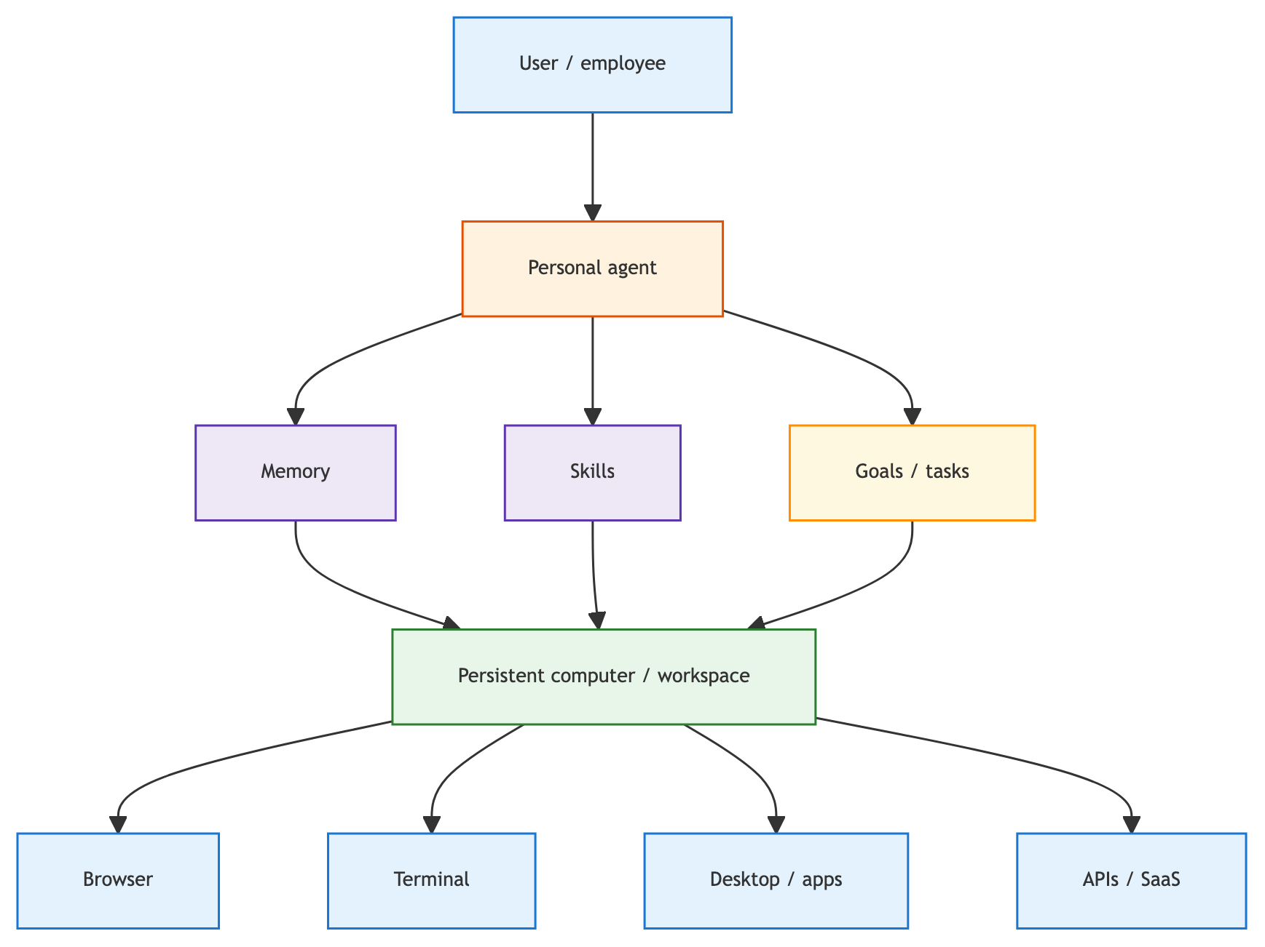
SECTION 6 · PERSONAL COMPUTER AGENTS
Personal agents wrap memory, Skills, and goals around a persistent workspace
Takeaway: The unit of AI consumption shifts from a single query to a persistent worker or role.
AI Application Landscape — 2026 Executive Briefing
21

Slide 24
SECTION 6 · PERSONAL COMPUTER AGENTS
Five products, five points on the same spectrum
Product | Positioning | Key idea
Meta Muse | Consumer personal agent | Assistant that continues doing the task, not just advising
OpenClaw | Local / self-hosted layer | “My AI operating layer,” not another chatbot website
Hermes Agent | Self-improving agent harness | Discovers a procedure, saves it as a Skill, reuses it
Grok Bot | Persistent cloud-computer teammate | Org model becomes role-based agents, not single queries
OpenAI Computer Use | Capability primitive | GUI actions belong in the tool/harness layer, not the whole product
AI Application Landscape — 2026 Executive Briefing
22

Slide 25
SECTION 7 · ENTERPRISE MODEL ADAPTATION
Private data does not automatically mean fine-tuning
Need | Preferred mechanism | Why
Current facts, policies, citations | RAG, databases, tools | Stays updateable, attributable, deletable
Stable format / terminology / behavior | Supervised fine-tuning (SFT) | Demonstrations teach repeatable behavior
Preferences without one right answer | Preference tuning | Ranked examples encode organizational choice
Complex reasoning with a reliable score | Reinforcement fine-tuning (RFT) | Trustworthy grader rewards good trajectories
Lower cost/latency at high volume | Distillation + fine-tuning | Small model learns a bounded behavior
AI Application Landscape — 2026 Executive Briefing
23

Slide 26
SECTION 7 · ENTERPRISE MODEL ADAPTATION
LoRA still leads open-weight fine-tuning in 2026
Current technique landscape
➤ LoRA — standard parameter-efficient method
➤ QLoRA — quantizes the base model, cuts memory cost
➤ DoRA — separates update magnitude/direction; helps some workloads
➤ Full fine-tuning — justified only at real data/compute scale
The governing principle
➤ “Retrieve facts; fine-tune behavior.”
➤ Fine-tuning cannot repair bad retrieval, tools, or workflow design
➤ Managed services may expose SFT/RFT without exposing the method
AI Application Landscape — 2026 Executive Briefing
24

Slide 27
SECTION 7 · ENTERPRISE MODEL ADAPTATION
Optimize the harness before touching model weights
Evals
Baseline
Prompts
Context
Workflow
Fine-tune / RFT
Define task-specific success criteria
Start from the strongest available model
Improve instructions and examples
Improve retrieval and data quality
Improve tools, verification, permissions
Only for a measured residual gap
Example: an automaker keeps regional complaint data in RAG; RFT only rewards evidence-based, causally sound recommendations.
AI Application Landscape — 2026 Executive Briefing
25

Slide 28
SECTION 8 · POST-TRAINING & INFERENCE-TIME SCALING
Two different scaling axes are often conflated
Post-training scaling
➤ Sample experience → evaluate → update weights
➤ Changes the model's behavior permanently
Inference-time scaling
➤ Sample candidates → evaluate → return the best result
➤ Leaves weights unchanged; spends runtime compute instead
AI Application Landscape — 2026 Executive Briefing
26

Slide 29
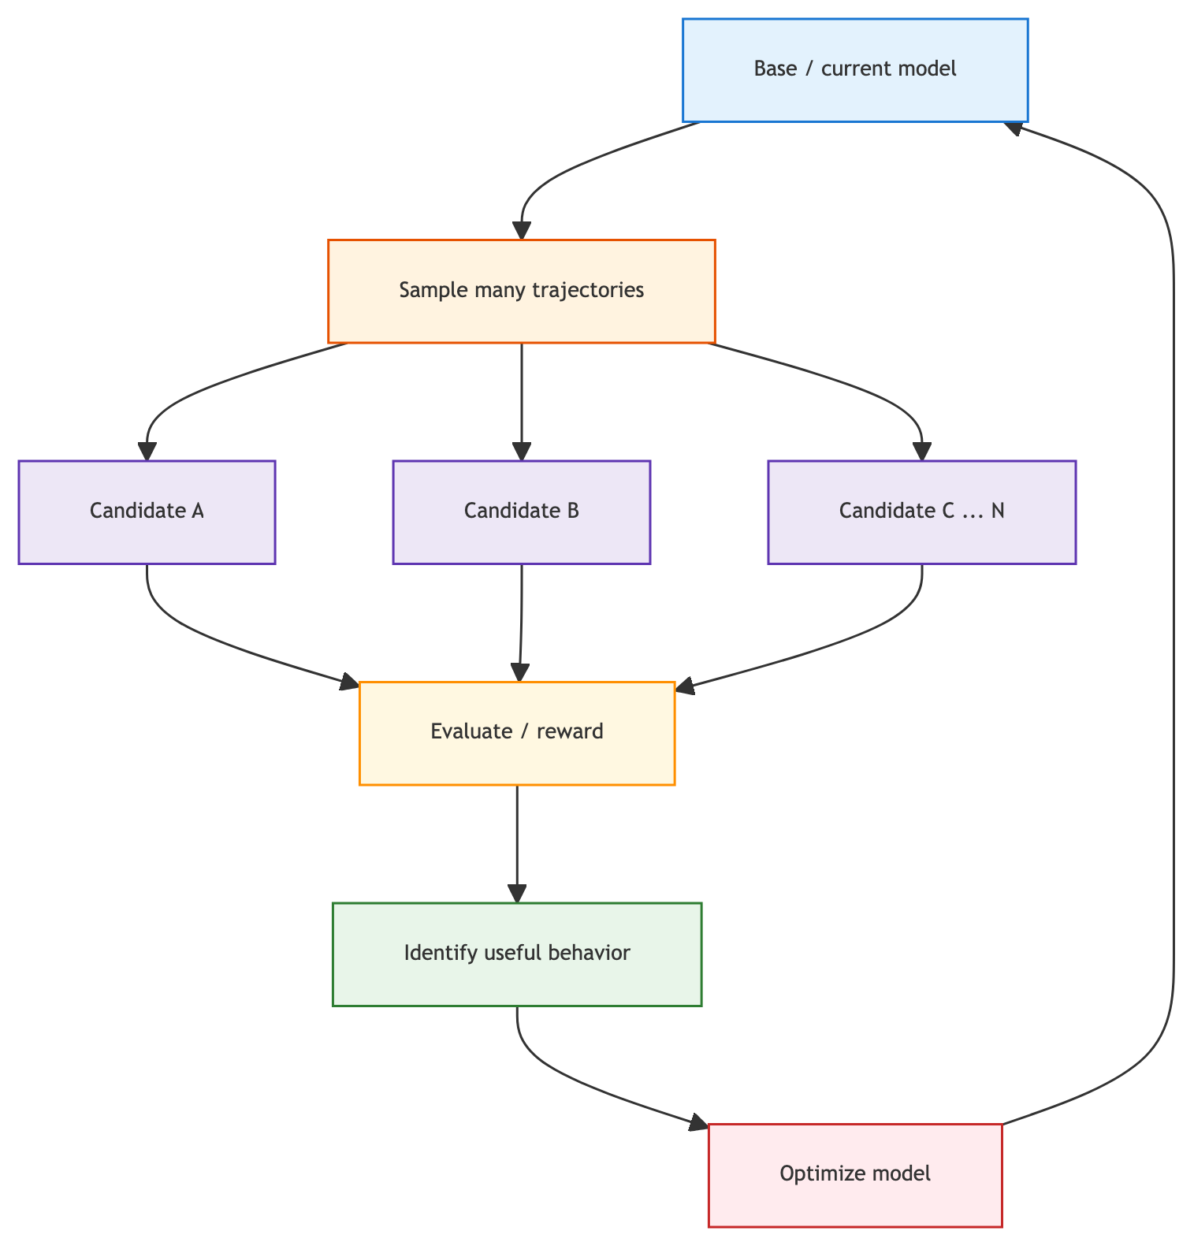
SECTION 8 · POST-TRAINING & INFERENCE-TIME SCALING
Post-training turns sampled trajectories into weight updates
Takeaway: For agents, a “sample” is a full trajectory — reason, tool, error, recovery, result — not just a text answer.
AI Application Landscape — 2026 Executive Briefing
27

Slide 30
SECTION 8 · POST-TRAINING & INFERENCE-TIME SCALING
Evidence supports RL post-training scaling — with real caveats
Where it works best
➤ Mathematics, coding — domains with strong automatic verifiers
➤ Complements pre-training and inference-time compute
Engineering questions that remain open
➤ How much exploration to permit
➤ How to reward recovery, not lucky outcomes
➤ How to prevent reward hacking from weak graders
AI Application Landscape — 2026 Executive Briefing
28

Slide 31
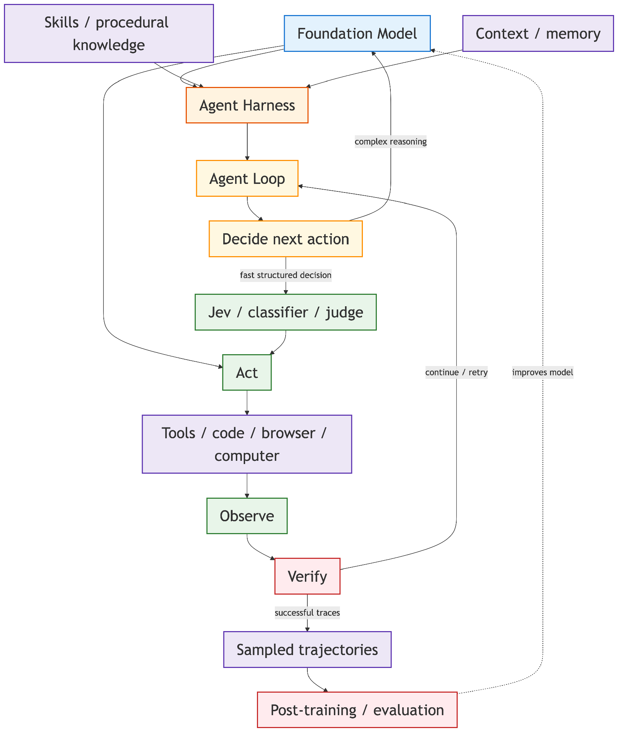
SECTION 9 · UNIFIED ARCHITECTURE
One architecture connects model, harness, decisions, and post-training
Takeaway: Model intelligence is only one component of agent intelligence.
AI Application Landscape — 2026 Executive Briefing
29

Slide 32
SECTION 10 · THE LARGER 2026 LANDSCAPE
Five eras of AI engineering — each one accumulates
2019–22
2022–24
2023–25
2024–26
2026 →
Model engineering
Prompt engineering
RAG / context engineering
Agent engineering
Harness + loop engineering
These layers accumulate rather than replace one another.
AI Application Landscape — 2026 Executive Briefing
30

Slide 33
SECTION 10 · THE LARGER 2026 LANDSCAPE
The market is climbing a five-step maturity ladder
1. AI that answers
2. AI that performs bounded tasks
3. AI that operates tools
4. AI that persists across tasks
5. AI as a digital worker / operating layer
AI Application Landscape — 2026 Executive Briefing
31

Slide 34
SECTION 11 · ENTERPRISE IMPLICATIONS
Nine issues executives should track (1/2)
Executive issue | Why it matters | What to monitor
Model commoditization | Apps increasingly switch/route among models | Portability, routing, cost/performance
Harness IP | Reliable execution can become proprietary | Internal tools, workflows, eval suites
Multi-agent economics | Parallel specialists multiply cost & failure paths | Baselines, decomposability, fan-out limits
Procedural knowledge | Operating knowledge becomes machine-executable | Skill repos, versioning, governance
Observability | Probabilistic workers need trace-level diagnosis | Traces, tool calls, costs, failure modes
AI Application Landscape — 2026 Executive Briefing
32

Slide 35
SECTION 11 · ENTERPRISE IMPLICATIONS
Nine issues executives should track (2/2)
Executive issue | Why it matters | What to monitor
Security | Agents can take consequential actions | Permissions, sandboxing, secrets, approvals
Computer use | Agents automate systems lacking APIs | Reliability, UI drift, authorization
Persistent agents | AI shifts to continuing responsibility | Identity, state, lifecycle management
Post-training | Operational trajectories become training data | Evaluation quality, data governance
The question is no longer only “which model?” but “what capabilities stay ours as models change?”
AI Application Landscape — 2026 Executive Briefing
33

Slide 36
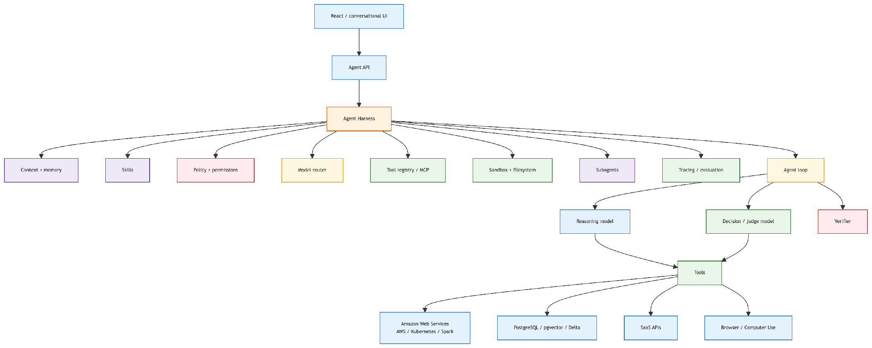
SECTION 12 · CONNECTION TO SOFTWARE PROJECTS
Modern AI applications look like distributed systems with a probabilistic worker inside
Takeaway: React → FastAPI → LLM API → RAG has become a full harness with routing, sandboxing, subagents, and tracing.
AI Application Landscape — 2026 Executive Briefing
34

Slide 37
SECTION 12 · CONNECTION TO SOFTWARE PROJECTS
Traditional distributed-systems skills are now core AI skills
Familiar infrastructure concerns return
➤ Isolated execution, ephemeral environments
➤ Identity, permissions, secrets management
➤ Queues, async work, retries, idempotency
➤ Observability, audit trails, cost controls
The reframe
➤ Not: “calling an LLM API”
➤ Instead: distributed-systems engineering around probabilistic workers
AI Application Landscape — 2026 Executive Briefing
35

Slide 38
SECTION 13 · PRACTICAL MENTAL MODEL
Four forms of intelligence combine into one system
① Model
② Harness
③ Procedural
④ Decision
Foundation-model weights
➤ Reasoning, language, coding, generalization
Agent architecture
➤ Context, tools, memory, orchestration, verification
Skills & workflows
➤ How to perform a specific job correctly
Judges, classifiers, Jev-like models
➤ Fast routing, scoring, verification, control
AI Application Landscape — 2026 Executive Briefing
36

Slide 39
SECTION 13 · PRACTICAL MENTAL MODEL
The strategic loop feeds experience back into the model
1. Model
2. Harness
3. Skills + tools
4. Agent loops
5. Real-world experience
6. Traces + evaluations → improve harness / Skills / model
AI Application Landscape — 2026 Executive Briefing
37

Slide 40
SECTION 14 · SOURCES (APPENDIX)
Primary sources behind this briefing
Harness, loop & Skills
➤ LangChain — Anatomy of an Agent Harness / Loop Engineering
➤ Anthropic — Building Effective Agents; Multi-Agent Research System
➤ Anthropic — Equipping Agents with Agent Skills
➤ OpenAI — Orchestration and Handoffs
Scaling, fine-tuning & interoperability
➤ Nature Machine Intelligence — Capability-saturation in multi-agent systems
➤ Google Research — Towards a Science of Scaling Agent Systems
➤ OpenAI — Optimizing LLM Accuracy; Supervised Fine-Tuning
➤ Google — Agent2Agent (A2A) Protocol, Linux Foundation v1.0
AI Application Landscape — 2026 Executive Briefing
38

Slide 41
KEY TAKEAWAY
Durable enterprise advantage increasingly comes from the combination of models, proprietary context, procedural Skills, integrations, evaluations, execution infrastructure, and accumulated experience — not from access to one foundation model alone.
AI_Application_Landscape_2026.md — Section 13, Practical Mental Model.

