Slide 1
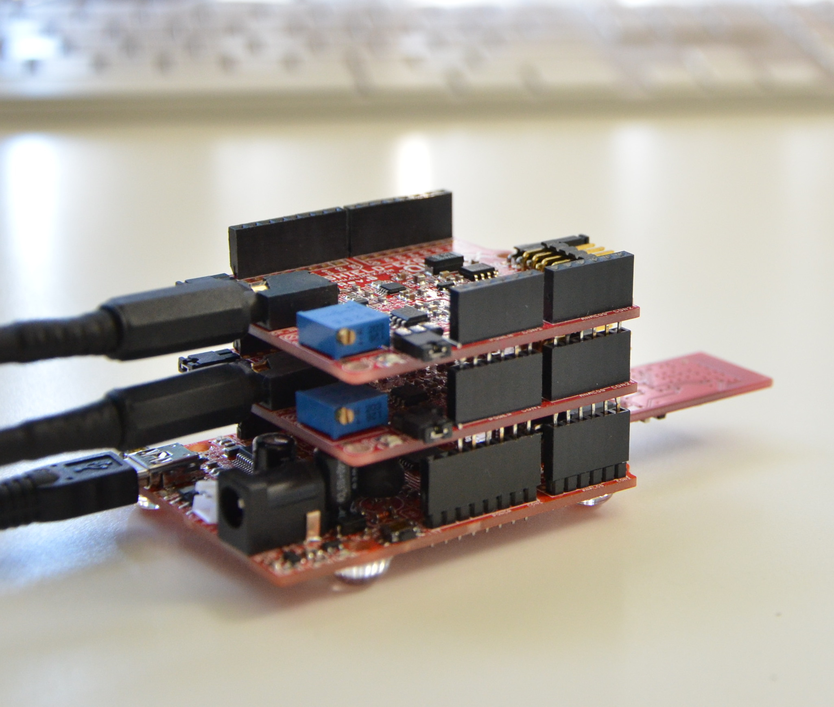
Shield board
(up to 6 channels)
Bluetooth
Olimex-328

