Slide 1
Stock market example
1500
deposit
stock
500
500
600
500
gain (€)
-800
decreasing
20%
stable
30%
increasing
50%

Slide 2
Stock market example
1500
deposit
stock
500
500
600
500
Expdeposit : 0.2 * 500 + 0.3 * 500
+ 0.5 * 500 = 500
Expstock: 0.2 * -800 + 0.3 * 600
+ 0.5 * 1500 = 680
gain (€)
-800
EMV
decreasing
20%
stable
30%
increasing
50%

Slide 3
Stock market example
1500
deposit
stock
500
500
600
500
Expdeposit : 0.2 * 500 + 0.3 * 500
+ 0.5 * 500 = 500
Expstock: 0.2 * -800 + 0.3 * 600
+ 0.5 * 1500 = 680
EV|PI : 0.2 * 500 + 0.3 * 600
+ 0.5 * 1500 = 1030
gain (€)
-800
decreasing
20%
stable
30%
increasing
50%

Slide 4
Stock market example
1500
deposit
stock
500
500
600
500
Expdeposit : 0.2 * 500 + 0.3 * 500
+ 0.5 * 500 = 500
Expstock: 0.2 * -800 + 0.3 * 600
+ 0.5 * 1500 = 680
EV|PI : 0.2 * 500 + 0.3 * 600
+ 0.5 * 1500 = 1030
EVPI : 1030 – 680 = 350
gain (€)
-800
decreasing
20%
stable
30%
increasing
50%

Slide 5
Stock market example
deposit
stock
1500
500
500
600
500
Expdeposit : 0.2 * 500 + 0.3 * 500
+ 0.5 * 500 = 500
Expstock: 0.2 * -800 + 0.3 * 600
+ 0.5 * 1500 = 680
EV|PI : 0.2 * 500 + 0.3 * 600
+ 0.5 * 1500 = 1030
EVPI : 1030 – 680 = 350
gain (€)
-800
EMV
decreasing
20%
stable
30%
increasing
50%
EV|PI
EMV
Knowing the direction the market will go (having perfect information) is worth 350€

Slide 6
Agricultural example
no fertilizer
fertilizer
Additional gain in yield
Nutrient content of soil

Slide 7
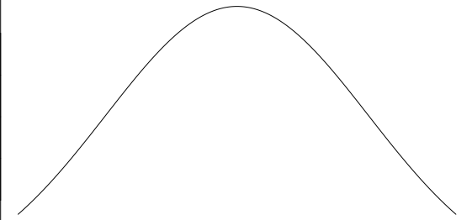
Agricultural example
no fertilizer
fertilizer
Additional gain in yield
Nutrient content of soil

Slide 8
Agricultural example
no fertilizer
fertilizer
Additional gain in yield
Nutrient content of soil

Slide 9
Agricultural example
no fertilizer
fertilizer
Additional gain in yield
A
Expno_fertilizer : 0
Expfertilizer: A - B → small pos value
EV|PI : A
EVPI : A – (A - B) = B
B
EMV
Nutrient content of soil
EV|PI
EMV

Slide 10
Agricultural example
no fertilizer
fertilizer
Additional gain in yield
Expno_fertilizer : 0
Expfertilizer: A - B → small neg value
EV|PI : A
EVPI : A – 0 = A
A
EMV
B
Nutrient content of soil
EV|PI
EMV
Knowing the nutrient content of the soil before deciding whether to apply fertilizer or not would increase the yield by the integral over (= the area of) A.

Slide 11
Assumptions
The model variable on the x-axis can take all values and the probability for all values is known
→ The EVPI is NOT the index to calculate, when there is one true value of the variable and we are uncertain about its value → sensitivity analysis
In the current implementation of EVPI, the probability distribution of the variable is assumed to follow a normal distribution. Mean and standard deviation are estimated within the function.
My definition: The EVPI expresses the expected gain (in whatever is on the y-axis) of knowing the value of the variable on the x-axis before taking a decision.
1500
500
500
600
500
gain (€)
-800
decreasing
20%
stable
30%
increasing
50%

