Slide 1
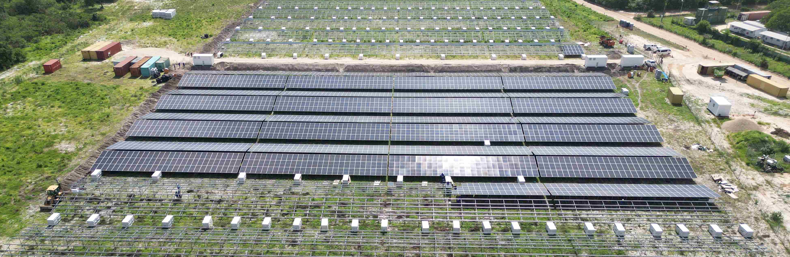
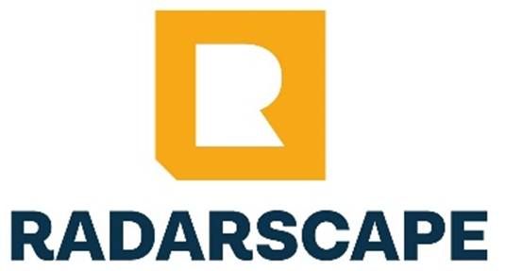
RADARSCAPE MOZAMBIQUE LIMITADA
COMPANY PROFILE

Slide 2
Executive Summary
Radarscape Mozambique Limitada is a Mozambican engineering and construction partner positioned to help clients deliver complex projects with reliability, speed, safety, quality, and commercial discipline. With proven operating exposure in the Afungi LNG corridor, a strong local market presence, and access to wider group capability, Radarscape is a trusted choice for clients seeking a credible local partner for Oil & Gas, industrial, energy, and strategic infrastructure delivery.

Slide 3
Why Choose Radarscape
Local Execution Strength Strong on-ground capability in Mozambique, including experience in LNG-linked operating environments. | Buyer Confidence Strong HSEQ alignment, disciplined delivery, and practical commercial control. | Scalable Support & Strategic Value Group-backed capacity, partnership-driven delivery, local content participation, execution agility, and dependable project performance.
Company Snapshot
Radarscape Mozambique Limitada is a Mozambican engineering, construction, and infrastructure delivery company serving clients in Oil & Gas, energy, industrial, and strategic infrastructure environments. We deliver practical, execution-focused solutions that help clients complete critical projects safely, on time, and with strong commercial control.
Established in September 2021 and operational since 2022, the company has rapidly built a credible execution presence in Cabo Delgado, with experience in demanding project environments linked to the TotalEnergies Mozambique LNG Area 1 ecosystem. This gives Radarscape relevant exposure to the standards, responsiveness, and delivery discipline expected on high-specification projects.

Slide 4
Radarscape combines local market access, execution agility, and group-backed technical depth. Supported by its parent group, Macefield Ventures Mozambique Limitada, and affiliated expertise from established regional businesses, the company gives clients a strong combination of local participation, scalable delivery capability, and international project standards.
Corporate Snapshot
Item | Description
Company Name | Radarscape Mozambique Limitada
Year of Establishment | 2021
Registration | Mozambique
License | Class 7 ALVARA
Head Office | Maputo, Mozambique
Core Operating Area | Cabo Delgado (Afungi LNG Corridor)
Parent Company | Macefield Ventures Mozambique Limitada

Slide 5

Purpose, Vision & Values
Vision
To be Mozambique’s most trusted and innovative Oil & Gas infrastructure partner.
Mission
To deliver value through strong partnerships, efficient execution, and practical solutions.
Core Values
  Safety-first execution
  Integrity and accountability
  Client-focused delivery
  Operational excellence
  Innovation and continuous improvement
  Sustainable local impact

Slide 6
Core Capabilities
We provide high-value, execution-focused capabilities that support clients from project planning through construction, infrastructure delivery, utilities, commissioning support, and ongoing maintenance.
Engineering, Civil & Industrial Construction
  Civil, structural, and infrastructure construction
  Mechanical and electrical installation works
  Roadworks, site preparation, and earthworks
  Industrial buildings, operational facilities, and support infrastructure
Design-Build & Turnkey Delivery
  Concept development and detailed engineering support
  Integrated project design coordination
  Turnkey delivery for selected project scopes

Slide 7
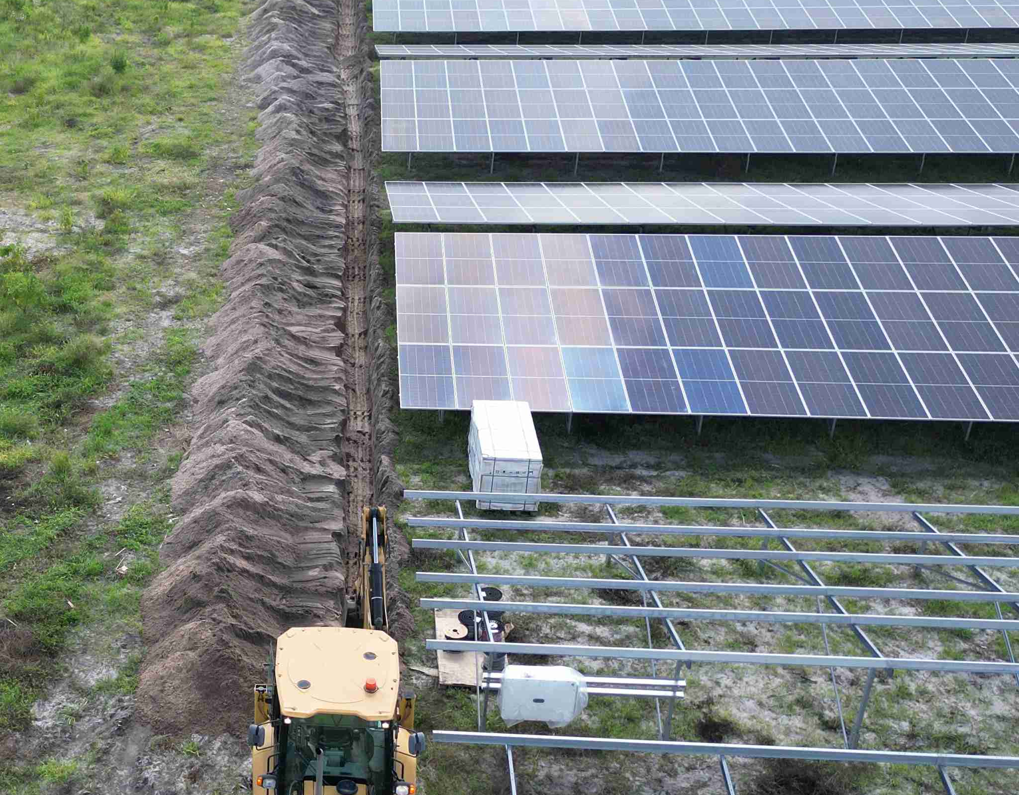
Energy, Power & Electrical Infrastructure
  Low- and medium-voltage electrical systems
  Solar and renewable energy infrastructure
  Substations and associated electrical works
Water, Utilities & Essential Infrastructure
  Water treatment, reticulation, and distribution systems
  Wastewater and support utility infrastructure
Maintenance, Facilities & Operational Support
  Civil, electrical, and HVAC maintenance services
  Industrial and commercial facilities support
  Responsive maintenance teams for mission-critical environments

Slide 8
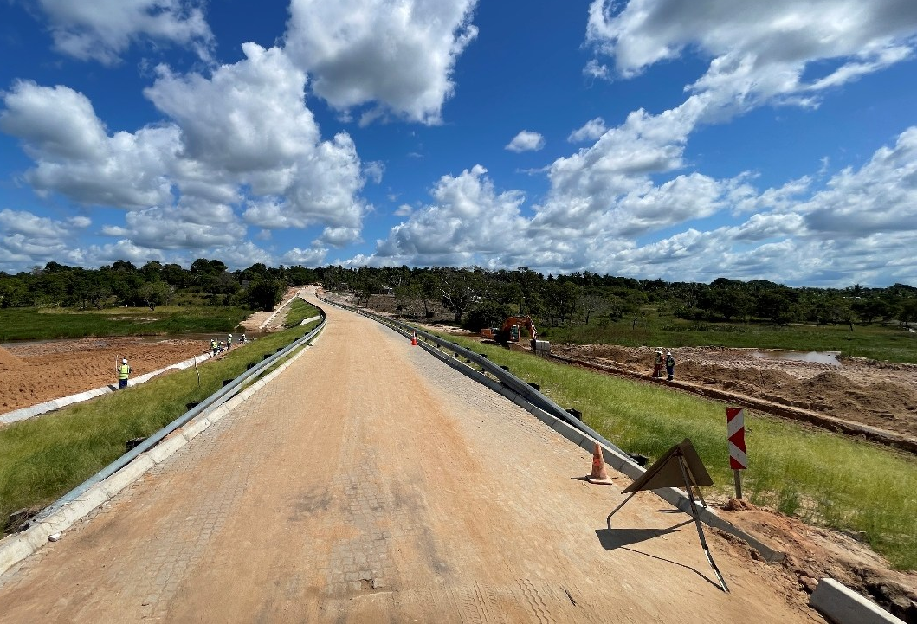
Relevant Project Experience
Our project experience demonstrates the ability to mobilize, execute, and deliver in remote, compliance-sensitive, and operationally demanding environments. Selected Mozambique experience includes:
  Rehabilitation of housing infrastructure in Quitunda (Palma)
  Afungi site improvement works (including Structure and steel works)
  Construction of Palma fish market road
  Construction of barracks and security infrastructure
  Installation of a 5MW solar PV plant in Afungi
  Afungi Airstrip Expansion
Together, these projects demonstrate Radarscape’s ability to:
  Operate under strict HSEQ and client compliance expectations
  Perform in LNG-linked and remote project environments
  Manage multi-disciplinary scopes with execution discipline
  Support local content delivery with practical on-ground capability

Slide 9
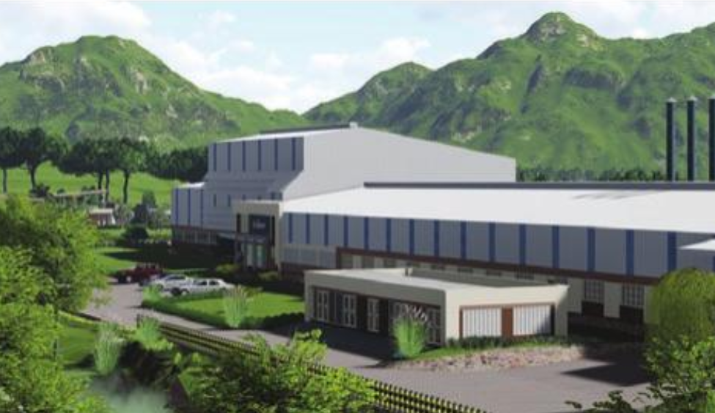
Delivery Platform & Group Strength
Through its wider group ecosystem, including affiliated regional contractors and technical businesses, Radarscape benefits from broader delivery depth, cross-border expertise, and additional execution capacity across engineering and infrastructure projects.
Large-scale industrial and commercial projects
Energy and power infrastructure
Road, civil, and urban development works
For clients, this translates into:
Greater technical depth and engineering support
Enhanced project mobilization and delivery capacity
Access to broader specialist expertise when projects scale

Slide 10
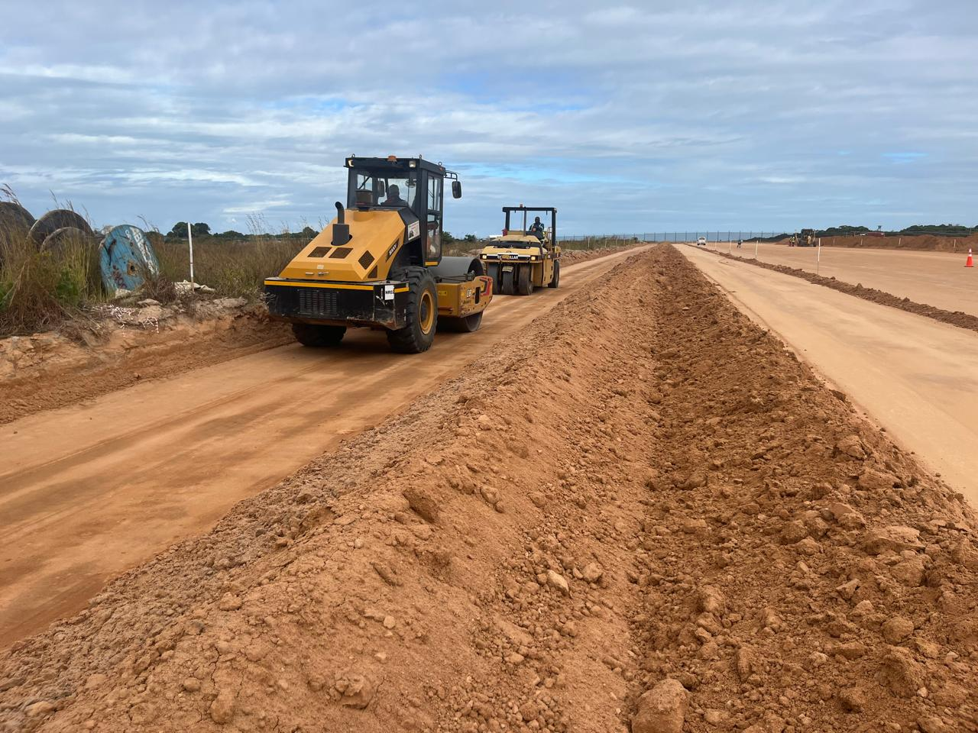
Delivery Model
Radarscape applies a flexible, partnership-enabled execution model designed to help clients deliver complex scopes with the right balance of local presence, technical support, and commercial control.
Partnership-Driven Project Access
Collaboration with established EPC and specialist contractors
Access to complex Oil & Gas and infrastructure opportunities
Balanced risk sharing and greater cost efficiency for clients
Execution Control & Asset Strategy
Project-specific delivery teams aligned to scope and schedule
Flexible equipment strategy combining leasing, rental, and selective ownership
Disciplined cost control and efficient use of equipment and resources
Capability Growth & Localization
Ongoing expansion in engineering, execution, and commissioning support
Progressive growth of in-house delivery capability
Stronger local content participation and long-term operational autonomy

Slide 11
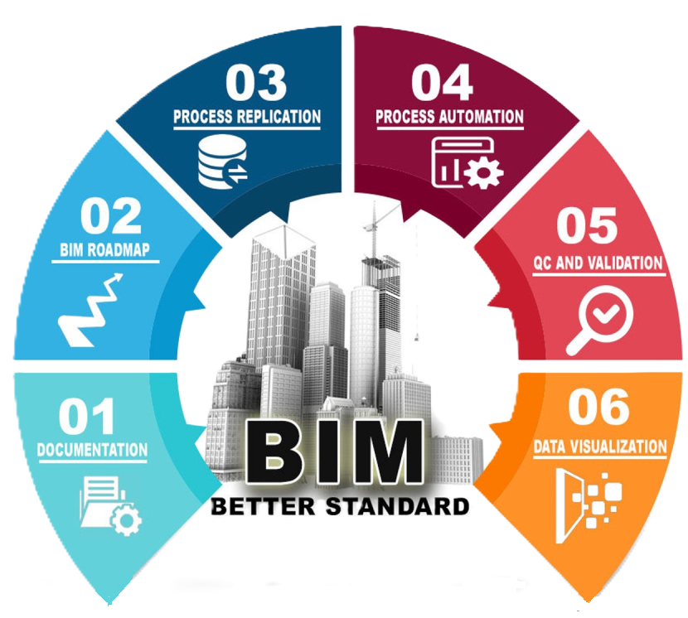
Technology, Systems & Controls
Radarscape uses modern project systems and digital controls to improve planning quality, cost visibility, coordination, and execution certainty.
Building Information Modeling (BIM)
Digital estimating and cost control systems using CCS Candy: a specialized, contractor-focused software suite designed for construction and engineering estimation, planning, and project control.
Benefits include:
Stronger project coordination and design visibility
Better cost control and reduced rework exposure
Improved real-time monitoring for timely decision-making

Slide 12
HSEQ & Compliance Assurance
Radarscape is built to operate in high-compliance, high-consequence environments. Our delivery approach is anchored in strong HSEQ discipline and alignment with client, regulatory, and international project requirements.
  Strict health and safety management
  Quality-focused project controls
  Environmental responsibility and sustainable work practices
For clients, this means:
  Safer project execution and reduced delivery risk
  Stronger compliance with site and regulatory requirements
  Greater confidence in project governance and performance

Slide 13
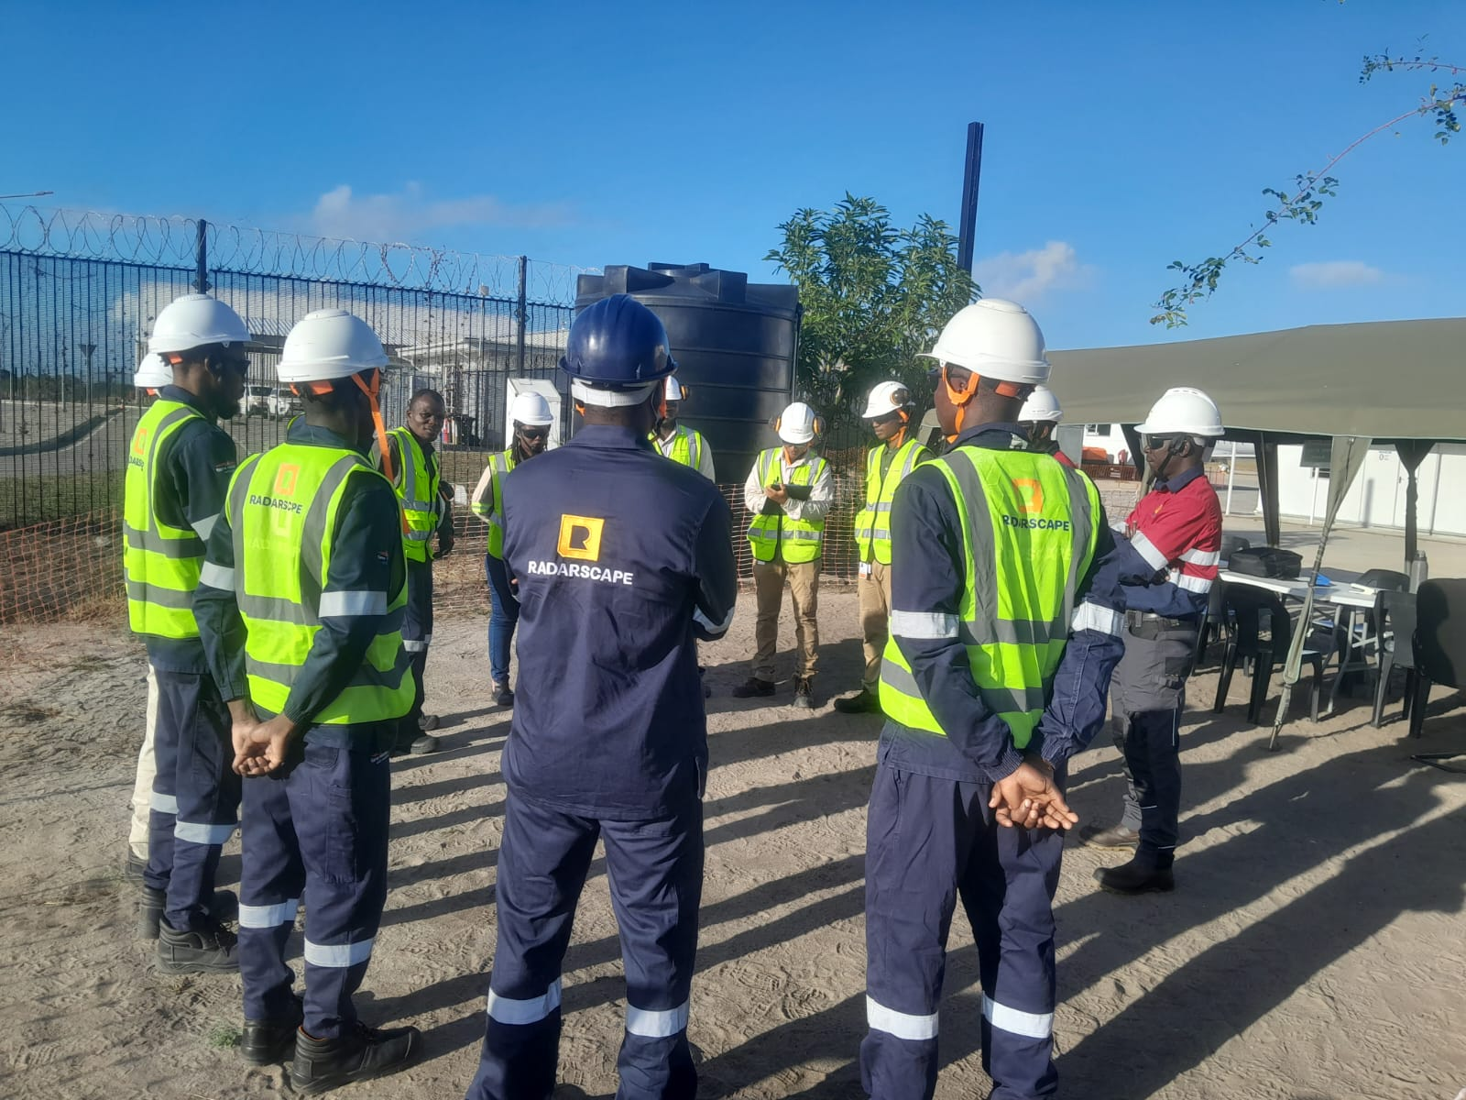
Strategic Advantage
Relevant Oil & Gas exposure in the Afungi LNG operating ecosystem Strong local presence backed by scalable group and partner capability Flexible commercial model that supports cost-effective delivery
Execution agility in challenging and remote environments Growing in-house technical depth across engineering and project execution Commitment to local content and long-term market presence in Mozambique

Slide 14

Market Position & Growth Strategy
Radarscape offers a strong value proposition for clients looking for a local contractor that can combine responsiveness, compliance discipline, and scalable delivery capability in Mozambique.
Oil & Gas construction and support infrastructure
Industrial and strategic infrastructure delivery
Energy and utility-linked project execution
The company’s growth strategy is focused on:
Earning higher-value work through stronger execution credibility
Delivering greater value through better project control and resource efficiency
Growing into adjacent sectors while building on our Oil & Gas expertise
Building long-term client partnerships and recurring project opportunities

Slide 15
Leadership, Team & Execution Support
Our delivery model is supported by a multidisciplinary team equipped to manage technical coordination, commercial control, procurement, HSEQ, and site execution across diverse project scopes.
Engineers and project managers
Quantity surveyors and HSE specialists
Commercial, procurement, and logistics professionals
This is reinforced by:
Group-level support in legal, commercial, tax, and contract management
A flexible staffing model that scales with project demand
Let’s Build with Confidence
Radarscape is ready to support clients seeking a credible local partner with execution discipline, scalable delivery support, and a strong fit for demanding, high-compliance project environments. We welcome opportunities to engage on tenders, subcontracting partnerships, direct awards, and strategic project collaboration across Mozambique.

Slide 16
CONTACT INFORMATION
🏢 Radarscape Mozambique Limitada
📍 Av. do Zimbabwe, No. 1512
Bairro da Sommershield
Maputo, Mozambique
📞 Tel: +258 849 459 905
✉️ Email: info@radarscapegroup.com

