Slide 1
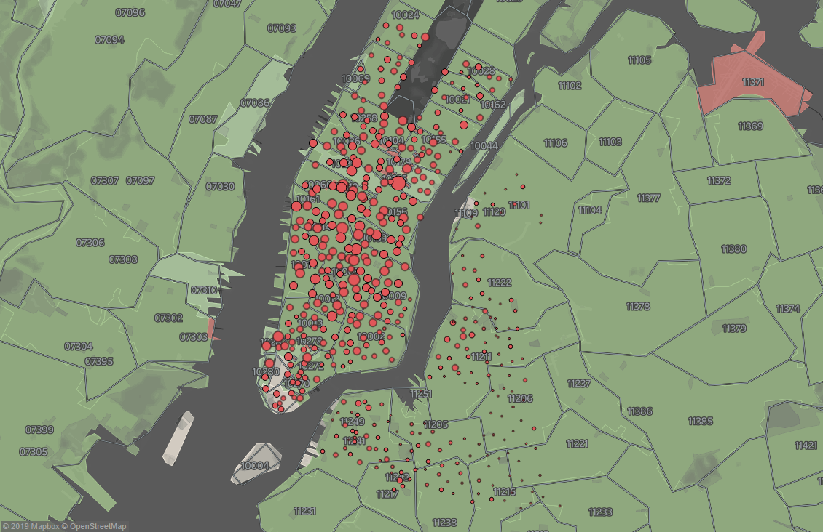

Analysis of Ridership
Jon Horvath

Slide 2
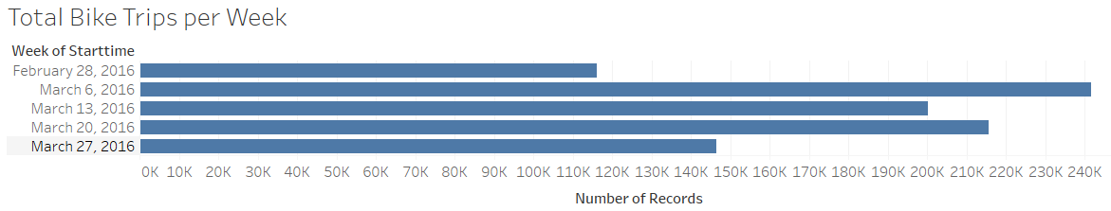
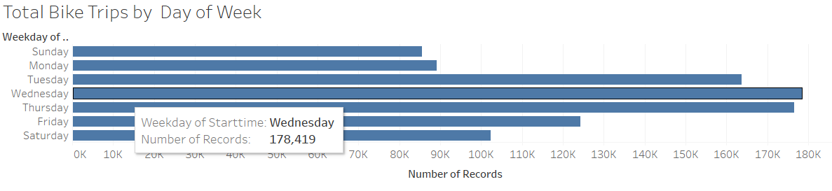
How many trips have been recorded total during the chosen period?
There was a total of 919,901 during the month of March 2016 with significant w/w volatility as you can see above and d/d volatility as you can see below.
When we look at the bike trips by day of week chart above, we see mid-week is busiest which makes me believe they are used for commuting as opposed to sightseeing or riding for exercise/pleasure.

Slide 3
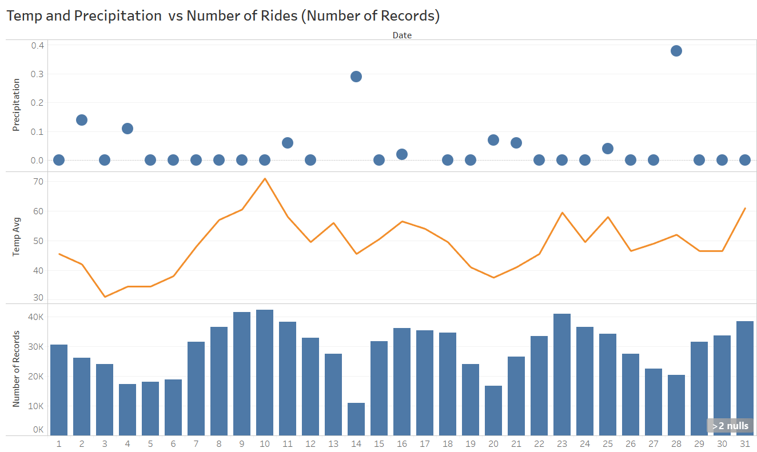
What is the biggest single driver of the volatility in the number of rides d/d and w/w ? In the below chart of March 2016 we can see the weather is a huge driver of this volatility. The number of rides is positively correlated with the average temperature and negatively correlated with precipitation. Next steps would be to work out what the impact is on ridership per degree of temp or per inch or precipitation.

Slide 4
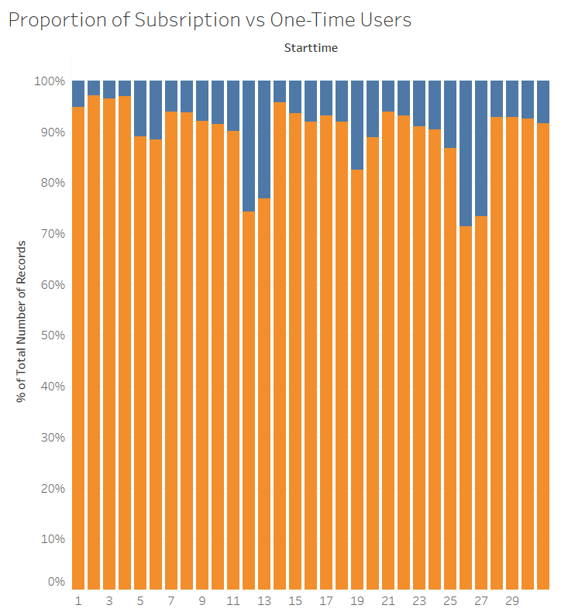
How has the proportion of short-term customers and annual subscribers changed?
We analyzed this by days in the month over a shorter time period, month of March 2016. You can see a few interesting trends – first the weekend increases in the proportion of one-time users, which fits with the thesis that weekday users are mainly commuter's vs weekends are tourists or NY residents doing outings.
Also, interestingly the proportion of subscribers declines each day of the week. As we approach the weekend.

Slide 5
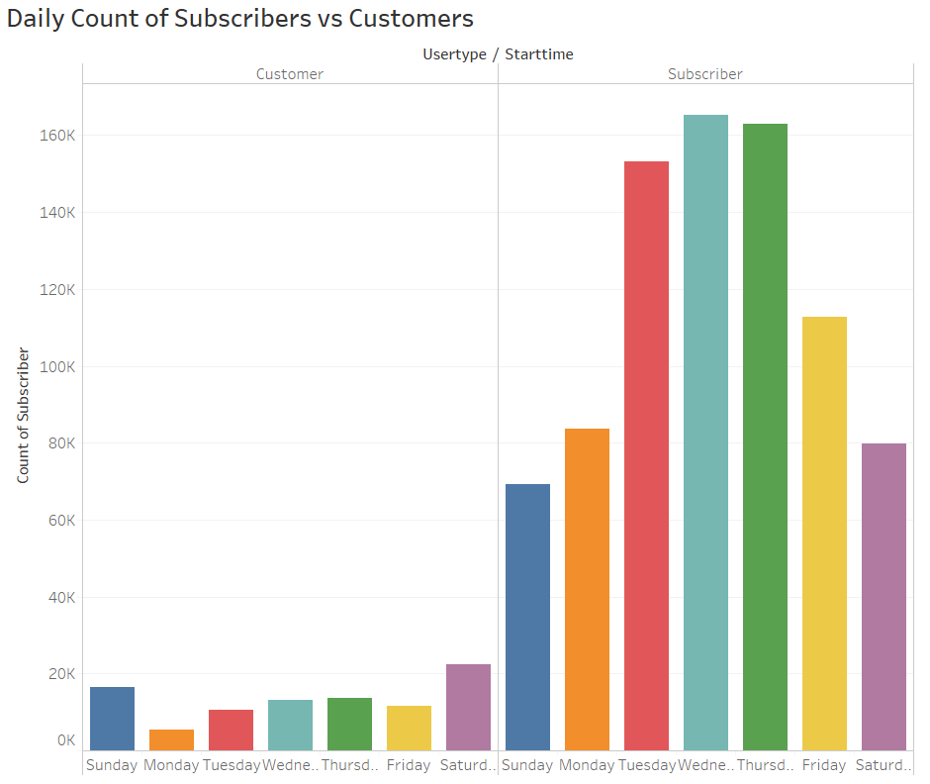
How has the proportion of short-term customers and annual subscribers changed? When I chart it by the day of the week it tells a similar story. Spikes of 1x users on the weekend and midweek favors the subscription/commuter customer.

Slide 6
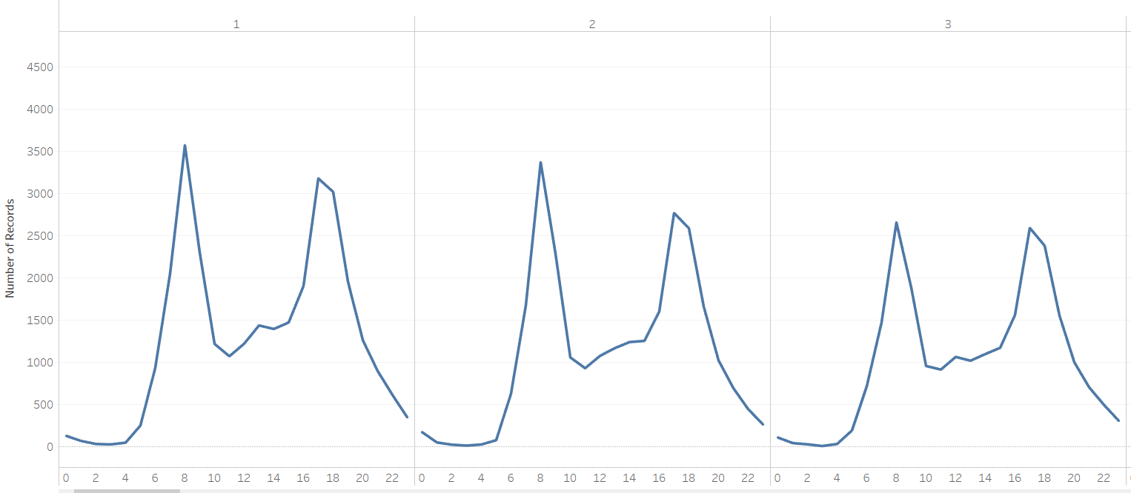
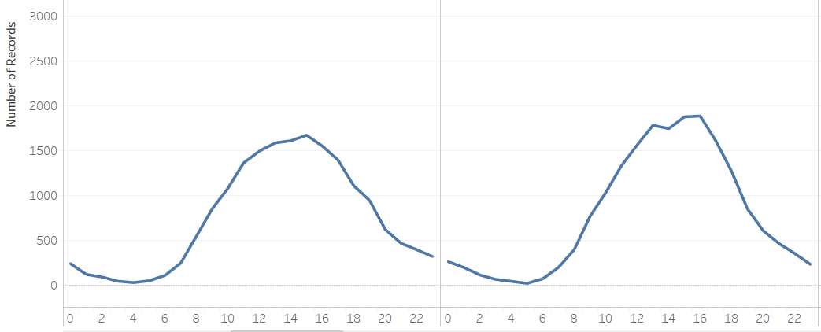
What are the peak hours in which bikes are used ?
We see two different dynamics- a commuting dynamic for weekdays and longer rides clustered around midday for weekends. Below is the weekday chart for the first 3 days of March 2016. You can see a big spike around 730-830AM for the morning commute and similar 430-630PM for the evening commute.
Weekends are completely different – as you can see in the 2 graphs on the right of a Saturday and Sunday. We see a much more gradual ramp up starting at 7-8AM end ending 8PM with a rounded top between 2-4PM. I suspect these are excursions to Central Park or Brooklyn or other popular weekend destinations.

Slide 7
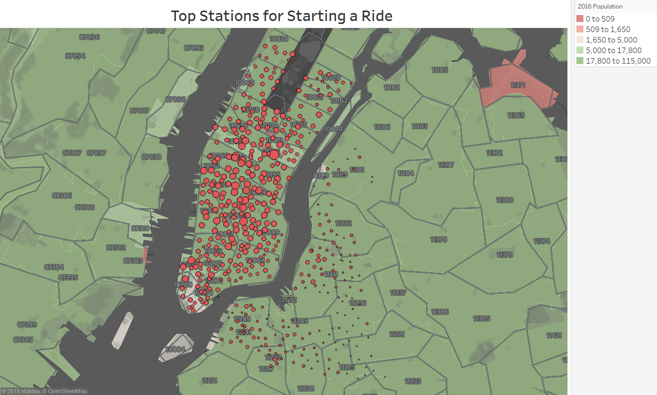
The size of the red circles represent the popularity of the station. Manhattan Island by far holds the most popular stations and they are clustered around working areas like Midtown.

Slide 8
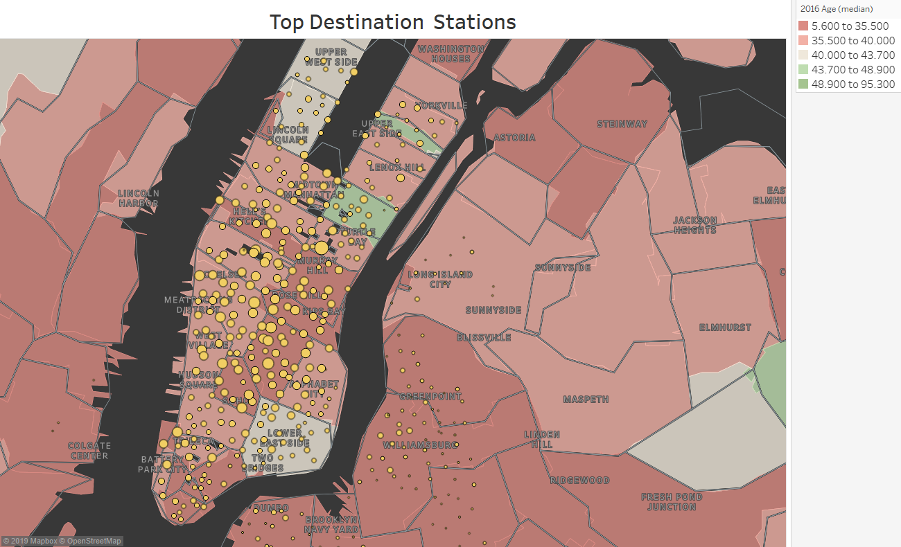
The size of the yellow circles represents popularity of the station. I used an age of population overlay instead of zip code to see if there was any significance but there doesn’t seem to be.

Slide 9
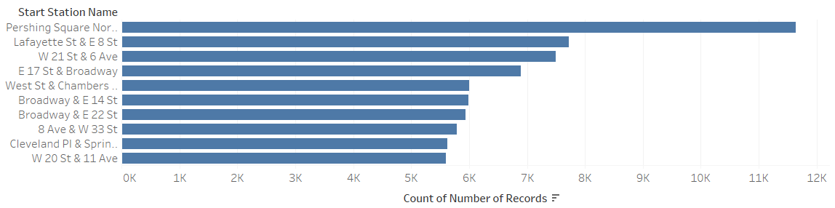
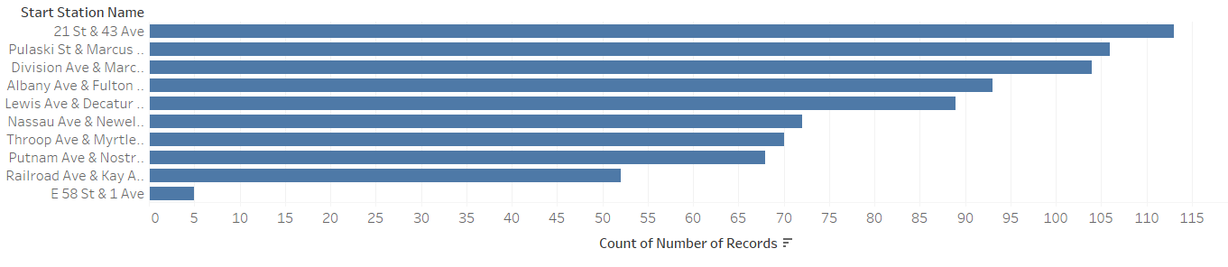
What are the top 10 stations in the city for starting a journey? See below chart of the top 10 stations for starting a ride. The most popular is Pershing Square North because it’s at Grand Central so not only at convergence of subway lines but also access to trains lines and commuters coming into Manhattan for work. The rest of the top 10 is lower Manhattan mostly high density residential/retail neighborhoods so makes sense as a starting point.
What are the bottom 10 stations in the city for starting a journey? Mostly they are in Brooklyn or just odd neighborhoods in Manhattan with low population density.

Slide 10
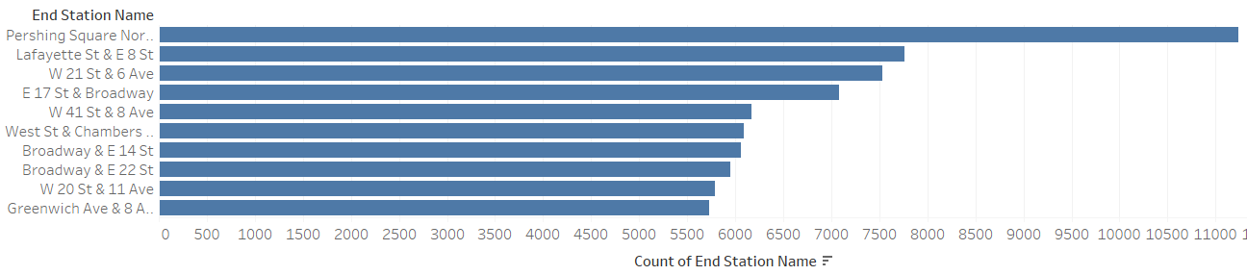
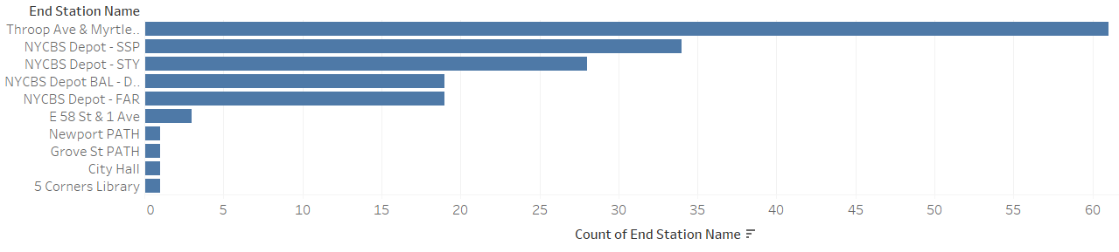
What are the top 10 stations in the city for ending a journey? Very similar to the top 10 stations for starting a ride, which fits the “commute” thesis. The main difference is one stop at 41st & 8th Ave which is Port Authority Bus Terminal so folks hopping on the bus. Not sure why this doesn’t show up in the start data, maybe folks to rushed in the AM.
What are the bottom 10 stations in the city for ending starting a journey? Half of them are NYCBS depots where bikes are temporarily stored while re-distributed from less popular to more popular start sites. The bottom half seems to be a couple of New Jersey sites by PATH commuter trains – not really sure why so unpopular since it’s a train station. I thought they would be more popular Start stations but they are not, there are no rides started at these PATH stations in NJ. And, at the bottom we have the 5 Corners Library in NJ. Not surprising as we believe library popularity peaked in the middle of the 20th century.

Slide 11
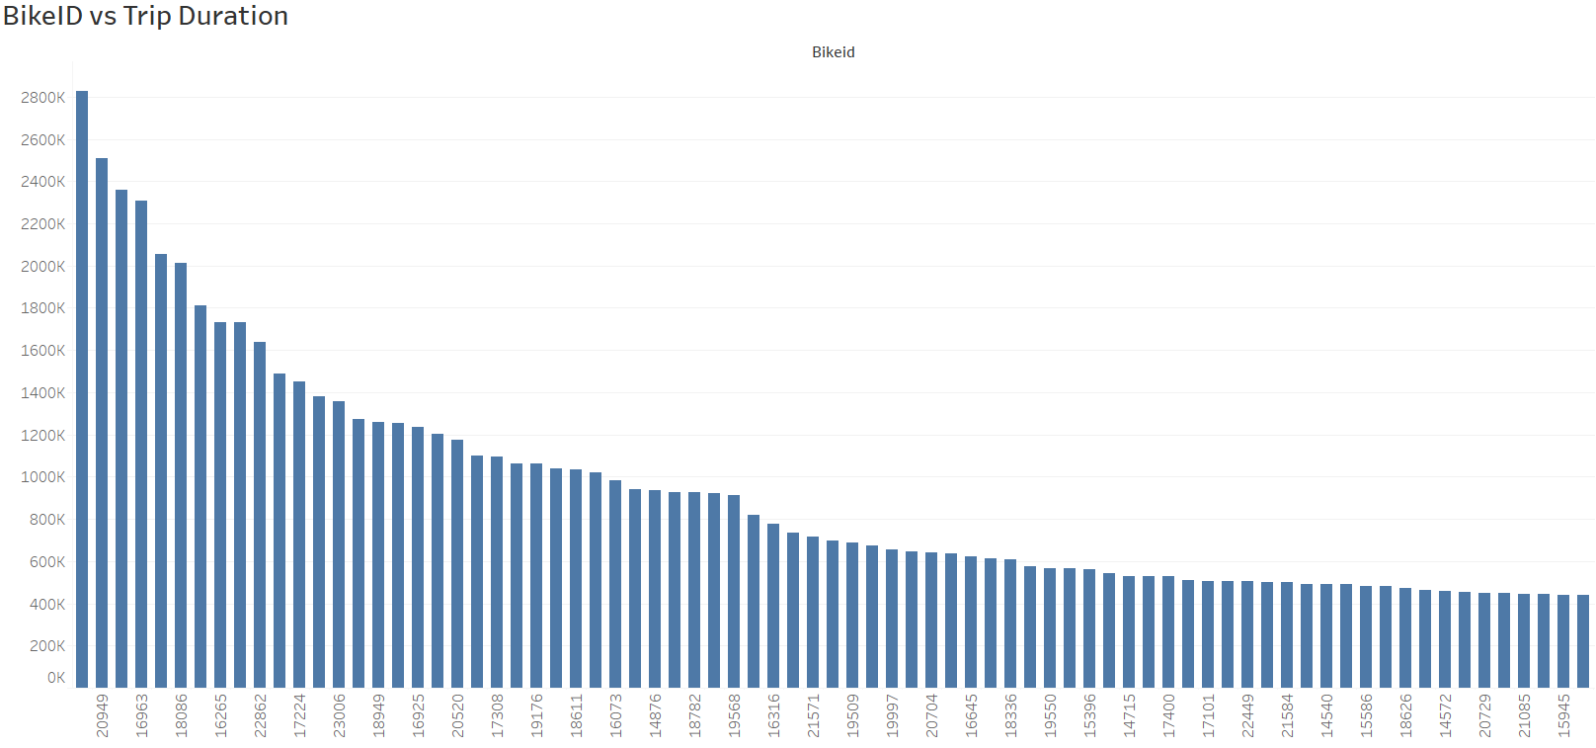
How variable is the utilization by bike ID? If you saw the tail of this chart you would see huge variability. As the trip duration varies significantly and drops to zero. The average is 1,020 seconds and as you can see in the chart the highest utilization bike was used for 2.8 million seconds in the month of March. The bikes that are getting zero utilization or close to it are either sitting at the depot or some very slow station and should be swapped out against the higher utilization bikes on some interval to reduce maintenance costs.
Which bikes (by ID) are most likely due for repair or inspection in the timespan? Below chart shows the BikeID vs avg trip duration for the month of March 2016. The most utilized bikes are probably due for inspection/repair.

Slide 12
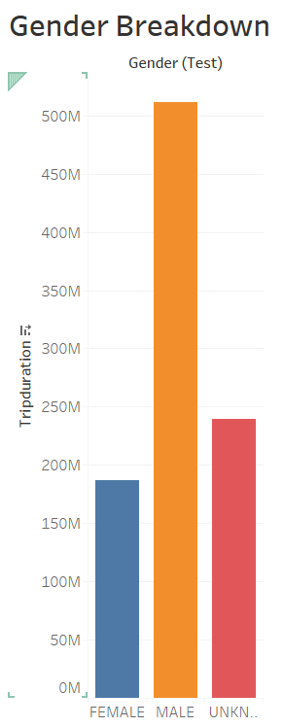
What is the gender breakdown of active participants (Male v. Female)?
Assuming an even balance of gender that don’t answer the gender question, the proportion is about 2.5x male to female ration.

Slide 13
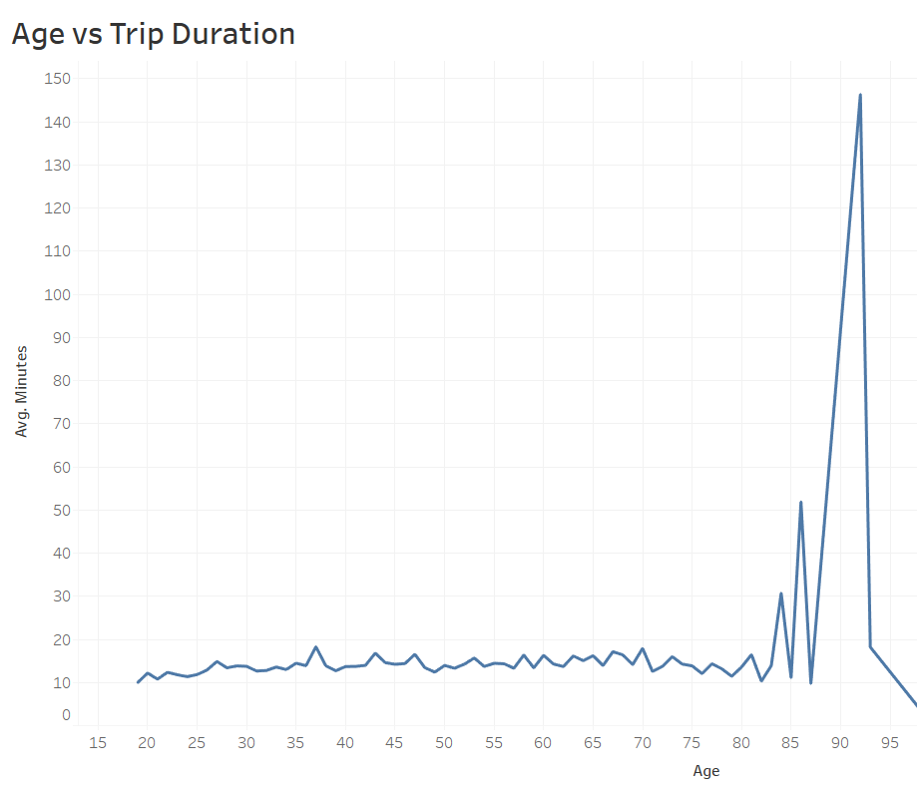
How does the average trip duration change by age?
I don’t think it changes much, let me explain. What we are seeing here in Month of March 2016 Age vs Trip Duration chart is mostly noise. We see some spikes as age goes up, specifically at 92 the avg trip duration is 146 minutes well above the teens of minutes level seen for most ages. When I drilled down into the data I see this particular spike was only a sample size of two long trip durations by the same person, and they did not go far. (stations were close). There might be some small increase in the trip duration over 80 but the sample size is too small.

