Slide 1

EFOP-3.4.3-16-2016-00009
A felsőfokú oktatás minőségének és hozzáférhetőségének együttes javítása a Pannon Egyetemen
Middleware
https://docs.microsoft.com/en-us/aspnet/core/fundamentals/middleware/?view=aspnetcore-3.1

Slide 2

Middleware
EFOP-3.4.3-16-2016-00009
A felsőfokú oktatás minőségének és hozzáférhetőségének együttes javítása a Pannon Egyetemen
Middleware is software that's assembled into an app pipeline to handle requests and responses. Each component:
Chooses whether to pass the request to the next component in the pipeline.
Can perform work before and after the next component in the pipeline.
Request delegates are used to build the request pipeline. The request delegates handle each HTTP request.
Request delegates are configured using Run, Map, and Use extension methods.

Slide 3
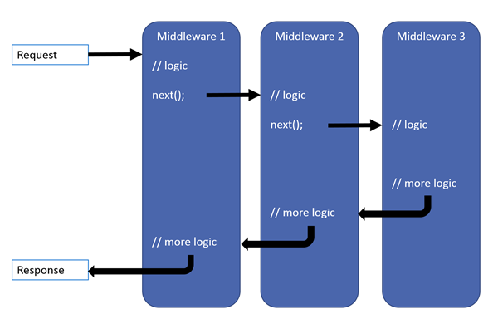
Middleware
EFOP-3.4.3-16-2016-00009
A felsőfokú oktatás minőségének és hozzáférhetőségének együttes javítása a Pannon Egyetemen
The ASP.NET Core request pipeline consists of a sequence of request delegates, called one after the other.

Slide 4
Middleware
EFOP-3.4.3-16-2016-00009
A felsőfokú oktatás minőségének és hozzáférhetőségének együttes javítása a Pannon Egyetemen
Each delegate can perform operations before and after the next delegate. Exception-handling delegates should be called early in the pipeline, so they can catch exceptions that occur in later stages of the pipeline.
The simplest possible ASP.NET Core app sets up a single request delegate that handles all requests. This case doesn't include an actual request pipeline. Instead, a single anonymous function is called in response to every HTTP request.
Chain multiple request delegates together with Use. The next parameter represents the next delegate in the pipeline. You can short-circuit the pipeline by not calling the next parameter.

Slide 5
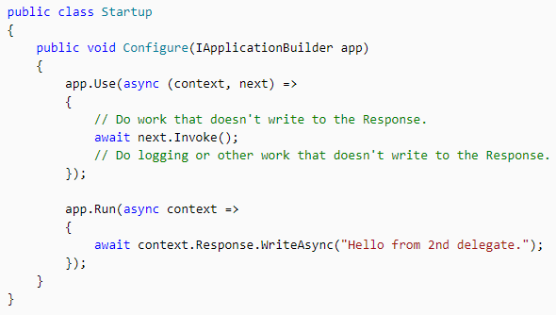
Middleware
EFOP-3.4.3-16-2016-00009
A felsőfokú oktatás minőségének és hozzáférhetőségének együttes javítása a Pannon Egyetemen

Slide 6
Middleware
EFOP-3.4.3-16-2016-00009
A felsőfokú oktatás minőségének és hozzáférhetőségének együttes javítása a Pannon Egyetemen
When a delegate doesn't pass a request to the next delegate, it's called short-circuiting the request pipeline. Short-circuiting is often desirable because it avoids unnecessary work.
For example, Static File Middleware can act as a terminal middleware by processing a request for a static file and short-circuiting the rest of the pipeline.
Middleware added to the pipeline before the middleware that terminates further processing still processes code after their next.Invoke statements.
Run delegates don't receive a next parameter. The first Run delegate is always terminal and terminates the pipeline.
Run is a convention. Some middleware components may expose Run[Middleware] methods that run at the end of the pipeline.

Slide 7
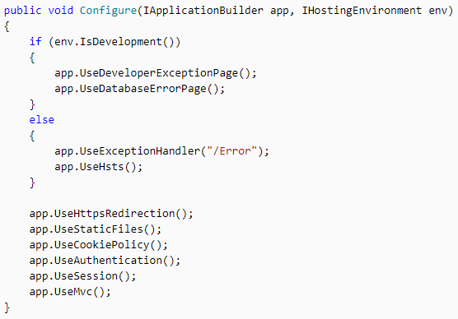
Middleware order
EFOP-3.4.3-16-2016-00009
A felsőfokú oktatás minőségének és hozzáférhetőségének együttes javítása a Pannon Egyetemen
The order that middleware components are added in the Startup.Configure method defines the order in which the middleware components are invoked on requests and the reverse order for the response.
The order is critical for security, performance, and functionality.

Slide 8
Branch the middleware pipeline
EFOP-3.4.3-16-2016-00009
A felsőfokú oktatás minőségének és hozzáférhetőségének együttes javítása a Pannon Egyetemen
Map extensions are used as a convention for branching the pipeline. Map branches the request pipeline based on matches of the given request path. If the request path starts with the given path, the branch is executed.

Slide 9
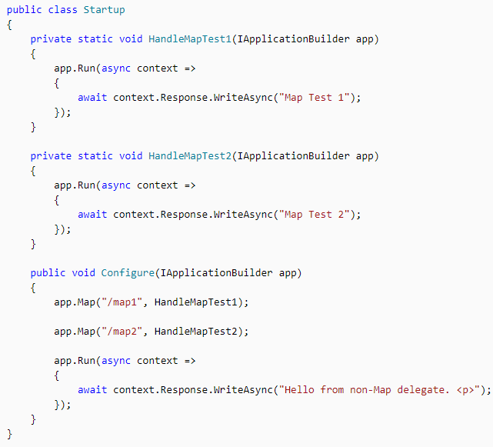
Branch the middleware pipeline
EFOP-3.4.3-16-2016-00009
A felsőfokú oktatás minőségének és hozzáférhetőségének együttes javítása a Pannon Egyetemen

Slide 10
Branch the middleware pipeline
EFOP-3.4.3-16-2016-00009
A felsőfokú oktatás minőségének és hozzáférhetőségének együttes javítása a Pannon Egyetemen
The following table shows the requests and responses from http://localhost:1234 using the next code.
Request | Response
localhost:1234 | Hello from non-Map delegate.
localhost:1234/map1 | Map Test 1
localhost:1234/map2 | Map Test 2
localhost:1234/map3 | Hello from non-Map delegate.

Slide 11
Built-in middleware
EFOP-3.4.3-16-2016-00009
A felsőfokú oktatás minőségének és hozzáférhetőségének együttes javítása a Pannon Egyetemen
ASP.NET Core ships with the following middleware components. The Order column provides notes on middleware placement in the request processing pipeline and under what conditions the middleware may terminate request processing. When a middleware short-circuits the request processing pipeline and prevents further downstream middleware from processing a request, it's called a terminal middleware.

Slide 12
Built-in middleware
EFOP-3.4.3-16-2016-00009
A felsőfokú oktatás minőségének és hozzáférhetőségének együttes javítása a Pannon Egyetemen
Middleware | Description | Order
Authentication | Provides authentication support. | Before HttpContext.User is needed. Terminal for OAuth callbacks.
Authorization | Provides authorization support. | Immediately after the Authentication Middleware.
Cookie Policy | Tracks consent from users for storing personal information and enforces minimum standards for cookie fields, such as secure and SameSite. | Before middleware that issues cookies. Examples: Authentication, Session, MVC (TempData).
CORS | Configures Cross-Origin Resource Sharing. | Before components that use CORS.
MVC | Processes requests with MVC/Razor Pages. | Terminal if a request matches a route.
Response Caching | Provides support for caching responses. | Before components that require caching.
SPA | Handles all requests from this point in the middleware chain by returning the default page for the Single Page Application (SPA) | Late in the chain, so that other middleware for serving static files, MVC actions, etc., takes precedence.
Session | Provides support for managing user sessions. | Before components that require Session.
Static Files | Provides support for serving static files and directory browsing. | Terminal if a request matches a file.
WebSockets | Enables the WebSockets protocol. | Before components that are required to accept WebSocket requests.

Slide 13
Summary
EFOP-3.4.3-16-2016-00009
A felsőfokú oktatás minőségének és hozzáférhetőségének együttes javítása a Pannon Egyetemen
Middleware is software that's assembled into an app pipeline to handle requests and responses.
Configure the HTTP pipeline using Use, Run, and Map
The Use method can short-circuit the pipeline (that is, if it doesn't call a next request delegate).
Run is a convention, and some middleware components may expose Run[Middleware] methods that run at the end of the pipeline.
Map extensions are used as a convention for branching the pipeline. Map branches the request pipeline based on matches of the given request path. If the request path starts with the given path, the branch is executed.

Slide 14
EFOP-3.4.3-16-2016-00009
A felsőfokú oktatás minőségének és hozzáférhetőségének együttes javítása a Pannon Egyetemen
Köszönöm a figyelmet!

