Slide 1

EFOP-3.4.3-16-2016-00009
A felsőfokú oktatás minőségének és hozzáférhetőségének együttes javítása a Pannon Egyetemen
Controllers
https://docs.microsoft.com/en-us/aspnet/core/mvc/controllers/actions?view=aspnetcore-3.1

Slide 2

What is a Controller?
EFOP-3.4.3-16-2016-00009
A felsőfokú oktatás minőségének és hozzáférhetőségének együttes javítása a Pannon Egyetemen
A controller is used to define and group a set of actions. An action (or action method) is a method on a controller which handles requests.
Controllers logically group similar actions together.
This aggregation of actions allows common sets of rules, such as routing, caching, and authorization, to be applied collectively.
Requests are mapped to actions through routing.

Slide 3
What is a Controller?
EFOP-3.4.3-16-2016-00009
A felsőfokú oktatás minőségének és hozzáférhetőségének együttes javítása a Pannon Egyetemen
By convention, controller classes:
Reside in the project's root-level Controllers folder.
Inherit from Microsoft.AspNetCore.Mvc.Controller.
A controller is an instantiable class in which at least one of the following conditions is true:
The class name is suffixed with Controller.
The class inherits from a class whose name is suffixed with Controller.
The [Controller] attribute is applied to the class.
A controller class must not have an associated [NonController] attribute.

Slide 4
What is a Controller?
EFOP-3.4.3-16-2016-00009
A felsőfokú oktatás minőségének és hozzáférhetőségének együttes javítása a Pannon Egyetemen
Controllers should follow the Explicit Dependencies Principle.
Methods and classes should explicitly require any collaborating objects they need in order to function correctly.
There are a couple of approaches to implementing this principle.
If multiple controller actions require the same service, consider using constructor injection to request those dependencies.
If the service is needed by only a single action method, consider using Action Injection to request the dependency.

Slide 5
What is a Controller?
EFOP-3.4.3-16-2016-00009
A felsőfokú oktatás minőségének és hozzáférhetőségének együttes javítása a Pannon Egyetemen
Within the Model-View-Controller pattern, a controller is responsible for the initial processing of the request and instantiation of the model.
Generally, business decisions should be performed within the model.
The controller takes the result of the model's processing (if any) and returns either the proper view and its associated view data or the result of the API call.
The controller is a UI-level abstraction.
Its responsibilities are to ensure request data is valid and to choose which view (or result for an API) should be returned.
In well-factored apps, it doesn't directly include data access or business logic. Instead, the controller delegates to services handling these responsibilities.

Slide 6
Defining Actions
EFOP-3.4.3-16-2016-00009
A felsőfokú oktatás minőségének és hozzáférhetőségének együttes javítása a Pannon Egyetemen
Public methods on a controller, except those with the [NonAction] attribute, are actions.
Parameters on actions are bound to request data and are validated using model binding.
Model validation occurs for everything that's model-bound.
The ModelState.IsValid property value indicates whether model binding and validation succeeded.
Action methods should contain logic for mapping a request to a business concern.
Business concerns should typically be represented as services that the controller accesses through dependency injection.
Actions then map the result of the business action to an application state.
Actions can return anything, but frequently return an instance of IActionResult (or Task<IActionResult> for async methods) that produces a response.
The action method is responsible for choosing what kind of response.
The action result does the responding.

Slide 7
Controller Helper Methods
EFOP-3.4.3-16-2016-00009
A felsőfokú oktatás minőségének és hozzáférhetőségének együttes javítása a Pannon Egyetemen
Controllers usually inherit from Controller, although this isn't required. Deriving from Controller provides access to three categories of helper methods.
Methods resulting in an empty response body.
Methods resulting in a non-empty response body with a predefined content type.
Methods resulting in a non-empty response body formatted in a content type negotiated with the client.

Slide 8
Controller Helper Methods
EFOP-3.4.3-16-2016-00009
A felsőfokú oktatás minőségének és hozzáférhetőségének együttes javítása a Pannon Egyetemen
Methods resulting in an empty response body.
No Content-Type HTTP response header is included, since the response body lacks content to describe.
There are two result types within this category
Redirect type returns a redirect to an action or destination.
For example, return RedirectToAction("Complete", new {id = 123}); redirects to Complete, passing an anonymous object.
HTTP Status Code type returns an HTTP status code. When methods are overloaded, they no longer qualify as HTTP Status Code responders, since content negotiation is taking place.
A couple of helper methods of this type are BadRequest, NotFound, and Ok.

Slide 9
Controller Helper Methods
EFOP-3.4.3-16-2016-00009
A felsőfokú oktatás minőségének és hozzáférhetőségének együttes javítása a Pannon Egyetemen
Methods resulting in a non-empty response body with a predefined content type.
Most helper methods in this category include a ContentType property, allowing you to set the Content-Type response header to describe the response body.
There are two result types within this category
View type returns a view which uses a model to render HTML.
For example, return View(customer);
Formatted Response type returns JSON or a similar data exchange format to represent an object in a specific manner.
For example, return Json(customer);
Other common methods of this type include File and PhysicalFile too. For example, return PhysicalFile(customerFilePath, "text/xml");

Slide 10
Controller Helper Methods
EFOP-3.4.3-16-2016-00009
A felsőfokú oktatás minőségének és hozzáférhetőségének együttes javítása a Pannon Egyetemen
Methods resulting in a non-empty response body formatted in a content type negotiated with the client.
This category is better known as Content Negotiation.
Content negotiation applies whenever an action returns an ObjectResult type or something other than an IActionResult implementation. An action that returns a non-IActionResult implementation (for example, object) also returns a Formatted Response.
Some helper methods of this type include BadRequest, CreatedAtRoute, and Ok.
Examples of these methods include return BadRequest(modelState);, return CreatedAtRoute("routename", values, newobject);, and return Ok(value);, respectively.

Slide 11
Cross-Cutting Concerns
EFOP-3.4.3-16-2016-00009
A felsőfokú oktatás minőségének és hozzáférhetőségének együttes javítása a Pannon Egyetemen
Applications typically share parts of their workflow.
Examples include an app that requires authentication to access the shopping cart, or an app that caches data on some pages.
To perform logic before or after an action method, use a filter. Using Filters on cross-cutting concerns can reduce duplication.
Most filter attributes, such as [Authorize], can be applied at the controller or action level depending upon the desired level of granularity.
Error handling and response caching are often cross-cutting concerns.
Many cross-cutting concerns can be handled using filters or custom middleware.

Slide 12
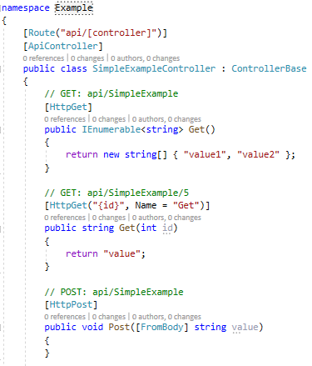
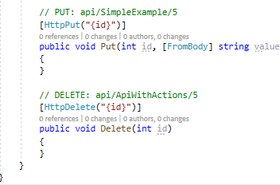
Simple Controller Example
EFOP-3.4.3-16-2016-00009
A felsőfokú oktatás minőségének és hozzáférhetőségének együttes javítása a Pannon Egyetemen

Slide 13
EFOP-3.4.3-16-2016-00009
A felsőfokú oktatás minőségének és hozzáférhetőségének együttes javítása a Pannon Egyetemen
Köszönöm a figyelmet!

