Slide 1



DataCo by CSta
Cam Horwood, Chris Comeau, Emilio Carretero and Luke Staeben

Slide 2
Agenda
Display historical data
Plan the purchase of future carbon offsets:
Calculate and display historical net carbon emissions
Outro
Predict and communicate future net carbon emissions

Slide 3

Introduction
Welcome to DataCo a dynamic team of four computer science students driven by a shared passion for data analysis and innovation. With expertise spanning machine learning, artificial intelligence, data mining, and statistical analysis, we specialize in unlocking valuable insights from complex datasets to empower businesses and organizations. Our mission is to revolutionize industries through data-driven decision-making, offering tailored solutions that optimize processes, predict market trends, and identify growth opportunities. Committed to excellence and innovation, DataCo is your trusted partner in harnessing the power of data to drive tangible results and shape a brighter future.
3

Slide 4
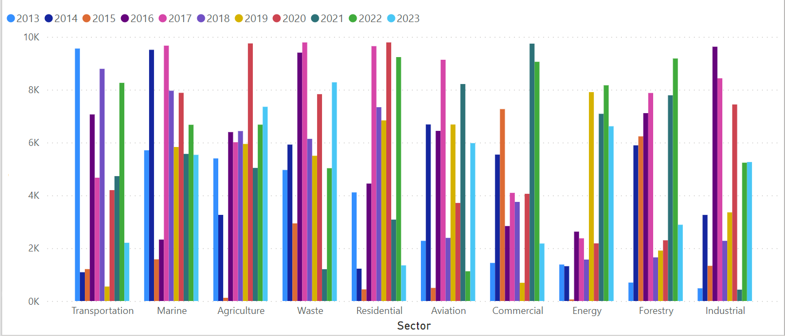
Irvine emissions 2013 through to 2023

Slide 5
Net carbon emission 2024
2024 net prediction: $10 147.09
2024 carbon tax: 6597.93 C02 tons
Note* before DataCo's software to reduce cost and carbon emissions

Slide 6
Irvine offsets
2013 through to 2023

Slide 7
Purchase of carbon offsets
Companies our algorithm chose: WindInnovations , GigaConserv , AquaConserv and TerraSolutions
C02 tons: -4254.82
Price: 2687.095455

Slide 8
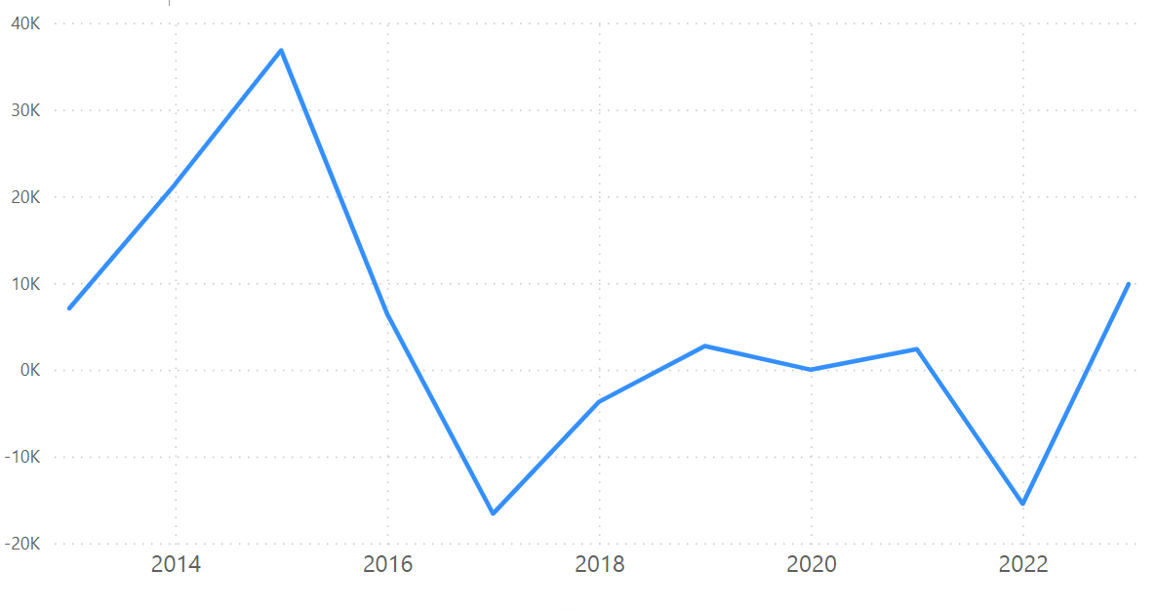
Irvine net carbon emissions 2013 through to 2023

Slide 9




Thank you
Luke Staeben
lstaeben@CSta.com
www.DataCObyCSta.ca

