Slide 1
Basic cocomo
Software evolution & configuration
Hor Weng Liang
Muhammad Hazim bin Kamaruzzaman
Luqman Hakim bin Ahmad Tamrin
Siti Sarah binti Azmi
Siti Aishah binti Aminuddin
Adreen binti Mohd Affendy
Nur Aainaa binti Ismail

Slide 2
What is cocomo
Constructive Cost Model (COCOMO) is a procedural software cost estimation model developed by Barry W. Boehm which use to estimate size, effort and duration base on the cost of the software.
COCOMO are divided into three mode which are
Organic
Semi-detached
Embedded
TYPE OF MODE

Slide 3

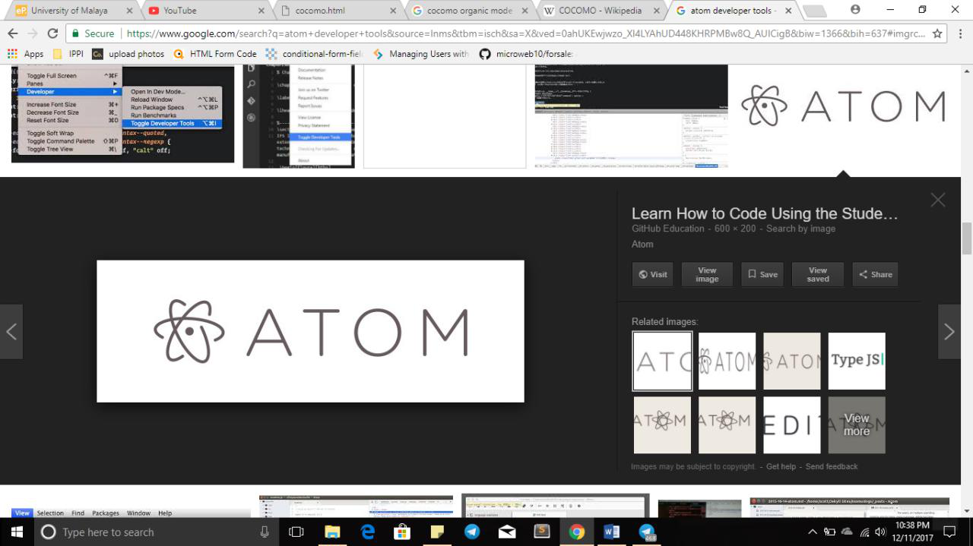
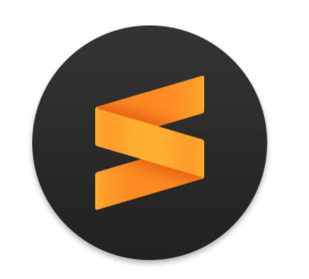
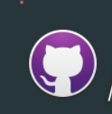
Tool assessment
Sublime text
Sketch (UI design)
Atom (coding development)
Github desktop & gitbash

