Slide 1
#OneCupOf
#Coffee
#Campaign
“What do you want?… Just Coffee. Black – like my soul. “ by Cassandra Clare, City of Bones
Health Effect
Kinds of Coffee
Brunch with Coffee
Lovely cafes for SNS
Welcome!
The content of introducing campaign.

Slide 2
#OneCupOf
#Coffee
#Campaign
Health
Home Kinds | Brunch | cafes for SNS
Jump to
1. Benefits
2. Diet
Health Effect
Benefits
Content
Diet
Content

Slide 3
Home
-What’s the campaign
-What for
health effect
-하루한잔의 커피
-많이 마시는 것 vs 꾸준히 마시는 것
kinds
brunch
lovely place for SNS

Slide 4
#OneCupOf
#Coffee
#Campaign
“What do you want?… Just Coffee. Black – like my soul. “ by Cassandra Clare, City of Bones
Health Effect
Kinds of Coffee
Brunch with Coffee
Lovely cafes for SNS
What’s the campaign about?
blah blah blah blah blah blah blah blah blah
blah blah blah blah blah blah blah blah
blah blah blah blah blah blah blah blah
What’s the campaign for?
blah blah blah blah blah blah blah blah blah
blah blah blah blah blah blah blah blah
blah blah blah blah blah blah blah blah

Slide 5
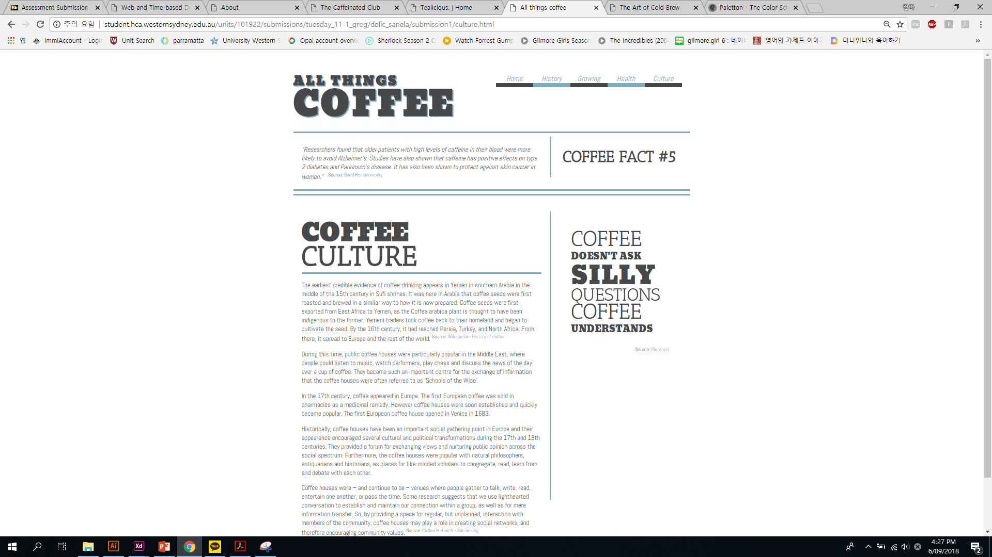
#OneCupOf
#Coffee
#Campaign
“What do you want?… Just Coffee. Black – like my soul. “ by Cassandra Clare, City of Bones
Health Effect
Kinds of Coffee
Brunch with Coffee
Lovely cafes for SNS
What’s the campaign about?
blah blah blah blah blah blah blah blah blah
blah blah blah blah blah blah blah blah
blah blah blah blah blah blah blah blah
What’s the campaign for?
blah blah blah blah blah blah blah blah blah
blah blah blah blah blah blah blah blah
blah blah blah blah blah blah blah blah

Slide 6
캐릭터 코드
알파벳순

