Slide 1
Hajj Doctor
A project by Forte Team

Slide 2
Dedicated for
Public Health

Slide 3
Problems
Overcrowding
Too many languages
Rapid aid

Slide 4
iOS Doctor App
Simply in few steps, we achieve:
Disease diagnosis
Medicine delivery

Slide 5
Demo

Slide 6
Solutions
Overcrowding Remote diagnosis
Too many languages
Rapid aid

Slide 7
Solutions
Overcrowding Remote diagnosis
Too many languages Support all languages
Rapid aid

Slide 8
Solutions
Overcrowding Remote diagnosis
Too many languages Support all languages
Rapid aid Medicine delivery

Slide 9
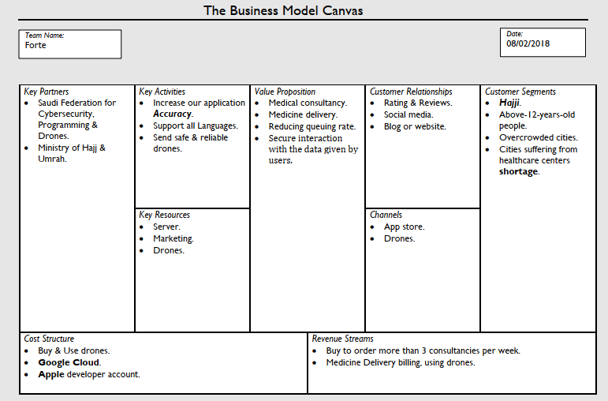
Business model

Slide 10
Any Questions ?

