Slide 1
Term Project
Group23
Names:
1- Hosam Mahmoud
2- Maryam Almashad
3- Nada Aboelfetouh
IDs:
1- 300327269
2- 300327220
3- 300327211

Slide 2

Problem’s overview
UNR-IDD dataset : this dataset that provide different types of attacks (Labels) and many attributes like: Switch ID, Port Numbers and many other attributes.
the machine learning model will learn the pattern and the relation between these attributes, to predict the type of the attack.
for example, if Unknown Load/Rate attribute has a high value that would give us an insight that there is may be a possible attack.
also, if Received packets attribute has unusual high value at specific interval, that indicates an upcoming attack.
and the same concept could be possible with the remaining attributes.
so, the mission of the machine learning model is to learn these pattern to be able to detect the possible attacks.
Packets
Packets
Packets

Slide 3
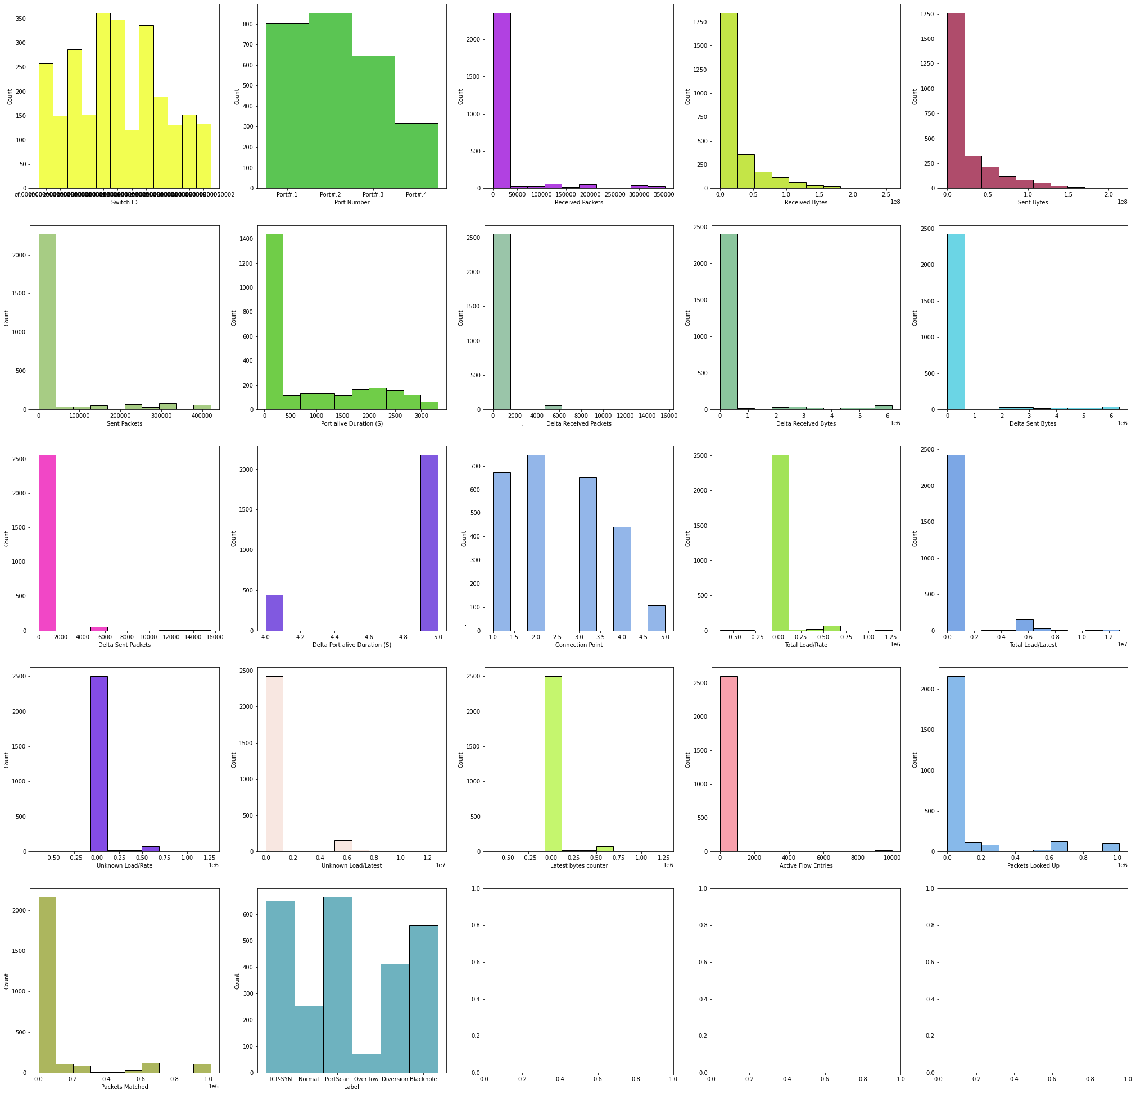
Dataset’s overview (EDA)
1- Data Distribution

Slide 4
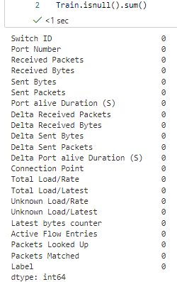
Dataset’s overview (EDA)
2- Check the null values

Slide 5
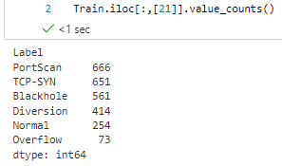
Dataset’s overview (EDA)
3- Number of instance per class

Slide 6
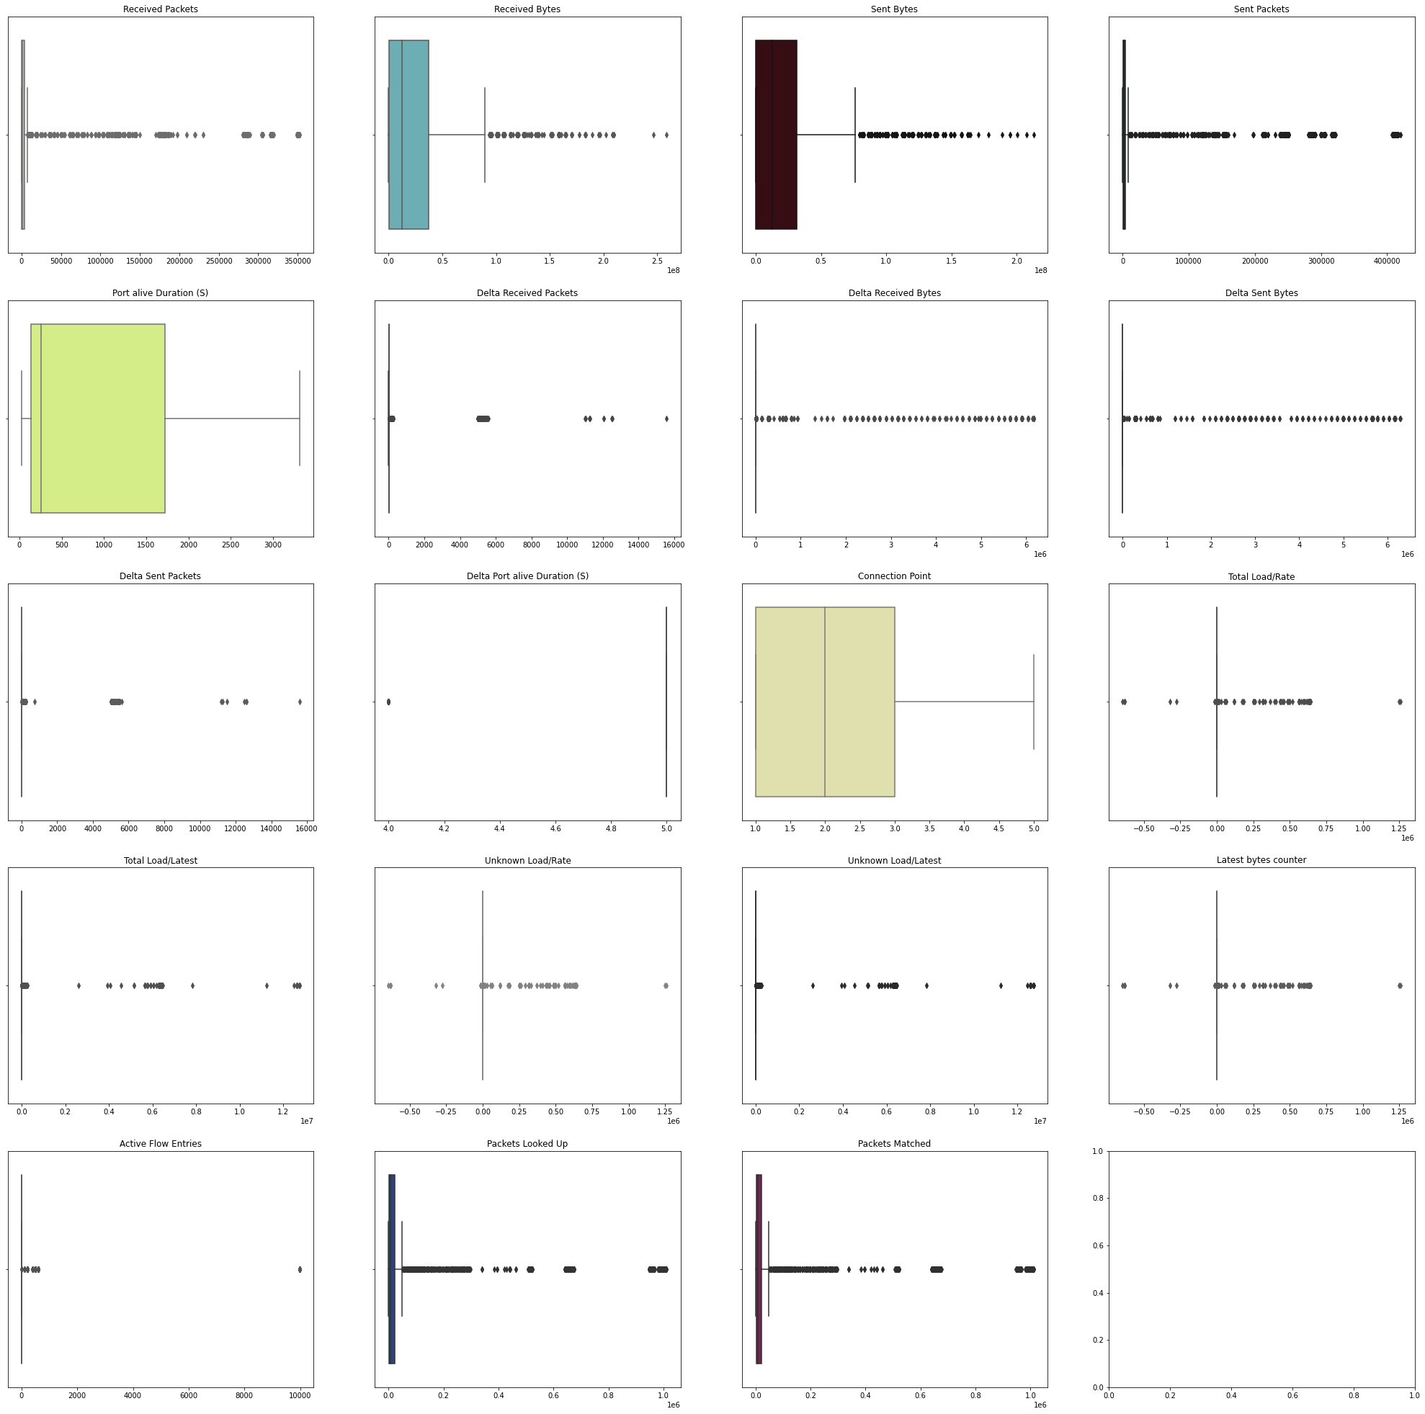
Dataset’s overview (EDA)
4- Outliers detection

Slide 7
Dataset’s overview (EDA)
4- Outliers detection
Received Packets
80
Received Bytes
58
Sent Bytes
55
Sent Packets
103
Port alive Duration (S)
0
Delta Received Packets
64
Delta Received Bytes
108
Delta Sent Bytes
105
Delta Sent Packets
59
Delta Port alive Duration (S)
0
Connection Point
0
Total Load/Rate
90
Total Load/Latest
185
Unknown Load/Rate
90
Unknown Load/Latest
185
Latest bytes counter
90
Active Flow Entries
18
Packets Looked Up
106
Packets Matched
106
Total number of outliers in Train = 657

Slide 8
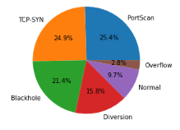
Dataset’s overview (EDA)
5- Data balancing check

Slide 9
Dataset’s overview (EDA)
6- Label Encoding
7- one-hot Encoding
8- feature scaling

Slide 10
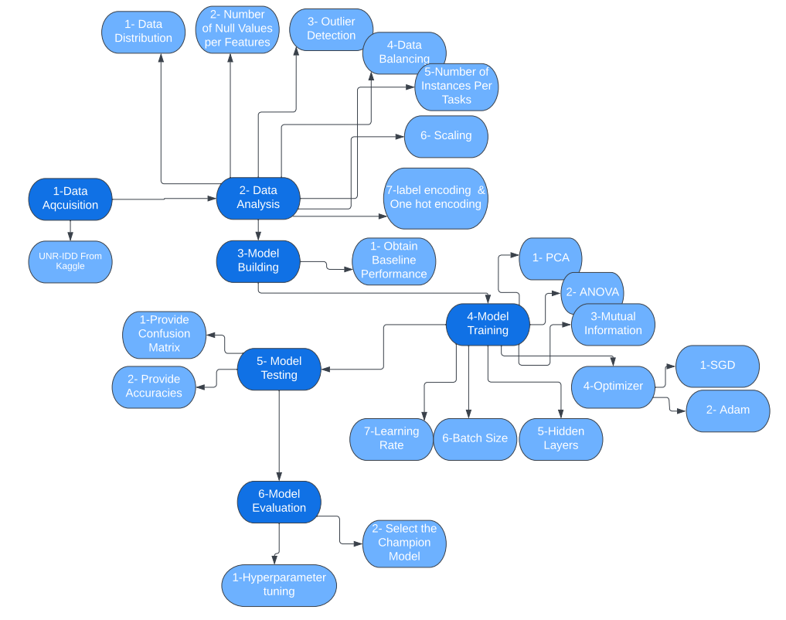
Flowchart

Slide 11

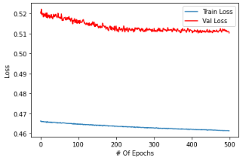
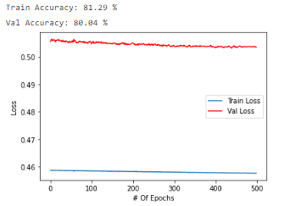
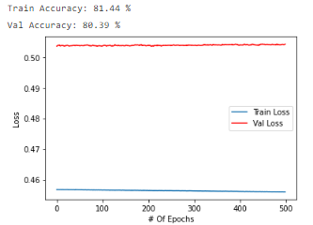
Q1) Obtain a baseline performance

Slide 12
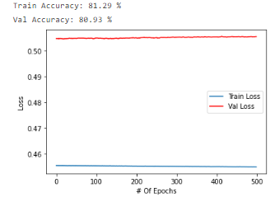
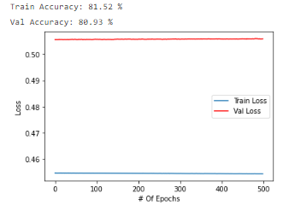
Q1) Obtain a baseline performance
Max training acc | Max test acc | Min training acc | Min test acc | Avg training acc | Avg test acc
81.51966333389282 | 78.07486631016043 | 81.13783597946167 | 77.00534759358288 | 81.33638620376587 | 77.89661319073083

Slide 13
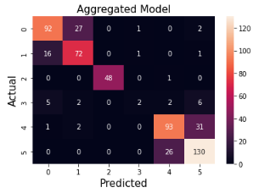
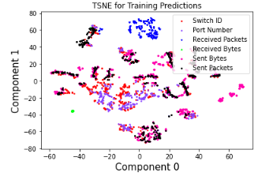
Q1) Obtain a baseline performance

Slide 14
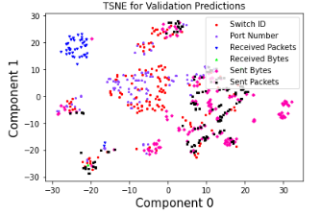
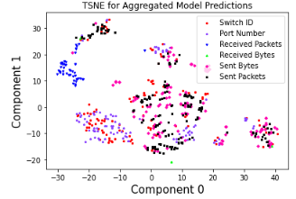
Q1) Obtain a baseline performance

Slide 15
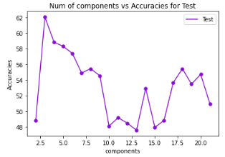
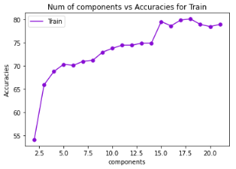
Q2) Compre dimensionality reduction to feature selection
Q2.1) Dimensionality reduction PCA

Slide 16
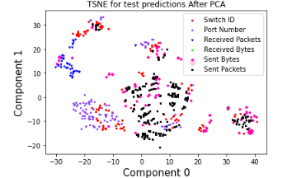
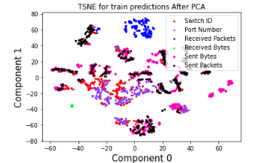
Q2) Compre dimensionality reduction to feature selection
Q2.1) Dimensionality reduction

Slide 17
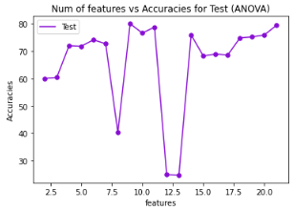
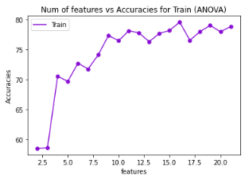
Q2) Compre dimensionality reduction to feature selection
Q2.2) Feature selection

Slide 18
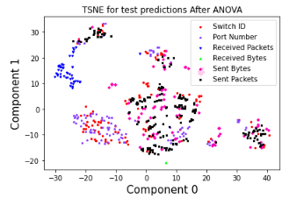
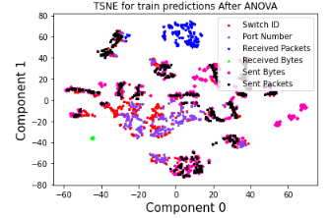
Q2) Compre dimensionality reduction to feature selection
Q2.2) Feature selection

Slide 19
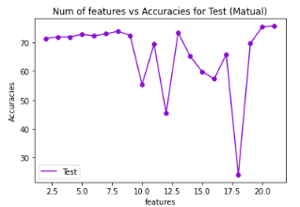
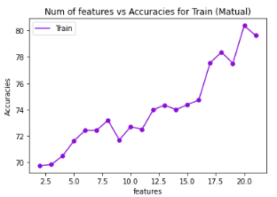
Q2) Compre dimensionality reduction to feature selection
Q2.2) Feature selection

Slide 20
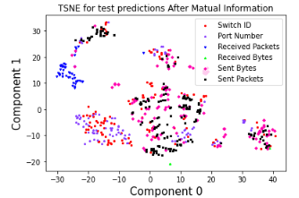
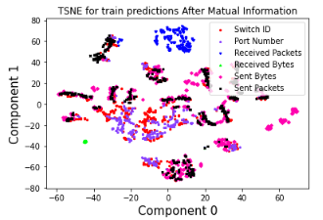
Q2) Compre dimensionality reduction to feature selection
Q2.2) Feature selection

Slide 21
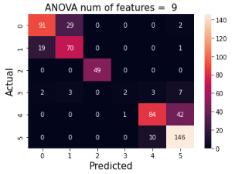
Q2) Compre dimensionality reduction to feature selection
Q2.2) Feature selection
highest test accuracy is for
ANOVA with 9 features
80.035

Slide 22
Q3) Vary the MLP parameters [1/5]
Q3.1) Batch size
Batch size= 32 |  |  |  |  |  | Batch size= 64 |  |  |  |  |  | Batch size= 128
Max train acc | Max test acc | Min train acc | Min test acc | Avg train acc | Avg test acc | Max train acc | Max test acc | Min train acc | Min test acc | Avg train acc | Avg test acc | Max train acc | Max test acc | Min train acc | Min test acc | Avg train acc | Avg test acc
79.8396348953247 | 78.4192442893982 | 78.23596596717834 | 78.78788113594055 | 79.18289422988892 | 80.14260292053223 | 80.29782176017761 | 81.63992762565613 | 77.24322080612183 | 79.14438247680664 | 79.06834602355957 | 80.42780637741089 | 78.6177933216095 | 80.21390438079834 | 78.04505825042725 | 78.78788113594055 | 78.4192442893982 | 79.39393997192383

Slide 23
Q3) Vary the MLP parameters [2/5]
Q3.2) Hidden layers vs. neurons/layer
 | 1 hidden layer |  |  |  |  |  | 2 hidden layer |  |  |  |  |  | 4 hidden layer |  |  |  |  |  | 8 hidden layer
# of neurons for each layer | Max train acc | Max test acc | Min train acc | Min test acc | Avg train acc | Avg test acc | Max train acc | Max test acc | Min train acc | Min test acc | Avg train acc | Avg test acc | Max train acc | Max test acc | Min train acc | Min test acc | Avg train acc | Avg test acc | Max train acc | Max test acc | Min train acc | Min test acc | Avg train acc | Avg test acc
10 | 79.95418310165405 | 81.46167397499084 | 78.15960049629211 | 78.60962748527527 | 79.09125566482544 | 80.21390318870544 | 82.20694661140442 | 83.60071182250977 | 79.87781763076782 | 80.92691898345947 | 81.42038941383362 | 82.10338711738586 | 79.91600036621094 | 77.54010558128357 | 77.89232730865479 | 72.72727489471436 | 78.77816081047058 | 75.86452841758728 | 84.45971608161926 | 80.21390438079834 | 80.90874552726746 | 75.57932138442993 | 83.27605962753296 | 77.5044572353363
20 | 82.24512934684753 | 83.2442045211792 | 80.41236996650696 | 80.74866533279419 | 81.32111430168152 | 81.60427808761597 | 85.29973030090332 | 85.02673506736755 | 83.73425006866455 | 81.63992762565613 | 84.45971727371216 | 83.31550717353821 | 84.65062975883484 | 81.81818127632141 | 83.12333226203918 | 77.183598279953 | 83.88697981834412 | 80.03564953804016 | 90.37800431251526 | 81.46167397499084 | 88.27796578407288 | 76.29233598709106 | 89.33180451393127 | 78.28876972198486
30 | 82.77968764305115 | 84.3137264251709 | 81.90149068832397 | 82.70944952964783 | 82.54295587539673 | 83.52941155433655 | 86.59793734550476 | 86.98752522468567 | 85.18518805503845 | 81.28342032432556 | 86.20847582817078 | 84.20677423477173 | 88.04887533187866 | 80.74866533279419 | 85.94883680343628 | 78.07486653327942 | 87.15540409088135 | 79.2513382434845 | 91.82894229888916 | 82.17468857765198 | 90.37800431251526 | 74.50980544090271 | 90.83619594573975 | 77.61140942573547
40 | 84.19243693351746 | 85.38324236869812 | 83.27605724334717 | 83.06595087051392 | 83.84116053581238 | 84.02851939201355 | 87.47613430023193 | 85.38324236869812 | 86.29247546195984 | 82.70944952964783 | 86.83466911315918 | 83.95721912384033 | 89.76708650588989 | 83.42245817184448 | 88.12524080276489 | 76.29233598709106 | 88.80488872528076 | 79.85739827156067 | 92.13440418243408 | 79.67914342880249 | 91.37074947357178 | 76.47058963775635 | 91.66093826293945 | 78.0035650730133

Slide 24
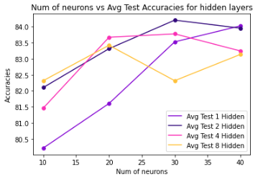
Q3) Vary the MLP parameters [2/5]
Q3.2) Hidden layers vs. neurons/layer

Slide 25
Q3) Vary the MLP parameters [3/5]
Q3.3) Learning rate and different optimizers
 | Learning rate=0.1 |  |  |  |  |  | Learning rate=0.01 |  |  |  |  |  | Learning rate=0.001
optimizer | Max train acc | Max test acc | Min train acc | Min test acc | Avg train acc | Avg test acc | Max train acc | Max test acc | Min train acc | Min test acc | Avg train acc | Avg test acc | Max train acc | Max test acc | Min train acc | Min test acc | Avg train acc | Avg test acc
AdamW | 86.97976469993591 | 86.36884212493896 | 85.7579231262207 | 82.17468857765198 | 86.24665975570679 | 83.88591885566711 | 86.82703375816345 | 84.49198007583618 | 85.56700944900513 | 82.17468857765198 | 86.23138546943665 | 83.49376082420349 | 87.28522062301636 | 84.84848737716675 | 85.4906439781189 | 82.88770318031311 | 86.36884212493896 | 84.0641725063324
SGD (momentum =0.1) | 84.0641725063324 | 74.23444032669067 | 86.33065819740295 | 82.70944952964783 | 86.60557389259338 | 84.91978764533997 | 81.90149068832397 | 83.77896547317505 | 80.0687313079834 | 83.06595087051392 | 81.17602229118347 | 83.35115671157837 | 74.60862994194031 | 75.40106773376465 | 73.80679845809937 | 74.33155179023743 | 74.23444032669067 | 75.04456281661987
SGD (momentum =0.5) | 88.96525502204895 | 75.81519722938538 | 87.24703788757324 | 80.74866533279419 | 87.90377974510193 | 82.5668454170227 | 83.42878818511963 | 85.5614960193634 | 82.47422575950623 | 83.06595087051392 | 82.97823548316956 | 84.24242377281189 | 76.13592743873596 | 77.00534462928772 | 75.5250096321106 | 75.04456043243408 | 75.81519722938538 | 75.97147822380066
SGD (momentum =0.9) | 75.97147822380066 | 80.9545624256134 | 82.81787037849426 | 81.63992762565613 | 86.09393000602722 | 83.67201447486877 | 87.13249564170837 | 85.20498871803284 | 85.83428859710693 | 81.28342032432556 | 86.4146637916565 | 83.88591766357422 | 81.74875974655151 | 83.2442045211792 | 80.14509081840515 | 80.92691898345947 | 80.9545624256134 | 82.45989322662354
Rprop

Slide 26
Q3) Vary the MLP parameters [4/5]
Q3.4) Activation functions
Relu |  |  |  |  |  | Leaky Relu |  |  |  |  |  | Sigmoid |  |  |  |  |  | Tanh
Max train acc | Max test acc | Min train acc | Min test acc | Avg train acc | Avg test acc | Max train acc | Max test acc | Min train acc | Min test acc | Avg train acc | Avg test acc | Max train acc | Max test acc | Min train acc | Min test acc | Avg train acc | Avg test acc | Max train acc | Max test acc | Min train acc | Min test acc | Avg train acc | Avg test acc
87.17067837715149 | 86.45276427268982 | 85.68155765533447 | 79.67914342880249 | 86.27720713615417 | 84.27807450294495 | 86.25429272651672 | 87.70053386688232 | 84.84154343605042 | 76.82709693908691 | 85.76555967330933 | 84.0641713142395 | 87.01794743537903 | 86.45276427268982 | 85.79610586166382 | 84.84848737716675 | 86.42229914665222 | 85.59714913368225 | 86.25429272651672 | 86.45276427268982 | 84.84154343605042 | 77.54010558128357 | 85.76555967330933 | 82.03208565711975

Slide 27
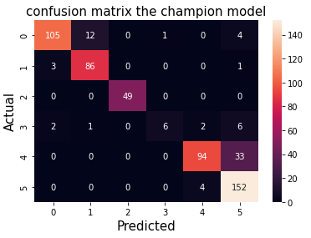
Q3) Vary the MLP parameters [4/5]
Q3.4) Activation functions

Slide 28
Q3) Vary the MLP parameters [5/5]
Q3.5) Bonus question
we have playing with the weight_decay parameter and trying different values like: 0.00001,0.0001,0.001
etc...
and we found that 0.00001 gave us the best results and improved the accuracy a lot.

Slide 29
Conclusion
we have learnt the whole procedure of deep learning from data cleaning to model evaluation as shown below.
and thar helped us a lot to move the accuracy
from 60% to nearly 90%

