Slide 1

space Tourism
Chatbot
GROUP DSA_202101_ 4

Slide 2

AlienBot
Proactive

Slide 3
AlienBot
Q & A about Space and
our Galaxy
Booking Spaceflights

Slide 4
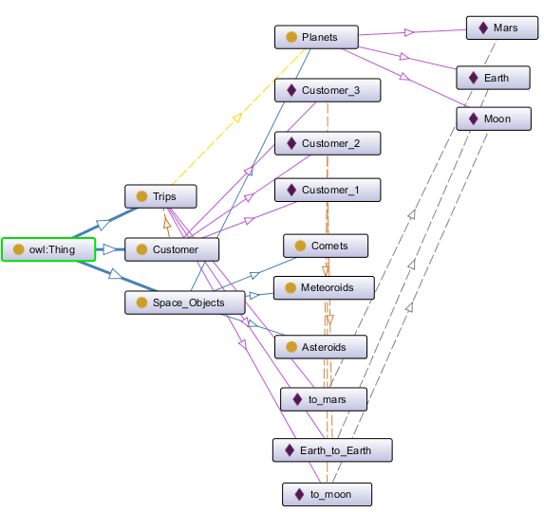
Ontology
Using Protege to develop the knowledge structure

Slide 5
Ontology

Slide 6
Competency Questions
Which galaxy do we live in?
What are planets in our galaxy?
Whose planet is the biggest?
How many moons does each planet have?
What space flights are available?
What activities can we do in space flights?

Slide 7
Competency Questions
Planets
Q&A
Galaxy
Moon
Available flights
Activities on space

Slide 8


Competency Questions
Planets
Moon
TO THE MARS
Moon and back
Q&A
Galaxy
Flights
Saturday
Sep 8 , 2022
Friday
STARSHIP SN15
Sep 8 , 2022
23:00 Time zone in Washington, DC, USA
STARSHIP SN15
23:00 Time zone in Washington, DC, USA
Available flights
$1.1M
$1.1M
Activities on space

Slide 9
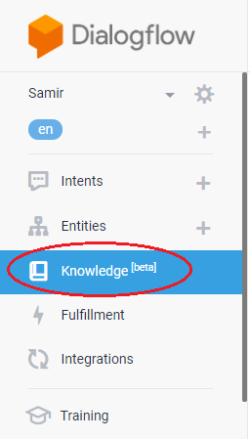
Competency Questions
Planets
Moon
Universe FAQ
Q&A
Galaxy
TO THE MARS
Flights
Saturday
Moon and back
Sep 8 , 2022
Friday
STARSHIP SN15
Sep 8 , 2022
23:00 Time zone in Washington, DC, USA
STARSHIP SN15
Available flights
$1.1M
23:00 Time zone in Washington, DC, USA
$1.1M
Activities on space

Slide 10
Competency Questions
HTML File
Planets
Moon
Universe FAQ
Q&A
Galaxy
TO THE MARS
Flights
Saturday
Moon and back
Sep 8 , 2022
Friday
STARSHIP SN15
Sep 8 , 2022
23:00 Time zone in Washington, DC, USA
STARSHIP SN15
Available flights
$1.1M
23:00 Time zone in Washington, DC, USA
Source:
$1.1M
https://www.thoughtco.com/faq-space-questions-3071107
Activities on space

Slide 11
Test Questions
Can you tell me which galaxy that earth belong to ?
List our galaxy planets
Giant planet in the milky way galaxy
How many moons milky way galaxy plants have
List of space flights
I want to have fun in space
VS

Slide 12
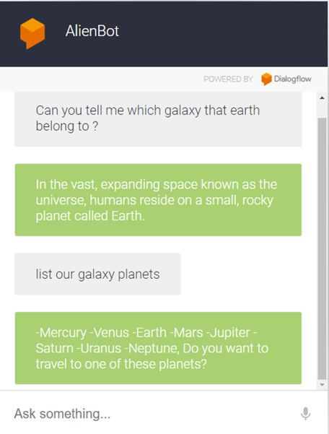
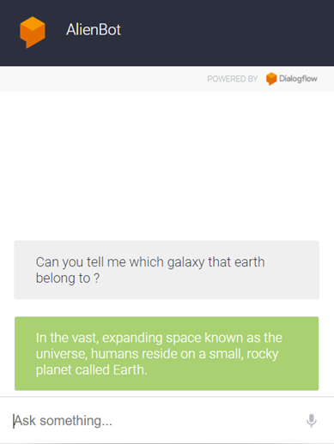
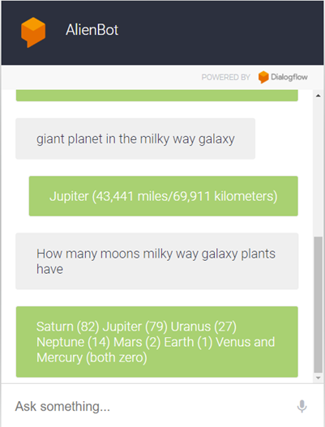
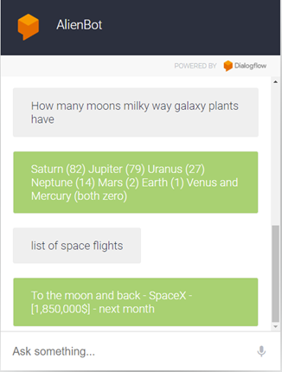
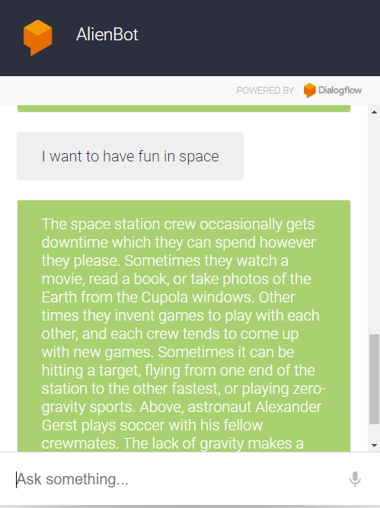
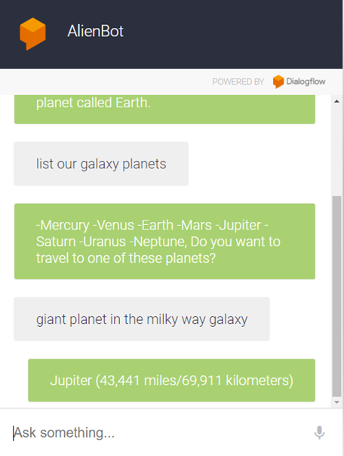
Test Questions

Slide 13
AlienBot Evaluation
Can not identify the time in a logic way
Can not Compare between planets

Slide 14
Test AlienBot

Slide 15
Thank You!

