Slide 1

Presentation to the Regional Sales Director of the Central US
By Jose G. Lora

Slide 2

Meeting Agenda
Background information on the project
Problem statement
The Hypotheses created
Data used
How it was manipulated
Insights gleamed
Recommendations

Slide 3
Background information on the project
I was asked to use the Data Analytics Workflow to analyze the Superstore orders and returns dataset for the central US and to make data-driven recommendations

Slide 4
Framing
The Regional Sales Director wants to understand what the reasons are for so many returns that we are experiencing in the central United States market in 2019. Conduct an analysis to make data-driven recommendations based on orders, product categories, and returns.

Slide 5
Framing (cont.)
If we examine all the product categories, we might identify that some categories are more prone to returns.
If we examine smaller or large purchases, we might identify that one area may be more prone to returns.
If we examine the salespersons, we might identify that specific salespersons have a higher return rate
If we examine the correlation between days to ship and returns we may find that items that take longer to ship have a higher return rate

Slide 6
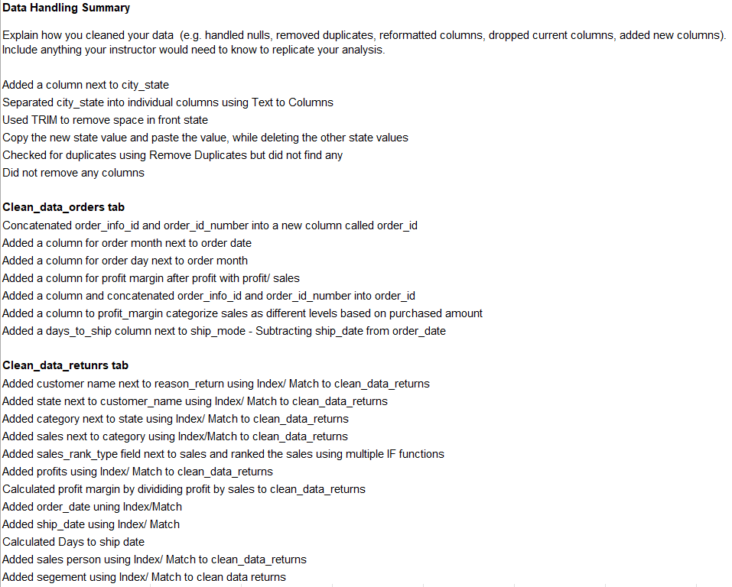
Wrangle and Prepare

Slide 7
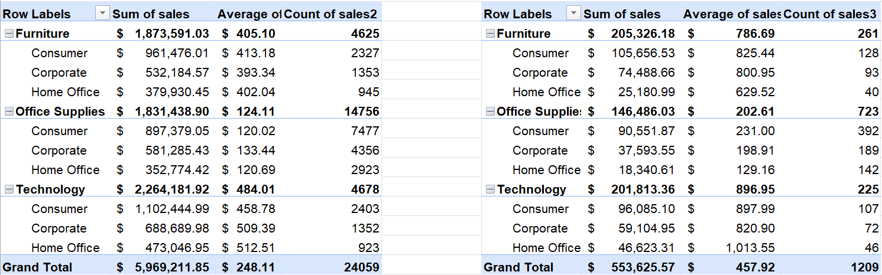
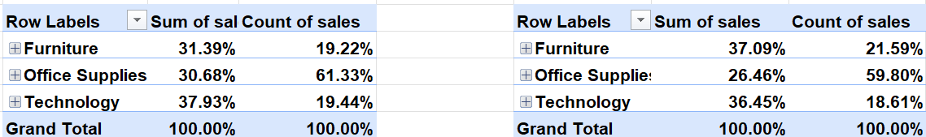
Analyze
Sales vs. Returns

Slide 8
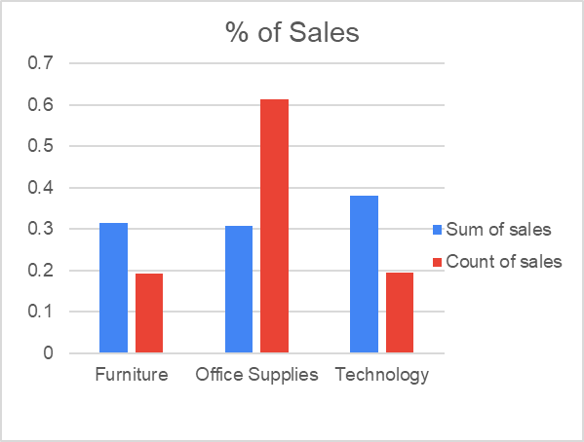
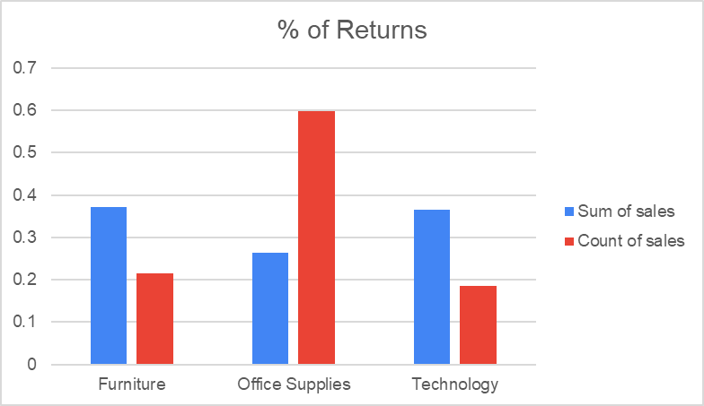
Interpret & Communicate

Slide 9
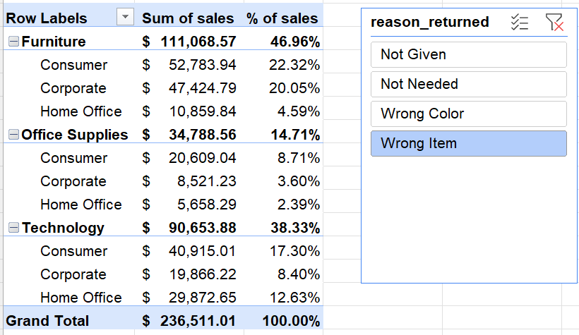
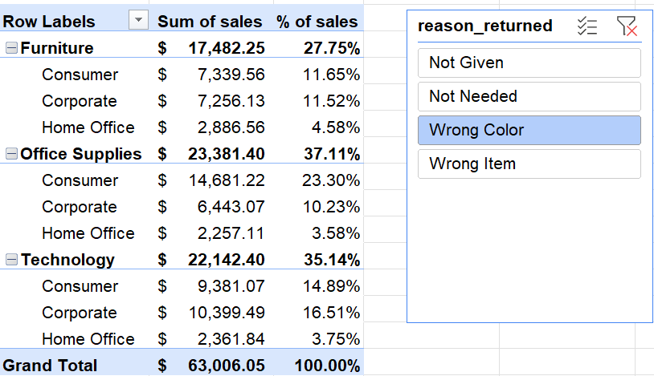
Analyze
Returns

Slide 10
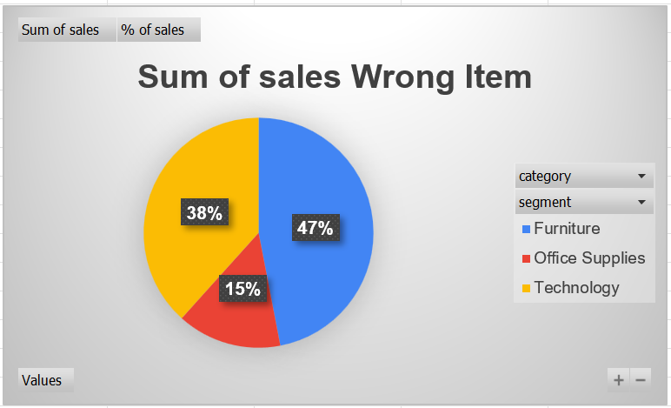
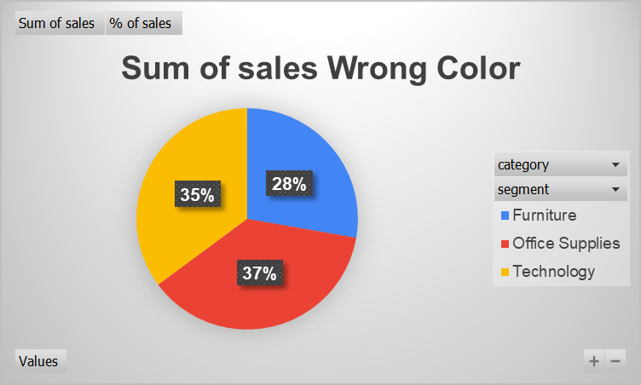
Interpret & Communicate

Slide 11
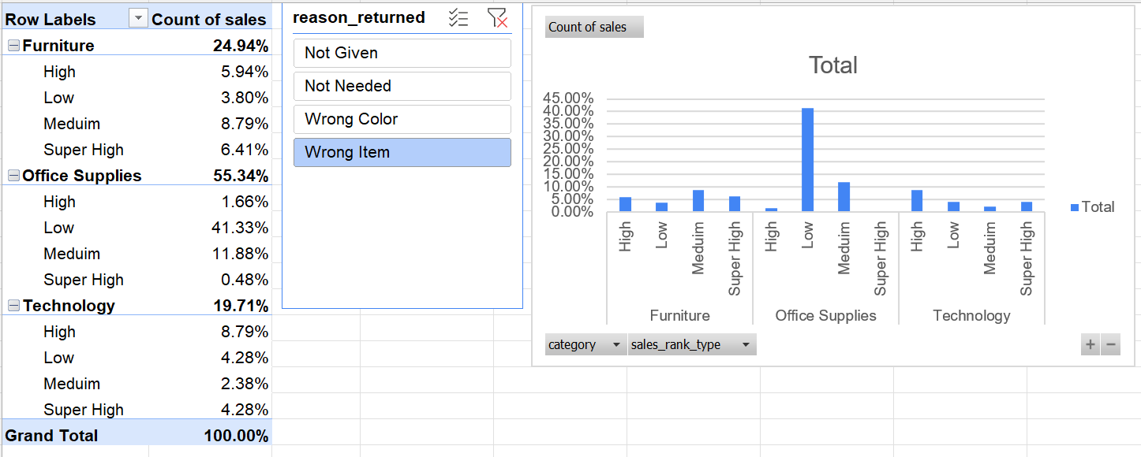
Analyze & Communicate
Returns

Slide 12
Framing (recap)
If we examine all the product categories, we might identify that some categories are more prone to returns.
5.7% growth in furniture returns over regular sales
If we examine smaller or large purchases, we might identify that one area may be more prone to returns.
Over 52% of returns are in the are in Office Supplies priced low or medium
If we examine the salespersons, we might identify that specific salespersons have a higher return rate
Turns out there is only one sales agent in the region. I thought the data set was for the company.
If we examine the correlation between days to ship and returns, we may find that items that take longer to ship have a higher return rate
Seems like there is no major observations. Returns seems to be indiscriminatory to when they were shipped.

Slide 13
Recommendations
Redo the return survey to collect data to understand what customers mean when they say “Wrong item.” Is it wrong because of us or them?
Work on the color descriptions for all products to be more specific leading to more clarity
Evaluate return policy and compare to competitors. Is it too lenient?

Slide 14
If I had more time…
Would have dug into the profit margin and discount items
Add more slides and be able to have the time to share those extra slides
Why do returns have higher average sale cost?
Compare how the returns in this region compare to others
What is driving the high returns of high-priced technological items

