Slide 1
Input
Evaluation
Object Name
Read in data
Apply offsets
Light Curve Data
Generate curve model
Evaluate residuals
(Period Guess)
(Offsets)
Print and plot results
Output

Slide 2

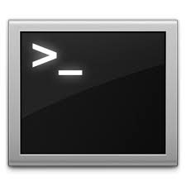
Code
Data
Object1
Object2
manosCurveFit.py
Object1Data_standard.txt
Object2Data_standard.txt
Object1_fitInfo.txt
Object2_fitInfo.txt

