Slide 1
Predicting Disruptions from Data
Hosea Siu

Slide 2
Looking at the data
Time series datasets containing
Disrupted shots with disruption times
Non-disrupted shots
This becomes a combined classification and prediction problem
Disrupted vs not-disrupted
Time until disruption given that a disruption occurs

Slide 3
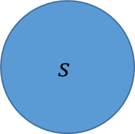
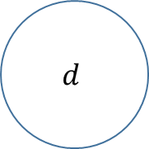
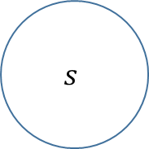
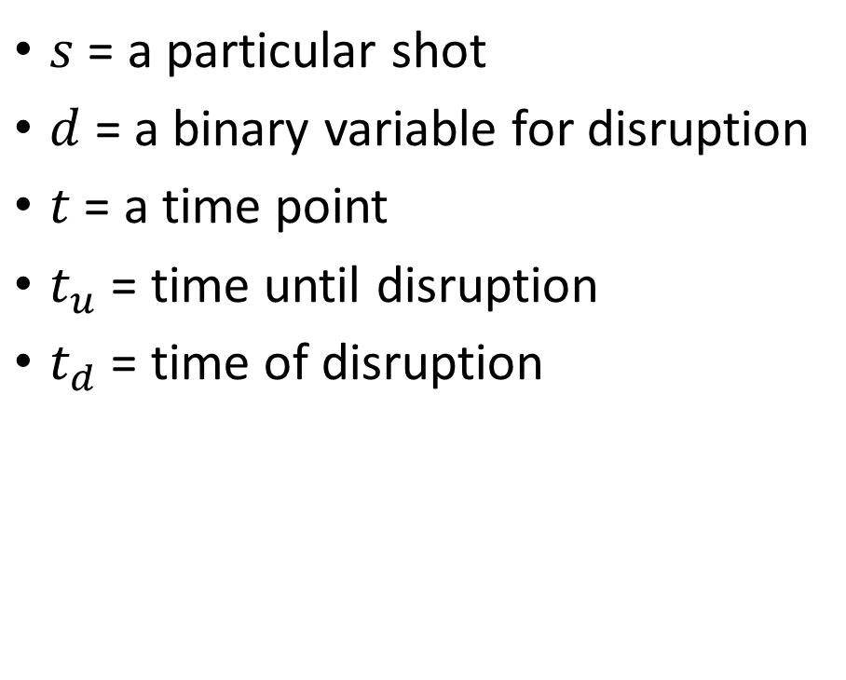
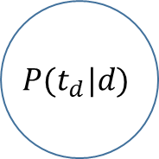
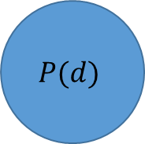
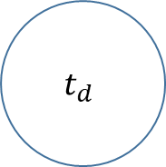
Problem structure
$$s$$
$$s$$
$s$ = a particular shot
$d$ = a binary variable for disruption
$t$ = a time point
$t_{u}$ = time until disruption
$t_{d}$ = time of disruption
$$d$$
$$P(d)$$
$$t_{d}$$
$$P(t_{d}|d)$$

Slide 4
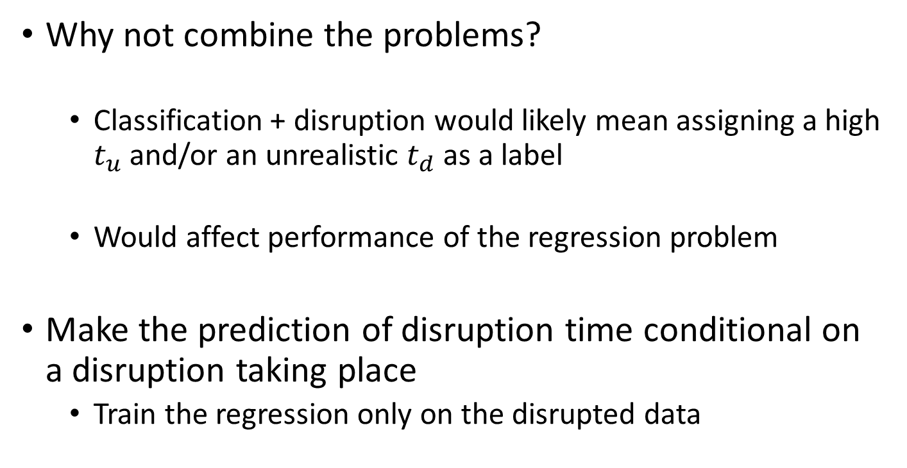
Classify into disrupted or not first
$$s$$
Why not combine the problems?
Classification + disruption would likely mean assigning a high $t_{u}$ and/or an unrealistic $t_{d}$ as a label
Would affect performance of the regression problem
Make the prediction of disruption time conditional on a disruption taking place
Train the regression only on the disrupted data
$$P(d)$$
$$P(t_{d}|d)$$

Slide 5
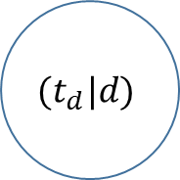
Classify into disrupted or not first
$$s$$
When classifying, only use the last 5 data points of the time series
End data most characteristic of disruption or not (disruption is likely to have already occurred)
Note that this would never work in an actual control scenario, because we’d only have data up to the present
$$P(d)$$
$$(t_{d}|d)$$

Slide 6
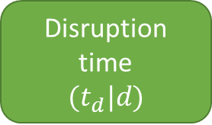
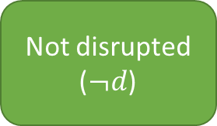
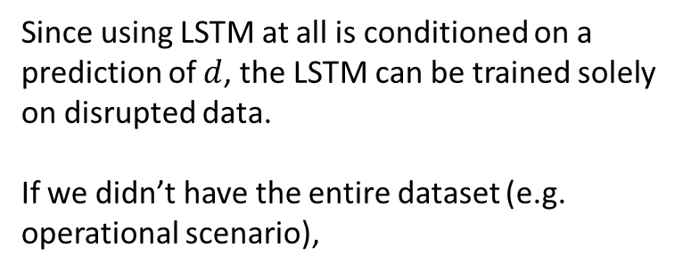
Solve the regression problem with an LSTM on the disrupted data
time series
Extract last 5 data points
KNN to predict disrupted or not
LSTM to predict disruption time
YES
NO
Since using LSTM at all is conditioned on a prediction of $d$, the LSTM can be trained solely on disrupted data.
If we didn’t have the entire dataset (e.g. operational scenario),
Not disrupted
($¬d$)
Disruption time
$$(t_{d}|d)$$

Slide 7
Results
Disruption classification accuracy: 95.17%
Regression RMSE (given classification) = 0.309

Slide 8
Transferring to other data
Trained LSTM can be

Slide 9
Example regression results: time until disruption when we do not have the whole sequence

