Slide 1
Project Name

Slide 2
Overall Block Diagram
Wireless Bluetooth ARM MCU
MEMS Speaker
MEMS Microphone
Power AMP
Audio Codec
Power
Chip Antenna
TOF Sensor
Touch Sensor Controller

Slide 3
Component Info
Component selection
Component specification
Datasheet link
Operation description
Pinout
Sample circuit
External parts selection
Simulation
PCB layout
Extra notes

Slide 4
MCU selection & Specification
RF transceiver supporting Bluetooth® 5.3 specification
Dedicated Arm® 32-bit Cortex® M0+ CPU for real-time Radio layer
ARM Cortex M4
Frequency up to 64 MHz
64 Pins / 1 MB Flash / 256 KB RAM
I2C / SPI / SAI
Touch sensing controller (TSC)
Ultra-low-power
1.71 to 3.6 V power supply

Slide 5
MCU Datasheet, Application Notes & Design Resources
Datasheet
STM32WB55RG
ANs
AN5156
Development of RF hardware using STM32WB55 MCUs
AN5042
Precise HSE frequency and startup time tuning for stm32 wireless MCUs STMicroelectronics
AN5407
Optimized RF board layout for STM32WL series STMicroelectronics
AN2867
Oscillator design guide for STM8AF/AL/S, STM32 MCUs and MPUs

Slide 6
MCU Datasheet, Application Notes & Design Resources
ANs
AN5378
STM32WB series microcontrollers bringup procedure STMicroelectronics
AN5246
Usage of SMPS on STM32WB Series microcontrollers application note
UM2550
Getting started with STM32CubeWB for STM32WB Series
Murata ref:
https://www.murata.com/en-us/products/inductor/chip/overview/feature/rf
https://www.murata.com/en-us/products/inductor/chip/overview/app/app1/mobile/mobileindex/ant

Slide 7
Operation Description
Sample circuit
RF part design
PCB layout & layer stack up
IPD
Embedded SMPS
PCB layout
Inductor & capacitance selection guide
Clock Source
PCB layout
Integrated trimming capacitors for 32MHz crystal oscillator
Touch sensing controller consideration
PCB layout
Denoising & optimization
Sampling capacitance selection guide

Slide 8
Capacitance Selection Guide
RF design
Use ceramic capacitors on surface mount version
RF matching
Multilayer ceramic capacitors offer linear temperature coefficients
low losses
stable electrical properties over time, voltage and frequency
SMD (Surface Mount Device) with a 0402 package
A good compromise between performance and handling
RF decoupling
Choose capacitance value
the frequency to be decoupled is close to or just above the self-resonant frequency of the capacitor

Slide 9
Inductor Selection Guide
RF design
high Q (quality factor = Im[Z] / Re[Z])
To reduce insertion loss
Generally recommended to use air core inductors
Do not use a magnetic core made of ferromagnetic material
Are wound on plastic, ceramic, or other nonmagnetic materials
Package: SMD 0402
RF matching and decoupling
use an inductor with medium Q
a good compromise between
application cost
RF performance

Slide 10
SMPS
In order not to disturb the RF performances, this SMPS has its switching frequency synchronous with the RF main clock source HSE.
The allowed frequency for the SMPS are 4 or 8 MHz.
To operate properly the SMPS needs two inductors and two capacitors, whose value depend upon the targeted performance, and upon the PCB area and total height allowed in the mechanical design.
For best power performances, 4 MHz should be selected, leading to a 10 µH inductor associated with a 4.7 µF bulk capacitance.
For smaller footprint, and especially to use very low profile inductor, the 8 MHz can be selected, making it possible to use a 2.2 µH inductor associated with a 4.7 µF bulk capacitance.
For all packages it is advised to add an extra 10 nH inductor in series with the 10 or 2.2 µH one, to filter the RF harmonic that can degrade the receiver performance.
Another 4.7 µF capacitor must be used to decouple the VDDSMPS supply.
All of these external components must have the lowest possible ESR values.
Note that VDDSMPS must be connected to VDD, and that voltage rising and falling must satisfy the conditions described in the STM32WB data sheet.

Slide 11
SMPS
For DC-DC converter, as the quality factor of a capacitor is inversely proportional to its ESR, a capacitor with low insertion loss and a good quality factor is recommended. The capacitor requires either an X7R or X5R dielectric.
For DC-DC converter, the nominal value is 10 µH. The inductor value affects the peak-to-peak ripple current, the output voltage ripple and the efficiency. The selected inductor has to be rated for its DC resistance and saturation current.

Slide 12
SMPS
Two working frequency:
4 MHz
Best power performance
10 uH
8 MHz
Smaller footprint
Low profile inductor
2.2 uH
An extra inductor
10 nH
To filter the RF harmonic
Low ESR inductors

Slide 13
SMPS
4.7 µF bulk capacitance
4.7 µF capacitor for decoupling the VDDSMPS supply
Connecting VDDSMPS to VDD
All external components with lowest possible ESR values

Slide 14
SMPS
DC-DC convertor
10 uH
High quality factor
Low ESR, low insertion loss
X5R/X7R dielectric
DC resistance
Saturation current

Slide 15
External crystal
The HSE (high speed external) with 32 MHz frequency for the RF subsystem
Placing HSE as close as possible to the oscillator pins
To minimize output distortion and start-up stabilization time
Integrated load capacitances on chip
Tuning according to the selected crystal via an internal register
AN5042:
Precise HSE frequency and startup time tuning for stm32 wireless mcus stmicroelectronics
High frequency accuracy to achieve the best performance for RF systems
Any clock deviation can cause system malfunctions and/or degrade performance.
Carrier accuracy requirement for RF protocols: ± 50 ppm

Slide 16
External crystal
The inaccuracy of the HSE is directly transferred to the RF clock
It must be fine-tuned by adjusting load capacitance at crystal terminals.
VFQFPN68
OSC_IN: 35
OSC_OUT: 34
carrier accuracy = sum of the maximum values of:
frequency tolerance
frequency versus temperature characteristics (for the temperature in which the crystal must be used)
aging (for the duration during which the crystal must be used)
Carrier accuracy <= ± 50 ppm

Slide 17
External crystal
Tuning in production:
Manual
Runs in SRAM (user program in Flash memory is not affected) (BOOT0 & BOOT1 pins)
3 Buttons
a frequency meter
Automatic
Runs in SRAM (user program in Flash memory is not affected) (BOOT0 & BOOT1 pins)
Need to set up a reference clock only once to trim as many devices as wanted
STM32CubeMonitor-RF
BLE stack and transparent mode FW must be flashed in the device
Requires several actions from the user for each product
modifying and running the script
a frequency meter
All methods require the use of a pin (MCO) to output the HSE signal for the frequency measurement.

Slide 18
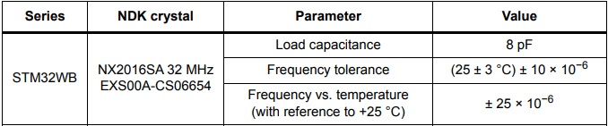
Crystal specifications

Slide 19
IPD
IPD (integrated passive device):
To replace the discrete matching network plus the integrated low-pass filter
keeping equivalent TX/RX performance
QFN68
MLPF-WB55-01E3
DS12804: 2.4 GHz low pass filter matched to STM32WB55Cx/Rx
Reducing the length of the track between the output of the IPD and the RF output
To decrease the dimensions of the PCB
Improving RF performance by reducing losses
due to the length of this track
Reducing PCB size and the bill of materials
Performance stability on volume production
Lower parameter dispersion compared with the discrete components

Slide 20
IPD
Output track width
450um (0.45mm)
Input track width
200um (0.2mm)
Input track length
1500um (1.5mm)

Slide 21
PCB stack and technology
FR4 substrate
Use TOP layer for the components and the RF transmission line
use a continuous ground plane on INNER 1 layer
Not sharing or assigning to signal or power nets
Uniquely allocated to ground
Partial ground planes on a layer for all RF components and transmission line
None broken ground planes under transmission line routing
Add liberally ground vias between layers throughout the RF portion of the PCB
To prevent accrual of parasitic ground inductance due to ground-current return paths
To prevent cross-coupling from RF and other signal lines across the PCB

Slide 22
PCB stack and technology
Fill unused area on the TOP layer with ground plane
connect this top fill with the INNER1 ground plane with several vias
Vias space about 1/10th of the wavelength apart
No signals routing on layers between the power supplies layer and the ground layer
More than 4 layers PCB:
Components and critical signals (e.g. RF, XTAL, SMPS) on the TOP layer
Ground plane in INNER1 layer before routing the signals on the others layers (INNER2, INNER3, …) to isolate the GPIOs from the critical signals

Slide 23
Critical parts
RF
Route the power supply and digital lines away from the RF section
Decoupling to isolate power supply pin from the high frequency noise
Route separately high-speed digital signal lines
On a layer different from that of the RF signal line
To prevent coupling
Route VDD and power lines on a dedicated layer
Provide adequate decoupling/bypass capacitors
at the main VDD distribution nodes
at VDD branches

Slide 24
Critical parts
RF
A matching network between the RF1 output pin and the RF low-pass filter
Place the matching network as near as possible to the RF output
Avoid long track between each component of matching network
Track between the output of the low-pass filter FLT1 and the SMA connector
variable length
depending upon the application
provided that its impedance is always 50 Ω

Slide 25
Critical parts
SMPS
some design rules for the layout of the VDDSMPS tracks
Capacitor (4.7 μF) between VDDSMPS pins
Ensure a whole ground plane just under the layer
cover the capacitor and the track between it and the VDDSMPS pins
Measure the width and length of the track between the VDDSMPS pin and the capacitor:
Track total lenght: 1.663 mm
Track width: 0.25 mm
Check the thickness and the permittivity of the dielectric
distance between the capacitor and the ground plane reference
Use the freeware Saturn PCB
The ground pin of C12 must return to the ground plane through a via as close as possible (see Figure 27).
Via from top to bottom layer Diameter = 200 µm
This via has also an ESL.
The board ESL = between the decoupling capacitance and the VDDSMPS pin
lower than 2.0 nH for QFN packages
verify the VSSSMPS pins of the chip, the negative pin of the capacitor and the exposed pad (for QFN pakages) are connected together as close as possible

Slide 26
Critical parts
LSE
place X2, CL as close as possible to their respective pins
XTALs
Place the XTALs on the component layer
keep them as close as possible to the oscillator pins of the device
Avoided long lines
No GPIO routing in the vicinity on the top layer and the layers below the XTAL as long as the ground layer is not inserted
Keep the XTAL far from:
SMPS
RF components (matching, filter, antenna)

Slide 27
Layout recommendations for reference boards
IC ground plane (exposed pad)
Solid ground plane on the component layer directly underneath the component
caring DC and RF return currents through the PCB to the assigned ground plane
to provide a thermal heat-sink
include the maximum number of vias allowed by the PCB design rules
These vias are ideally thru-vias (penetrating through all the PCB layers)
Component orientation
Inductors on the PCB generate a magnetic field
Coupling with other components and RF line
To obtain a good isolation between those components:
place them orthogonally and
space them as much as possible

Slide 28
Check list
1. Verify that the bypass capacitors are as close as possible to the power supply pins that they are meant to bypass.
2. Ensure that each decoupling capacitor only decouples the specific pins recommended on the reference design and that the capacitor be of the correct value and type.
3. Check that the SMPS parasitic inductance is lower than the limit, and the ground position, as detailed in Section 5.3.2
4. Verify that the stack-up matches the reference design. If the design is 4-layer or higher, verify that ground planes is INNER1 layer just below TOP/components layer.
5. Changing the spacing/stack-up affects the matching in the RF signal path and must be carefully accounted.
6. A solid ground plane must be placed below the device and the RF path. No ground plane must be placed below the antenna unless recommended by the manufacturer.

Slide 29
Check list
7. Verify that the RF signal path matches the reference design as close as possible (components should be arranged in a very similar way and oriented the same way).
8. The XTALs should be as close as possible to the oscillator pins of the device. Long lines to the oscillator must be avoided.
9. No GPIOs net nearby the XTAL area.
10. Verify that the ground pours on the TOP layer are stitched to the INNER ground plane and to the BOTTOM layer plane with many vias, especially around the RF path. Vias on the rest of the board should be no more than a tenth of wavelength apart.
11. If the device uses a battery, do not place it under the antenna because it acts as a ground plane.
12. The board should specify impedance controlled traces, meaning that the layer spacing and FR4 permittivity must be controlled and known.

Slide 30
Check list
Important considerations for the antennas:
1. Be sure to copy the reference design exactly with the same stack-up.
2. Changes to feed line length of antenna change input impedance matching.
3. Metals in close proximity, plastic enclosures, and human body change the antenna input impedance and resonance frequency.
4. For multiple antennas on the same board use antenna polarization and directivity to isolate them.
5. For chip antennas, verify that the spacing from and orientation with respect to the ground plane is correct (as specified in the antenna datasheet).

Slide 31
Pinout
STM32CubeMX screen shots

Slide 32
MCU Simulation
Simulation based on MCU IBIS model

Slide 33
Tools
Altium
ADS
CST
IAR
STM32CubeMX
Autocad
Freecad
Fusion 360

Slide 34
Software Configuration
Altium layer stack up manager
MCU Pins Configuration in STM32CubeMX
CST simulation
ADS simulation

Slide 35
PCB Design
Rigid-Flex PCB
Capacitive Touch Sensor
RF design
Matching Network

Slide 36
Matching Network Design

Slide 37
Inductor and Capacitance Selection Guide

Slide 38
Power Consumption

Slide 39
Components
VL6180 (TOF Sensor)
Sample circuit
Signal: 1.8V / VDD: 2.8V
MP34DT06JTR (Mic)
Sample circuit
1.8V
IPD (MLPF-WB55-01E3)
Sample circuit
PCB Layout
LM48580TL/NOPB
Sample circuit
PCB layout
2.5 to 5.5V
UT-P2020
Sample circuit

Slide 40
Components
LD39050PUR
Sample circuit
Resistor selection
VOUT = VADJ (1 + R1 / R2 ) with VADJ = 0.8 V (typ.)
1.8V
TPS61040DBVR
Sample circuit
Resistor selection
VOUT = 1.233 (1 + R1 / R2)
Component selection
PCB layout
1.8 V
MAX98091ETM+
Sample circuit
1.8V

Slide 41
TOF Sensor
Proximity and ambient light sensing (ALS) module
VL6180X:
Datasheet
Operating voltage:
Functional range
2.6 to 3.0 V
Optimum range
2.7 to 2.9 V
Size: 4.8 x 2.8 x 1.0 mm
Ranging: 0 to 100 mm
I2C
400 kHz serial bus
Address: 0x29 (7-bit)

Slide 42
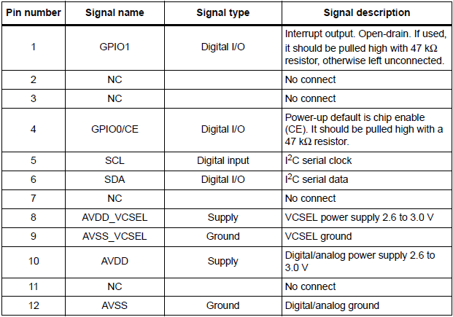
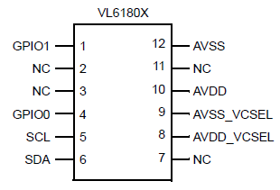
VL6180X
Pinout
Pin Description

Slide 43
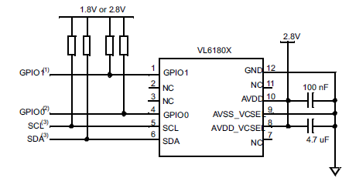
VL6180X (Sample Circuit)
1. Open drain. If pin is used, then 47 kΩ recommended, otherwise leave floating
2. Open drain, 47 kΩ recommended
3. Open drain. Pull up resistors typically fitted once per I2C bus at host
Note
Capacitors on AVDD and AVDD_VCSEL should be placed as close as possible to the supply pads.

Slide 44
MEMS Microphone
MEMS audio sensor omnidirectional digital microphone
MP34DT06J
Datasheet
Features
Single supply voltage
Low power consumption
Omnidirectional sensitivity
PDM output

Slide 45
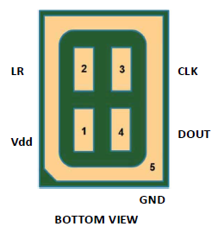
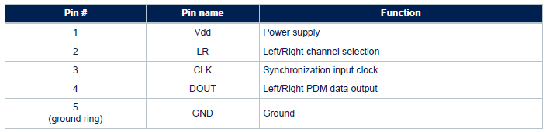
MP34DT06J
pinout
Pin Description

Slide 46
MP34DT06J
Supply voltage
Min: 1.6 Typ: 1.8 Max: 3.6 V
Current consumption in normal mode: 650 μA
Current consumption in power-down mode: 5 μA
power-down mode: Input clock in static mode
Capacitive load: 100 pF
fCLK Clock frequency for normal mode
Min: 1.2 MHz Max: 3.25 MHz

Slide 47
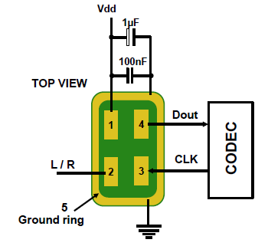
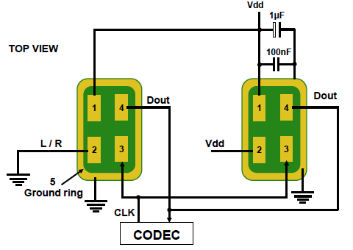
MP34DT06J (Sample Circuit)
Mono
Stereo

Slide 48
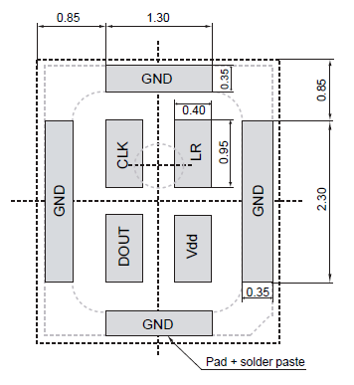
MP34DT06J (PCB Layout)
Power supply decoupling capacitors (100 nF ceramic, 1 μF ceramic) should be placed as near as possible to pin1 of the device.
The L/R pin must be connected to Vdd or GND

Slide 49
MEMS Speakers
ACHELOUS UT-P2020
Datasheet
Capacity: 27±5 nF
Maximum AC voltage (peak) – up to 20 kHz: 15VP
Maximum DC voltage:15V
Size [mm]: 6.7 x 4.7 x 1.58

Slide 50
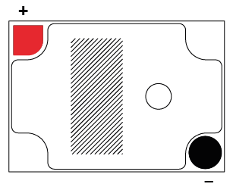
UT-P2020
Description
Pinout (Bac kside)
The speaker is driven by applying voltage between the + and the - connection.
The potential of + has to be always equal or higher than the -.
To ensure this a DC voltage together with the AC signal has to be applied on +.
Attention:
The AC peak voltage must always be smaller than or equal to the DC voltage.
The membrane will move downwards/inside by applying a positive voltage on the + connection.

Slide 51
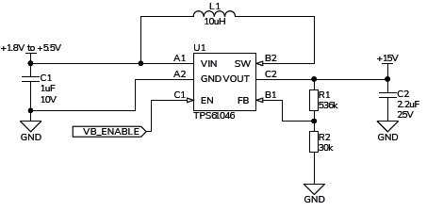
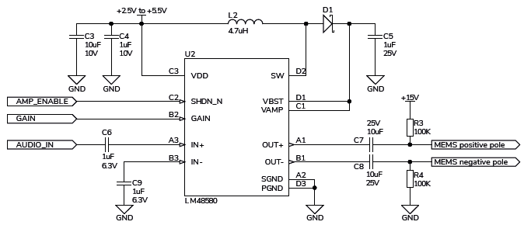
UT-P2020
DC-DC Convertor
Power Amplifier

Slide 52
Low-Power DC-DC Boost Converter
TPS61040
Datasheet
1.8-V to 6-V Input Voltage Range
Adjustable Output Voltage Range up to 28 V
400-mA Internal Switch Current
Up to 1-MHz Switching Frequency
28-μA Typical No-Load Quiescent Current
1-μA Typical Shutdown Current
L Inductor
Min: 2.2 μH Max: 10 μH
CIN Input capacitor
NOM: 4.7 μF
COUT Output capacitor
Min: 1 μF

Slide 53
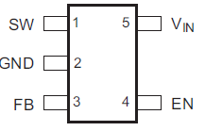
TPS61040
Pinout

Slide 54
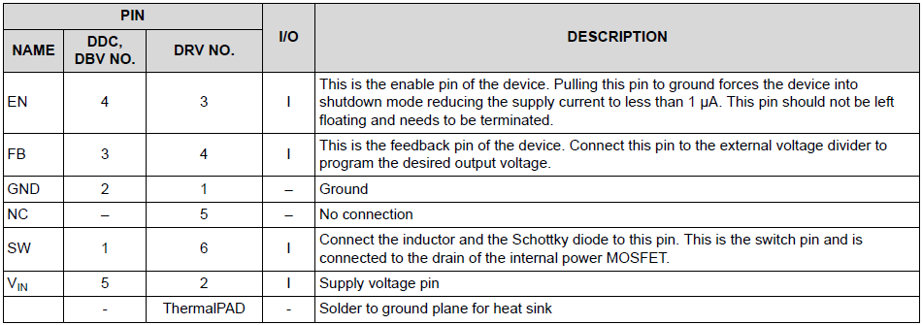
TPS61040 (Pin Description)

Slide 55
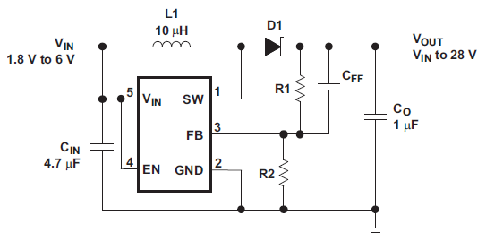
TPS61040
Component Selection
Sample Circuit
L1: Sumida CR32-100
D1: Motorola MBR0530
C1: Tayo Yuden JMK212BY475MG
C2: Tayo Yuden TMK316BJ105KL
CFF: 22pF
Output Current: 10 mA
VOUT = 1.233V * (1 + R1 / R2)
R1 = 2.2 MΩ R2 = 160 KΩ

Slide 56
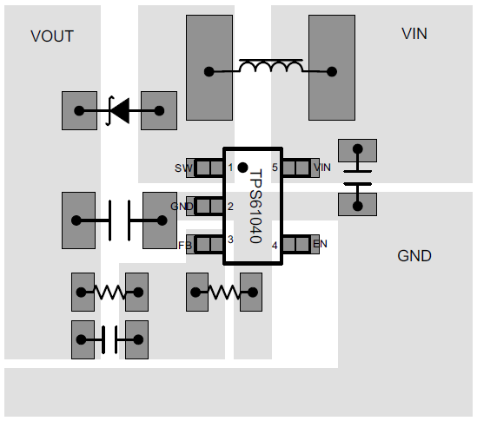
TPS61040 (PCB Layout)

Slide 57
Audio Power Amplifier
LM48580
Datasheet
High Efficiency Class H
Haptic Piezo Actuator / Ceramic Speaker Driver
Integrated Boost Converter
Low Supply Current
Supply Voltage Range
Min: 2.5 V Max: 5.5 V

Slide 58
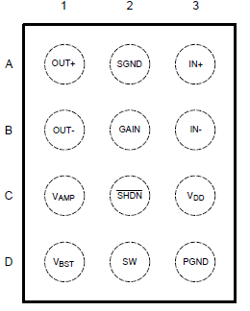
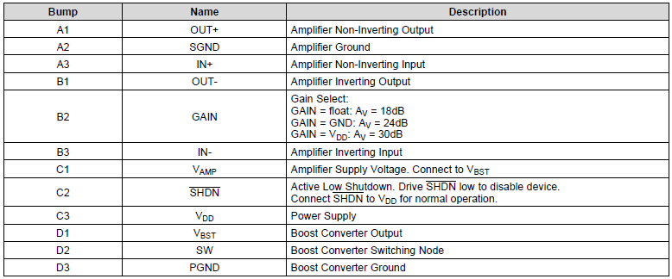
LM48580
Pinout
Pin description

Slide 59
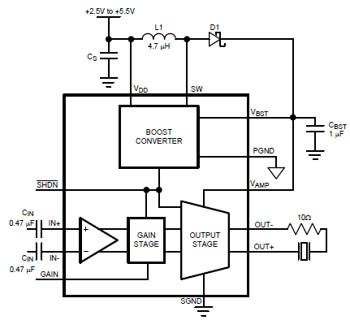
LM48580 (Sample Circuit)

Slide 60
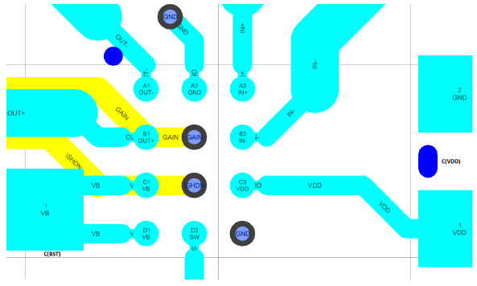
LM48580 (PCB Layout)

Slide 61

LM48580
Recommended Inductors
Gain setting
Taiyo Yuden
BRL3225T4R7M
4.7 μH
ISAT: 1.1 A
Coilcraft
LP3015
4.7 μH
ISAT: 1.1 A

Slide 62
Voltage Regulator
LD39050
Datasheet
Input voltage from 1.5 to 5.5 V
Ultra low-dropout voltage (200 mV typ. at 500mA load)
500 mA guaranteed output current
Compatible with ceramic capacitor COUT = 1 μF

Slide 63
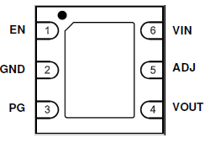
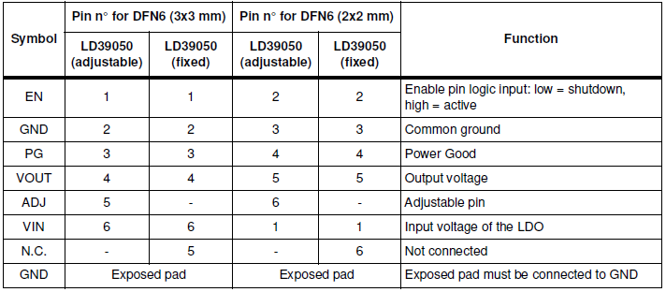
LD39050
Pinout
Pin description

Slide 64
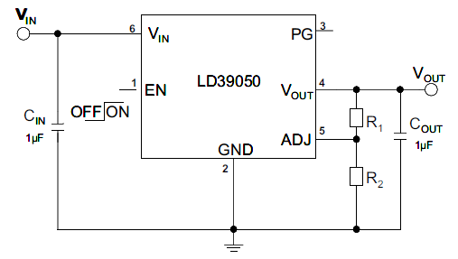
LD39050
Note
Sample circuit
VOUT = VADJ (1 + R1 / R2)
VADJ = 0.8 V
Power dissipation
PD = (VIN -VOUT) IOUT

Slide 65
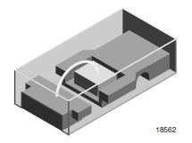
LED
TLMS1000-GS08
Datasheet
Low Current 0603 SMD LED
Color: super red
Forward current: 2mA
Forward voltage
Min: 1.8V Max: 2.6V
1.6 mm x 0.8 mm x 0.6 mm (L x W x H)

Slide 66
Bluetooth Antenna
NANO mXTEND (NN02-101)
Datasheet
Smallest clearance
5mm x 5mm
Miniature
Smallest Virtual Antenna™ form factor of 3.0 mm x 2.0 mm x 0.8 mm
Bluetooth and Wi-Fi (2400 – 2500MHz)
Impedance: 50 Ohms
Dimensions (L x W x H): 3.0 mm x 2.0 mm x 0.8 mm

Slide 67
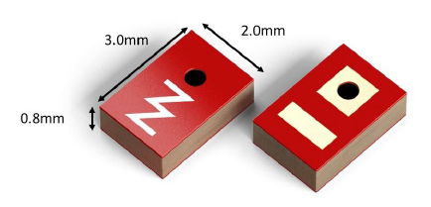
NN02-101

Slide 68
Low-Dropout Regulators (1.8 V)
MAX8887EZK18+T
Datasheet
Guaranteed 300mA Output Current (500mA for Pulsed Loads)
55μA No-Load Supply Current
0.1μA Shutdown Current
Input Voltage VIN
Min: 2.5 V Max: 5.5 V

Slide 69
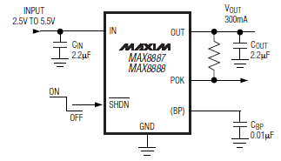
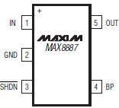
MAX8887EZK18+T
Pinout
Sample circuit

Slide 70
LDO Regulators (1.2V)
MAX1963AEZT120+T
Datasheet
Low 1.62V Minimum Input Voltage
Guaranteed 300mA Output Current
Input Voltage VIN
Min: 1.62 V Max: 3.60 V

Slide 71
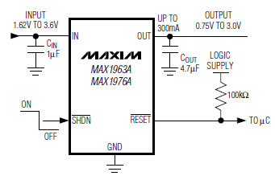
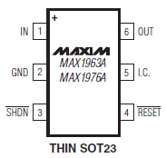
MAX1963AEZT120+T
Pinout
Sample circuit

Slide 72
RF Inductors
Inductors for high-frequency circuits are used in the high-frequency band from 10 MHz to several GHz
RF inductors require:
a high Q (Quality factor) value
a non-magnetic core structure
mainly using:
in the high-frequency circuits
mobile communications equipment
mobile phones
wireless LANMain type
Main types:
Film type
Wire wound type
Multilayer type

Slide 73
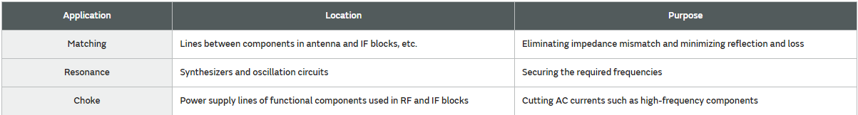
RF Inductor Applications

Slide 74
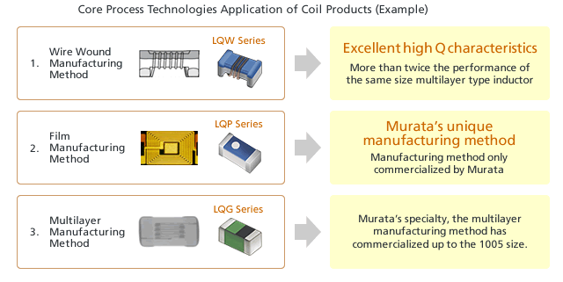
Manufacturing Technologies

Slide 75
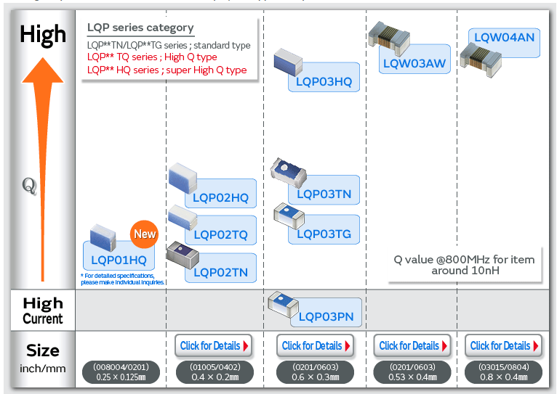
Murat RF Inductor Comparison

Slide 76
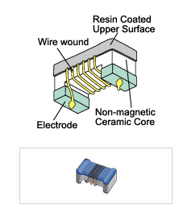
Wire Wound Structure
The wire wound structure is formed by winding copper wire in a spiral shape around an alumina core.
The coil can be formed using thicker wire than the multilayer and film structures, which provides the following features:
Low DC resistance is possible
Extremely high Q (Quality factor) value
Large currents can be supported

Slide 77
Wire Wound Application
suitable for:
matching applications in antenna and PA circuits that require an extremely high Q factor, and resonance applications in IF circuits.

Slide 78
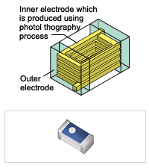
Film Structure
Film structure chip inductors have a multilayer structure, but the coil is formed with high accuracy over ceramic materials using Murata's original micro-processing technology. Extremely accurate cores can be formed, providing the following features:
High-performance electrical characteristics can be realized even for compact chips such as 0603 size
Prepared fine lineup of close inductance steps and tight inductance tolerance.
High Q and high SRF
This makes film structure chip inductors suitable for RF circuit matching and resonance applications that require narrow tolerance and a high Q factor to support trends toward smaller and more lightweight mobile communication equipment.

Slide 79
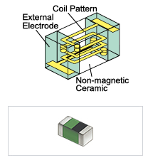
Multilayer Structure
The multilayer structure is formed by layering ceramic materials and a coil conductor to create an integrated multilayer-type inductor. This enables a smaller size and lower cost compared to the wire wound structure. While the Q factor is lower than that of the wire wound structure, the multilayer structure provides good overall balance between the L value tolerance, rated current, size, price, and other characteristics, enabling use in a wide range of applications. The multilayer structure is suitable for various applications such as RF circuit matching, choke, and resonance for mobile communication equipment.

Slide 80
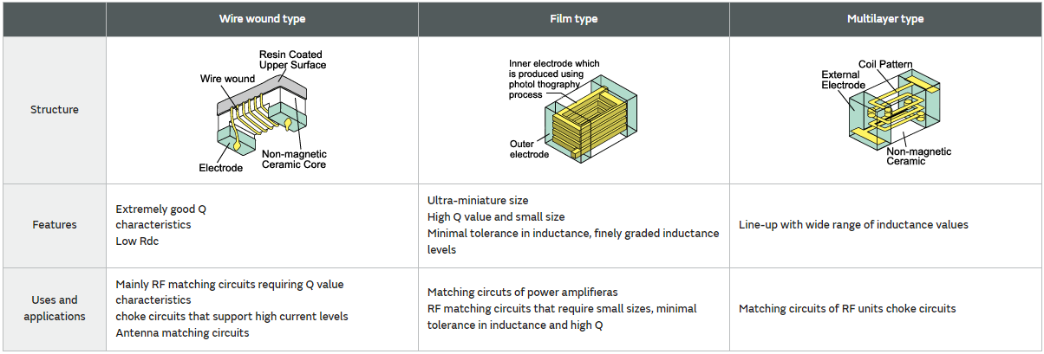
The differences in characteristics based on the structures

Slide 81
Effective use of Inductors
High-frequency coils are mainly used in cell phones, wireless LANs and other high-frequency circuits. Some typical examples of their uses and applications are described below.
Wire wound type
The wire wound inductors in the LQW series feature a high Q value. Inductors with high Q values are used in the matching circuits of RF units because their high Q values give them excellent attenuation characteristics inside the pass band of the filters. They are also frequently used in the matching applications of antennas for maintaining the transmission and reception sensitivity of the antennas. Furthermore, since they have low Rdc characteristics, they are also employed in choke circuits in which high current levels flow.

Slide 82
Effective use of Inductors
Film type
The film inductors in the LQP series have a different set of features, since micromachining of the coil patterns is enabled by forming the electrodes using a photolithography technique. The inductors can have smaller sizes and high Q characteristics, while at the same time the series offers a line-up of inductors with inductance values that both deviate minimally and are finely graded. The line-up consists of a wide range of the inductors in the 0603 size, which is becoming the mainstream, and in the 0402 size, which is the smallest in the industry, and both sizes support the trend toward miniaturized sizes. These inductors are used in the matching and resonance circuits of RF units that require miniaturized sizes, minimal tolerance in inductance and finely graded inductance levels. They are also used in choke circuits that demand miniaturized sizes and low Rdc.

Slide 83
Effective use of Inductors
Multilayer type
Multilayer inductors have the lowest Q value of the three structures. They feature a good overall balance in terms of the inductance value line-up, size and cost, and are used in the matching and resonance circuits of RF units and in all kinds of choke circuits.
For typical usage examples, please refer to"Application Examples"page.

Slide 84
RF Inductor Mobile Phones Antenna
https://www.murata.com/en-us/products/inductor/chip/overview/app/app1/mobile/mobileindex/ant
Selection Method of Inductors used for Antennas
Select an inductor with a high Q
which can maintain a low insertion loss, In order to prevent the deterioration of the radiation characteristics of the antenna.
Use an inductor with less tolerance
in order to suppress the variation in the resonance frequency
Radiation Characteristics of Antennas by Types of Inductors
Frequency Variation by Tolerance of the Inductor

Slide 85
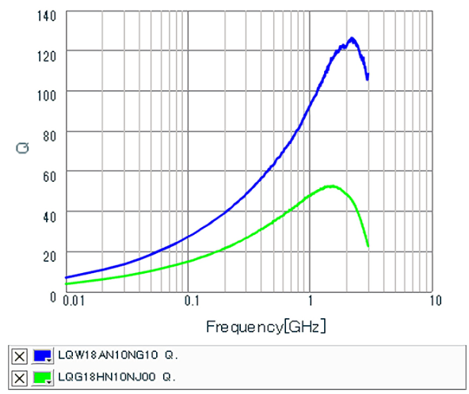
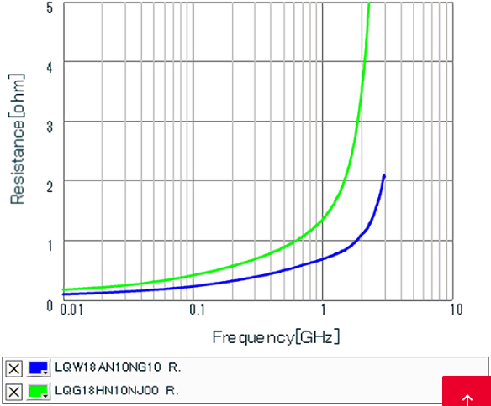
Radiation Characteristics of Antennas
Q characteristics
R characteristics

Slide 86
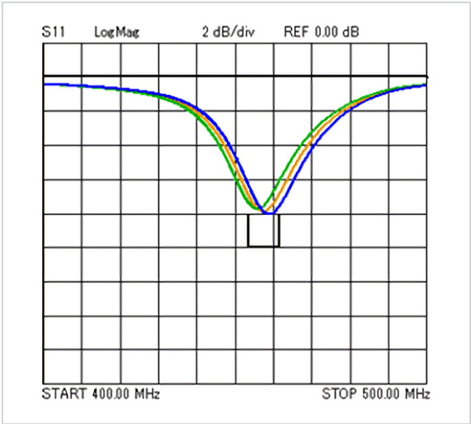
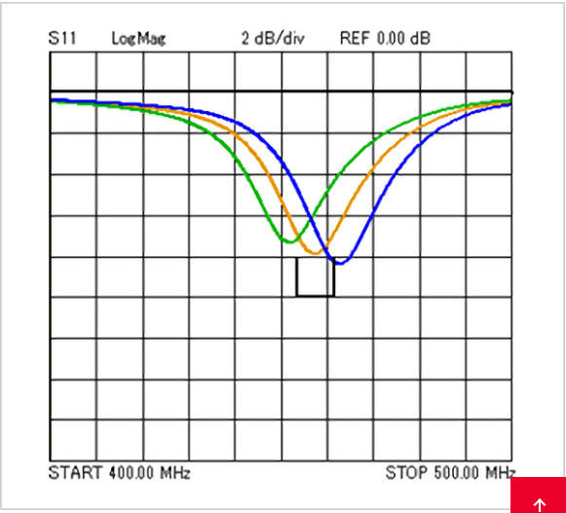
Tolerance of the Inductor Return Loss
±2% Tolerance
±5% Tolerance

Slide 87
RF Inductors - Matching
https://www.murata.com/en-us/products/inductor/chip/overview/learn/apply/matching

