Slide 1

Done by: Hussein Shiri

Slide 2
Outline:
Sustainability goals
Chemistry and the atom
Problem statement + learn about Jack
Relation to the sustainability goals
SS-VQE & QSE
Results for H2
Results for N2H2 Diazene
Future directions

Slide 3

UN Sustainability Goals
Are a set of goals that aim to end poverty and protect the planet by 2030.

Slide 4
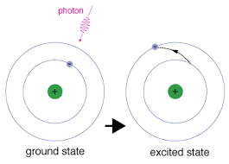
Chemistry and the atom
Energy Gap: Energy difference between the ground and excited state
Catalyst: A substance that increases the rate of a chemical reaction
PhotoCatalyst: a material that absorbs light to increase its energy level before transferring that energy to a responding substance to start a chemical reaction

Slide 5

Learn about Jack
Works as a quantum chemistry researcher in a company
Started his job this week
Specific focus of designing new catalysts for chemical reactions
1-2 % of annual energy on fertilizers production

Slide 6

Problem Statement
Dinitrogen
Diazene
Ammonia
Dinitrogen
Diazene
Ammonia
80% of annual Ammonia production is used in fertilizers
A Photocatalyst increases the rate and efficiency of this process

Slide 7


Relation to sustainability goals
More sustainable food production
Less emmition of CO2 due to more efficient reactions

Slide 8
Algorithms
Jack made his research and found two algorithms to try
SS-VQE
QSE
Subspace-Search VQE
Quantum Subspace Expansion
Finds both ground and excited states using a variational circuit
Finds the ground state energy using VQE then the excited after diagonalization

Slide 9
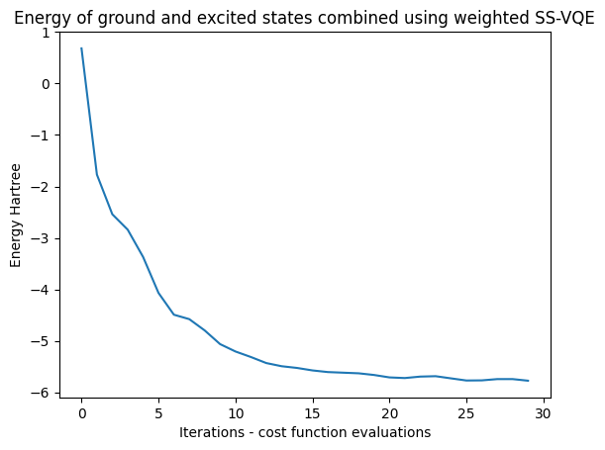
Results for H2
Algorithm | Ground E | 1st excited E
SS-VQE | -1.12 | -0.44
Pyscf | -1.03 | -0.86
Algorithm | Ground E | 1st excited E
QSE | -1.26 | -0.824
Pyscf | -1.03 | -0.86
All energies are in Hartree

Slide 10
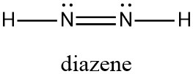
Results for N2H2 using QSE only
Requires 12 qubits to simulate
Fix the first two orbitals
Requires 8 qubits to simulate
Finding the gap energy between 1st excited and ground state is far more important than the exact energy for the photocatalyst
Algorithm | Ground vs 1st excited energy gap | Ground vs 2nd excited energy gap
QSE | 0.102 | 0.166
Pyscf | 0.117 | 0.163

Slide 11
Future directions
Accuracy was good but chemical reactions require higher accuracy
Access to HPC devices to run for complex molecules and more accuracy
Studying the effect of noise in noisy simulators and real hardware

Slide 12
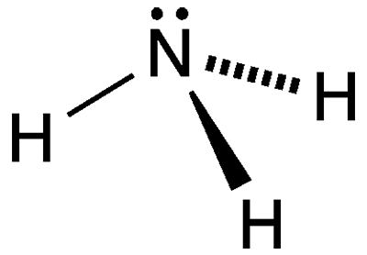
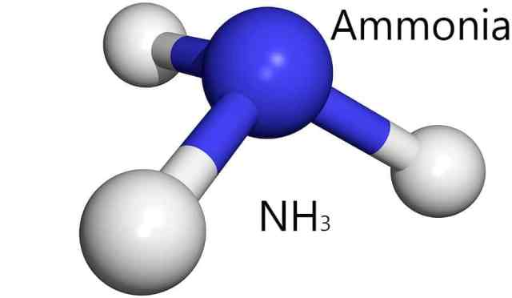
Thank You

