Slide 1
Indoor Positioning System
Nico Hein / 1st Jun 2015

Slide 2
Indoor Positioning Use Cases
General Indoor Navigation
Customer Assistance and Support
Indoor Navigation for Blind Peope
Navigation for Healthcare
Proximity Marketing
Personalized and Augmented Experiences
Location analytics
People and Object tracking
Robotics
Real Life Social Networks
GeoFencing

Slide 3
Infrastructure vs. Independent Mode
Infrastructure Mode | Independent Mode
infrastructure tracks device | device locates itself
no user interaction | user interaction
hard to detect | -
only radio frequency | Radio and Non-Radio

Slide 4
Social Acceptance
The biggest concern of the customer is data privacy...
Adopt the “privacy by design” approach
Seek consumers’ permission before collecting
Develop a clear, comprehensive mobile-privacy policy.
Update it regularly.
inform customers about exactly what personal data you’re collecting and why
spelling out what data you won’t collect
Describe how you store personal information.
Explain whether and how you share personal information.
Tell customers how they can decide
(by Technology_Review_Custom_MIT, 2015)

Slide 5




Radio vs. Non-Radio Positioning Strategies
Radio Positioning | Non-Radio positioning
WiFi | 3D sensors
Bluetooth Beacons | LED Patterns
Other Active RFID Systems | Magnetometer / Compass
Zigbee | Barometer
A-GPS (Assisted GPS) | Gyroscope
NFC Tags | Accelerometer
Constraints: Floor Plan; Beacon locations; Landmarks; Magnetic Flux Maps; WiFi, Blotooth or Zigbee Fingerprinting (RSS); LED pattern map; Pedestrian Movement Model

Slide 6
Sensor Fusion, Error Correction and Filtering
Bayesian Networks
Kalman Filter
Central Limit Theorem
Error Analysis
GPS – Invalid Position Filter
GPS – Mask Filter
Map Matching
Particle Filter
Hidden Markov Model
Dempster-Shafer Theory

Slide 7
Compared Systems
Solution | Technoloy | Accuracy
Indoo.rs | Bluetooth 4.0 | 2m
Estimote | Bluetooth 4.0 | 2m
MazeMap | WiFi deliverd by Cisco is default | -
Infsoft | WiFi, Bluetooth 4.0 and internal sensors | 1m
Sailstech | WiFi, Bluetooth 4.0 and internal sensors | 1m
Navizon | WiFi Fingerprinting (& Active Beacons) | 1m
Locata | Locata (Earth GPS like) | 0.1m
ByteLight | LED light, Bluetooth 4.0, internal sensors | <1m
IndoorAtlas | Magnetic Flux | ~2m

Slide 8
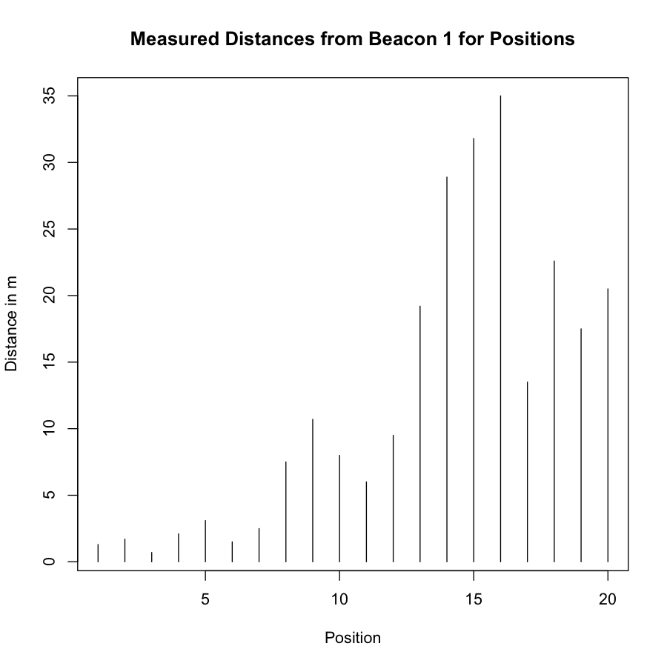
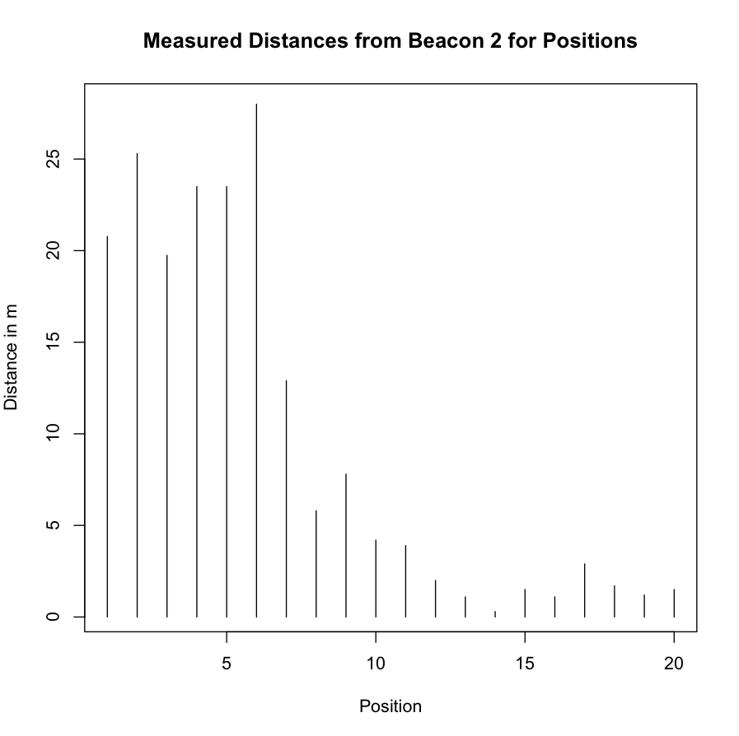
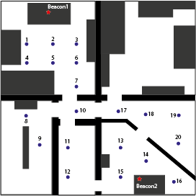
Experiment: Fingerprinting or Proximity
9,5m

Slide 9
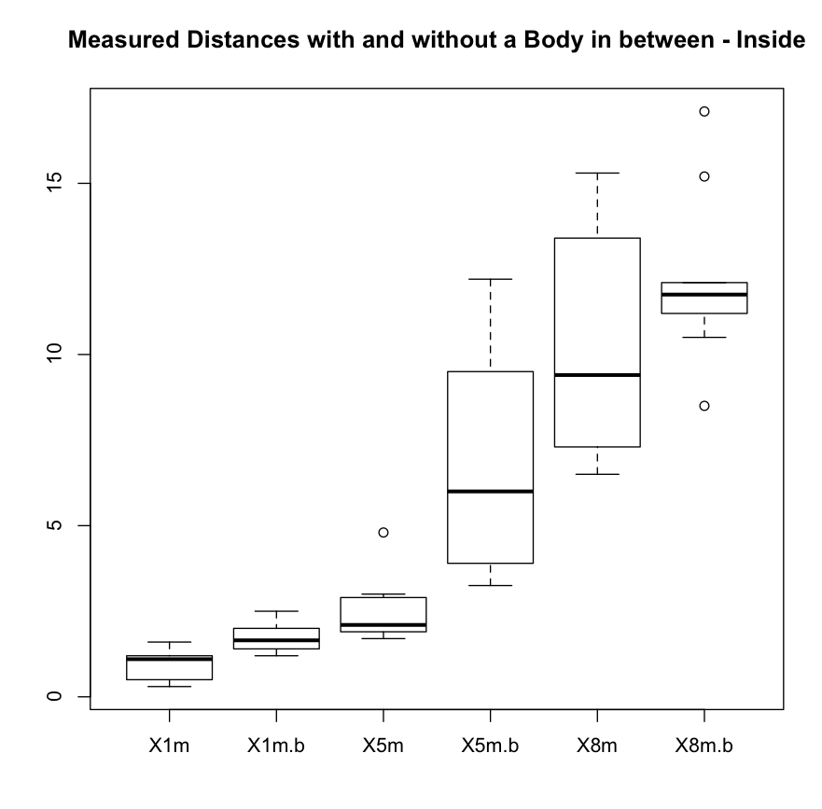
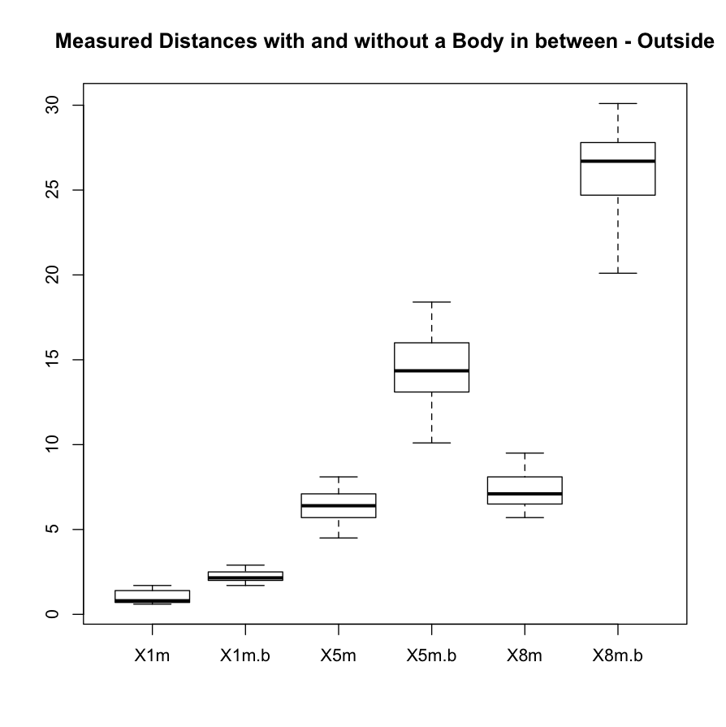
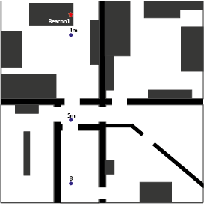
Experiment: Reflection and Dynamics
→ A combination of proximity and fingerprinting using relative values and Sonsor data!

Slide 10
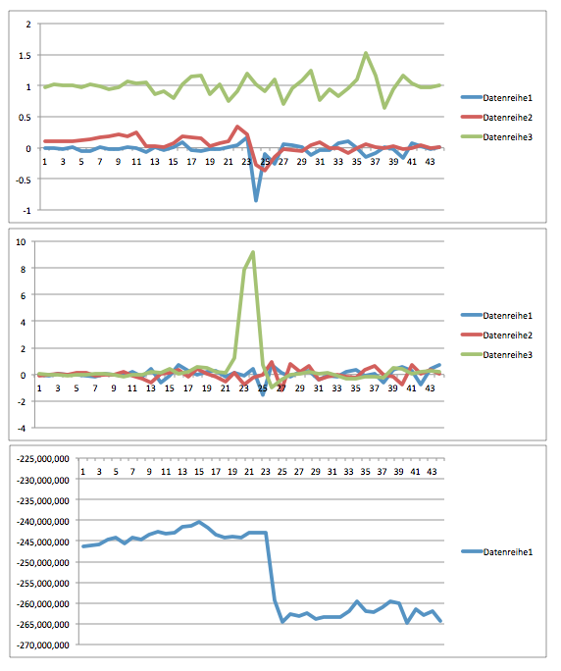
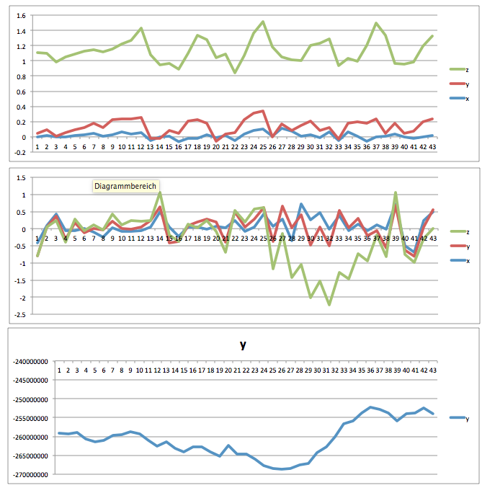
Experiment: Sensordata
Rotation beim gehen
Kurve gehen
Gerätedrehung

Slide 11
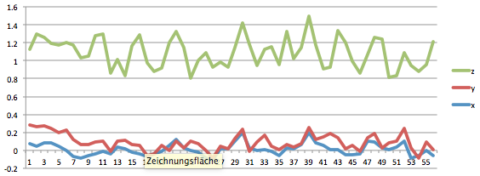
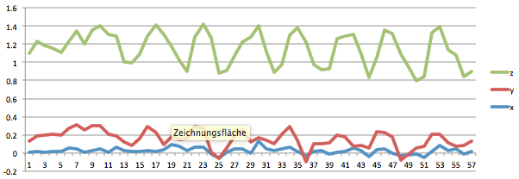
Experiment: Sensordata
Stairs or fast steps?
Slow stairs or steps?

Slide 12
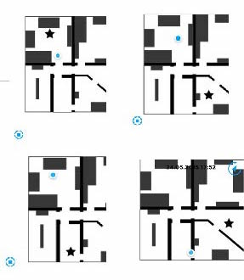
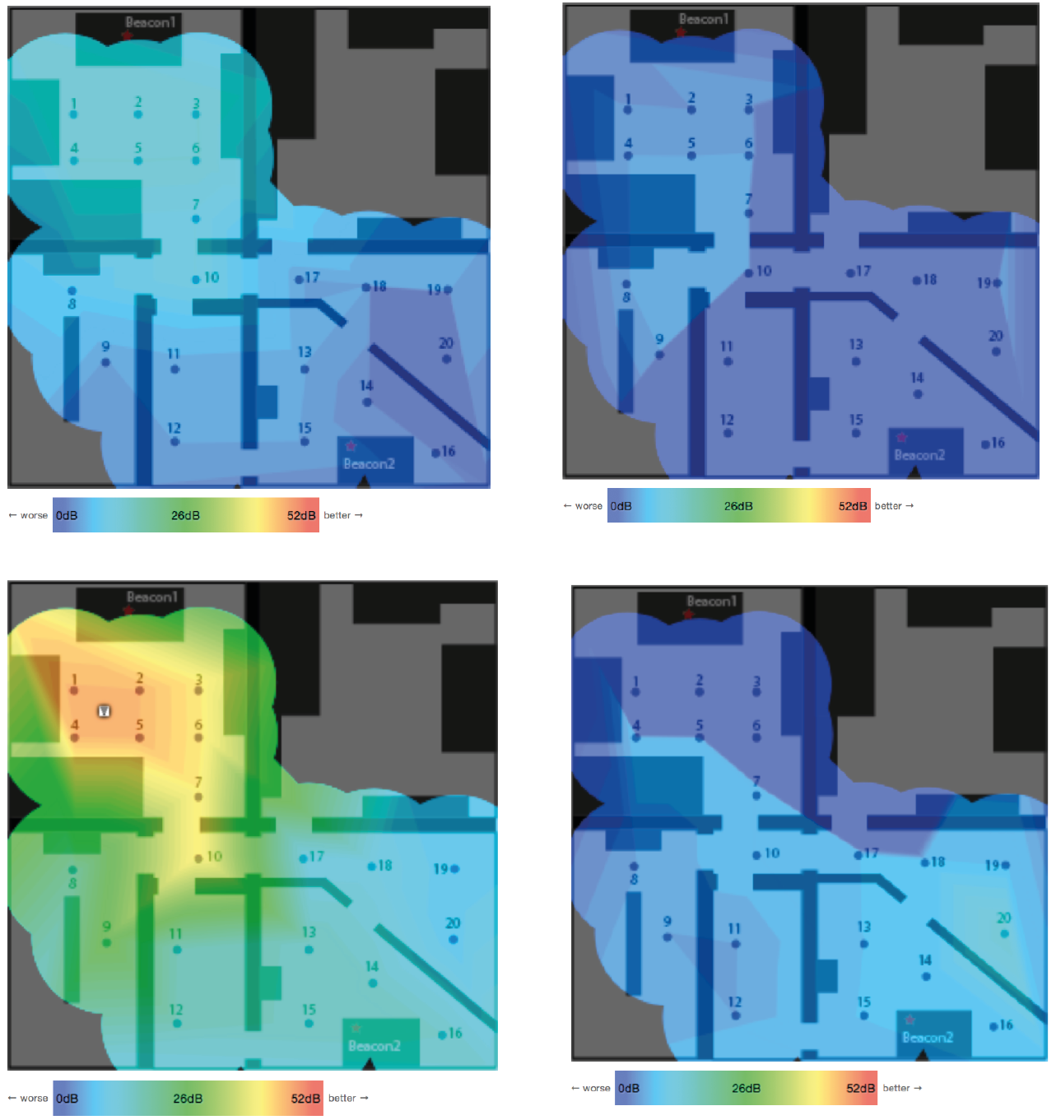
Experiment: Magnetic Flux und WiFi
→ only in environments with steel; attantion to self-repeating patterns

Slide 13
The Concept

Slide 14
Good to know
High demand of IPS
Data privacy is possible using independed mode
Costs depend on Use Case not so much on solution
This solution is to expensive for simple proximity marketing
map matching is necessary
Locata could replace independend mode IPS

Slide 15
Thank you

