Slide 1


WORKS WITH YOUR POS
Nighthawk Discount Card
8 supported POS systems. Every business welcome.

Slide 2
3 INTEGRATION TIERS
Tier 1: Full API Integration
Toast · Square · Clover · Shopify
Discount auto-applies at POS when card is scanned. No manual entry.
Tier 2: Barcode Scan
Revel · Heartland · SpotOn
POS reads the barcode and applies the configured coupon automatically.
Tier 3: Manual Verification
Any POS · Cash register
Cashier scans QR or views card on phone. Green verification screen confirms.

Slide 3
TIER 1: FULL API INTEGRATION
Discount applies automatically. Zero cashier action needed.
Toast
HOW: QR scan → our server → promo code auto-applies to check
NEEDS: Client ID, Client Secret, Restaurant GUID, promo code
Square
HOW: QR scan → customer identified → catalog discount applied
NEEDS: Access Token, Location ID
Clover
HOW: QR scan → REST API applies discount to open order
NEEDS: Merchant ID, API Access Token
Shopify POS
HOW: QR scan → discount code auto-entered via POS SDK
NEEDS: Store domain, Admin API Access Token

Slide 4
TIER 2: BARCODE SCAN
POS scans the Code128 barcode on the card. Looks up coupon. Applies discount.
Revel
HOW: Card ID barcode scanned as a coupon product → discount applied to order
NEEDS: Revel API URL, API Key, API Secret
Heartland
HOW: Coupon code scanned via barcode or typed by cashier → discount applied
NEEDS: Heartland API Key, Store ID
SpotOn
HOW: QR scan → discount pushed to location via API
NEEDS: SpotOn API Key, Location ID

Slide 5
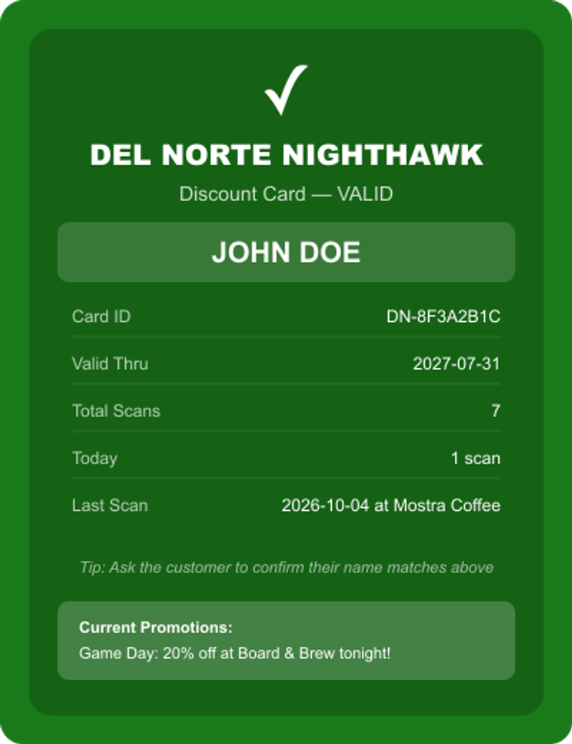
TIER 3: MANUAL VERIFICATION
Works with ANY POS or even cash registers. No tech setup required.
1
Customer presents the card (digital or physical)
2
Cashier scans the QR code with any camera or scanner
3
Green verification screen appears with cardholder name
4
Cashier applies discount manually in their POS
5
Scan is logged automatically for analytics

Slide 6



CARD TECHNOLOGY
QR Code (primary)
Compatible with: Modern POS cameras, smartphones
Encodes: URL: /card/DN-XXXXXXXX
Code128 Barcode (alternate)
Compatible with: Legacy POS barcode scanners
Encodes: Card ID: DN-XXXXXXXX
NFC (tap)
Compatible with: NFC-enabled payment terminals (iPhone 6s+)
Encodes: Card ID: DN-XXXXXXXX
Visual (show card)
Compatible with: Any business, no tech needed
Encodes: Gold Nighthawk card on phone

Slide 7
BUSINESS FAQ
Q: Do I need to change my POS system?
A: No. The card works with whatever you have.
Q: Does this cost me anything?
A: No POS integration cost. Sponsorship fee covers everything.
Q: What if my POS has no QR scanner?
A: Customer shows the card on phone. Cashier verifies visually.
Q: Can I see how many customers used the card?
A: Yes. Private sponsor dashboard with visits, unique customers, and dates.

