Slide 1

MODERNIZING THE
NIGHTHAWK
DISCOUNT CARD
Del Norte High School Football
Board Review — 2026-2027 Season

Slide 2
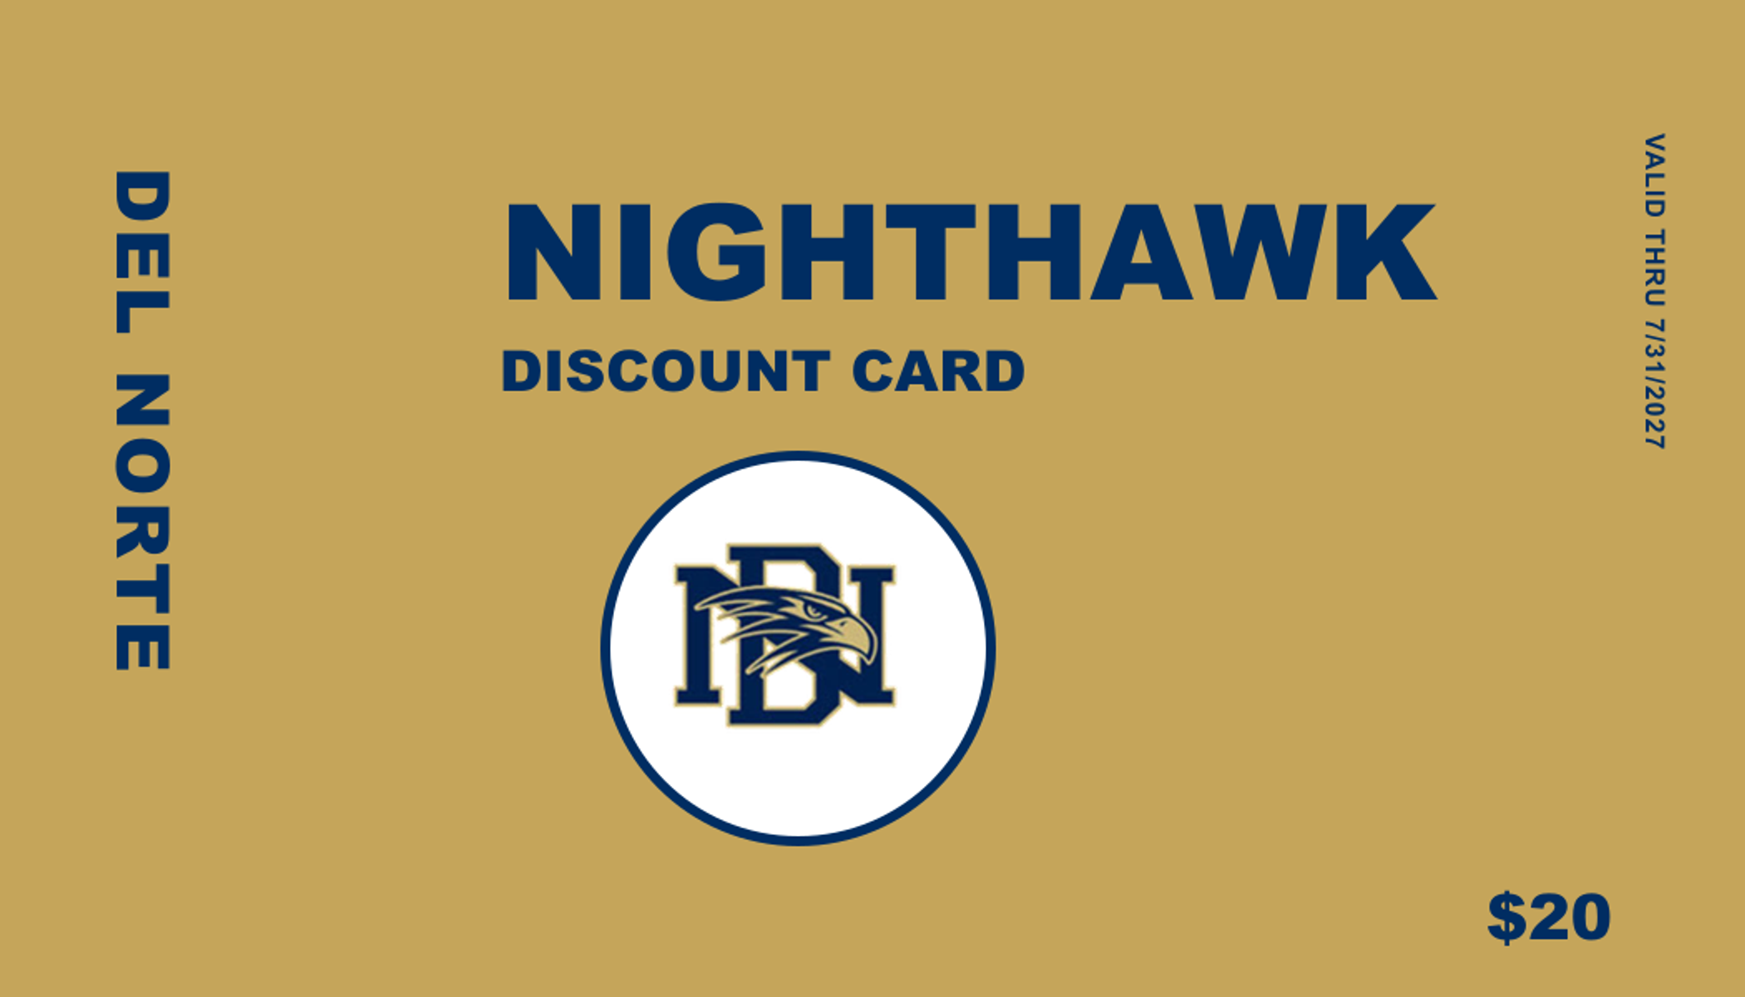
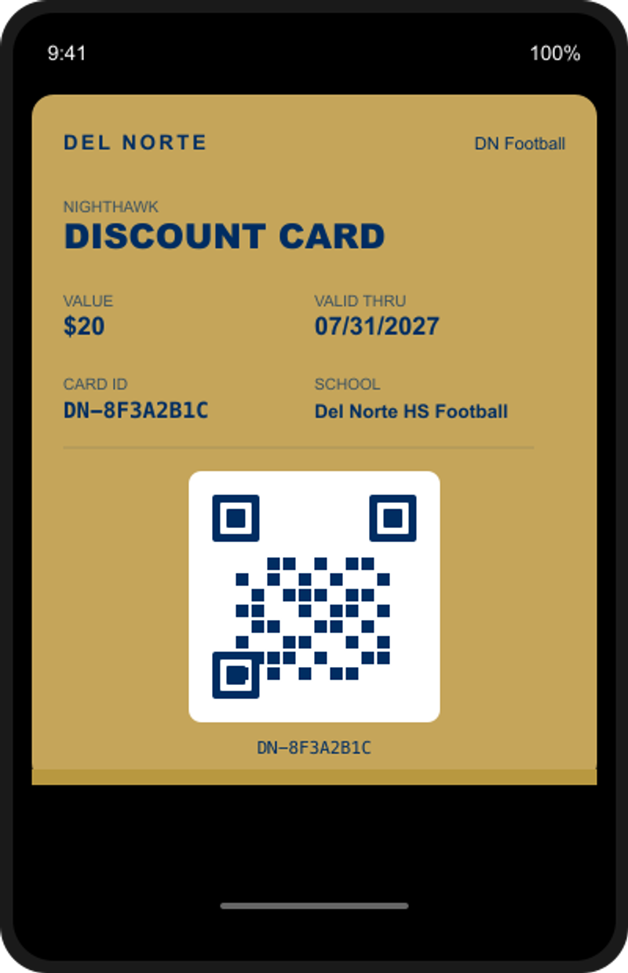

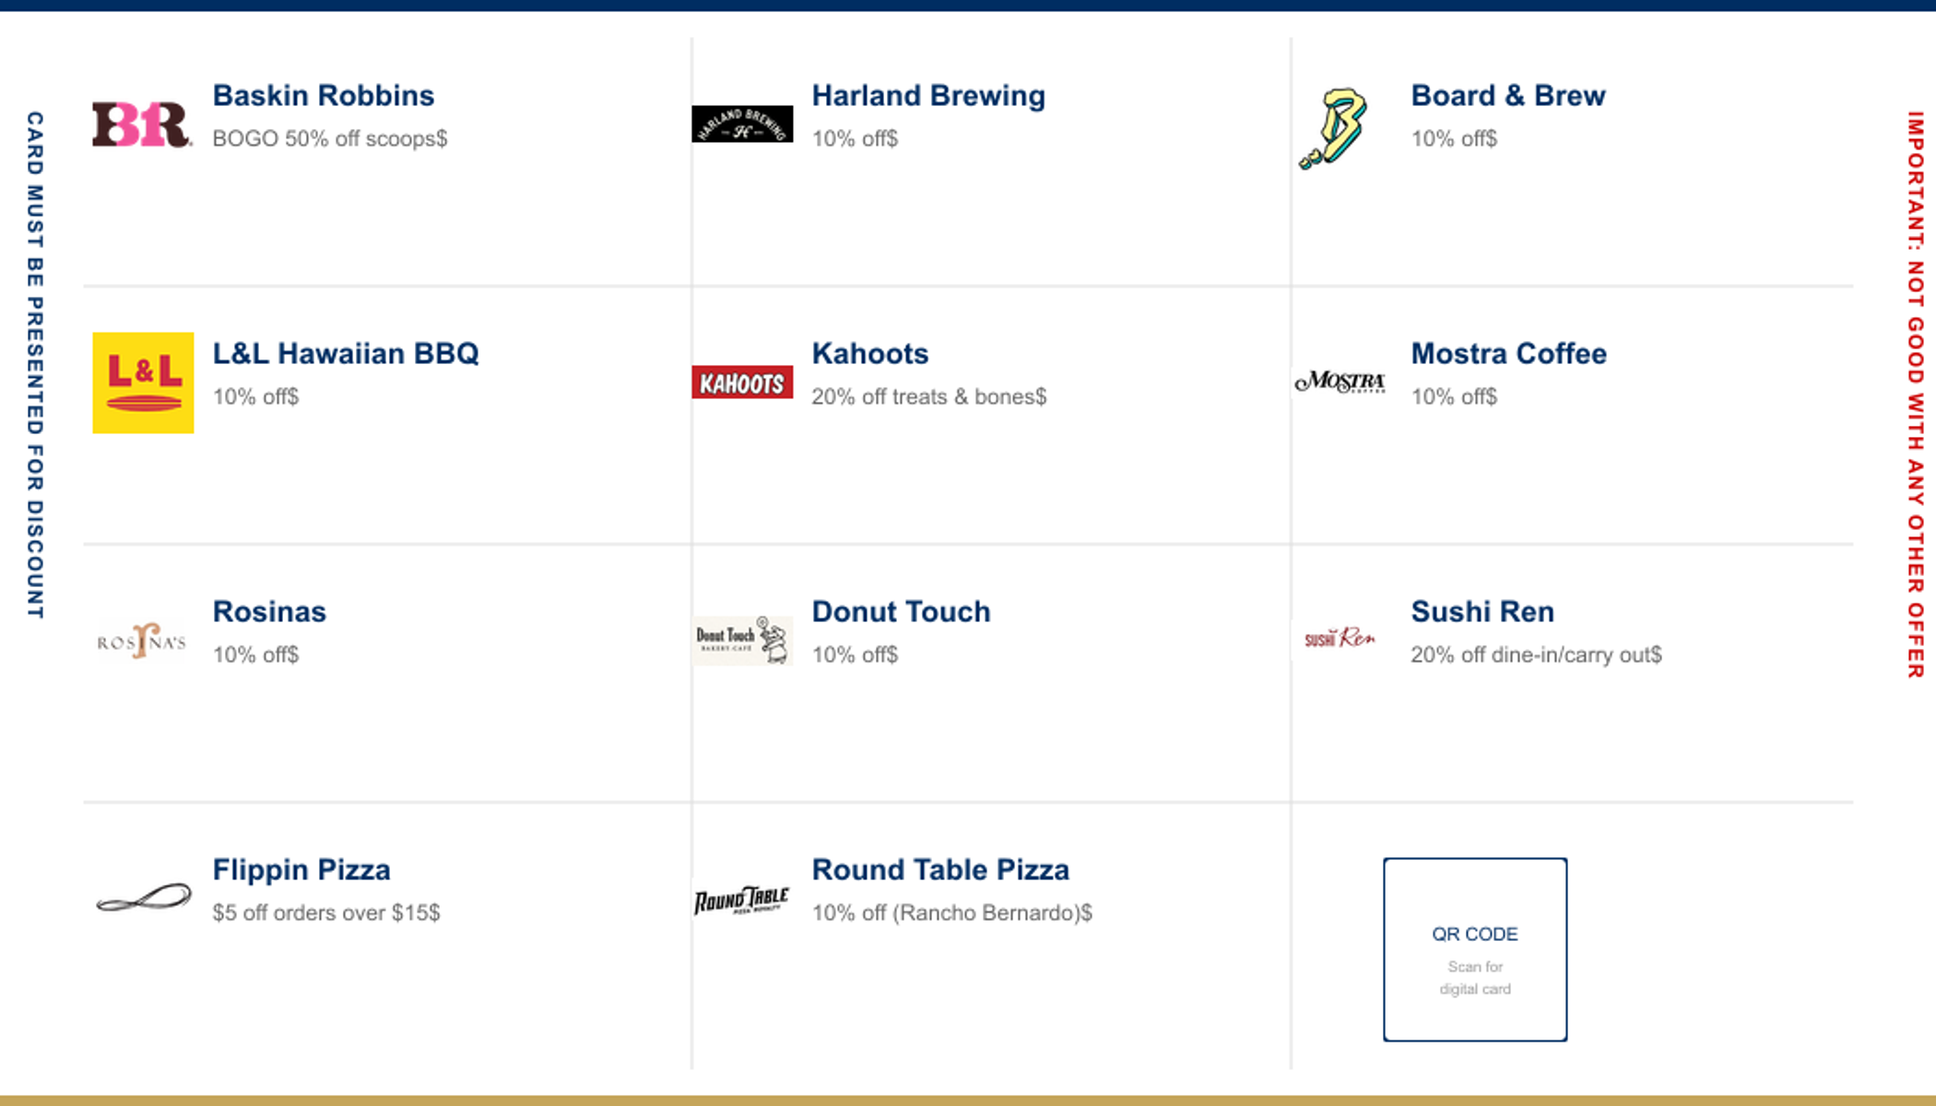
WHAT IT LOOKS LIKE
Physical Card (Front)
Apple Wallet Version
Unique QR Code
Physical Card (Back) with Unique QR
Each card gets a different
QR code linking physical
to digital.

Slide 3

REVENUE AND COSTS
REVENUE
COSTS
200 cards x $20
$4,000
Apple Developer (annual)
$99
Gold sponsors (est. 3)
$1,500
Server hosting (annual)
$60-120
Silver sponsors (est. 5)
$1,250
Card printing
Existing budget
Bronze sponsors (est. 3)
$300
Software licenses
$0
Projected Total
$7,050
Total Cost
~$160-220

Slide 4
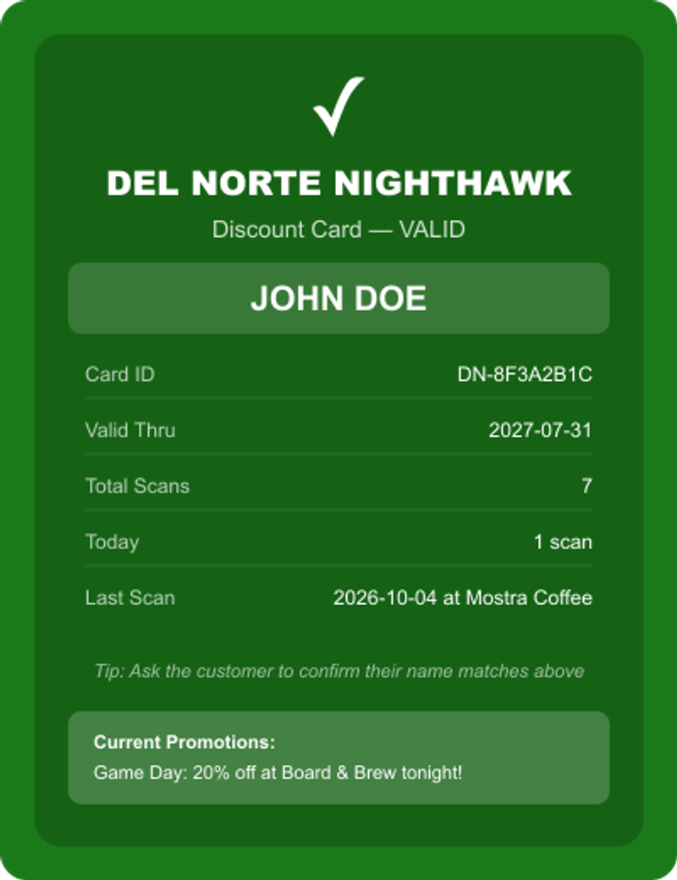
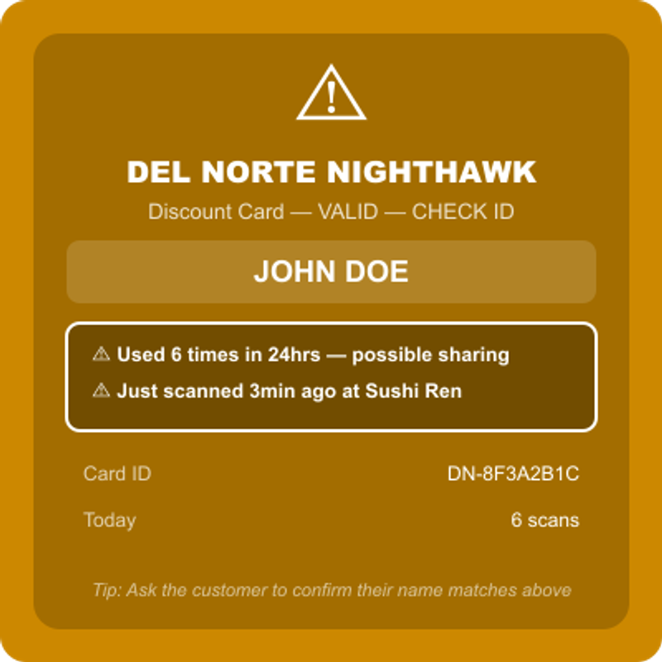
FRAUD PREVENTION
Unique Card IDs — no two cards alike
Valid Scan
Fraud Warning
Cardholder's name shown on scan — cashier verifies
Rate limiting — flags 5+ scans in 24hrs
Rapid scan detection — warns if just used elsewhere
Instant deactivation from admin dashboard
Screenshots don't work — cashiers verify the holder's name on screen and the card's scan history.

Slide 5
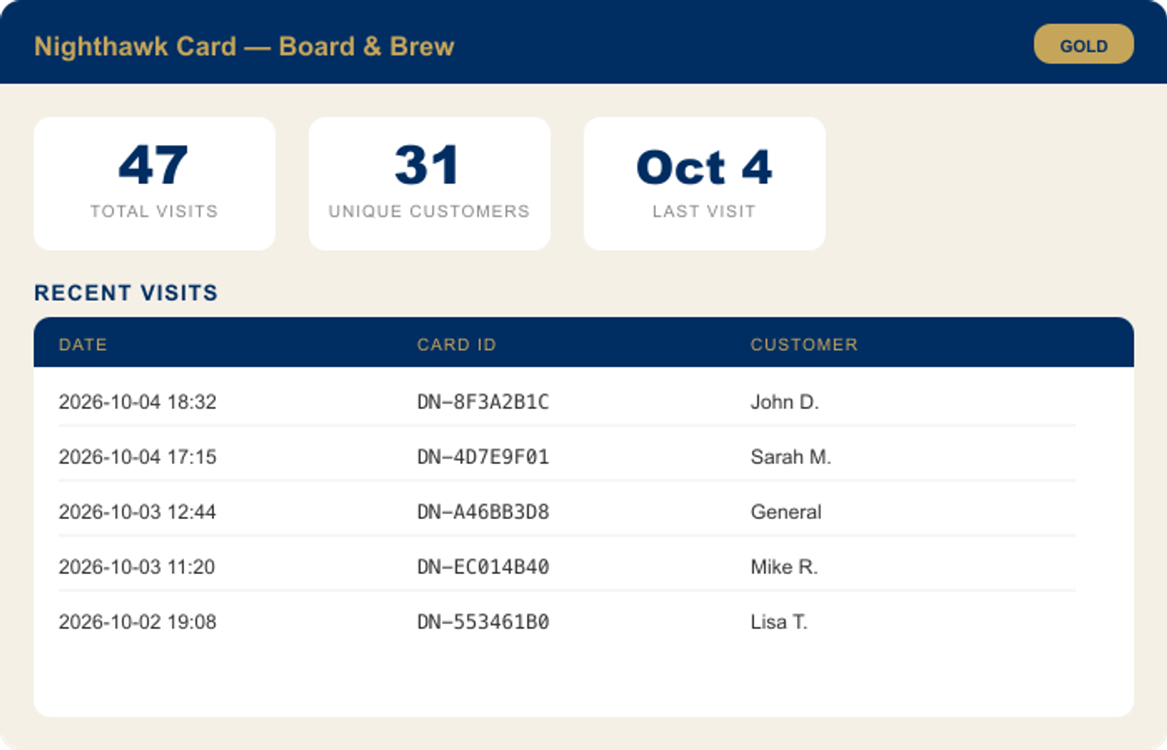
SPONSOR DASHBOARDS & PUSH PROMOTIONS
Each sponsor gets a private login showing:
Total visits from cardholders
Unique customer count
Visits by day
Recent scan history
Push promotions let you:
Send deals to every cardholder's phone
Lock-screen notification on every iPhone
Card updates automatically in Wallet
Promotions can have expiration dates
Terms & Conditions, Privacy Policy, and Sponsor Agreement govern all data usage.

Slide 6
REQUESTING BOARD APPROVAL
Same fundraiser. Better experience.
More data. Lower cost.
~$160
$7K+
200+
Annual cost
Projected revenue
Cards in Wallets

