Slide 1

DEL NORTE
NIGHTHAWK
Digital Discount Card
Del Norte High School Football — 2026-2027 Season
"Your business in every fan's pocket"

Slide 2
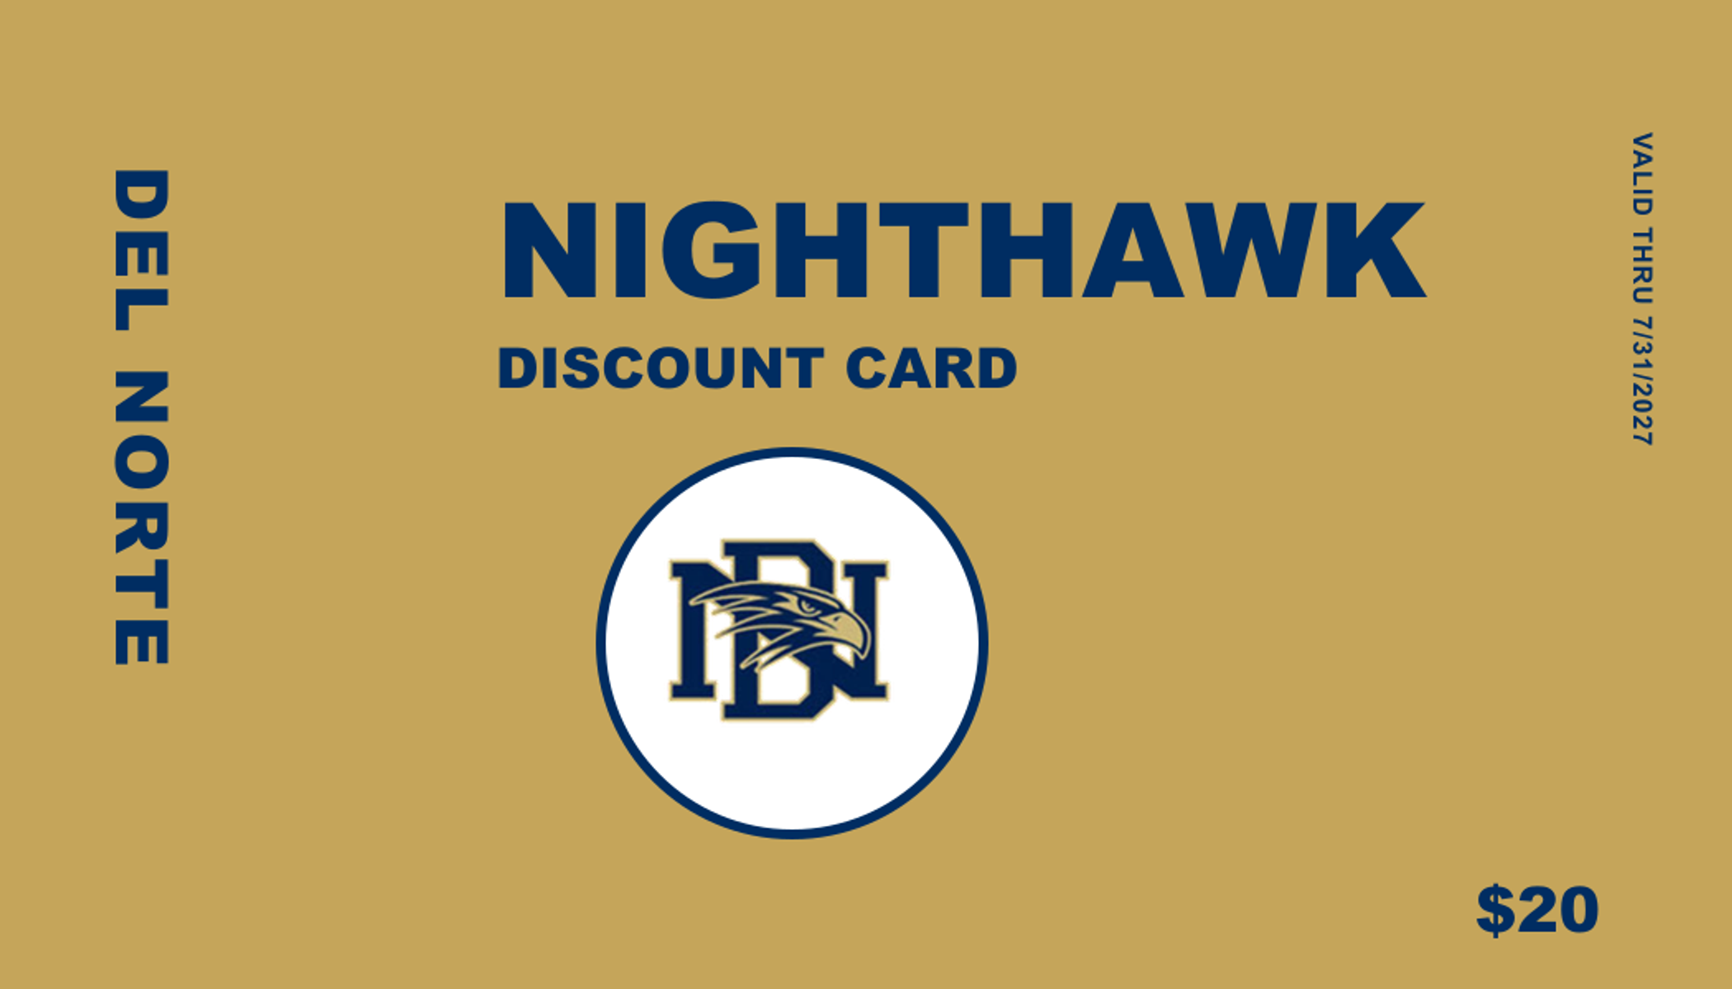
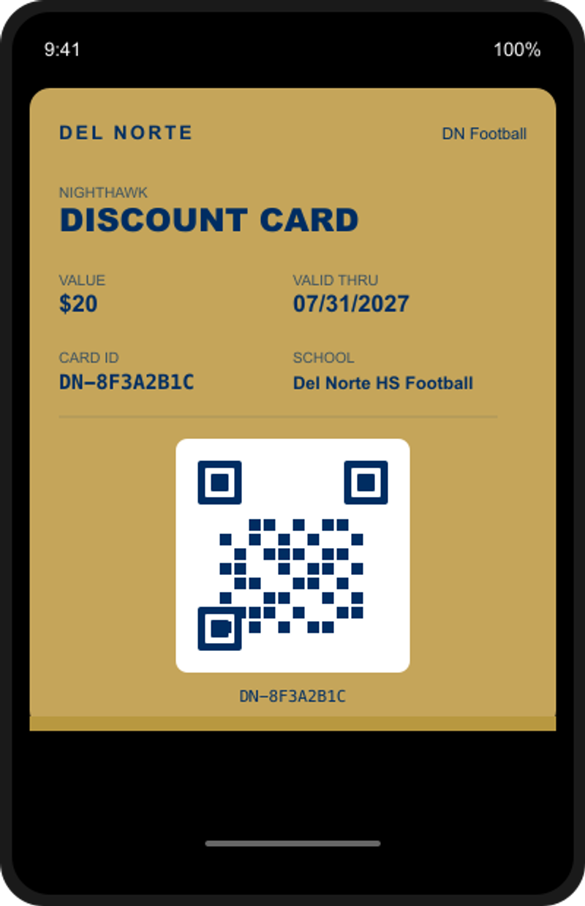
THE NIGHTHAWK DISCOUNT CARD
Physical Card
Apple Wallet
>>>
Every person gets a physical card with a unique QR code. Scan it to add to Apple Wallet.

Slide 3
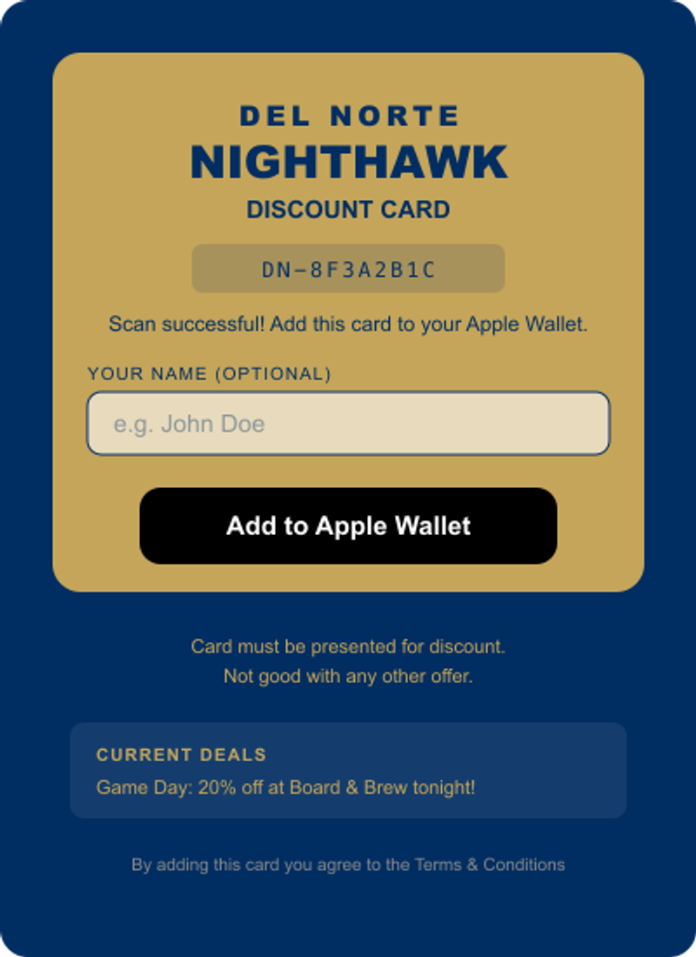
HOW IT WORKS — FOR THE CUSTOMER
1
Scan the QR code on their physical card
2
Enter their name and tap "Add to Apple Wallet"
3
Show the card at participating businesses
4
Discount applied — simple, fast, no paper

Slide 4
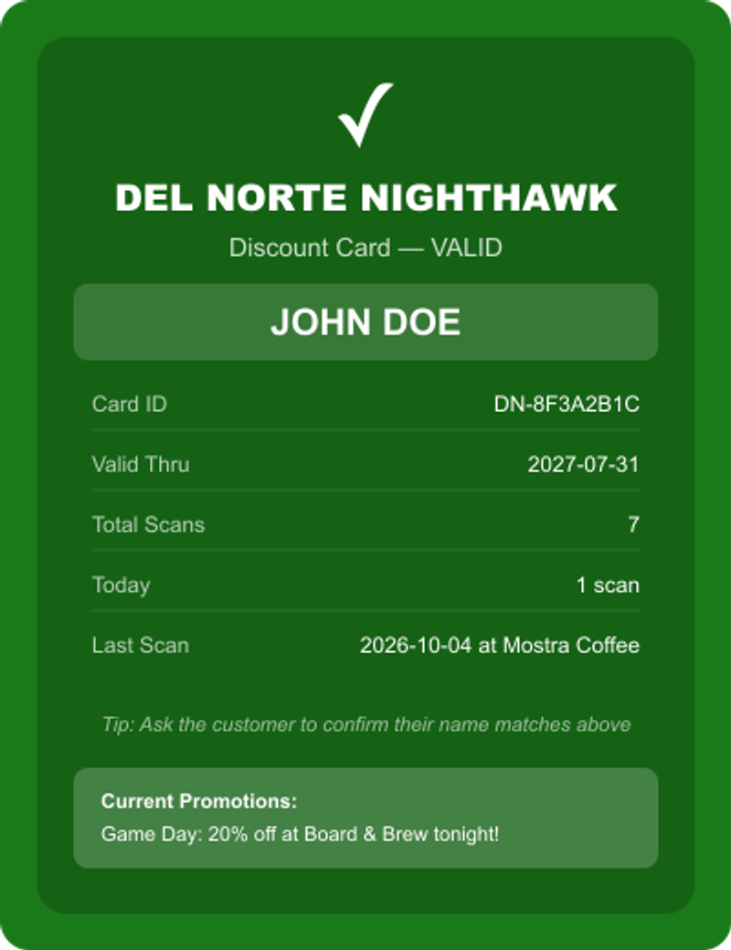




HOW IT WORKS — FOR YOU
Your business listed on every digital card
Customer scans QR → you see this verification screen
Every visit tracked — you get usage reports
Integrates with your POS (Toast, Square, Clover, and more)

Slide 5
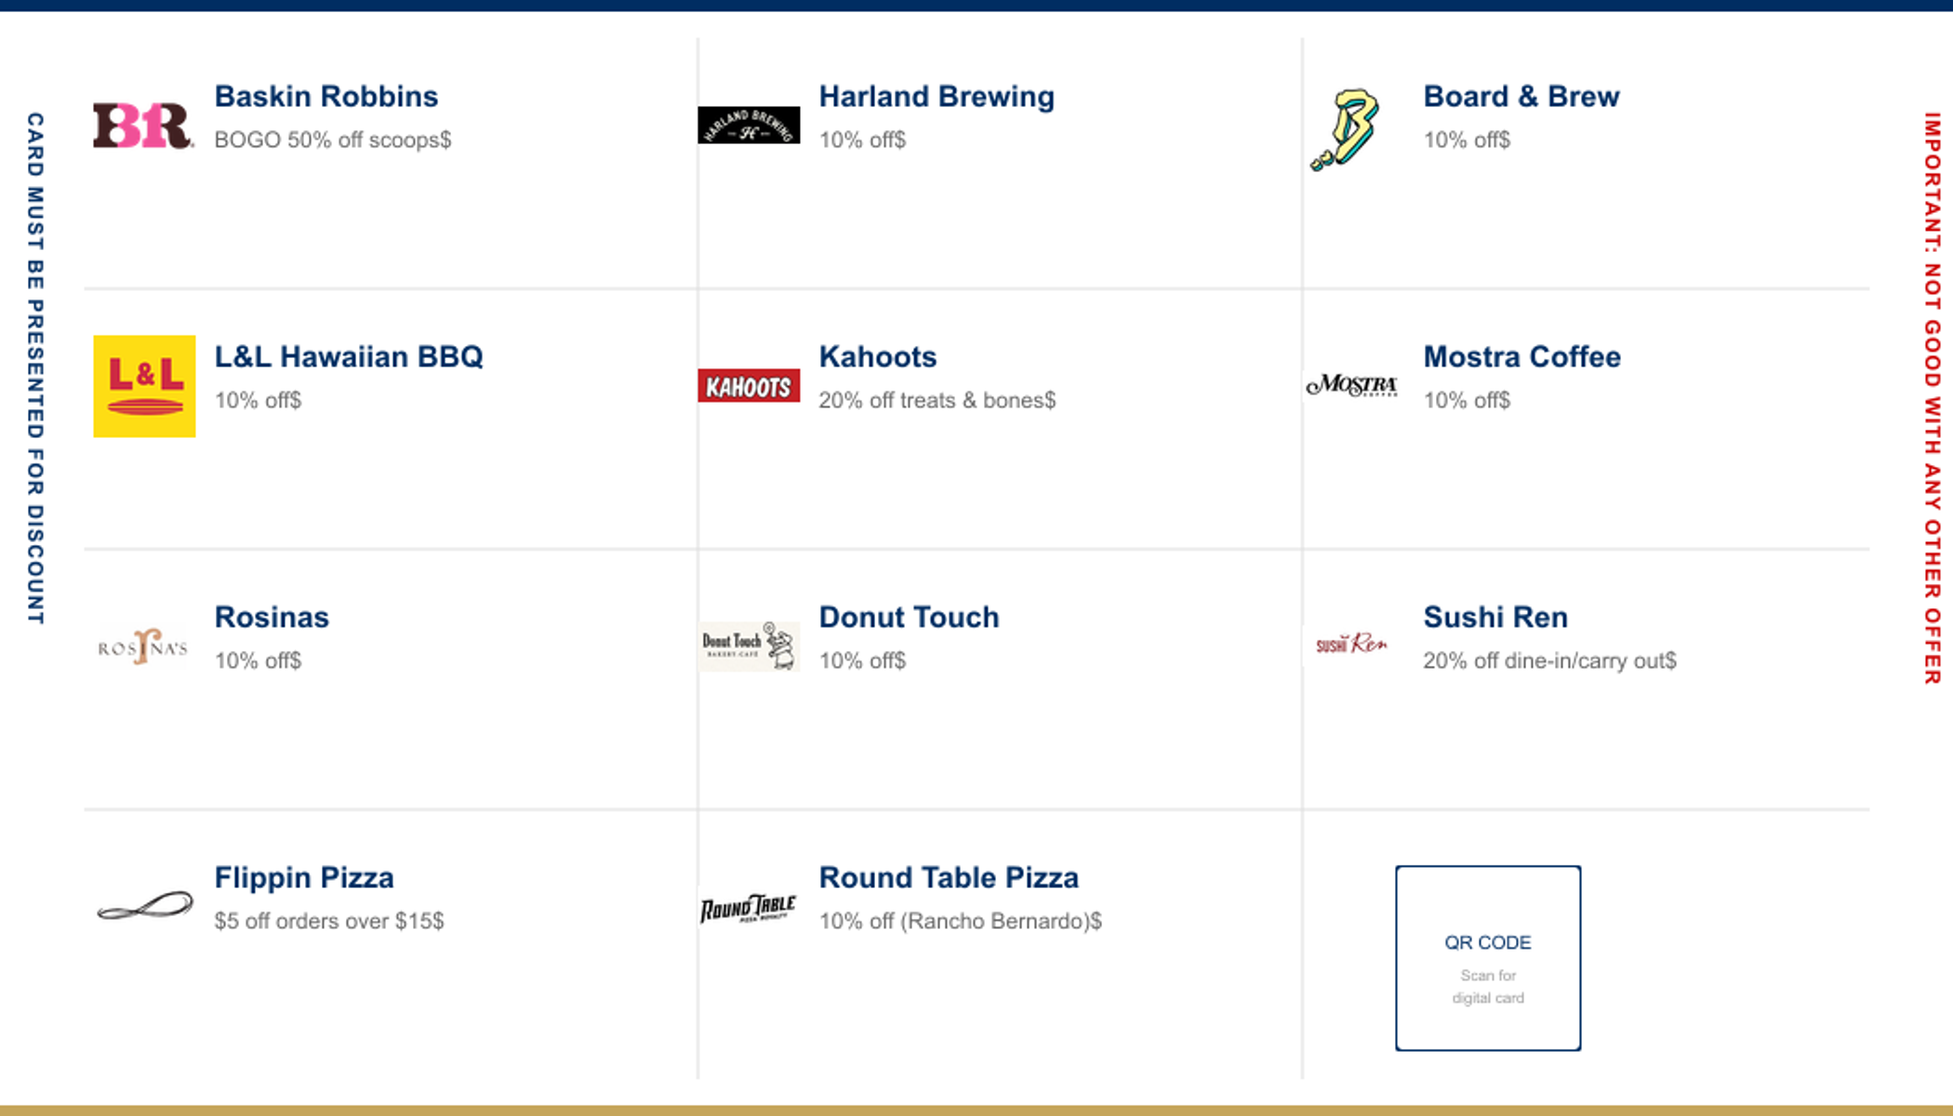
YOUR BUSINESS ON EVERY CARD
Every physical card has a unique QR code on the back. Scan it to load the digital version into Apple Wallet.

Slide 6
WHY DIGITAL BEATS PHYSICAL
Physical Card
Digital Card
Gets lost, forgotten at home
Always in their phone
No way to track usage
Every scan is tracked
Static once printed
Push new deals anytime
One-time impression
Ongoing notifications
Printing costs
Zero printing costs

Slide 7

PUSH PROMOTIONS
The Game Changer
Push limited-time promotions directly to every cardholder's phone.
Game Day Special: 20% off at Board & Brew — tonight only!
Homecoming Weekend: Buy one get one at Baskin Robbins
End of Season: Double discount at all sponsors this week
Cardholders get a lock-screen notification and their card updates automatically.

Slide 8

WHAT SPONSORS GET
Brand Visibility
On every digital card — hundreds of fans
Push Promotions
Featured deals pushed to every cardholder's phone
Usage Reports
See visits and unique customers on your own dashboard
Community Goodwill
Your business supports local student athletes
Zero Setup
No app, no POS integration, no tech hassle

Slide 9
WORKS WITH YOUR POS
Full API Integration
Toast, Square, Clover, Shopify — discount applies automatically at the POS when the card is scanned. No manual entry.
Barcode Scan Integration
Revel, Heartland, SpotOn — POS reads the barcode on the card and applies the configured coupon.
Any Other POS
Cashier scans the QR code or views the card on the customer's phone. Verification screen confirms the card is valid.
We configure everything for you. No tech changes needed at your business.

Slide 10
SECURE & PRIVATE
Unique Cryptographic IDs
Every card has a one-of-a-kind ID that can't be guessed, copied, or faked
Anti-Sharing Protection
Cards scanned too many times get flagged automatically with a warning
Name Verification
Cashier sees the cardholder's name on the verification screen
Your Data Is Yours
Sponsors only see their own analytics — never other sponsors' data
No Personal Data Collected
No emails, phone numbers, or payment info — just an optional name
Encrypted & Compliant
HTTPS everywhere, CCPA compliant, hosted on secure cloud infrastructure

Slide 11
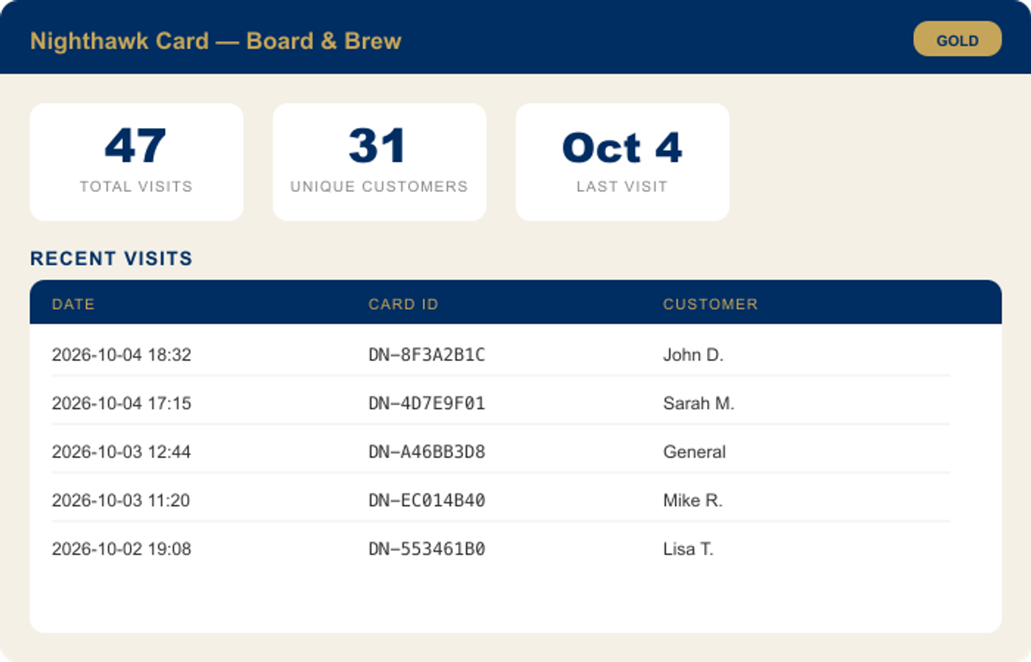
YOUR OWN DASHBOARD
Each sponsor gets a private login to view their analytics.

Slide 12
CURRENT SPONSORS (2026-2027)
Baskin Robbins
Harland Brewing
Board & Brew
L&L Hawaiian Barbecue
Kahoots
Mostra Coffee
Rosinas
Donut Touch
Sushi Ren
Flippin Pizza
Round Table Pizza
Join them and put your business in front of the entire Nighthawk community.

Slide 13
SPONSORSHIP TIERS
GOLD
SILVER
BRONZE
$500
$250
$100
Featured at top of card
Listed on the card
Listed on the card
2 push promotions/month
1 push promotion/month
Seasonal usage reports
Monthly usage reports
Quarterly usage reports
Logo on game day materials

Slide 14
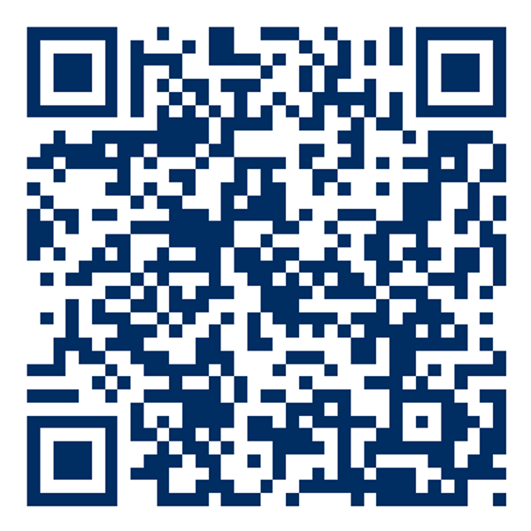
HOW TO GET STARTED
1
Choose your sponsorship tier
2
Tell us your discount offer
3
We add your business to the card — live immediately
Sample QR Code
4
Existing cardholders get a push notification
5
Start seeing customers with the Nighthawk Card

Slide 15
DEL NORTE HIGH SCHOOL FOOTBALL
Nighthawk Discount Card Program
"Support student athletes. Drive customers to your door."
All sponsorships subject to Terms & Conditions, Privacy Policy, and Sponsor Agreement.

