Slide 1
자율주행차용 object detection model의 regularization을 이용한 경량화
Hoseung Kim
Embedded Software Lab.

Slide 2
Introduction
Object detection is a crucial task for autonomous driving.
Need to accurately detect objects in real-time.
Other sensors cannot replace image-based object detection.
Object detection issues
Accuracy : The detector should achieve more recall and precision.
Small model size : Object detector must operate on processors that far less power than Computers(GPUs).
Speed : The detector should have real-time inference speed.

Slide 3
Related Work
Regularization
- Learning Structured Sparsity in Deep Neural Networks
- Morphnet
Object Detection Model
- Faster R-CNN
- YOLO
- SqueezeDet

Slide 4












MorphNet : Background
Layer = $1,…,M+1$
$$O_{L}개$$
Neural Network Definition
Only consider convolutions
Objective function :
Problem Setup
Finding the Optimal Dimension
$$x_{L}$$
$$z_{L}$$
*
…
=
$$I_{L}$$
$$g_{L}$$
$$O_{L}$$
$$w_{L}$$
$$y_{L}$$
$$I_{L}$$
$$f_{L}$$
Input
Feature Map
Filter
Output
Feature Map
: The number of FLOPs per inference
or the model size
: Resource Constraints

Slide 5
Shrink/Expand Model Size
Width Multiplier
ω < 1 : shrink network / ω > 1 : expand network
Sparsifying regularizer
Induce sparsity in the neurons

Slide 6
MorphNet : Approach
Algorithm
width Multiplier +
Sparsifying regularizer
Constraints
Constraint quantity of a layer :
with indicator function :
Total constrained quantity :

Slide 7
MorphNet : Regularization
Applying penalty on the loss
Variables of batch normalization with L1 norm
The regularizer for the whole Network

Slide 8
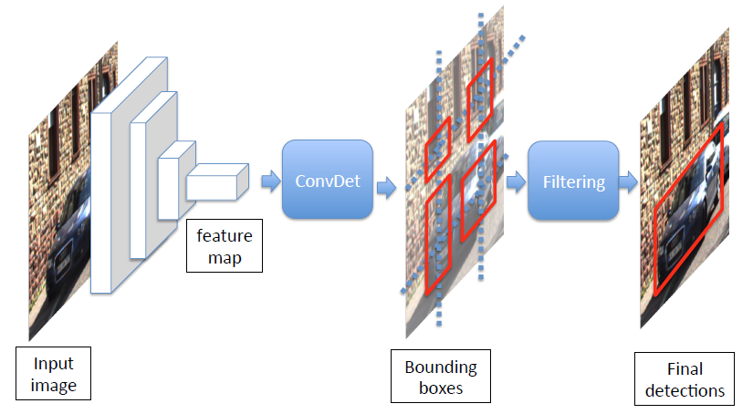
SqueezeDet : Detection Pipeline
SqueezeNet extract feature map
ConvDet layer compute bounding boxes
Each bounding box is associated with C + 1
Number of classes, confidence score
Confidence of the bounding box prediction
To obtain the final detections, use Non-Maximum Suppression to filter

Slide 9
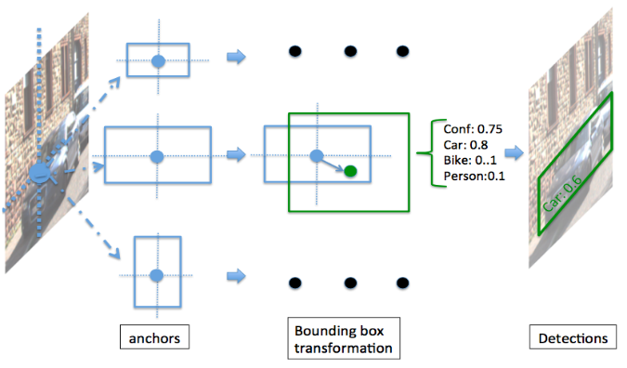

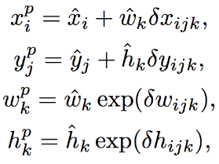
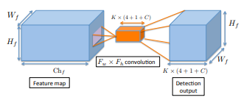
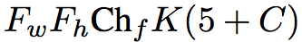
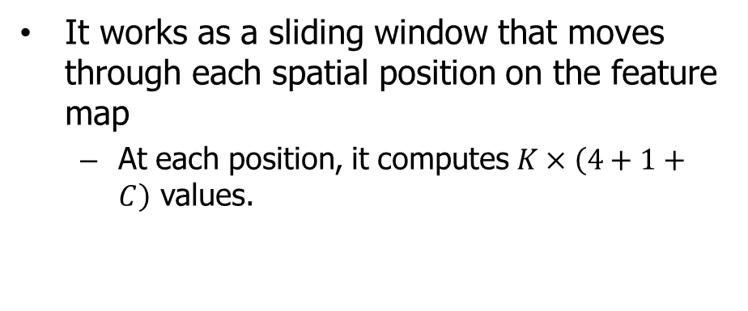
ConvDet
It works as a sliding window that moves through each spatial position on the feature map
At each position, it computes $K×\left(4+1+C\right)$ values.
(x, y) : grid center
(w, h) : width, height
The output of ConvDet keeps the same dimension as the feature map.
For each reference grid, the number of parameter is
Predicted bounding coordinates

Slide 10
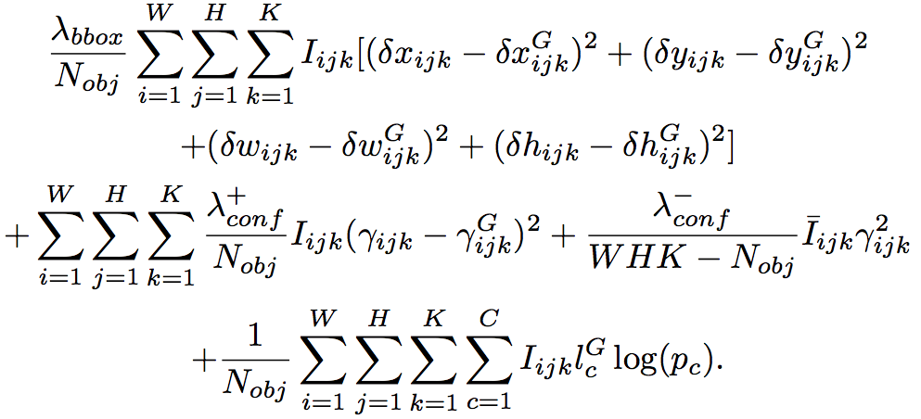
SqueezeDet : Training
Define a multitask loss function to train the ConvDet layer to learn detection, localization, and classification.
Bounding box regression :
Confidence score regression :
Cross-entropy loss for classification :

Slide 11
Issue
Appropriate regularizer selection
The loss function of SqueezeDet is very different from the normal CNN.
Adjusting the optimization problem
Additional improvements

Slide 12
계획
SqueezeDet 서버에서 training
SqueezeNet에 MorphNet algorithm 적용 후 기존 weight decay와 성능 비교
ConvDet에 regularizer와 constraint 다양하게 설정 후 성능 비교
추가 개선사항 적용

Slide 13
진행 일정
월 | 진행 일정
4 | 서버에 SqueezeDet, MorphNet 환경 구현
5 | SqueezeNet 에 MorphNet 적용
6 | -
7 | Constraint, regularizer 변화시키며 전체 모델 training
8 | 결과분석 및 문제점 해결
9 | 중간보고서 작성 및 개선 방안 마련
10 | 논문 최종 제출

