Slide 1
OVERALL PERFORMANCE
Presented by : Hosham Younis
Last updated :June 1sth.2021

Slide 2







1- What is the overall financial performance of the project?
Overview
5- Which high-selling products are actually unprofitable?
Performance Consistency
6- Can pricing adjustments recover profitability?
2- Is performance consistent across categories and time?
Action
7-What actions should the business take?
3- Why doesn’t strong revenue translate into profit?
Revenue vs Profit
What-If Scenario
4- Where exactly are the losses concentrated?
Loss Concentration
Hidden Risk

Slide 3
-1OVERVIEW
What is the overall financial performance of the project?

Slide 4
General business situation
3.51M
Total Revenue
The overall result is positive, but it is followed by a rise in cost or a near-equalization, which is a cause for concern.
3.46M
Total Cost
Given the high sales volume, profits should be more reasonable, and this may indicate a genuine, deep-seated collapse.
7K
Total Quantity
Large numbers always hide negatives, and that's what we will reveal later.
45.81K
Total Profit

Slide 5
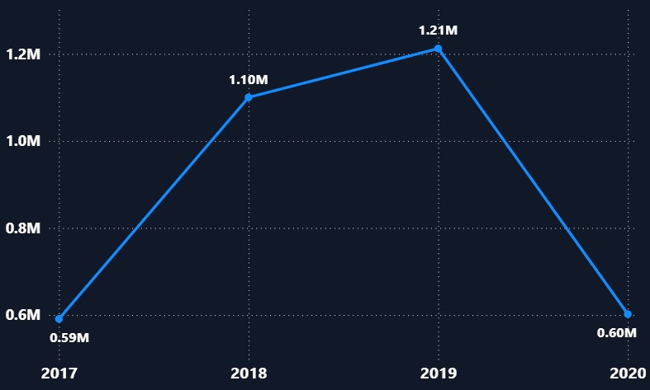
Sales over the years
Sales have increased over the past three years
Total Sales
The peak was in 2018
We're back to square one in 2020.

Slide 6
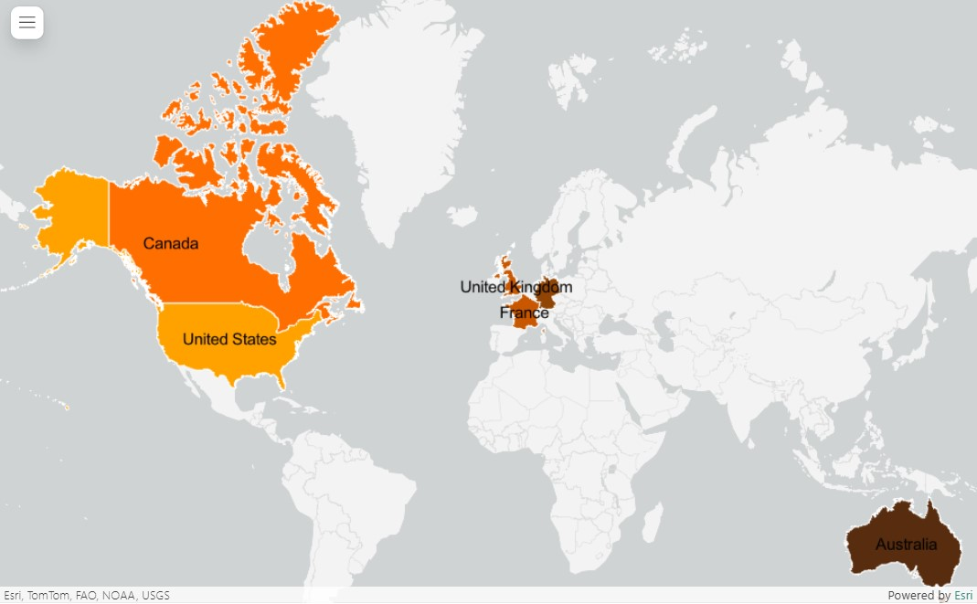
Total Quantity by Country
High
Australia has the lowest quantities sold, while the United States has the highest quantities sold.
Low
Note : Sometimes quantities do not indicate the quality of the profit.

Slide 7
Profit Distribution by Country
Country | Profit
USA | 36,917
Canada | 15,486
France | 3,510
UK | 820
Germany | -3,541
Australia | -7,385
Although Australia carries small quantities (185), it has suffered the highest losses over the years.
America had the highest share of profits
In the next slide, we'll discover which products have the most impact.

Slide 8
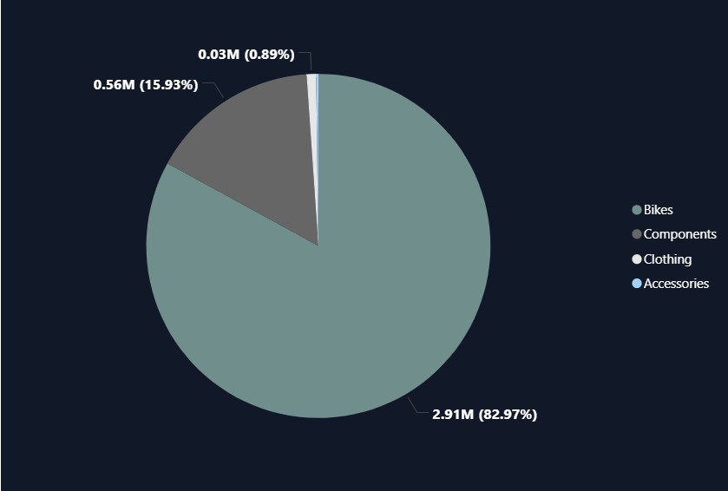
Category Distribution
Bikes are the biggest contributor to sales, while accessories are almost invisible.
However, it is experiencing a massive loss estimated at 10,000 in total.
It should be noted that Canada and France are the only contributors to the positive profits in relation to Bikes.

Slide 9
2- Performance Consistency
Is performance consistent across categories and time?

Slide 10
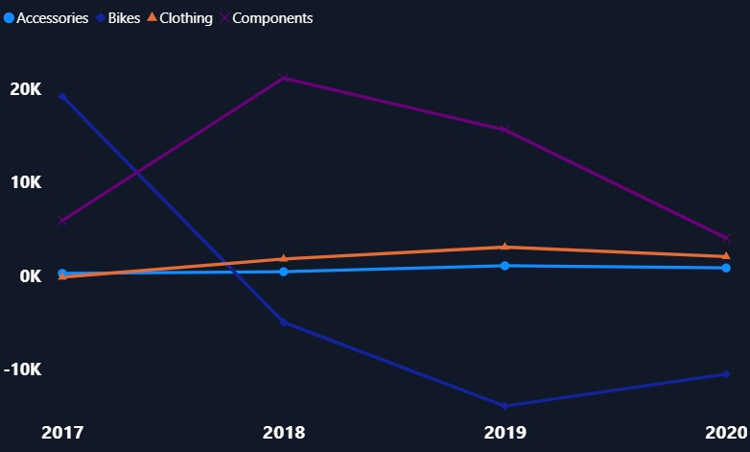
Profit trend over the years
General situation
Accessories and clothing have maintained a relatively stable and positive trend over the years.
It is important to clarify that Accessories are almost unprofitable or have no impact over the years.
It is sad to say that Bikes have truly entered the danger zone, while Components are declining but in a last position so far.

Slide 11
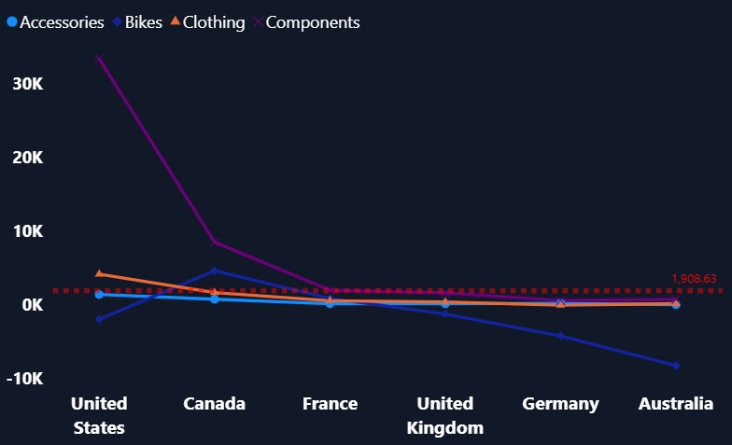
Distributing profits by countries
Profit
Performance varies significantly by country, even within the same category, indicating weak consistency over time and geography.
We are playing below average in all countries, and here we discover that profit is only one element, and it is now also on the verge of being lost.
Loss

Slide 12
3- Revenue vs Profit
Why doesn’t strong revenue translate into profit?

Slide 13
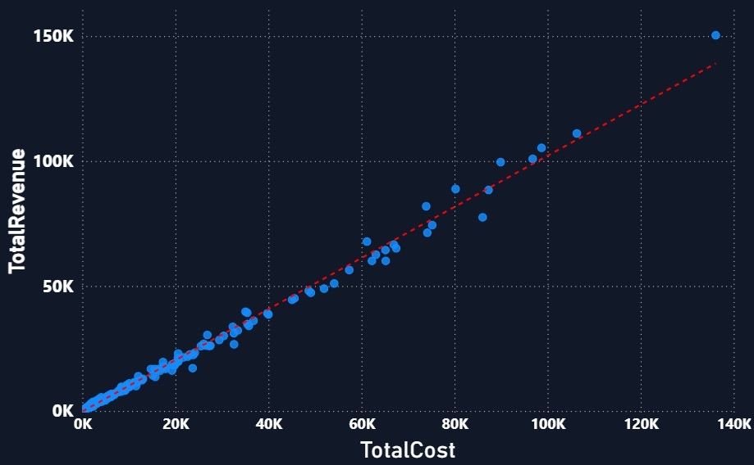
Cost Weight VS Revenue
One of the problems is that revenues are equal to or close to cost prices.
Products
There shouldn't be a trend between sales and costs, as this might indicate that we are selling on a small margin.

Slide 14
4- Loss Concentration
Where exactly are the losses concentrated?

Slide 15
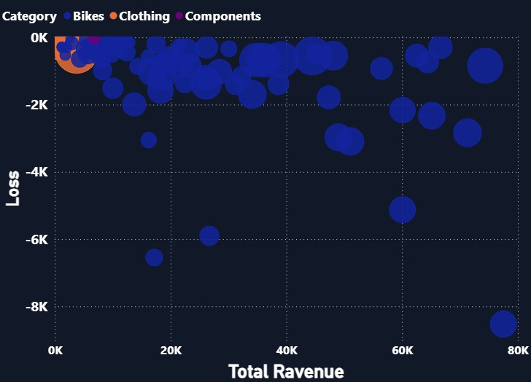
Segments
Products
Bikes play a significant role in preventing revenue from being converted into profits, and there is an outlier that needs to be carefully studied.
The problem is likely due to the price or cost being too high so far.

Slide 16
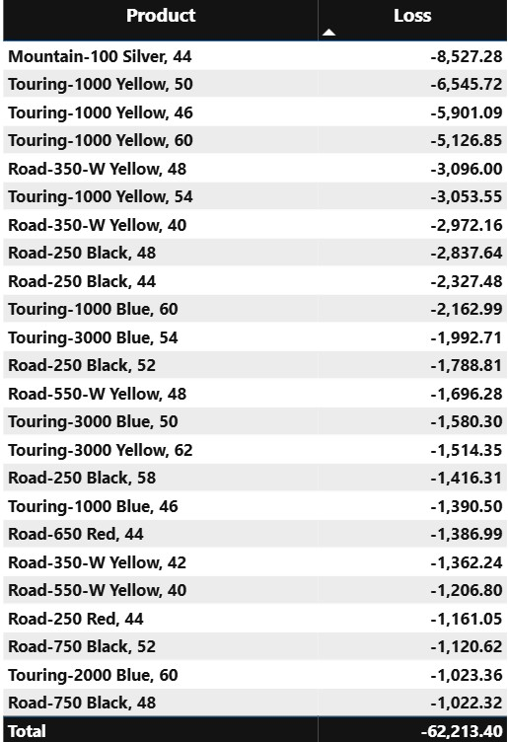
Bikes products contribute the most to the losses
The major problem is that Bikes contribute the most to sales, around 85%.
Are the most sought-after colors the ones that lose the most, or is the problem that the low prices are what makes these colors in demand?
Note : These elements are filtered to Losses starting from “-1000”

Slide 17
5- Hidden Risk
Which high-selling products are actually unprofitable?

Slide 18
In the previous slide, we focused on products that were generally unprofitable, but here we will try to find out if there are products that are sold in large quantities but are not profitable.

Slide 19
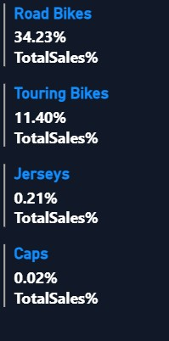
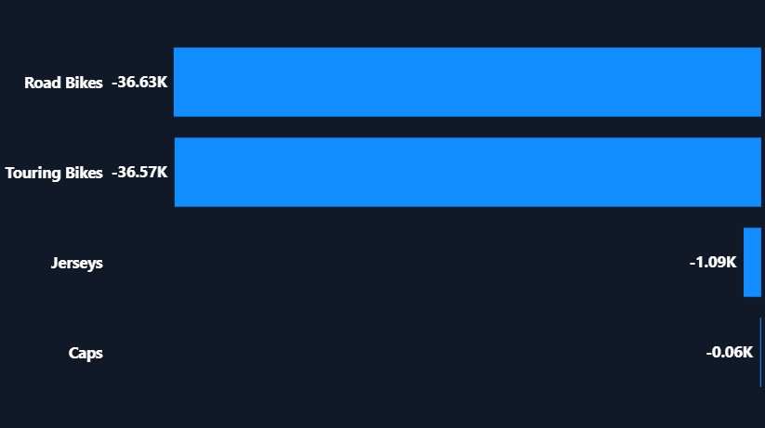
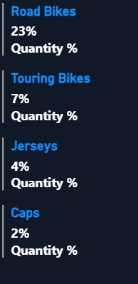
Lost total sales
subcategory loss
Lost total quantity
Road bikes and touring bikes contribute to overall losses over the years, but their numbers are decreasing annually, a good indicator of recovery. Caps and jersey bikes, however, haven't been successful over the past four years, but they haven't suffered significant losses either. They alternate between gains and losses, resulting in a balance.
This data shows the loss for all four years combined.

Slide 20
6- What-If Scenario
Can pricing adjustments recover profitability?

Slide 21
In this scenario, we will not focus on all past years, but rather on the current year, and see if, by increasing the price each time, we will achieve a noticeable recovery.

Slide 22
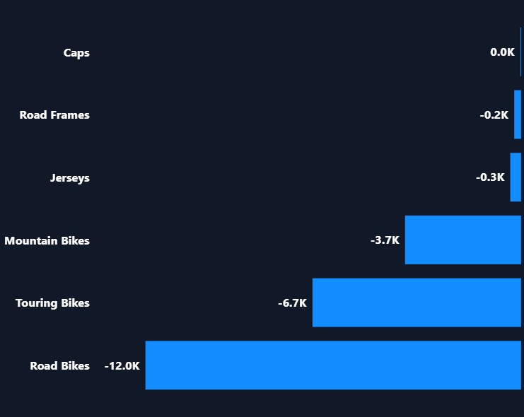
19k
Total Loss
losses this year
Here we present the losses for this year before the manipulation

Slide 23
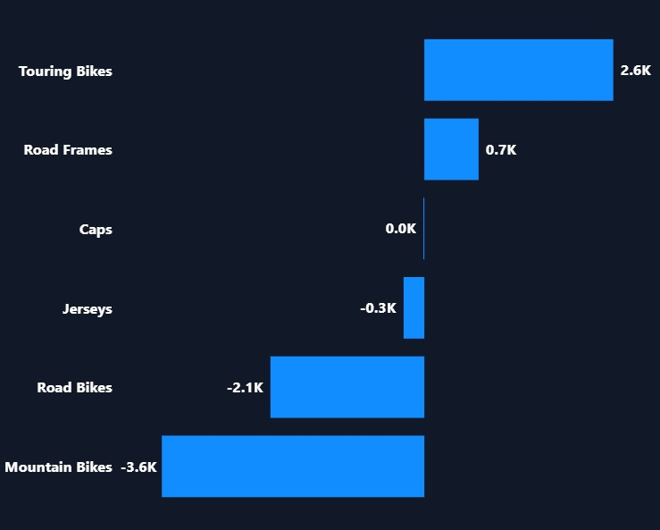
Here I increased the price by 5%, and while some products have recovered, others remain negative despite the increase.
This means that these products are vital, but they need pricing solutions.

Slide 24
-7Action
What actions should the business take?

Slide 25
Things we might do based on the data
As for the Caps, they aren't selling in large quantities, only 10 pieces so far. Because of the low sales, they're losing money. We'll need to either market them or stop production.
As for Touring Bikes Road, Frames and Road Bikes , a 5% increase would save them from collapse, and even a small reduction in costs would be profitable.
The mountain Bikes haven't been addressed even with the increase, so I recommend checking the cost or the suppliers.
Bikes are our only hope in this business and are the biggest driver, accounting for 85% of revenue. The company may need to reconsider canceling other products and focus on the losses and costs associated with Bikes

Slide 26
Thank You

