Slide 2
3D LIDAR

Slide 3
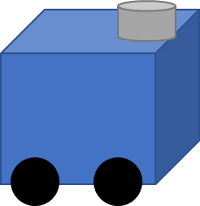
: High reflection intensity
: Low reflection intensity

Slide 4
: Free places
: Unknown places
: Occupaied places
Path plan

