Slide 1

Introduction
HTML(Hyper Text Markup Language)
    Language of web
    Provides structure of web page.
    HTML tags are used to mark up content explaining the content and how it relates to other content on the page.
    Some Tags <p></p>,<h1></h1>,<body></body>,<title></title> etc.
    Learning HTML means understanding syntax and rules of using HTML tags in order to author web pages.

Slide 2
Use of HTML Tags Example
<html>
<head>
<title>Introduction To HTML</title>
</head>
<body>
<h1>This is h1 tag</h1>
<h2>This is h2 tag</h2>
<p>
First Paragraph. Paragraph are kept here. This is <u>Underlined Text</u> in paragraph.
<strong> This is Strong</strong> meanwhile <strong> <u>This is Strong and Underlined </u> </strong>
</p>
<p>
Next Paragraph
</p>
</body>
</html>

Slide 3
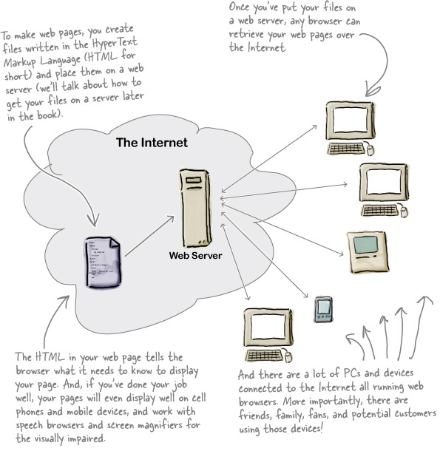
Web Architecture
World wide web (WWW) is a concept realized in the 90s for people and machines to communicate with each other by exchanging, distributing, and sharing information in a network.
It provides infrastructure of the internet.
  Data transmission protocols (TCP/IP, HTTP, HTTPS)
  Representation formats (HTML, CSS, XML)
  Addressing standards (URI, URL).
Web consisted mostly static websites based on HTML also called two tier or Client Server model:
Web Server(Server), Web Browser(Client)
From Head First HTML and CSS, 2nd Edition by Elisabeth Robson; Eric Freeman,O'Reilly,2012

Slide 4
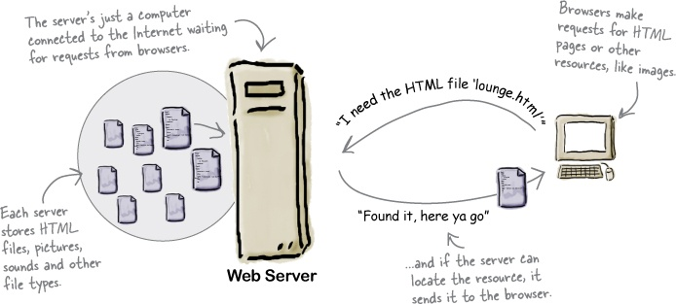
Web Architecture
Web Server Responsibility
From Head First HTML and CSS, 2nd Edition by Elisabeth Robson; Eric Freeman,O'Reilly,2012

Slide 5
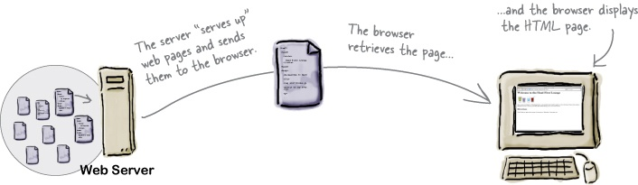
Web Architecture
Web Browser Responsibility (From Head First HTML and CSS, 2nd Edition by Elisabeth Robson; Eric Freeman,O'Reilly,2012)
From Head First HTML and CSS, 2nd Edition by Elisabeth Robson; Eric Freeman,O'Reilly,2012

Slide 6
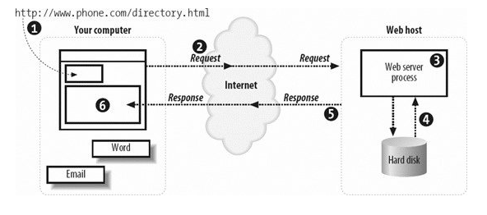
Client Server
From: Learning PHP and MySQL (Michele Davis, Jon Phillips), O'Reilly, 2006

Slide 7
Three Tier
Modern Web consists of Dynamic Web Pages.
Application logic sits between the client and the server.
Application server (eg. IIS,php,tomcat) and database server(eg,mysql,Oracle,SQL Server)are used to translate application code /database queries into meaningful web pages.
Javascripts/css are used on front end to generate necessary html for client to consume.
Basis for web application.

Slide 8
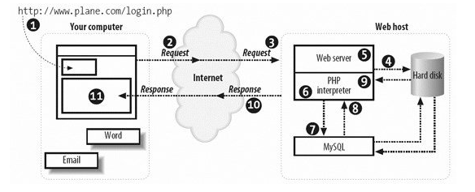
Three Tier
From: Learning PHP and MySQL (Michele Davis, Jon Phillips), O'Reilly, 2006

Slide 9
HTTP
HTML defines how web pages are formatted and displayed by web browser.
HTTP (HyperText Transfer Protocol) defines how messages are formatted and transmitted between Web servers and browsers.
URL (Uniform Resource Locator) provides address of the resource such as web page in world wide web architecture.
URL entered in browser, sends an HTTP command to the Web server to fetch and transmit given Web page/resource as directed in URL.
Some HTTP commands
  CONNECT
  DISCONNECT
  GET
  POST
  HEAD

