Slide 1
#32 Improved Hamiltonian Simulation
Hao-Yu Chung, Shintaro Niimura, Masahiko Saito, Bai-Siang Ye (a-z order)
Coach: Almudena Carrera Vazquez

Slide 2
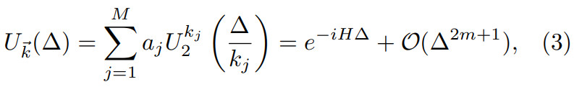

Problem
To simulate the dynamics of a physical system, we need exponentiated operators.
Want: A circuit for $e^{iHt}$
Given: $H=H_{1}+H_{2}$, circuits for $e^{iH_{1}t}$ and $e^{iH_{2}t}$, $\left[H_{1},H_{2}\right]≠0$
Because $\left[H_{1},H_{2}\right]≠0$, $e^{iH_{1}t}e^{iH_{2}t}=e^{iHt}+𝓞(t^{2})$
${(e^{\frac{iH_{1}t}{M}}e^{\frac{iH_{2}t}{M}})}^{M}=e^{iHt}+𝒪(\frac{t^{2}}{M})$
Another way proposed in arXiv:1907.11679 [quant-ph]:
We need a way to do operator additions

Slide 3
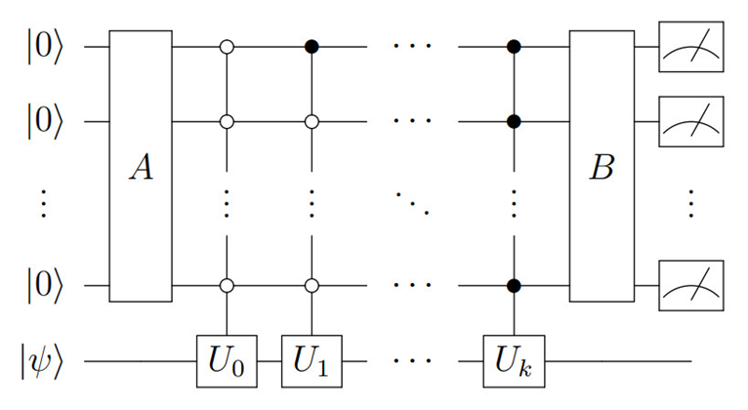




Our work
Referring to arXiv:1202.5822 [quant-ph], we implemented a circuit to construct $U=\sum{a_{j}U_{j}}$, given $a_{j}$ and $U_{j}$
$$a_{j}$$
Map $a_{j}$ to amplitudes of ancilla states
Discard the result if the measurement outcome is not 0 (postselection)
If the measurement outcome is 0,
The circuit $=\left.|00…0\right\rangle U\left.|ψ\right\rangle$

Slide 4
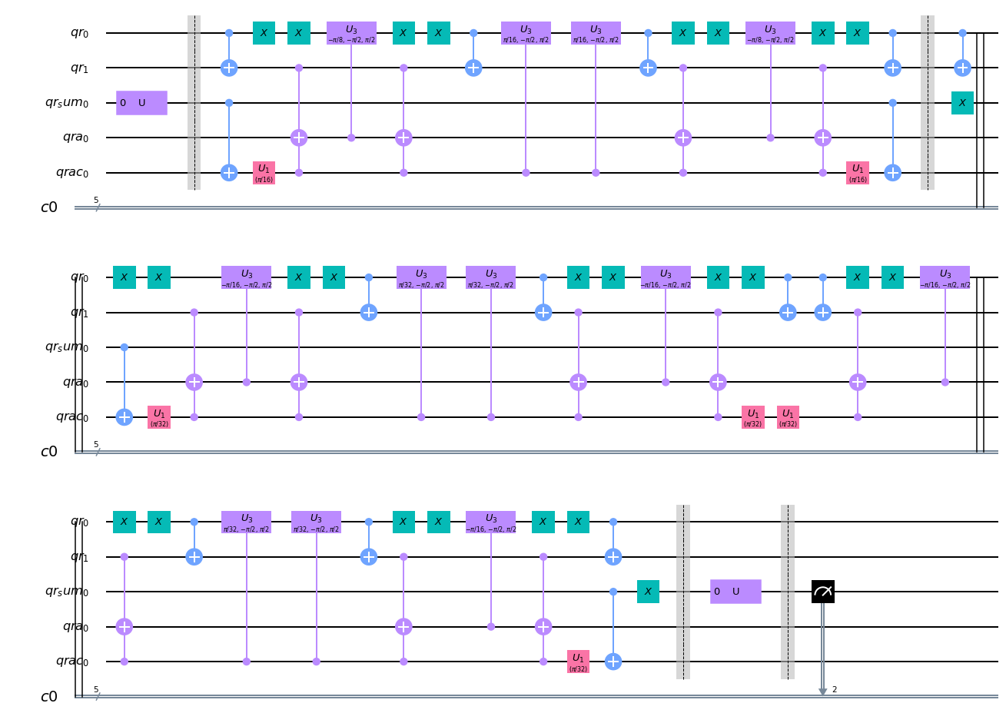

Our work
Circuit implementation of $e^{iHt}$ on qr[0], qr[1]
$H=\left(\begin{matrix}π/8 & 0 & 0 & 0 \\ 0 & π/8 & 0 & 0 \\ 0 & 0 & π/8 & 0 \\ 0 & 0 & 0 & π/8\end{matrix}\right)+\left(\begin{matrix}0 & π/8 & 0 & 0 \\ π/8 & 0 & 0 & 0 \\ 0 & 0 & 0 & π/8 \\ 0 & 0 & π/8 & 0\end{matrix}\right)+\left(\begin{matrix}0 & 0 & 0 & 0 \\ 0 & 0 & π/8 & 0 \\ 0 & π/8 & 0 & 0 \\ 0 & 0 & 0 & 0\end{matrix}\right)$

Slide 5
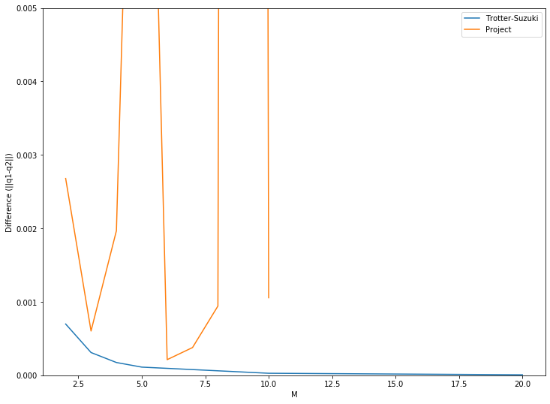
Next step
Debug
Error
Our project
(the supposedly smart way)
Trotter-Suzuki
(the simple way)
Complexity

Slide 6
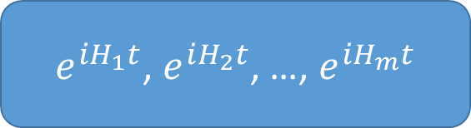

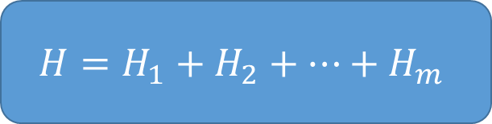

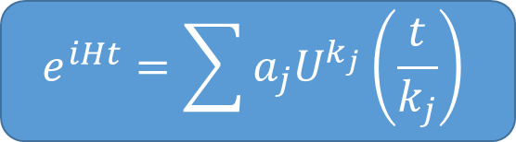
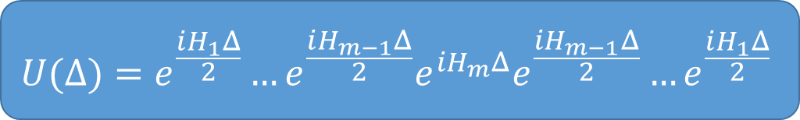
Next next step
Combine with algorithms to decompose Hamiltonians (#20)
Efficient general algorithm for Hamiltonian simulation.
$$H$$
(#20)
(#20)
$$H=H_{1}+H_{2}+…+H_{m}$$
$e^{iH_{1}t}$, $e^{iH_{2}t}$, …, $e^{iH_{m}t}$
$$U(Δ)=e^{\frac{iH_{1}Δ}{2}}…e^{\frac{iH_{m−1}Δ}{2}}e^{iH_{m}Δ}e^{\frac{iH_{m−1}Δ}{2}}…e^{\frac{iH_{1}Δ}{2}}$$
$$e^{iHt}=\sum{a_{j}U^{k_{j}}\left(\frac{t}{k_{j}}\right)}$$
(#32)
(#32)
$$e^{iHt}$$

Slide 7


Problem
To simulate the dynamics of a system, we need exponentiated operators.
Want: Find a circuit for $e^{iAt}$, where $A∈ℂ^{N×N}$ and $t∈ℝ$
Given: $A=H_{1}+H_{2}$, circuits for $e^{iH_{i}t},i=1, 2$, $\left[H_{1},H_{2}\right]≠0$
$$e^{iH_{1}t}e^{iH_{2}t}=e^{iAt}+𝒪(t^{2})$$

Slide 8
Problem
To simulate the dynamics of a system, we need exponentiated operators.
Want: Find a circuit for $e^{iAt}$, where $A∈ℂ^{N×N}$ and $t∈ℝ$
Given: $A=H_{1}+H_{2}$, circuits for $e^{iH_{i}t},i=1, 2$, $\left[H_{1},H_{2}\right]≠0$
$$e^{iH_{1}t}e^{iH_{2}t}=e^{iAt}+𝒪(t^{2})$$
↑ Easy to do in a quantum circuit

Slide 9

Problem
To simulate the dynamics of a system, we need exponentiated operators.
Want: Find a circuit for $e^{iAt}$, where $A∈ℂ^{N×N}$ and $t∈ℝ$
Given: $A=H_{1}+H_{2}$, circuits for $e^{iH_{i}t},i=1, 2$, $\left[H_{1},H_{2}\right]≠0$
$${(e^{\frac{iH_{1}t}{M}}e^{\frac{iH_{2}t}{M}})}^{M}=e^{iAt}+𝒪(\frac{t^{2}}{M})$$

Slide 10
Problem
To simulate the dynamics of a system, we need exponentiated operators.
Want: Find a circuit for $e^{iAt}$, where $A∈ℂ^{N×N}$ and $t∈ℝ$
Given: $A=H_{1}+H_{2}$, circuits for $e^{iH_{i}t},i=1, 2$, $\left[H_{1},H_{2}\right]≠0$
$${(e^{\frac{iH_{1}t}{M}}e^{\frac{iH_{2}t}{M}})}^{M}=e^{iAt}+𝒪(\frac{t^{2}}{M})$$
Lie-Trotter

Slide 11

Problem
To simulate the dynamics of a system, we need exponentiated operators.
Want: Find a circuit for $e^{iAt}$, where $A∈ℂ^{N×N}$ and $t∈ℝ$
Given: $A=H_{1}+H_{2}$, circuits for $e^{iH_{i}t},i=1, 2$, $\left[H_{1},H_{2}\right]≠0$
$${(e^{\frac{iH_{1}t}{2M}}e^{\frac{iH_{2}t}{M}}e^{\frac{iH_{1}t}{2M}})}^{M}=e^{iAt}+𝒪(\frac{t^{3}}{M^{2}})$$

Slide 12


Problem
To simulate the dynamics of a system, we need exponentiated operators.
Want: Find a circuit for $e^{iAt}$, where $A∈ℂ^{N×N}$ and $t∈ℝ$
Given: $A=H_{1}+H_{2}$, circuits for $e^{iH_{i}t},i=1, 2$, $\left[H_{1},H_{2}\right]≠0$
$${(e^{\frac{iH_{1}t}{2M_{1}}}e^{\frac{iH_{2}t}{M_{1}}}e^{\frac{iH_{1}t}{2M_{1}}})}^{M_{1}}=e^{iAt}+\frac{t^{3}}{{M_{1}}^{2}}+𝒪(\frac{t^{4}}{{M_{1}}^{3}})$$
$${(e^{\frac{iH_{1}t}{2M_{2}}}e^{\frac{iH_{2}t}{M_{2}}}e^{\frac{iH_{1}t}{2M_{2}}})}^{M_{2}}=e^{iAt}+\frac{t^{3}}{{M_{2}}^{2}}+𝒪(\frac{t^{4}}{{M_{2}}^{3}})$$

Slide 13

Problem
To simulate the dynamics of a system, we need exponentiated operators.
Want: Find a circuit for $e^{iAt}$, where $A∈ℂ^{N×N}$ and $t∈ℝ$
Given: $A=H_{1}+H_{2}$, circuits for $e^{iH_{i}t},i=1, 2$, $\left[H_{1},H_{2}\right]≠0$
$${(e^{\frac{iH_{1}t}{2M_{1}}}e^{\frac{iH_{2}t}{M_{1}}}e^{\frac{iH_{1}t}{2M_{1}}})}^{M_{1}}=e^{iAt}+\frac{t^{3}}{{M_{1}}^{2}}+𝒪(\frac{t^{4}}{{M_{1}}^{3}})$$
$${(e^{\frac{iH_{1}t}{2M_{2}}}e^{\frac{iH_{2}t}{M_{2}}}e^{\frac{iH_{1}t}{2M_{2}}})}^{M_{2}}=e^{iAt}+\frac{t^{3}}{{M_{2}}^{2}}+𝒪(\frac{t^{4}}{{M_{2}}^{3}})$$
$$\frac{{M_{2}}^{2}}{{M_{1}}^{2}}×$$

Slide 14
Problem
To simulate the dynamics of a system, we need exponentiated operators.
Want: Find a circuit for $e^{iAt}$, where $A∈ℂ^{N×N}$ and $t∈ℝ$
Given: $A=H_{1}+H_{2}$, circuits for $e^{iH_{i}t},i=1, 2$, $\left[H_{1},H_{2}\right]≠0$
$${(e^{\frac{iH_{1}t}{2M_{1}}}e^{\frac{iH_{2}t}{M_{1}}}e^{\frac{iH_{1}t}{2M_{1}}})}^{M_{1}}=e^{iAt}+\frac{t^{3}}{{M_{1}}^{2}}+𝒪(\frac{t^{4}}{{M_{1}}^{3}})$$
－
$${(e^{\frac{iH_{1}t}{2M_{2}}}e^{\frac{iH_{2}t}{M_{2}}}e^{\frac{iH_{1}t}{2M_{2}}})}^{M_{2}}=e^{iAt}+\frac{t^{3}}{{M_{2}}^{2}}+𝒪(\frac{t^{4}}{{M_{2}}^{3}})$$
$$\frac{{M_{2}}^{2}}{{M_{1}}^{2}}×$$

Slide 15
Problem
To simulate the dynamics of a system, we need exponentiated operators.
Want: Find a circuit for $e^{iAt}$, where $A∈ℂ^{N×N}$ and $t∈ℝ$
Given: $A=H_{1}+H_{2}$, circuits for $e^{iH_{i}t},i=1, 2$, $\left[H_{1},H_{2}\right]≠0$
$${(e^{\frac{iH_{1}t}{2M_{1}}}e^{\frac{iH_{2}t}{M_{1}}}e^{\frac{iH_{1}t}{2M_{1}}})}^{M_{1}}=e^{iAt}+\frac{t^{3}}{{M_{1}}^{2}}+𝒪(\frac{t^{4}}{{M_{1}}^{3}})$$
－
$${(e^{\frac{iH_{1}t}{2M_{2}}}e^{\frac{iH_{2}t}{M_{2}}}e^{\frac{iH_{1}t}{2M_{2}}})}^{M_{2}}=e^{iAt}+\frac{t^{3}}{{M_{2}}^{2}}+𝒪(\frac{t^{4}}{{M_{2}}^{3}})$$
$$\frac{{M_{2}}^{2}}{{M_{1}}^{2}}×$$

