Slide 1

Confirming Process, Missing Function.
The uninstrumented oversight layer in AI transparency and control research.
Brian Moriarty
Stevens Institute of Technology
AITC 2026 · Nuremberg · June 5 and 6
Notes:
Name, what I do (~20s)
Speak: Let's set context. Industry setting. A review occurred vs. what was substantive. From the outside, each appear identical. [SLOW]

Slide 2





01
/
THE PROBLEM
Two states, one record.
The contrast that matters is obscured in the audit trail.
SAMPLE
SAMPLE
LANE A
AX-4471 · reviewer #214
LANE B
AX-4471 · reviewer #338
ENGAGED · EXAMINED OUTPUT
NOT ENGAGED · CLICKED THROUGH
REVIEWED
14 : 32 : 07
REVIEWED
14 : 32 : 07
DECISION
14 : 50 : 14 (+18 min)
DECISION
14 : 32 : 13 (+6 sec)
DOCUMENTATION
4 of 4 fields
DOCUMENTATION
4 of 4 fields
COMPLIANT
COMPLIANT
One review took eighteen minutes of substantive evaluation. One took six seconds of procedural confirmation. The audit record does not distinguish them.
Notes:
Two records, the reveal, the structural point (~75s)
Speak: Here are two records from the same kind of work, abstractions from my finance experience. Both pass audit, both look clean. But one reviewer engaged for eighteen minutes. The other signed off in six seconds. [PAUSE on the reveal] And the infrastructure can't tell which is which. Part of this is human nature, older than AI. The structural point: we instrument the model and its outputs, not the cognitive work that gives oversight its value. So the two failures compound.
Analogy: a commit message that was just the letter "D". Required, entered, logged compliant, nothing real survived.
If asked (time): time is the crudest proxy and it's gameable. You can leave a doc open eighteen minutes and do nothing. I measure whether reviewers catch problems I've planted instead. Offline after.

Slide 3
01
/
THE PROBLEM
Three claims hold up the paper.
1.
The oversight function is a system component , not a binary switch.
2.
It degrades predictably under operational conditions. The degraded state and the functional state leave identical governance traces.
3.
Current detection, interpretability, and governance methods do not close the gap, because they instrument the wrong layer .
Notes:
Three claims: not a switch, identical record, wrong layer (~75s)
Speak: Three claims hold up the paper. First, oversight isn't a switch you flip on. It's a component in a system, and it can quietly stop working while everything still looks connected. Second, when it degrades, the degraded reviewer and the engaged one leave the exact same record. [SLOW] Nothing tells them apart. Third, our big tools, detection, interpretability, governance, all watch the model. None watch the person doing the checking. We instrumented the wrong layer.
Analogy: two students hand in the same filled-out worksheet; the page can't show who copied. Or: every camera on the vault, none on the guard.
If asked (Bainbridge): the human side is old news and I build on it; what's new is that all our tooling watches the model. Trade refs after.

Slide 4
02
/
THE PATTERN
Behavior degrades. The record stays uniform.
GOVERNANCE RECORD
GOVERNANCE RECORD
GOVERNANCE RECORD
status
COMPLIANT
status
COMPLIANT
status
COMPLIANT
approvals
47
approvals
47
approvals
47
PHASE 1
PHASE 2
PHASE 3
Substantive Engagement
Procedural Scanning
Formality
Catches errors. Modifies. Escalates.
Pattern-matches. Approves most.
Approves all. No correction events.
Takes time and attention.
Threshold rose. Quality didn't.
Controller, now confirmer.
Same status. Same approval count. Same record.
The audit log does not capture the signal the behavioral channel is losing.
Notes:
Three phases, the record stays uniform (~85s)
Speak: It degrades in three phases. At first the reviewer does real work, reading closely, catching errors, sending things back. Then the corrections fall off and it looks like the AI got better. It didn't. The reviewer's bar dropped. [POINT at the bar, HOLD] By the end they're just confirming. The approval is a reflex. And the part that matters: the record is identical across all three phases. No alarm, no incident.
Analogy: three chest X-rays all stamped healthy when only the first one is. The label never changed; the patient did.
If asked (evidence): the automation literature and Green's review of forty-one policies back the pattern, and my cohort is testing it now. Share after.

Slide 5
02
/
THE PATTERN
Model-centric vs. oversight-centric transparency.
TODAY
PROPOSED
Model-centric
Oversight-centric
OBJECT INSTRUMENTED
Model reasoning, outputs, behavior
Functional state of the oversight mechanism
EVIDENCE PRODUCED
Interpretability maps, audit logs, governance artifacts
Engagement metrics, correction trajectories, calibration indicators
FAILURE MODE ADDRESSED
Hallucination, bias, distribution shift
Authority drift, procedural confirmation, oversight formality
HUMAN ROLE ASSUMED
Stable recipient of explanations
Degradable component requiring care and feeding
Detection, interpretability, and governance each compound the gap rather than closing it.
Notes:
Every fix points at the model; the shift (~55s)
Speak: Look at what we reach for when something goes wrong. Tools that flag when the AI is off. Tools that crack the model open to see how it reasoned. Policies that require a sign-off. Every one points at the model. None watch the person checking it, so each one widens the same gap. This isn't someone breaking the rules. It's boredom. The light's green because green is what's happening. The shift: stop measuring the model, start measuring whether the review still happens.
Analogy: we keep polishing the gauges; the question is whether anyone's reading them.
If asked (won't better tooling catch it): those tools watch the model; the gap is the person, so they miss it by design. Cases after.

Slide 6
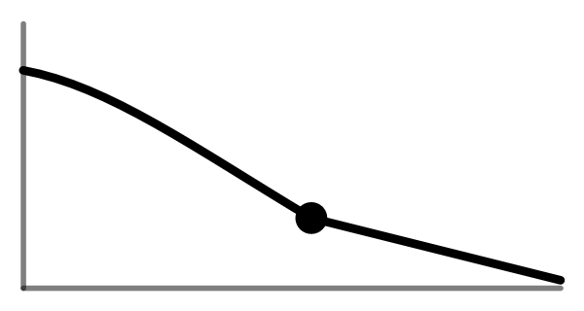
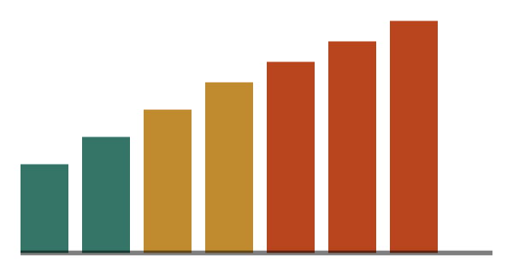
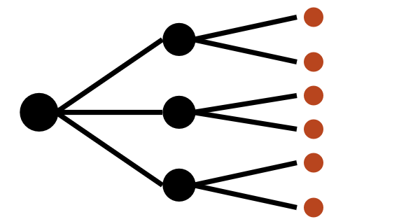
03
/
TOWARD INSTRUMENTATION
Three candidate proxies for engagement state.
Correction trajectory
Validation load
Dependency accumulation
Reviewer engagement against output volume over deployment duration.
Outputs requiring review per unit of reviewer capacity.
Downstream workflow nodes depending on each approved output.
DESIGN PRINCIPLE
Satisfying the metric and exercising genuine oversight should be difficult to decouple.
Designed as workflow-level structural signals, not individual reviewer monitoring.
Notes:
Sweep three indicators, all on the workflow (~60s)
Speak: Three things you can actually measure. How often reviewers correct the AI, and whether that's sliding over time, that's your early warning. How many items each reviewer has to clear, because overload is where attention dies. And how much downstream work rides on a single approval. All of it reported on the workflow, never on a person, and built so you can't hit the number without doing the real reviewing.
Analogy: a traffic sensor that counts cars but can't read a plate, by design.
If asked (surveillance): it only ever reports on the workflow, never a named person, and that's built into the data, not just promised. Safeguards after.

Slide 7

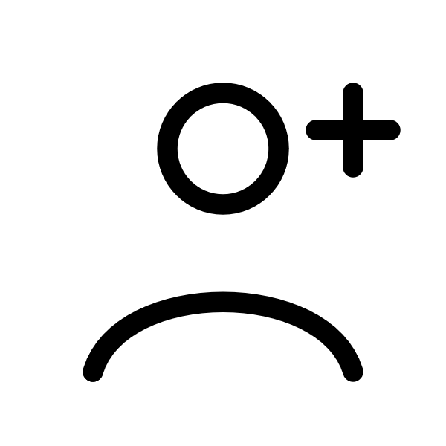
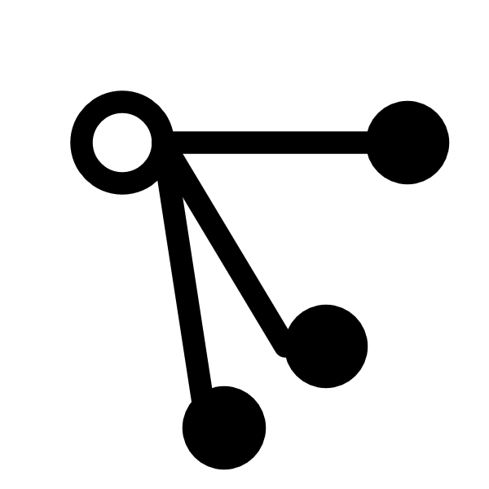
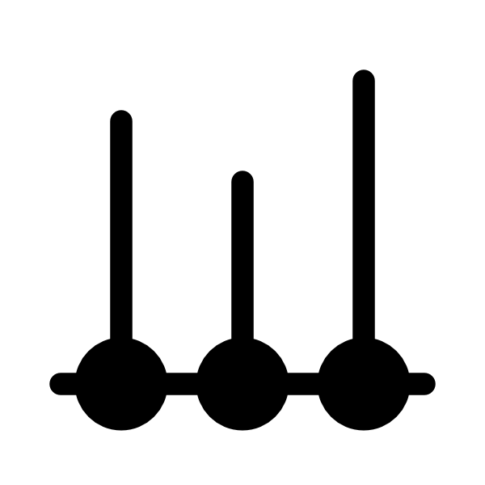
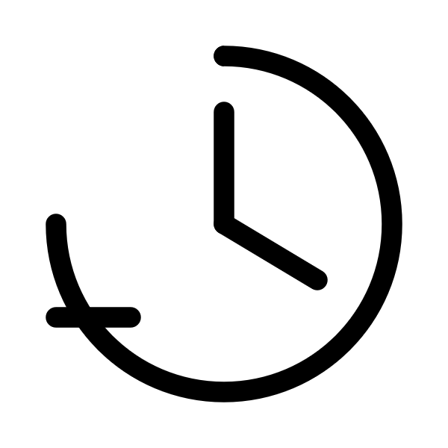
03
/
TOWARD INSTRUMENTATION
Five mechanisms practitioners can pilot today.
01
Seeded calibration checks
Pre-validated outputs injected into the queue. Disagreement rate on seeded items tracks engagement on the rest.
02
Onboarding-period baselines
Log new reviewers' correction patterns before calibration. Gaps signal that operational norms have drifted.
03
Dependency surfacing at decision time
Show the reviewer how many downstream things depend on this approval, at the moment of approval.
04
Decision-point logging for long-running workflows
Structured events at each irreversible decision in an agentic trajectory, not just the final output.
05
Workload ceilings with backpressure
Routing refuses additional outputs to a saturated reviewer. Converts an indicator into an enforcement mechanism.
All can be built with current workflow infrastructure and existing logging.
Notes:
Name five fast, dwell on two (~75s)
Speak: Five things you can build today with logging you already have. Name them fast: seeded checks, onboarding baselines, stakes shown at decision time, irreversible-action logging, workload caps. Two to dwell on. Seeded checks: plant items you've already reviewed and see who catches them, like a secret shopper who can't be spotted, so everyone gets treated right. And irreversible-action logging: for AI agents, record every irreversible step, not just the final output, because the damage is usually in the steps, an email sent or a record deleted, that the output never shows. None of these are proven yet. They're candidates to deploy, watch, and refine.
If asked (gaming): the seeded checks can't be faked, you have to actually look. The rest report system strain, not a score on anyone. Offline.

Slide 8


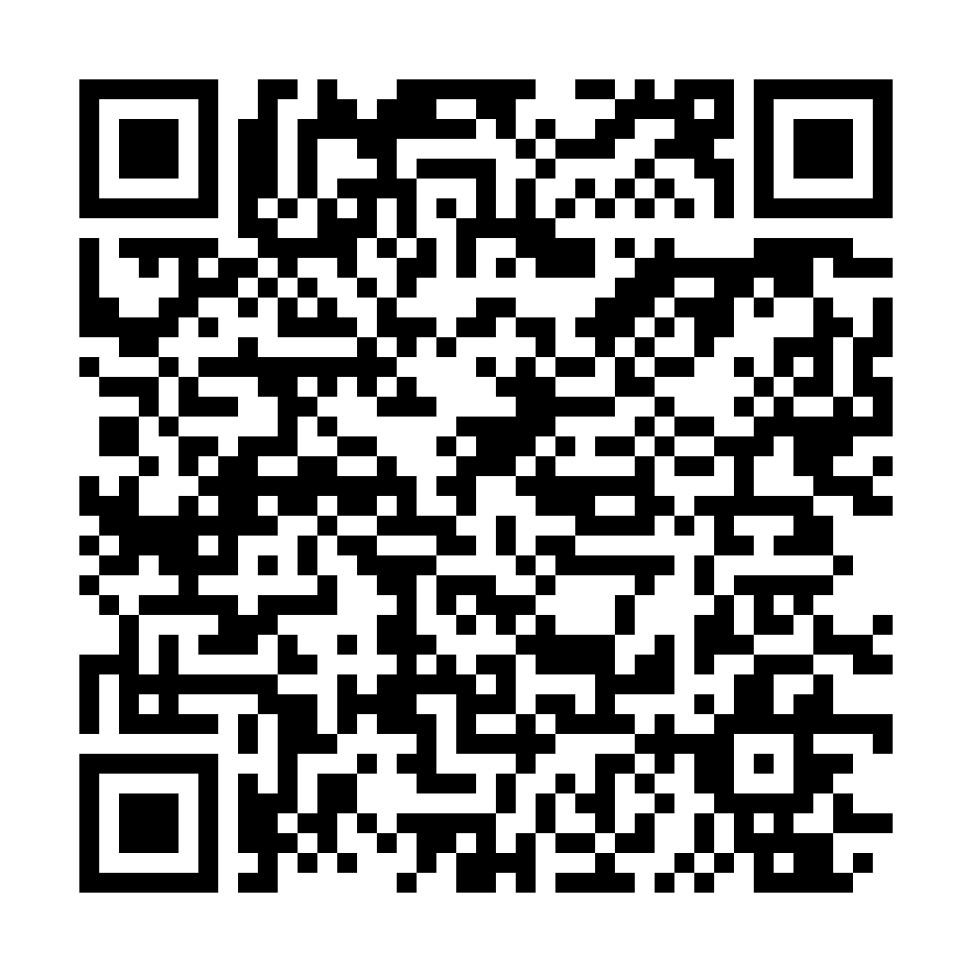

03
/
TOWARD INSTRUMENTATION
Three partnership types.
Shaped by experience teaching and working in enterprise deployments.
Deployment-context partners instrument oversight quality in operational settings, under structural-and-aggregate constraints.
Regulatory and standards partners work on making oversight requirements functionally rather than procedurally auditable.
Methodological partners bring expertise on the cognitive dynamics of evaluative judgment under fluent-text review.
Process compliance was the right thing to measure when the risk was non-compliance. It is not the right thing to measure when the risk is procedural compliance coexisting with functional absence.
SCAN TO FOLLOW UP
Full paper
Follow up
This deck
OpenReview · Github
LinkedIn · btmoriarty
PPTX
Brian Moriarty · brian.moriarty@stevens.edu · Stevens Institute of Technology
AITC 2026 · Nuremberg · June 5 and 6
Notes:
Three partners, then the close (~65s)
Speak: I'm looking for three kinds of partner: deployment, regulatory, methodological. [SLOW] And to close: process compliance was the right thing to measure when the risk was non-compliance. It is not the right thing to measure when the process is followed perfectly and the function is gone. The work is the infrastructure that tells those two states apart.
Fallback if you blank: we built the measure for cheating; the risk now is the opposite, perfect compliance with empty function.
If asked (sole-author, no data): the gap I'm naming rests on published work, and the experiment that builds on it is underway. Continue after.

