Slide 1
2heads - Tic-tac-toe v2.0
Title

Slide 2
2heads - Tic-tac-toe v2.0
Title
• Line 1 • Line 2

Slide 3
2heads
Tic-tac-toe v2.0

Slide 4
2heads - Tic-tac-toe v2.0
Objectives

Slide 5
2heads - Tic-tac-toe v2.0
Objectives
• Implement simple AI functionality • Perform some major refactoring

Slide 6
2heads - Tic-tac-toe v2.0
Let’s play

Slide 7
2heads - Tic-tac-toe v2.0
Digging in

Slide 8
2heads - Tic-tac-toe v2.0
Refactoring

Slide 9
2heads - Tic-tac-toe v2.0
Refactoring
• Line 1 • Line 2

Slide 10
2heads - Tic-tac-toe v2.0
AI

Slide 11
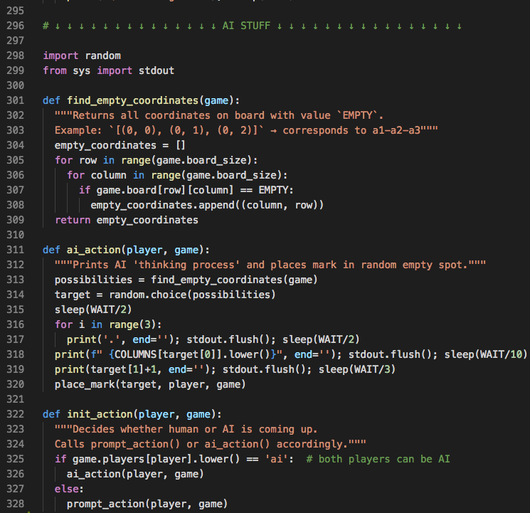

Slide 12
2heads - Tic-tac-toe v2.0
Let’s play more

Slide 13
2heads - Tic-tac-toe v2.0
Future plans

Slide 14
2heads - Tic-tac-toe v2.0
Thanks :)

