Slide 1

Music Store Database Analysis Project
Music Store Database Analysis Project
Contribution:
JANANI SRINIVASAN
MONISHA B R
PRAVEENKUMAR
VARSHA
VISWANATH VIRALAM RAMAMURTHY
Contribution:
JANANI SRINIVASAN
MONISHA B R
PRAVEENKUMAR
VARSHA
VISWANATH VIRALAM RAMAMURTHY

Slide 2
Project Overview
Objective: Analyze sales data from a music store to gain insights into sales performance, customer behavior, and product trends through descriptive statistics, data cleaning, aggregations, joins, subqueries, and advanced SQL functions.
Dataset: 11 tables including Employee, Customer, Invoice, InvoiceLine, Track, MediaType, Genre, Album, Artist, PlaylistTrack, and Playlist.
Tools Used: SQL for data querying and manipulation

Slide 3
Simple Relationships Overview:
One artist → Many albums.
One album → Many tracks.
One customer → Many invoices.
One invoice → Many tracks.
Playlists link to many tracks and vice versa.

Slide 4
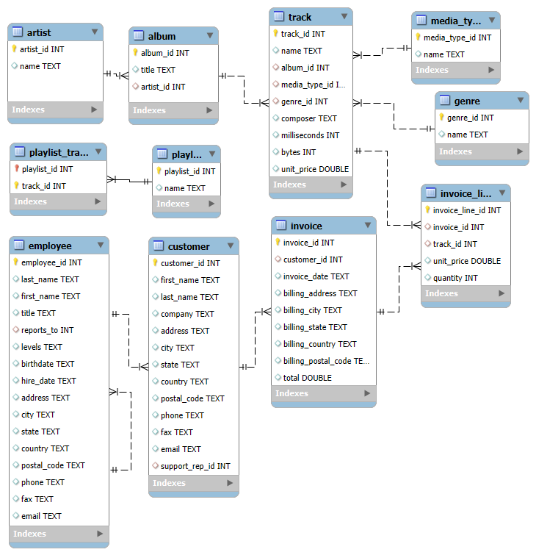
Database Schema
Visual representation of the 11 tables and their relationships.
Highlight key tables: Invoice, Track, Artist, Customer, Genre.

Slide 5
Key Business Questions:
What is the total revenue generated from all sales ?
Which country has the most customers ?
Who is the senior-most employee based on job title ?
Which countries have the most invoices ?
What are the top 3 highest invoice totals ?

Slide 6
Summary:
The MusicStore DB effectively models a digital music collection.
Key entities include albums, artists, tracks, customers, and invoice.
Schema supports operations like browsing and purchasing music.

