Slide 1
Team password123
Do you remember your password?

Slide 2
Abstract
The Subject Collection and Password Recollection Capstone seeks to help determine the rate at which people memorize passwords of varying complexity and in doing so, help to ascertain both the necessity and the practicality of having people adhere to stricter security standards in a world that is increasingly interconnected through the internet.

Slide 3
Project Overview
he purpose of this project is to explore the following questions regarding passwords:
Do people change their passwords drastically, or are their passwords similar to their previous passwords?
How well do people remember passwords of varying complexity? How likely are people to reuse complex passwords?
What is the correlation between interval of required password changes and password memorability?

Slide 4
Functional Requirement
Functional Requirement | Test Plan test cases
Login/GUI: Users will be able to login and take a survey Which will allow them to compete for Chick-fila | 1.a) User logs in with correct username and password and gains access to their account Expect result> user gains access to their profile (normal test case) 1.b) User logs in with incorrect user name/password Expected result> user is denied access to account (abnormal test case)
User logs in only at assigned intervals: User will be able to login only when they are emailed to login. | 2.a) User logs in when they are emailed to log in Expected result> user is given access and allowed to play the game to reach a new high score (normal test case) 2.b) User attempts to login when they have not been emailed to login Expected result> user is able to see their current high score, but unable to play game and reminded that they can only play when they are emailed to login and play. (abnormal test case)

Slide 5
Customer meeting and action points
Prototype
Create the login page
Add format for emails that will remind participants to login
Create survey questions to ask participants when they change their passwords
Questions
Polish the questions we are asking in our proposal
Be more specific and dive deeper into each question
Password requirements
Create login time intervals
Create password requirements for each test group
Abstract
Create a paragraph abstract about our project

Slide 6
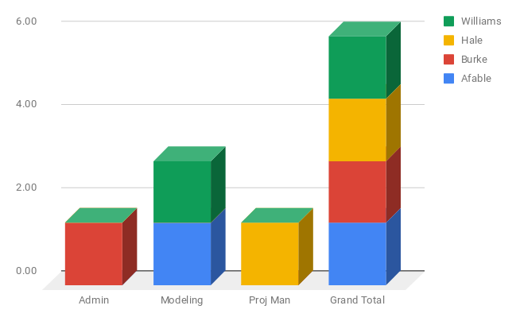
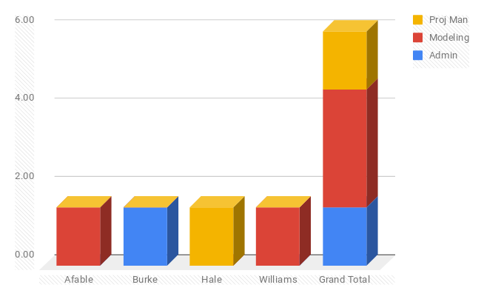
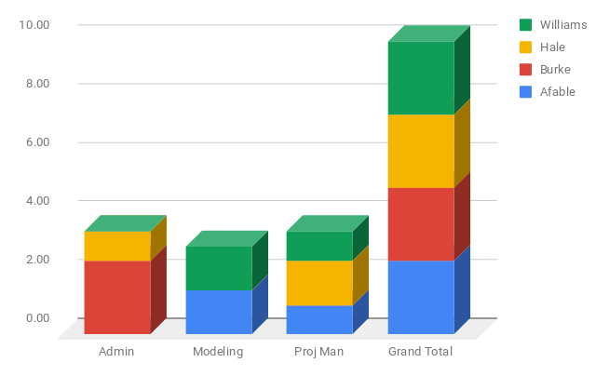
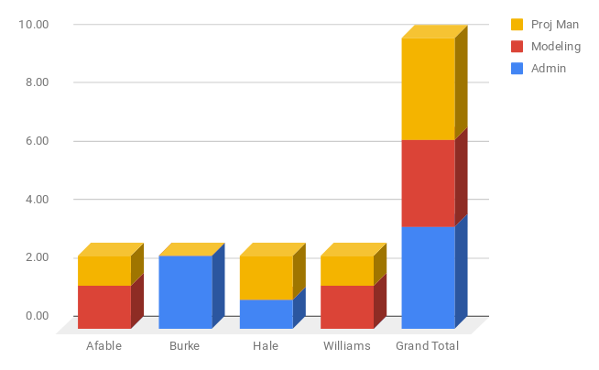
Workload matrices

Slide 7
Project Planning Gantt Chart
Task | NOVEMBER |  |  |  |  |  | DECEMBER |  |  |  | JANUARY |  |  |  | FEBURARY |  |  |  |  | MARCH |  |  |  |  | APRIL |  |  |  | MAY
 | 2 | 9 | 16 | 22 | 24 | 30 | 7 | 14 | 21 | 25 | 1 | 8 | 15 | 22 | 1 | 8 | 15 | 22 | 29 | 1 | 11 | 15 | 22 | 29 | 5 | 12 | 19 | 26 | 3 | 10 | 17 | 24
User Interface
Email Automation
Password metrics
Databasing
Social outreach
Analysis

Slide 8
Prototype
http://midn.cs.usna.edu/~m196924/capstone/login.php?

Slide 9
Assigned Software Engineering paper
M. Fowler, and J Highsmith, The Agile Manifesto, Dr. Dobb’s Digest, Aug 2001, available at http://www.ddj.com/architect/184414755.

Slide 10
Discussion

