Slide 1
Predict Profitable App Categories from Google Play Store Data
Rayhan Hossain
CS 594

Slide 2
Motivation
Help App based startups to choose profitable and trendy app categories
Explore the Google Play local app market
Analyze the profit margin for free app vs paid app
Discover the users engagement with various App categories

Slide 3
Data Column
'App',
'Category',
'Rating',
'Reviews',
'Size',
'Installs',
'Type',
'Price',
'Content Rating',
'Genres',
'Last Updated', 'Current Ver', 'Android Ver'

Slide 4
Contributions
So far, I do not have a plan to implement a new tool or new algorithm for data analysis. I’m using existing linear data analysis techniques, and plotting the data with the help of data plotting libraries like- matplotlib, seaborn etc.

Slide 5
Background and Related Work
For the implementation, I use Python 3.0 with Jupyter Notebook. To make the development faster, I take help from the Pandas, Seaborn, and matplotlib libraries.
K-means clustering algorithm is used for data clustering [I changed my mind, will talk to TA]
No directly related published work was found similar to this work

Slide 6
Methodology
Predict the result using plotting

Slide 7
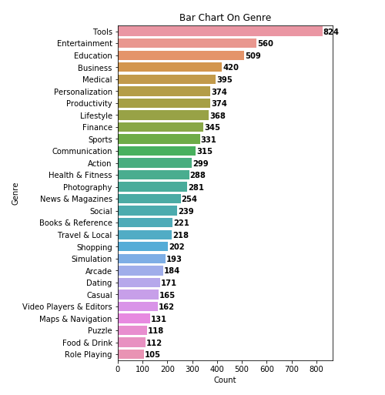
Results

Slide 8
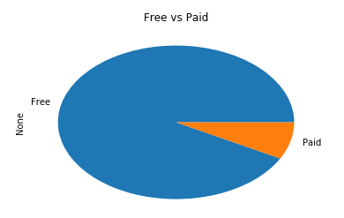
Results

Slide 9
Lessons Learned and Future Work
Here I process the Google Play Store data, analyze data using the linear relationships of attributes, and suggest the possibly profitable app category
As the future work, I would like to build a web or mobile tool to suggest the profitable local app market
I got the partial result, and still working to finish and fine tune my results

