Slide 1

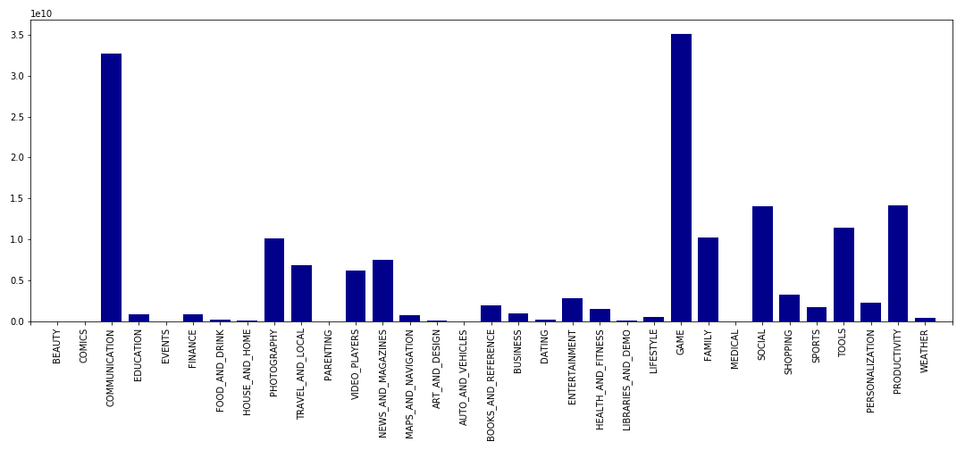
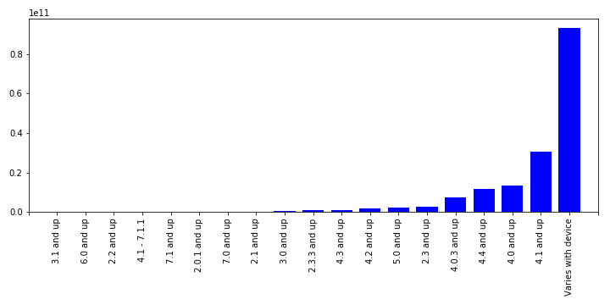
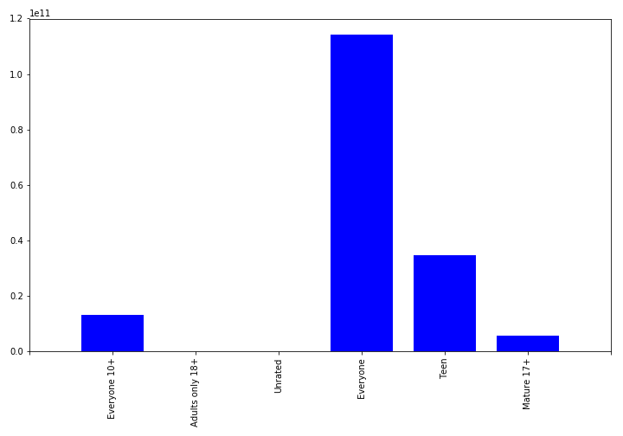
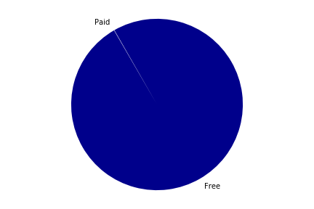
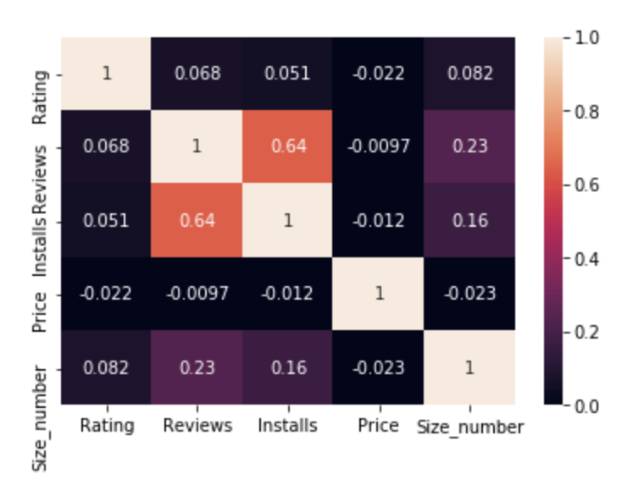
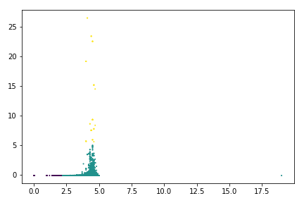
Predict Profitable App Categories from Google Play Store Data
Rayhan Hossain , CS MS Student
Course Instructor: Dr. Michela Taufer
Motivation
Google Play Data Set
For Android App development based startups, it is essential to explore the App market and identify the profitable app categories. To help these startups at the very beginning, we tried to answer the following questions-
- Which App categories have the maximum app downloads?
- Which one might be profitable for business, free apps or paid apps?
- Which age group of users should be the target of the business?
- How many different Android versions should be supported?
Data is collected from Kaggle.com https://www.kaggle.com/lava18/google-play-store-apps
10,841 13-dimensional data points
5 Numerical and 8 Categorical data columns
DATA
COLUMNS
App
Category
Rating
Reviews
Size
Installs
Type
Price
Content Rating
Genres
Last Updated
Current Version
Android Version
Data Analysis Workflow
Tools and Algorithms
Preprocessing
Map-Reduce
Data Analysis and Visualization
Python with Jupyter Notebook
PySpark, a Python API for Spark
Pandas
Matplotlib for Plotting
Seaborn, a Python Data Visualization Library
Map Reduce
Counting and Plotting
K-means Algorithm
Correlation of data and Heatmap
Data are fed into Spark’s RDD in order to make our project scalable
Replaces the missing values with NP Nan
Filters out the irrelevant columns
Handles unexpected data format
Preprocessed Data
Map-Reduced is applied on the preprocessed data
Mapped data are reduced by different key values for different analysis, like- Category, Type, Content Rating, and Android Version
Raw Data
Number of total App downloads are counted against several categorical columns, and plotted with bar and pie diagrams
Correlation among the Numerical columns are calculated
K-Means algorithm applied to cluster and see the relationships of numerical data columns- Reviews, Rating, Installs, Price, and App size
Clean data with no unexpected or unformatted values in RDD format
Raw Data
Result and Findings
Relationships among data Columns
Result Analysis
Here, we consider the total number of installs as the prime factor to be a profitable application. The number of total installs is strongly related with the categorical data columns rather than numeric columns. After counting and plotting, we can predict the followings.
From Fig-1, Game, Communication, Social, Photography, and Tools are the most popular App categories
From Fig-2, Supporting the devices with Android version 4.0 and up might maximize the possibility of downloads
From Fig-3, Targeting users from all ages or Teenage is the best option
From Fig-4, Possibility of gaining massive success with paid App is very low
From Fig-5 and Fig-6, Numerical data columns are not strongly correlated. The K-Means algorithm is applied after doing the data standardization
Total Installs -->
Total Installs -->
Android Versions -->
App Categories -->
Fig-2: Android Version vs Total Installs
Fig-1:App Category vs Total Installs
Four numerical columns are considered for clustering- Rating, Reviews, App Size, and Total Installs.
Free: 167560477406 Paid: 72956081 Paid Percentage: 0.0435 %
Total Installs -->
Fig-4: Free vs Paid Installs
Future Work
Content Rating -->
Fig-5: Correlation Heatmap
Fig-6: K-Means with K = 3
- Analyze the local App Market
- Build a tool to provide localized App market suggestions
Fig-3: Content Rating vs Total Installs

