Slide 1

Workplace Injury Analysis (OSHA 2021)
Presented by: Mohammad Shahriar Hossain
Date: December 16, 2024

Slide 2

Table of Contents
Purpose of This Analysis
Key Findings and Insights
Interactive Dashboard
Conclusion
Appendix

Slide 3

Purpose of This Analysis
"Analyzing workplace injury trends and patterns to uncover key insights that can guide the development of effective safety initiatives, enhance workplace conditions, and reduce the risk of severe incidents across industries."
uncover key
insights
safety initiatives
reduce the risk

Slide 4
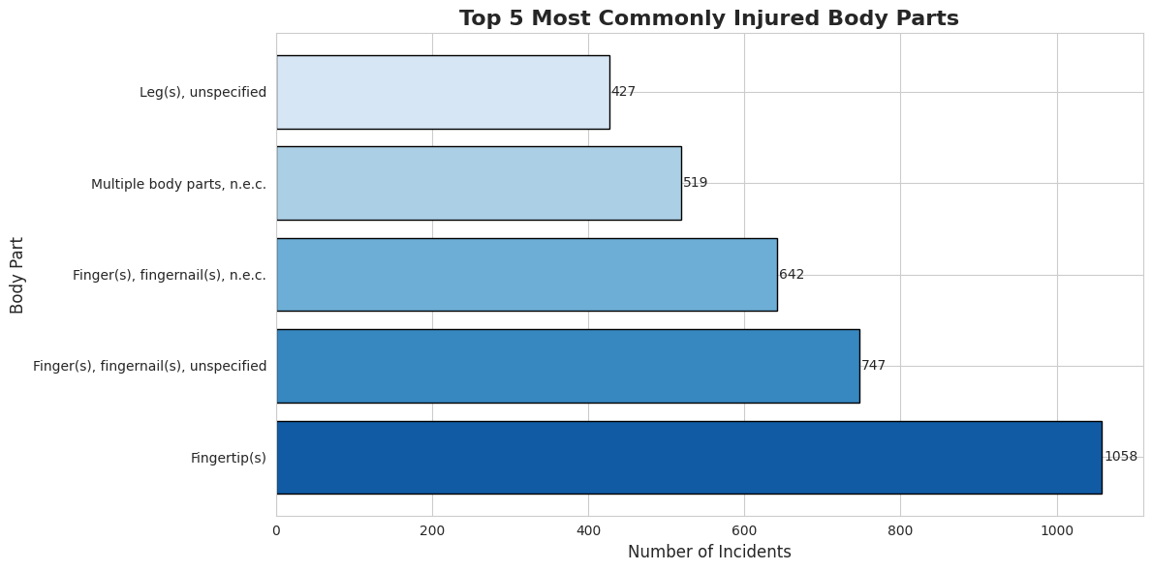

Slide 5
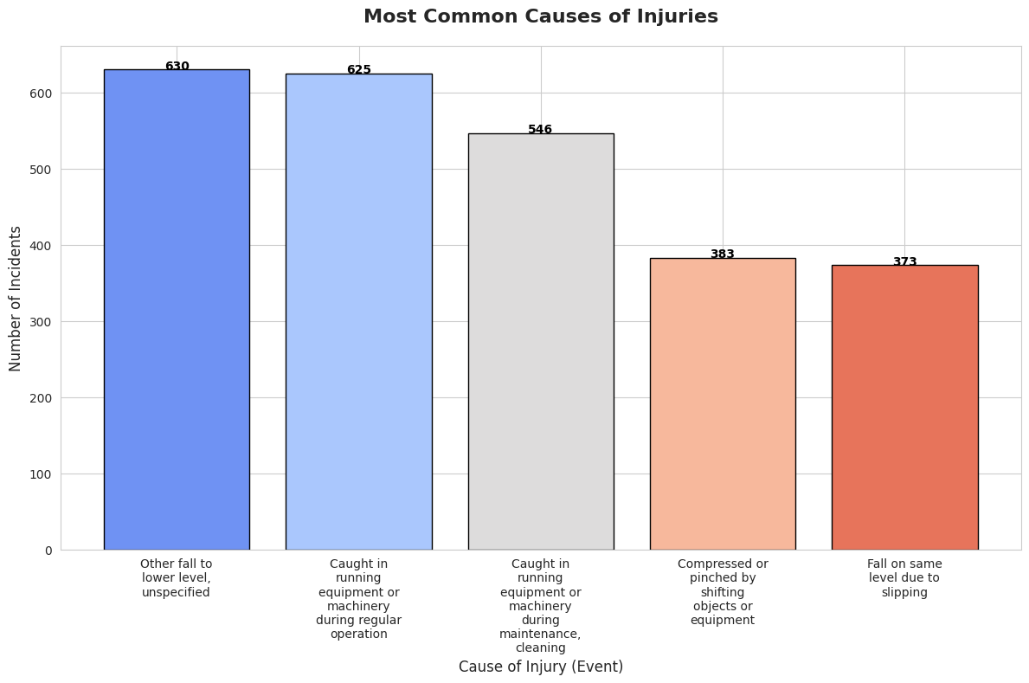

Slide 6
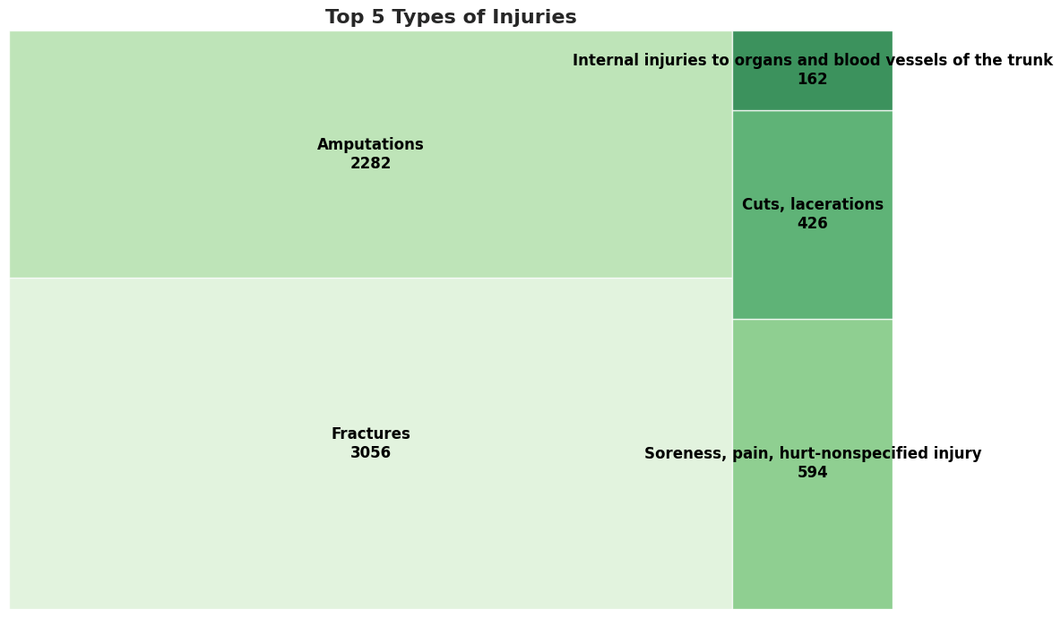

Slide 7
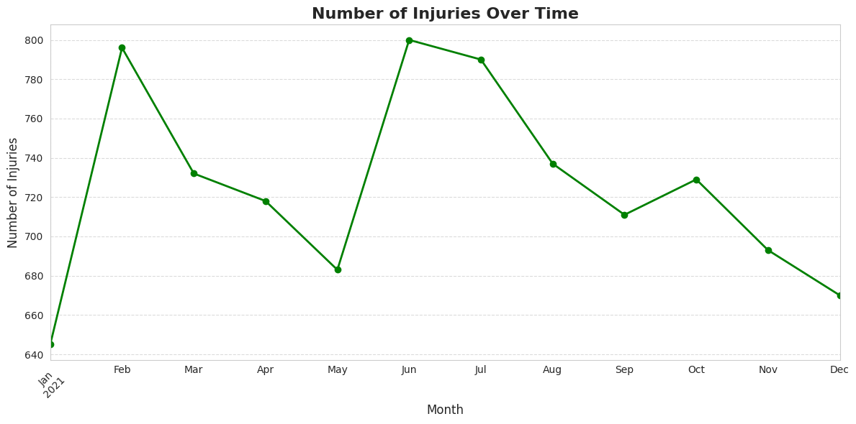

Slide 8
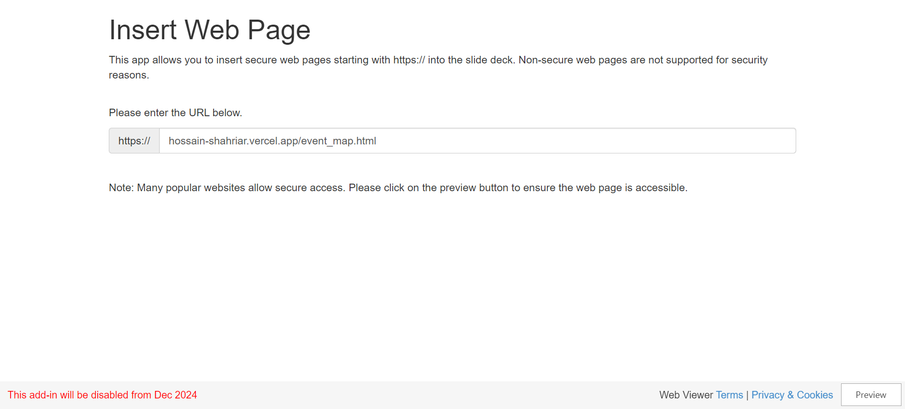
Incidents plotted on the map

Slide 9
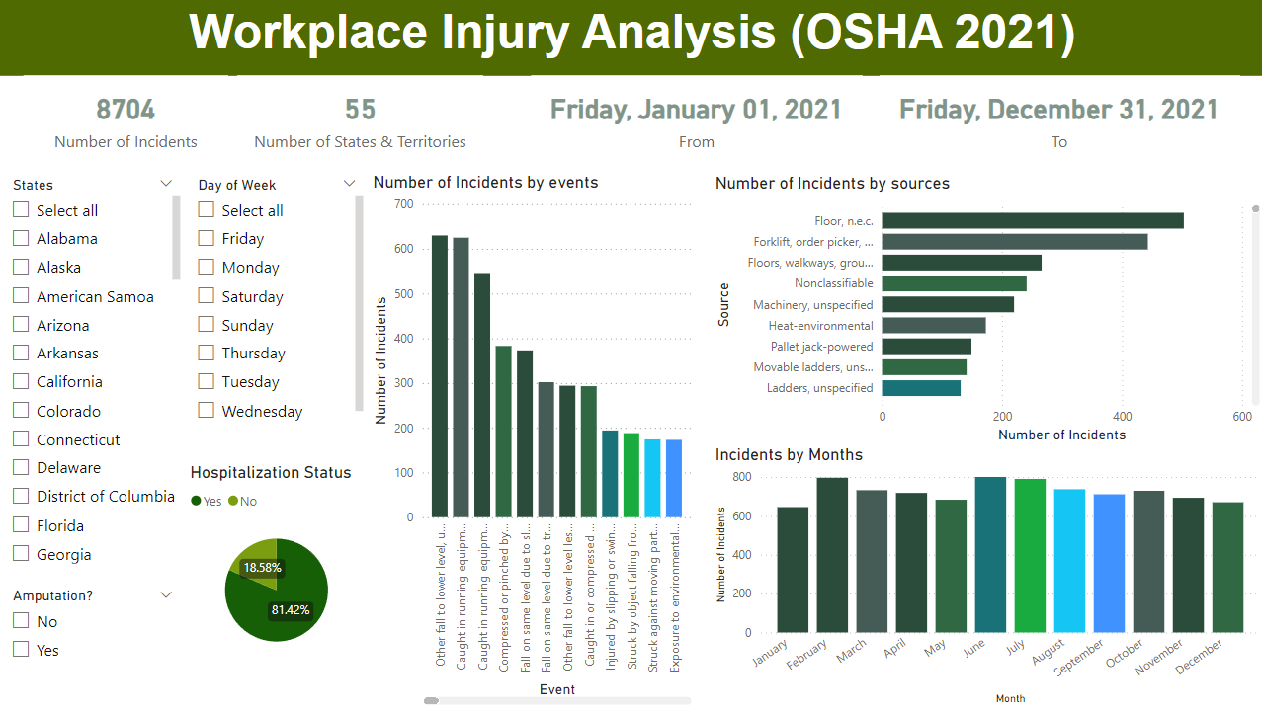
Interactive Dashboard
Power BI Dashboard Link
Tableau Dashboard Link

Slide 10

Conclusion
"By analyzing the data and uncovering trends and patterns, we can identify key areas of concern, enabling us to take targeted actions to mitigate risks and enhance workplace safety."
identify key areas of concern
mitigate risks
enhance workplace safety

Slide 11
Thank you!

Slide 12
Appendix
https://github.com/hossain-shahriar/OSHA-2021-Data-Analytics/blob/main/Nutrien.ipynb

