Slide 1

“An Overview of Research Papers Regarding Road Scene Analysis”
Supervisor : MD. Tamim Hossain
Presented By : Afroja Akter Dalia

Slide 2

Studied Papers & Identified Categories
Helmet & Compliance Detection
Scene Understanding & Behavior Analysis
Temporal Traffic Modeling
2

Slide 3
Identified Patterns
✔ Object detection (vehicles, pedestrians, obstacles)
✔ Helmet detection & compliance
✔ Behavior detection (crossing, overtaking, lane change, sudden movements)
✔ Scene classification (road type, environment)
✔ Video-sequence based analysis
2

Slide 4
Category 1: Helmet & Compliance Detection
Key Insights and Findings:
YOLO-based object detection
Helmet / No-helmet classification
Mirror absence detection
License Plate OCR
Traffic violation analytics
2
3

Slide 5
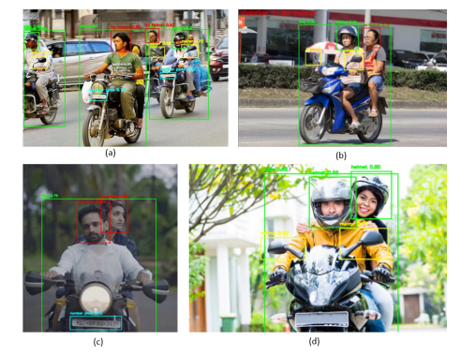
Example (Category 1) :
Example Outputs:
Bounding boxes detecting helmet vs no-helmet
LPR + OCR for identifying violators
Real-time helmet detection using YOLOv5/Yolov8
***System output examples: (a) Multiple violators. (b) Rider/pillion noncompliance. (c) LP detection & OCR. (d) No violations.

Slide 6
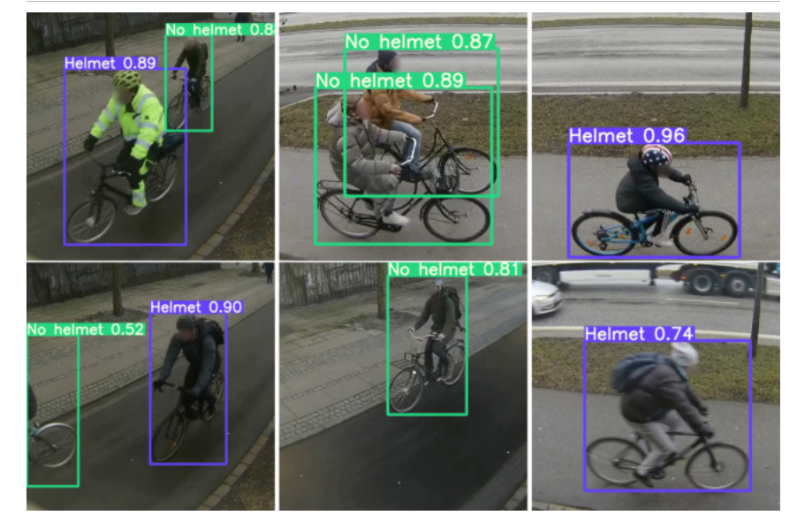
More Example Outputs :
***System output examples: Whether a person is wearing helmet or not.

Slide 7
Conclusion & Implementation:
Helmet detection is well-studied and accurate with YOLO models.
It forms the foundation for any object-detection module.
to prepare datasets.
to train YOLO models.
to detect relevant objects n FPV frames
2
3

Slide 8
Category 2: Scene Understanding & Behavior Analysis
Key Insights and Findings:
Vehicle & pedestrian detection
Road-type classification
Multi-object tracking
Behavior extraction (crossing, ovetaking, risky actions)
2
3

Slide 9
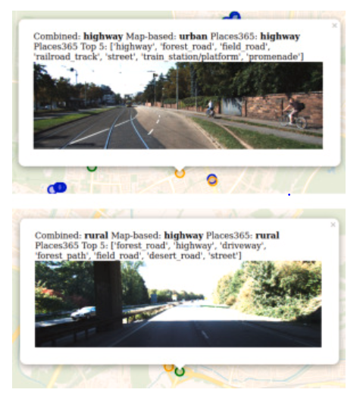
Example (Category 2) :
Example Outputs:
Pedestrian crossing detection
Vehicle overtaking analysis
Predicting risky behavior (sudden crossing, wrong-side driving)
Scene classification: junction, straight road, urban, rural
***Examples of correctly classified images: (a) urban predicted as urban (b) rural predicted as rural.

Slide 10
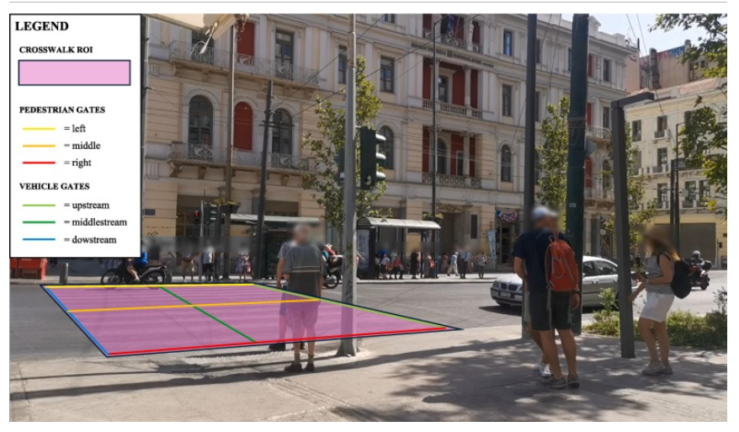
More Example Outputs :
***Examples of correctly classified images: Pedestrian crosswalk.

Slide 11
Conclusion & Implementation:
Scene & behavior analysis is essential for FPV systems.
It gives meaning to objects by analyzing how they move.
Action classification
Behavior detection
Risk assessment
2
3

Slide 12
Category 3: Temporal Traffic Modeling
Key Insights and Findings:
Object movement
Speed changes
Direction changes
Interaction between objects
Event development
2
3

Slide 13
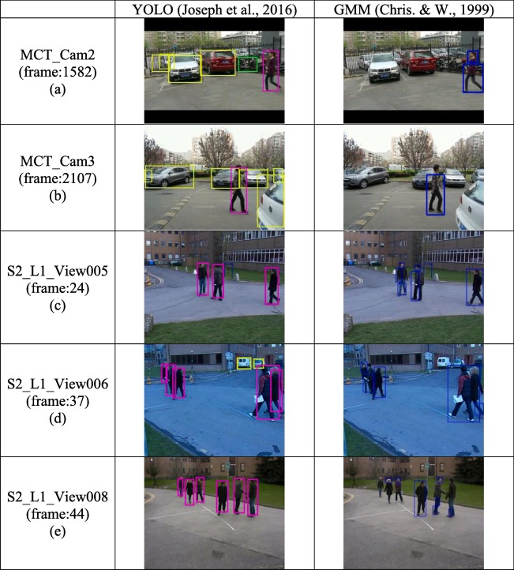
Example (Category 3) :
Example Outputs:
Object trajectory mapping
Predicting near-miss events
Behavior timeline generation
Motion curve analysis
***A structural description of pedestrian movement behavior in multiple surveillance videos
.

Slide 14
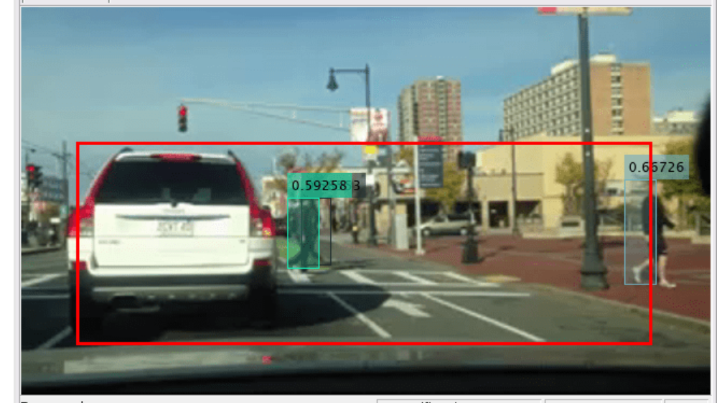
More Example Outputs:
***A structural description of pedestrian movement behavior in multiple surveillance videos
.

Slide 15
Conclusion & Implementation:
Temporal modeling helps detect events such as sudden jumps, near misses, or risky movements.
Continuous FPV video processing
Event detection
Multi-frame risk scoring
2
3

Slide 16
THANK
YOU
PREMIERE UNIVERSITY

