Slide 1

Road Scene Analysis:
Safety & Segmentation
Architectures
Supervisor : Md. Tamim Hossain
Presented By : Abhi Kumar Nath Shuva

Slide 2




Studied Papers & Identified Categories
Cluster 1: Compliance & Safety
Cluster 2: Scene Segmentation
Cluster 3: Data & Model Architecture
Focuses on advanced driver-assistance systems (ADAS) and sophisticated violation detection mechanisms, crucial for proactive biker safety.
Explores cutting-edge foundation models such as Mask R-CNN and PSPNet, essential for detailed environmental understanding.
Examines the underlying deep learning frameworks and novel techniques for blur estimation, vital for robust perception in challenging conditions.
2

Slide 3
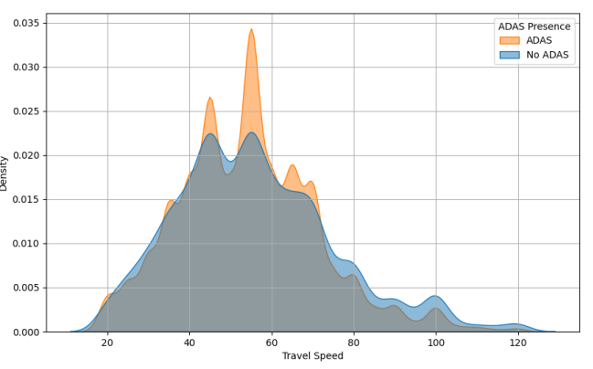
Category 1: Compliance & Safety Insights
Referenced Papers :
1. Intelligent System for Automatic Detection of Traffic Rules Violation
2. Harnessing ADAS for Pedestrian Safety
3. Predicting High NCAP Safety Ratings using ML Models
Violation Detection: Intelligent systems use Background Subtraction and Object Tracking to detect red light jumps and wrong-lane driving.
ADAS Efficiency: Pedestrian Automatic Emergency Braking (PAEB) is effective but performance drops in low light.
Safety Ratings: Machine Learning models can accurately predict NCAP safety ratings based on vehicle features.
2
3

Slide 4
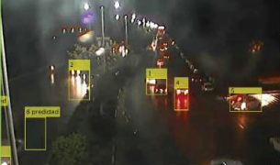
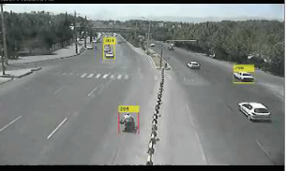
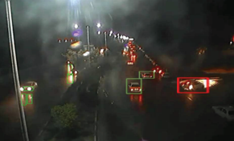
Example & Findings (Category 1) :
Example Outputs
Visual Tracking: Bounding boxes that follow a vehicle across frames to establish a "track".
Rule Validation: If the track crosses a "Stop Line" during a red signal $\rightarrow$ **Violation Flagged** (Red Light Jump).
Trajectory Analysis: Visual lines showing the path of moving vehicles to detect swerving or wrong-lane driving.

Slide 5
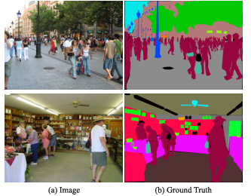
Category 2: Advancing Scene Segmentation
Referenced Papers :
4. Road Marking Segmentation with GAN
7. Mask R-CNN
Mask R-CNN: Identified as the baseline. Provides pixel-level masks crucial for object presence analysis (Instance Segmentation).
PSPNet: Excellent for global scene context (e.g., separating road from sky) which aids in risk assessment (Semantic Segmentation).
GANs: Potential for detecting faded/damaged road markings, essential in unstructured environments.
2
3

Slide 6
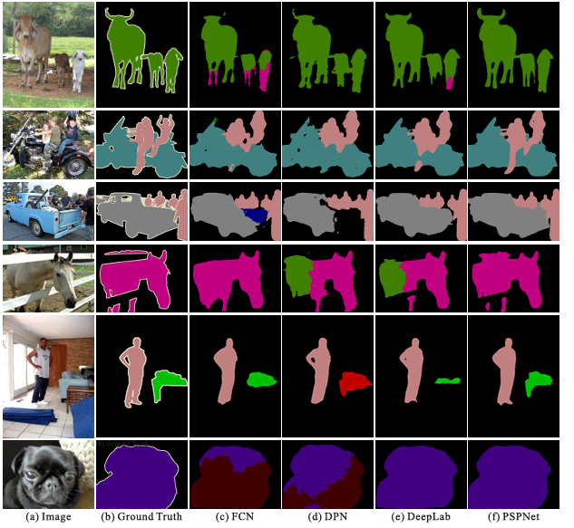
Example & Findings (Category 2) :
Example Outputs
Instance Masking: Separates every unique object (Car A, Car B, Pedestrian 1, Pedestrian 2) with its own mask.
Semantic Masking: Classifies the entire image into categories like 'Road', 'Sidewalk', 'Building', providing context.
Precision Input: High-resolution pixel masks are used as input for precise velocity and distance calculations (e.g., PAEB).

Slide 7
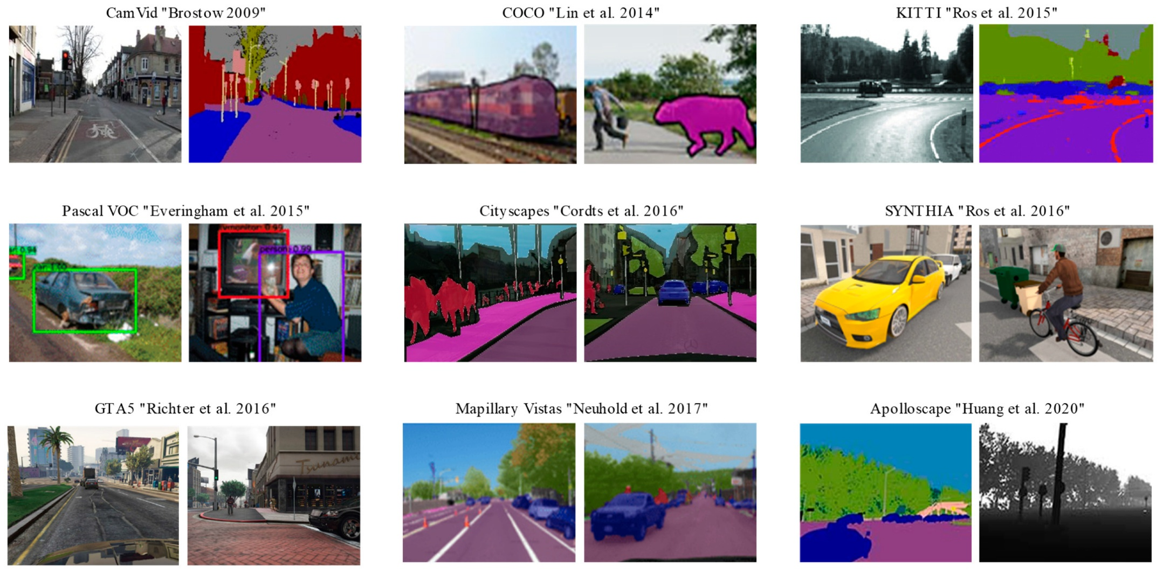
Category 2: Data & Model Review Insights
Referenced Papers :
6. Novel Image Blur Kernel Estimation
8. Semantic Segmentation Review
Blur Kernel Estimation: Critical pre-processing step to counteract motion blur from ego-centric (bike) camera movement.
Deep Learning Review: Confirms U-Net and Attention mechanisms are highly effective for complex segmentation and feature extraction tasks.
Transfer Learning: Use of pre-trained models (YOLO, ResNet) is standard practice to reduce training time and improve generalization.
2
3

Slide 8
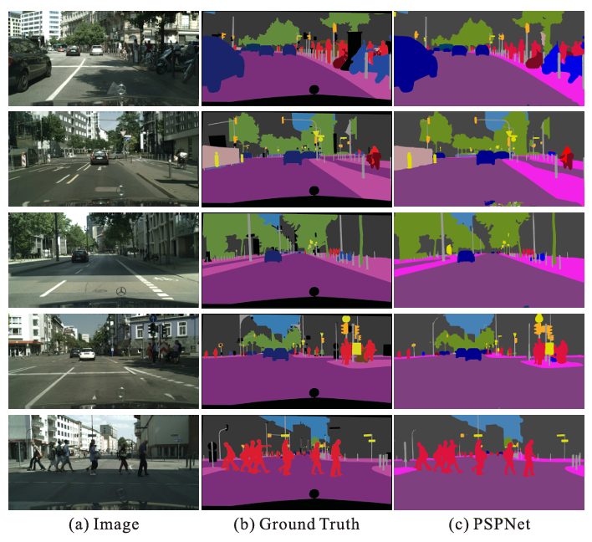
Example & Findings (Category 2) :
Example Outputs
Image Restoration: Raw, motion-blurred frames are transformed into sharp, high-quality images ready for detection.
Performance Gain: Models trained on de-blurred images show a significant increase in metrics (e.g., $+5\%$ mIoU) compared to raw input.
Architecture Validation: Review confirms the suitability of a lightweight, multi-task framework (like YOLO-based) for real-time edge deployment.

Slide 9



Conclusion & Implementation:
Logic Defined
Will implement tracking logic from Cluster 1 findings.
Data Prep
Blur correction will be applied to the dataset first (Cluster 3).
Baseline Selected
Mask R-CNN selected for core detection tasks.
2
3

Slide 10
THANK
YOU
PREMIer UNIVERSITY

