Slide 1
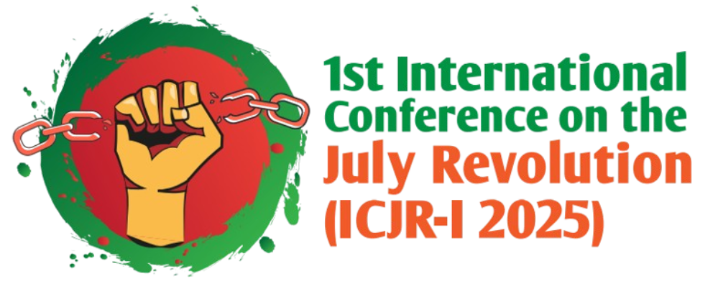

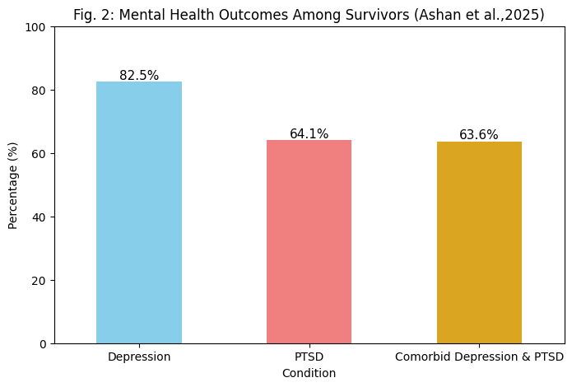
July Monsoon Revolution: The Gen Z's Vision for the Reform, Transitional Justice, and Hope for Bangladesh 2.0
Poster ID # ICJR 321
Delower Hossain (Ph.D. Student)¹, Mahmuda Sharmin (BDS, FCPS Trainee)², Farhana Afroz
¹ Department of Computer Science, The University of Alabama at Birmingham, AL 35294, USA
² Bangladesh Medical University (BMU), Dhaka, Bangladesh
Contact: hossainstudy7@gmail.com
ABSTRACT
Introduction
Methodology
The July Monsoon Revolution of 2024 marks a historic Gen Z-led movement in Bangladesh demanding justice, dignity, and democratic reform. This study explores the potential of transitional justice in reshaping "Bangladesh 2.0," grounded in truth, accountability, and healing. Drawing on international models, human rights reports, and youth narratives, it proposes a Victim-Centered Truth and Healing Commission. Article demonstrates that over 1,400 deaths and mass violations were identified, underscoring the urgency for institutional reform. The revolution reflects a generational shift from protest to policy engagement. Gen Z envisions a decolonized justice model resisting elite dominance. Overall, the movement advocates for a new social contract founded on equity and participatory peace. Bangladesh stands at a critical juncture for reimagining its democratic future.
This article explores the role of transitional justice in shaping Bangladesh 2.0 following the 2024 Gen Z-led July Monsoon Revolution. It analyzes the movement’s demands for justice, accountability, and healing in response to decades of repression and post-liberation trauma. The study investigates global best practices for addressing crimes against humanity and proposes a decolonized, victim-centered Truth and Healing Commission. Key objectives include assessing post-revolution civic discourse, identifying barriers to a just welfare state, aligning reforms with Gen Z's vision, and promoting inclusive, community-based reconciliation that centers marginalized voices. While Google Scholar retrieves over a thousand entries on the July Monsoon Revolution, there remains a critical research gap in studies specifically focused on transitional justice, institutional reform, and the mental health challenges faced by survivors.
The methodology integrates analysis of primary statistics from the UN OHCHR Fact-Finding Mission (2025) report, Human Rights Watch’s (HRW) statements, Amnesty International portal report, and Odhikar’s human rights monitoring report, along with Case studies from post-revolutionary nations (Argentina, Germany, Rwanda, South Africa). In addition to analyzing international human rights defender reports, a study was conducted to examine social media narratives, scholarly literature, youth declarations, national news media articles, and digital campaigns, capturing the discourse of Gen Z protest.
Timeline of Significant Events of July Revolution-2024
June 5, 2024:
Event Began after High Court Order
July 14, 2024:
State Violence Against Student Protesters
July 15, 2024:
Extrajudicially killed (Abu Sayed) by police
July 17, 2024: Massive Student Protest at DU, Internet shutdown
July 18-19, 2024: Mass state violence, killing, arrest, torture
July 20, 2024: Military and curfew were deployed
Aug 5, 2025: Prime Minister fled
Aug 9, 2025: Interim govt formed
Result
1
The UN Fact-Finding Report (2025) confirms over 1,400 civilian deaths, mass arrests, and severe injuries during the July Monsoon Revolution (Fig. 1 & 3), with credible evidence of crimes against humanity. Youth activism has evolved into proactive civic engagement, demanding accountability, judicial reform, and democratic integrity. Despite interim reforms, mental health studies reveal high rates of depression (82.5%) and PTSD (64.1%) among survivors (Fig. 2), exhibiting the need for building Victims Mental Health & Rehabilitation care in post-revolution Bangladesh.
Table 2: Global Comparative Transitional Justice Model After Revolution
Country | Region | Year | Mechanism(s) | Key Focus Areas | Legacy / Outcome | References
Argentina | Latin America | 1983 | CONADEP, criminal trials | Disappearances, torture | Extensive prosecutions after delay | Nunca Más Report
Germany (East) | Europe | 1990 | Lustration, Stasi archive opening, trials | Institutional vetting, memory | High transparency, robust reforms | BSTU
South Africa | Africa | 1994 | Truth and Reconciliation Commission (TRC) | Truth-telling, amnesty, reconciliation | High moral impact, limited prosecutions | TRC Report, 1998
Rwanda | Africa | 1994 | ICTR & Gacaca Courts | Genocide trials, community justice | Broad prosecutions, reconciliation uneven | UN ICTR
Bosnia & Herz. | Europe | 1995 | ICTY, national courts | Ethnic cleansing, genocide | Justice partial, reconciliation still fragile | ICTY
Sierra Leone | Africa | 2002 | Special Court & TRC | Hybrid justice, war crimes | International precedent, limited national impact | UN SCSL
Colombia | Latin America | 2016 | JEP, Truth Commission | FARC conflict, reparations, reintegration | Model for balancing justice and peace | JEP Colombia
5
Institutional Reform
Truth and Reconciliation Commission (TRC)
Transitional Justice Process
2
Institutional Reform
Criminal Justice
Table 1: Transitional Justice Process: Bangladesh (post-apartheid)
Pillar | Status /Execution? | Recommendation
TRC | ❌ Not Yet | July Shonod
Criminal Justice | ⚠️ Partial | Crime against humanity trail accomplishment
Reparations | ✅ Yes | Monetary compensation
Institutional Reform | ❌ Not Yet | New Constitution, police reform
Memorialization | ⚠️ Partial | Apartheid Museum, national remembrance days
4
Reparations
3
Fig. 4: Key Mechanism of Transitional Justice
The key Institutional Reform recommendations by Human Rights Watch (HRW) report:
End Political Interference in Security Forces
Ensure Civilian Oversight and Accountability
Enforce International Standards on Use of Force
End Arbitrary Arrests, Enforced Disappearances, Torture, and Extrajudicial Killings
Disband the Rapid Action Battalion (RAB) and Reform Justice System
Overall, Institutional reform must ensure accountability, transparency, and independence across all branches—executive, legislative, judiciary—and constitutional bodies, including the EC, ACC, PSC, HRC, and intelligence and law enforcement agencies (DGFI, NSI Armed Forces, Detective Branch, Special Branch, and Counter Terrorism and Transnational Crime unit (CTTC)
Discussion and Conclusion
REFERENCES
The absence of transitional justice mechanisms, such as truth commissions, legal accountability, reparations, and institutional reform, has historically proved to be the failure of revolutions and the resurgence of authoritarianism.
In this context, the July Monsoon Revolution represents a profound generational shift, with Gen Z at the forefront. Their movement calls for the urgent implementation of a hybrid, UN-recommended transitional justice framework that combines institutional reform with a victim-centered healing process. It further demands a new social contract rooted in dignity, equity, accountability, and inclusive peacebuilding—mobilizing all sectors of society to co-create a just and transformative future for Bangladesh 2.0.
OHCHR Fact-Finding Report: Human Rights Violations and Abuses related to the Protests of July and August 2024 in Bangladesh. Accessed: April 1, 2025: https://www.ohchr.org/en/documents/country-reports/ohchr-fact-finding-report-human-rights-violations-and-abuses-related.
J. Bleckner, “After the Monsoon Revolution,” Jan. 2025:HRW, https://www.hrw.org/report/2025/01/27/after-monsoon-revolution/roadmap-lasting-security-sector-reform-bangladesh
Third Quarterly Human Rights Report July-September. 2024:
https://www.icnl.org/wp-content/uploads/HRR_July-September_2024_English.pdf
M. S. Ahsan et al., “Mental Health Consequences of the July Revolution in Bangladesh: A study on depression and post-traumatic stress disorder among survivors of violence and persecution,” Cureus, May 2025, doi: 10.7759/cureus.84358.

