Slide 1


LlamaAffinity: A Predictive Antibody-Antigen Binding Model Integrating Antibody Sequences with Llama3 Backbone Architecture
20th conference on Computational Intelligence methods for Bioinformatics and Biostatistics
Biomedical Informatics
& Data Science
Md Delower Hossain^{1,2}, Ehsan Saghapour^{2,3}, Kevin Song^{2,4}, Jake Y. Chen^{1,2,3,4}
¹Department of Computer Science ²Systems Pharmacology AI Research Center (SPARC)
³Department of Biomedical Informatics & Data Science
⁴Department of Biomedical Engineering, School of Medicine, The University of Alabama at Birmingham, US
Email: jakechen@uab.edu
Sep 10th 2025

Slide 2
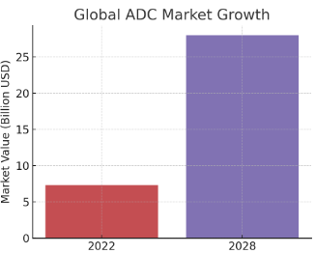
Background & Motivation
Therapeutic antibodies have revolutionized treatment in oncology (breast, lung, and bladder cancers), autoimmune diseases, and infectious diseases. Also, reduced Immunogenicity minimizes immune system reactions, enhancing safety and tolerability.
AI-driven next-generation antibody design can reduce cost and significantly improve computational efficacy and pharmacokinetics.
The FDA has approved at least 13 antibody drug conjugates (ADCs), including treatments for triple-negative metastatic breast cancer (MBC) and the HR-positive, HER2-negative subtypes, as reported by AXIS Pharma. By 2025, three additional ADCs developed by AstraZeneca, Daiichi Sankyo, and AbbVie are anticipated to receive FDA approval (Biopharma PEG).
The global antibody drug conjugate (ADC) market was valued at $7.35 billion in 2022 and is projected to surpass $28 billion by 2028, reflecting substantial growth (Biopharma portal report).
Affinity prediction is essential in antibody design as it ensures strong and specific binding to target antigens, enhancing therapeutic efficacy. In silico prediction also reduces costly and time-consuming experimental screening.

Slide 3
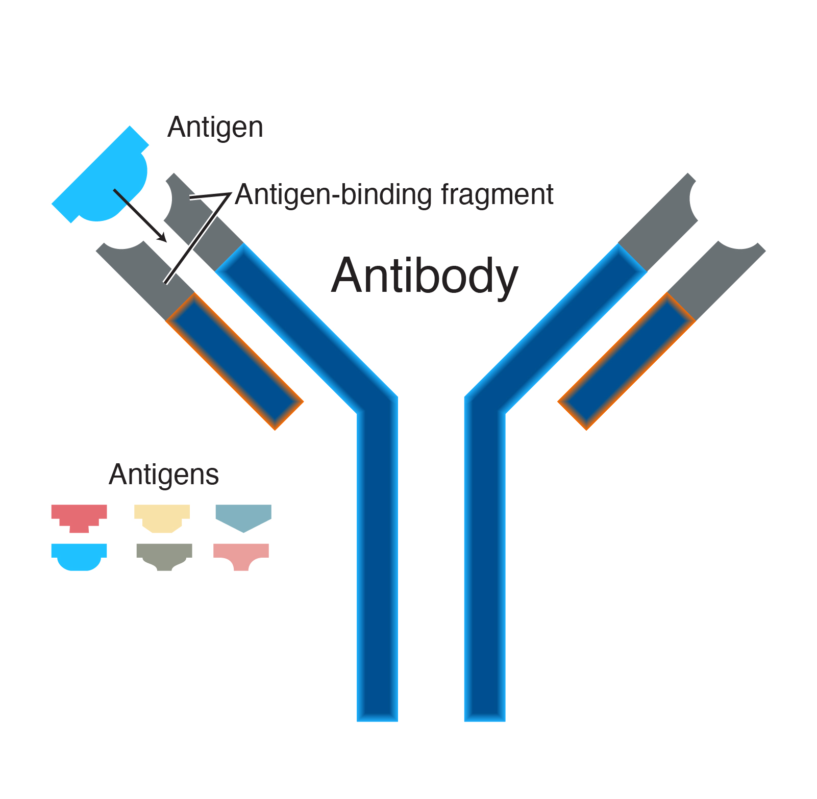
Research Problem: “How can custom LLaMA-based architectures be leveraged to improve the accuracy and efficiency of antibody binding affinity prediction?”
Accurate prediction of antibody–antigen binding affinity remains a challenge due to sequence diversity, structural complexity, and limited labeled datasets.
Existing models (e.g., AntiBERTa, AntiFormer) struggle to balance prediction accuracy with computational efficiency.
There is a need for custom fine-tuning approaches (like LLaMA backbones) that can better capture antibody sequence representations for robust affinity prediction.

Slide 4
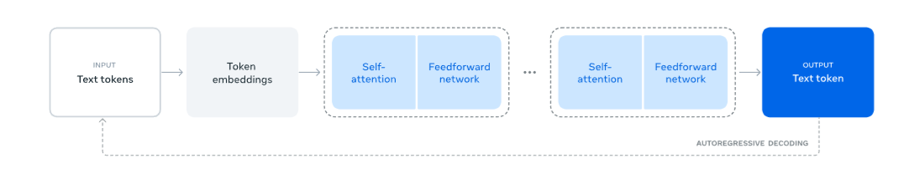
Llama3-Based Antibody Affinity Modeling Pipeline
Dataset: Heavy and light chain amino acid sequences are used as inputs; sequences above the 85th redundancy percentile are labeled as binders, while those below are labeled as low-affinity. Data was collected from (AntiFormer article (Q. Wang. et al.,)).
Data Split: 5-fold cross-validation
Preprocessed data was employed from AntiFormer official repository.
Model Architecture:
Llama3 Backbone (Custom Training & Configuration), Detailed configuration in the next slide.
Inputs are tokens of amino acid sequence, where the output is binder (1) or low affinity (0).
Training Phase:
Five-fold stratified cross-validation was performed over 10 epochs on a Colab GPU. The total training time was ~27.5 minutes (~5.49 minutes per fold).
Llama3 workflow Source: Llama 3 technical report

Slide 5
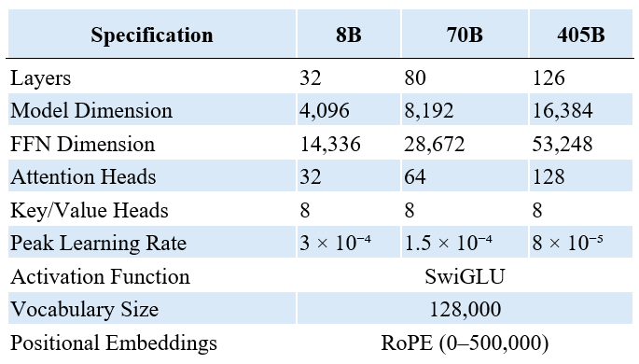
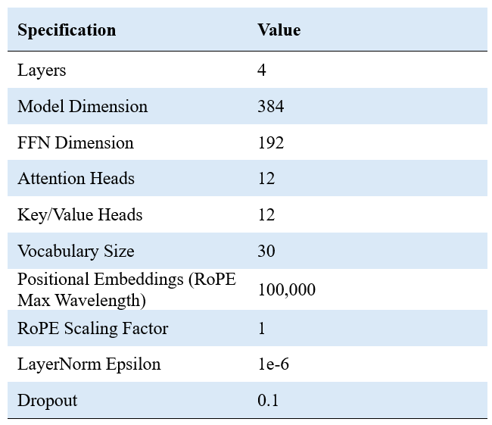
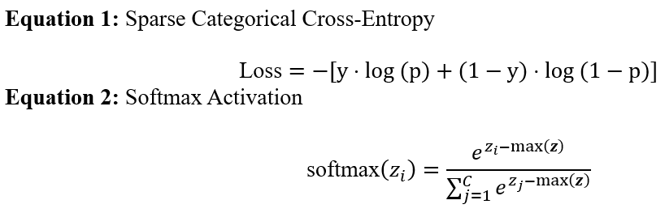
Model Configuration: Llama3 vs LlamaAffinity
Llama 3 Configuration
LlamaAffinity Configuration
Source: Llama 3 technical report
Advantages of LlamaAffinity
Superior Accuracy
Higher Computational Efficacy
Advanced transformer architecture (custom)

Slide 6
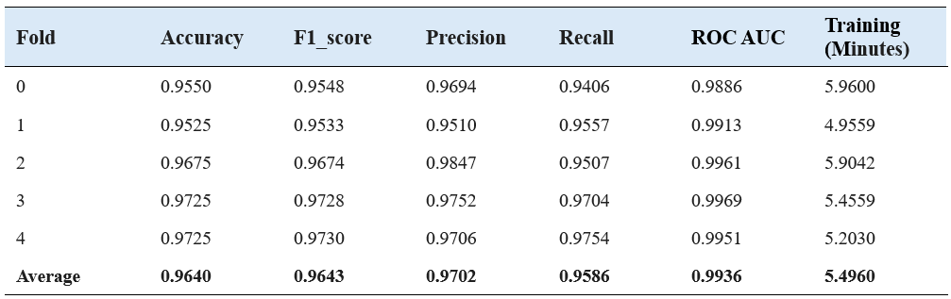
LlamaAffinity: Cross-validation results across five folds

Slide 7
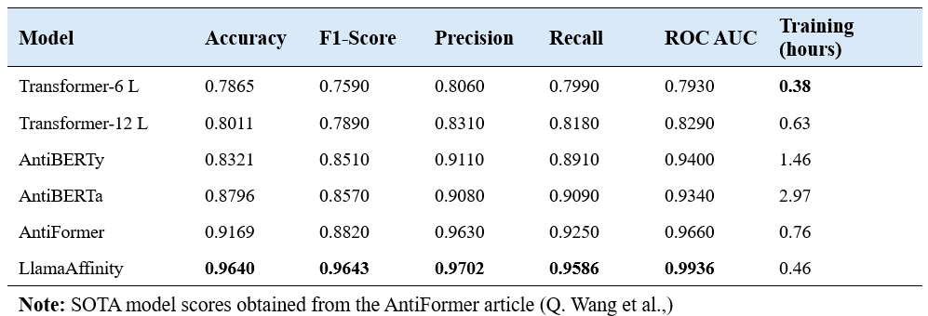
Experiment Results: Benchmark Comparison
As shown, LlamaAffinity achieves the highest accuracy score of 96.40%, outperforming other competitive methods, with an F1 score of 96.43%, Precision of 97.02%, and Recall of 95.86%, while requiring significantly less training time (0.46 h). Although the Transformer-6 Layers model reported the shortest training time, its performance was not satisfactory.

Slide 8
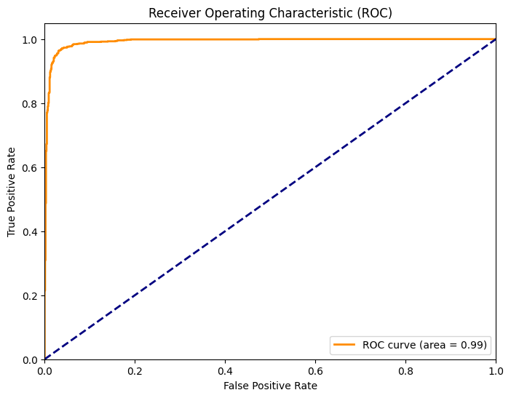
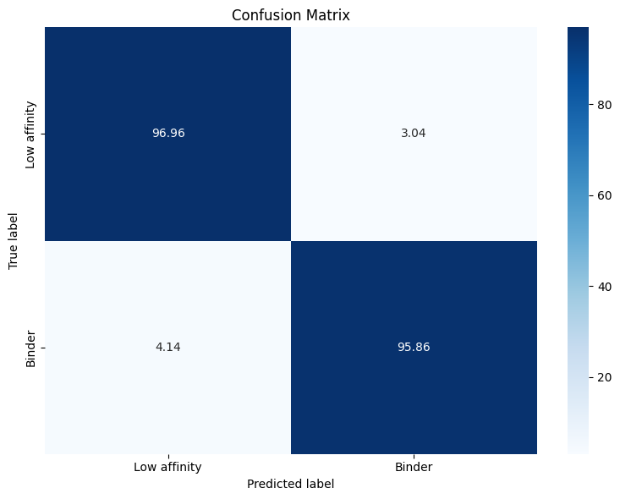
LlamaAffinity: ROC-AUC & Confusion Matrix
Figure 1. LlamaAffinity ROCAUC curve
Figure 2. LlamaAffinity Confusion Matrix
Receiver Operating Characteristic (ROC) Curve. The curve demonstrates the excellent performance of the LlamaAffinity model, with an Area Under the Curve (AUC) of 0.99.
Confusion matrix (CM) revealed strong and accurate positive rates, along with low misclassification rates, with only 3.04% predicted false positives and 4.14% predicted false negatives (Figure 2)

Slide 9
Discussion
LlamaAffinity Model: Novel Llama 3–based framework using antibody sequences for predicting antibody–antigen binding affinity.
Higher Performance: Outperforms AntiBERTa and AntiFormer with top metrics (Accuracy 0.9640, F1-score 0.9643, AUC-ROC 0.9936) and lower training time.
Impact & Future Work: Enhances antibody design pipelines; future validation through case studies on targets like SARS-CoV-2 spike protein and HER2.

Slide 10





Acknowledgments
Systems Pharmacology
AI Research Center
Manuscript & GitHub Repository
Ehsan Saghapour, Ph.D.,
Radomir Matthew, MD, Ph.D Student
Sharma, Rahul, Ph.D
Kevin Song, Ph.D Student
Fuad Al Abir, Ph.D Student
Md Delower Hossain, Ms, MBA, Ph.D. Student
Zhandos Sembay, MS
Melissa Hall, MS
Hari Merla, MS
Andrew Trotter, MS
Maryam Choucha, MS
NIH Grants
U54OD036472, U54DK137307, 1OT2OD032742, and R01HL150078,
UMI-TR004771, OT2:lOT20D032742-01

