Slide 1

Department: COMPUTER SCIENCE AND ENGINEERING
Semester: Spring-2023
Program: Bachelor of Computer Science and Engineering
Course Title:Structured Programming Language.
Course Code :0611-CSE-1106.
PRESENTATION on "assignment I and lab work VII & VIII".
Student Name: | Md. Siam Hossain
Student ID: | 23100084
Student Batch: | 26th
Submission Date: | 02/07/2023
Course Teacher: | Kingkar Proshad Ghosh. Department Head. Computer Science & Engineering.

Slide 2
This presentation aims to demonstrate the versatility and practicality of the programming language C through
the implementation of five different tasks:
Average Calculation: This task showcases C's ability to handle user inputs and perform arithmetic calculations.
Printing Unique Elements: This task highlights C's array manipulation capabilities and its usefulness in managing data.
3.2D Array Summation: This task showcase C's capability in handling two-dimensional arrays and performing various arithmetic
operations efficiently. participants must gain a deeper understanding of C's array manipulation abilities and how it can be
applied to practical data processing tasks.
4.3D Array Multiplication: This task demonstrates C's ability to work with complex data structures and perform
multi-dimensional array operations.
5.Doctor's Information: This task exemplifies how C can effectively organize and store diverse data with the help of structures.
This presentation aims to showcase C as a powerful programming language with capable of handling different
types of tasks.

Slide 3
INDEX
Task No: | Task | Page No:
 | Introduction | 04
01 | To find the average of n elements (inserted by the user) in an array. | 04-06
02 | To print all unique (not repeated) elements of the inserted array. | 04-06
03 | To fill in this row and column with the totals of each column, each row, and the grand total. | 06-08
04 | To get the multiplication result of two different tables of an array of array of arrays (3D array) and show the multiplied result in a array of arrays. | 08-11
05 | To make a list of doctors from different hospitals in different specialties, where you should have the doctor's name, ID, profession, hometown, registered hospital, designation, blood type, age, and doctor's salary with using Structure. | 11-12
 | Conclusion | 13
All of these programs should be written in programming language C.

Slide 4
Introduction: -Welcome to our presentation on "assignment I and labwork VII & VIII".
-Today, I will explore the programs, how those works and results.
Task-1&2: Write a program in the programming language C,
01) to find the average of n elements (inserted by the user) in an array,
02) to print all unique (not repeated) elements of the inserted array.
//01.
#include<stdio.h>
int main()
{
int tot_ele,i,sum=0,j,c;
printf("Enter total elements to find the avarage: ");
scanf("%d",&tot_ele);
//Declaring array size from the user.
int arr[tot_ele];
//Inserting the values in the Array...
for(i=0; i<tot_ele; i++)
{
scanf("%d",&arr[i]);
}

Slide 5
for(i=0; i<tot_ele; i++)
{
sum=sum+arr[i];
}
float avarage;
avarage=(float)sum/tot_ele;
printf("\nAvarage=%.2f",avarage);
//02.
printf("\nThe unique numbers is: ");
for(i=0; i<tot_ele; i++)
{
c=0;
for(j=0; j<tot_ele; j++)
{
if(i!=j) //It means that if i=0 then j starts from 1.
{
if(arr[i]==arr[j]) //Programs check the arr[i] values with all the elements as arr[j].
{
c++; //If the values of c is change then the arr[i] values is not an unique numbers.
}
}

Slide 6
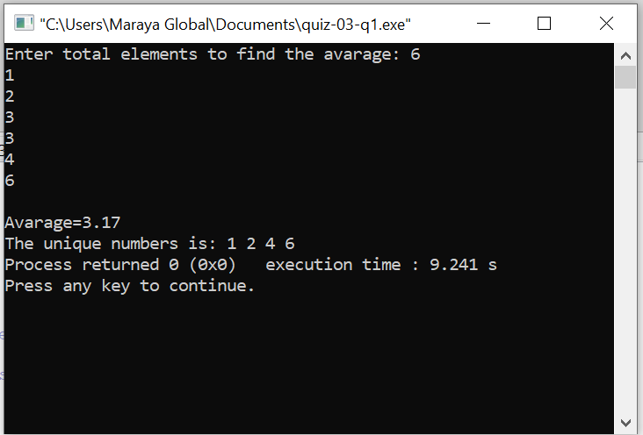
}
if(c==0) //If the values of c is not change then the arr[i] values is an unique numbers.
{
printf("%d ",arr[i]);
}
}
}
Task-03:Write a program in the programming language C, to fill in this row and column with the totals of each column, each
row, and the grand total.
#include<stdio.h>
int main()
{
int i,j,sum,row,col;
//Declaring array row and column with extra one because
//we dont know the values of 5th row and 6 column & grand total.
int arr[5][6]={{1,2,3,4,5},{2,4,6,8,10},{20,10,5,3,1},{3,6,9,12,15} };

Slide 7
//Row
for(i=0; i<4; i++)
{
sum=0;
for(j=0; j<5;j++)
{
sum=sum+arr[i][j];
}
//Inserting the sum results in 6th column.
arr[i][5]=sum;
}
//Column
for(i=0; i<5; i++)
{
sum=0;
for(j=0; j<4;j++)
{
sum=sum+arr[j][i];
}
sum=0;
for(i=0;i<4;i++)
{
for(j=0;j<5;j++)
{
sum+=arr[i][j];
}
}
//The sum results of every row & every column is remain same which is grand total will insert in last row in last column.
arr[4][5]=2*sum;
printf("\nFinal Matrix is=");
for(i=0; i<5; i++)
{
for(j=0; j<6;j++)
{
printf("%d ",arr[i][j]);
}
printf("\n\t\t");
}
}
//Inserting the sum results in 5th row.
arr[4][i]=sum;
}

Slide 8
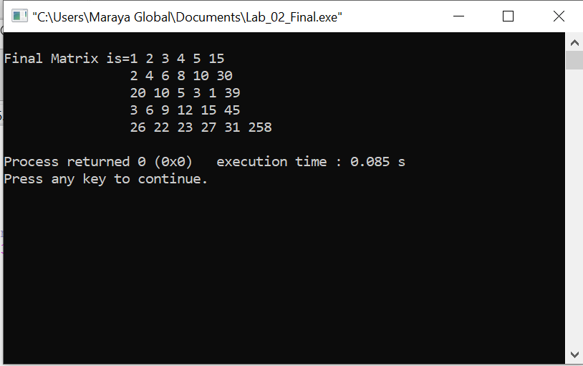
Task-04:Write a program in the programming language C, to get the multiplication result of two different tables of an array of array of arrays (3D array) and show the multiplied result in a array of arrays. All inputs should come from the user.
#include<stdio.h>
int main()
{
int k,i,j,r1,c1,r2,c2;
int tab=2; //from the questions.
printf("Enter the Row and Column numbers of 1st Matrix: ");
scanf("%d %d",&r1,&c1); //user inserted 1st array row and column.
printf("Enter the Row and Column numbers of 2nd Matrix: ");
scanf("%d %d",&r2,&c2); //user inserted 2nd array row and column.
///Declaring the size of table,row & column of array 1 and array 2.
int arr1[tab][r1][c1],arr2[tab][r2][c2];
int mult=0;

Slide 9
while(c1!=r2) //Two matrix can be multiplicative only when the column of 1st and row of 2nd matrix is remain same.
{
printf("\nError,Please enter the same numbers of row of 1st & column of 2nd Matrix...");
printf("\nEnter totall row & column numbers of 1st Matrix:");
scanf("%d %d",&r1,&c1);
printf("\nEnter totall row & column numbers of 2nd Matrix:");
scanf("%d %d",&r2,&c2);
}
printf("Mat[%d][%d][%d]=",k,i,j);
scanf("%d",&arr1[k][i][j]);
}
printf("\n");
}
}
if(k==tab-1)
{
printf("\nEnter the values of 2nd Matrix:\n");
for(i=0; i<r2; i++)
{
for(j=0; j<c2; j++)
{
printf("Mat[%d][%d][%d]=",k,i,j);
scanf("%d",&arr2[k][i][j]);
}
printf("\n");
}
}
}
//Inserting the values in Array 1 & Array 2 by the user=
printf("\nEnter the values of 1st Matrix:\n");
for(k=0; k<tab; k++)
{
if(k==tab-tab)
{
for(i=0; i<r1; i++)
{
for(j=0; j<c1; j++)
{

Slide 10
if(k==tab-tab)
{
for(i=0; i<r1; i++)
{
for(j=0; j<c1; j++)
{
printf("%d ",arr1[k][i][j]);
}
printf("\n\t");
}
}
if(k==tab-1)
{
printf("\nArray 2=");
for(i=0; i<r2; i++)
{
for(j=0; j<c2; j++)
{
//using multf to convert 3D Mult results to 2D Mult results.
//Multiplication results matrix should be same of row of 1st and column of 2nd matrix.
int multf[r1][c2];
for(i=0; i<r1; i++)
{
for(j=0; j<c2; j++)
{
for(int c=0; c<c1; c++)
{
//The column of 1st & row of 2nd array is remaining same that is why we take the common as c.
mult=mult+arr1[tab-tab][i][c]*arr2[tab-1][c][j];
//mult results of row & column between two table is storing in the cell of multf array.
multf[i][j]=mult;
}
mult=0;
}
}
printf("%d ",arr2[k][i][j]);
}
printf("\n\t");
}
printf("\nArray 1=");
for(k=0; k<tab; k++)
{

Slide 11
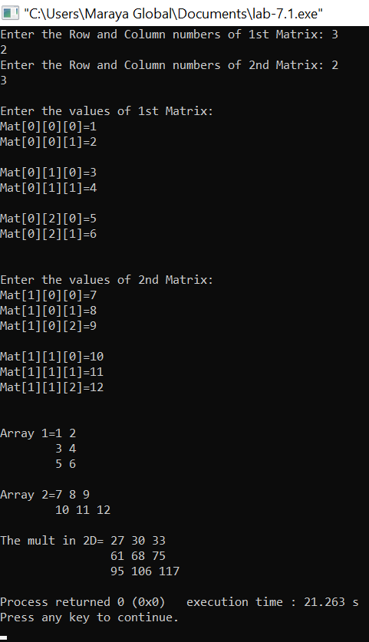
}
}
//printing the Multiplication of two tables from a 3D array to 2D array=
printf("\nThe mult in 2D= ");
for(i=0; i<r1; i++)
{
for(j=0; j<c2; j++)
{
printf("%d ",multf[i][j]);
}
printf("\n\t\t");
}
}
Part-05:Write a program in the C programming language using a structure to make a list of doctors from different hospitals in different specialties, where you should have the doctor's name, ID, profession, hometown, registered hospital, designation, blood type, age, and doctor's salary.
#include<stdio.h>
//lets store information of n different doctors information.
//Product information contains name,ID,profession,hometown,registered hospital,designation,blood type,age & salary.
struct doctor
{
char name[30];
int ID;

Slide 12
char profession[25];
char hometown[30];
char reg_hospital[30];
char designation[25];
char blood[5];
int age;
int salary;
};
int main()
{
//declares an array of structure which can store 15 doctors infprmation.
struct doctor doctor[15];
int n,i;
printf("\nEnter the quantity of doctor that you have to list: ");
scanf("%d",&n);
//accepts data for doctors information from user and stores it to structure with using for loop.
//This for loop will loop only n times as we have declared doctor structure variable to store n doctors information.
for(i=0; i<n; i++)
{
printf("\nEnter the name of %dth Doctor: ",i+1);
fflush(stdin);
gets(doctor[i].name);

Slide 13
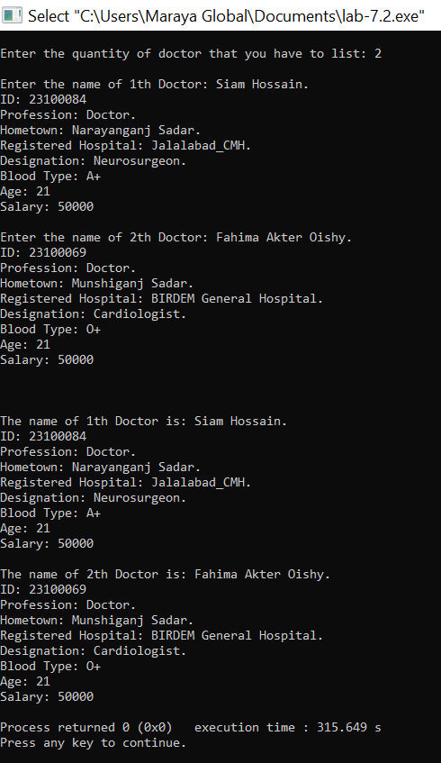
printf("ID: ");
scanf("%d",&doctor[i].ID);
fflush(stdin);
printf("Profession: ");
gets(doctor[i].profession);
printf("Hometown: ");
gets(doctor[i].hometown);
printf("Registered Hospital: ");
gets(doctor[i].reg_hospital);
printf("Designation: ");
gets(doctor[i].designation);
printf("Blood Type: ");
gets(doctor[i].blood);
printf("Age: ");
scanf("%d",&doctor[i].age);
printf("Salary: ");
scanf("%d",&doctor[i].salary);
}
printf("\n\n");
printf("\nProfession: %s",doctor[i].profession);
printf("\nHometown: %s",doctor[i].hometown);
printf("\nRegistered Hospital: %s",doctor[i].reg_hospital);
printf("\nDesignation: %s",doctor[i].designation);
printf("\nBlood Type: %s",doctor[i].blood);
printf("\nAge: %d",doctor[i].age);
printf("\nSalary: %d",doctor[i].salary);
printf("\n");
}
}
//printing n numbers of doctor information.
for(i=0;i<n;i++)
{
printf("\nThe name of %dth Doctor is: %s",i+1,doctor[i].name);
printf("\nID: %d",doctor[i].ID);

Slide 14
Conclusion
Overall, the presentation covered essential concepts in C programming, including arrays, loops, user input, structures, and multi-dimensional arrays. It provided practical examples of solving problems and managing data in C using arrays and structures, demonstrating how to handle different scenarios, such as finding averages, identifying unique elements, performing matrix multiplication, and managing structured data like the list of doctors.
Thank You for your attention.

