Slide 1
Multiplication, Multipliers and Booth’s algorithm

Slide 2
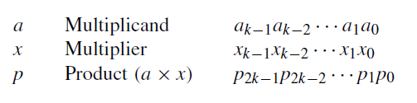
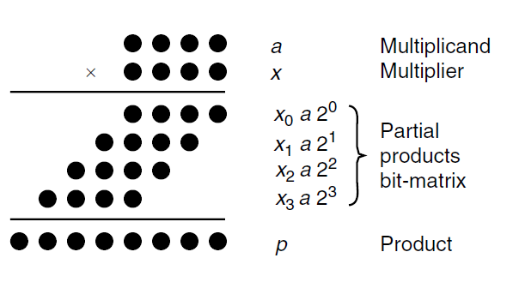
Multiplication: SHIFT/ADD ALGORITHMS
Since xj is in {0, 1}, each term xja is either 0 or a. Thus, the problem of binary multiplication reduces to adding a set of numbers, each of which is 0 or a shifted version of the multiplicand a.

Slide 3
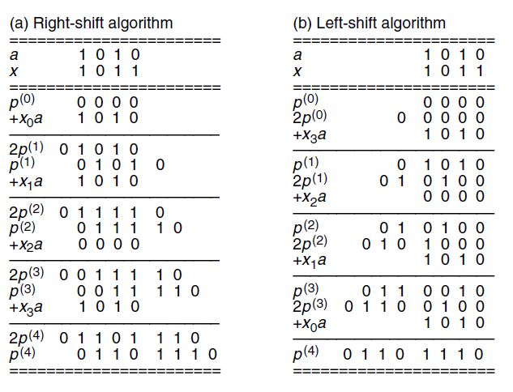

Slide 4
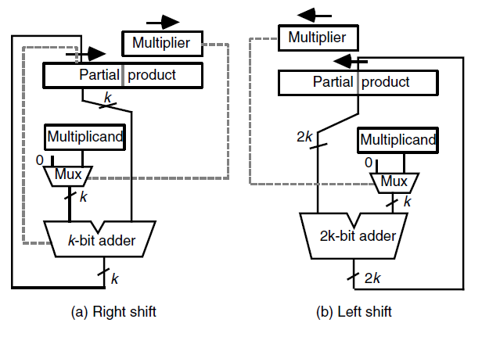
Multiplication with right shifts is the preferred method… Why?

Slide 5
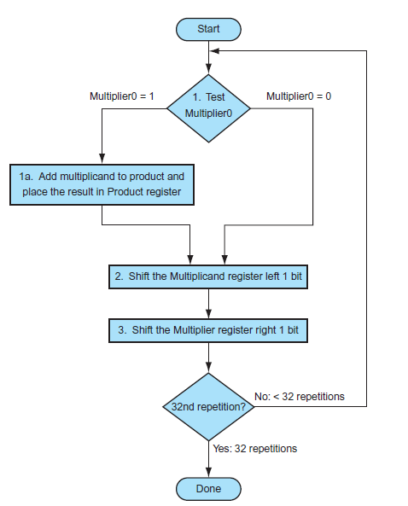
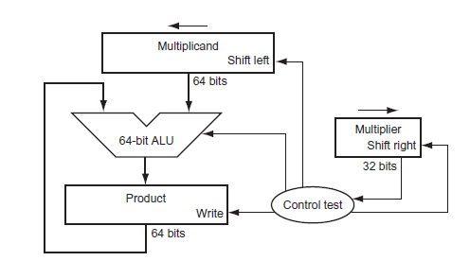

Slide 6
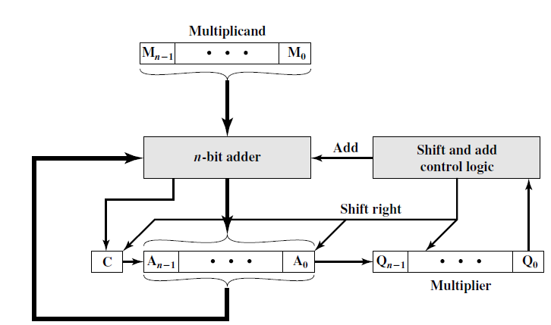
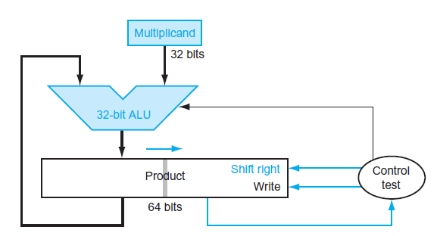
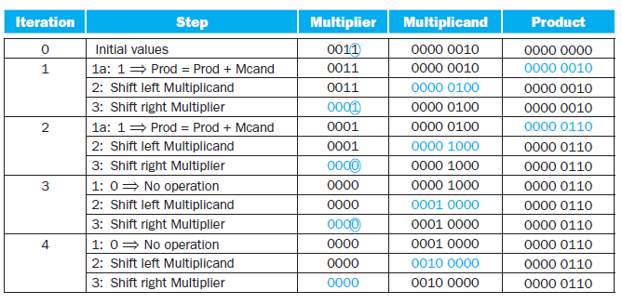

Slide 7
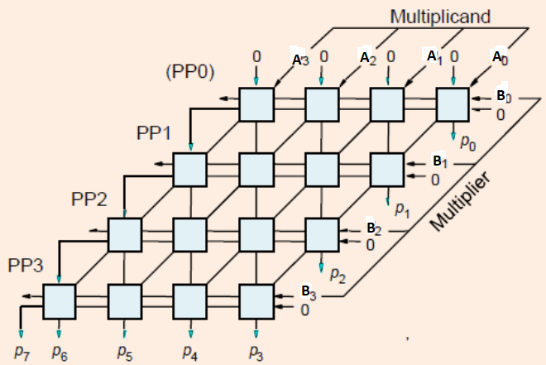
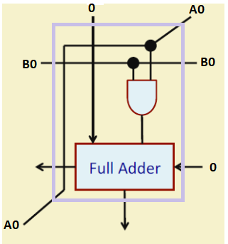

Slide 8
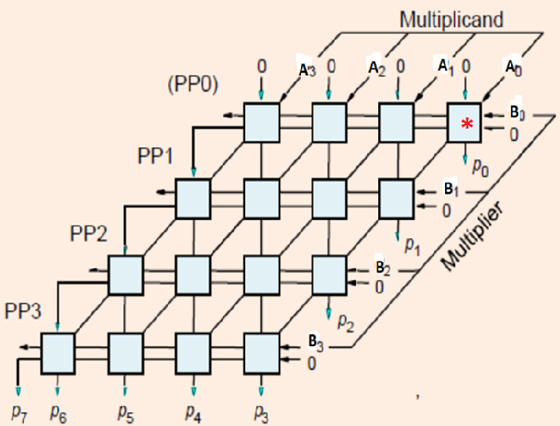

Slide 9
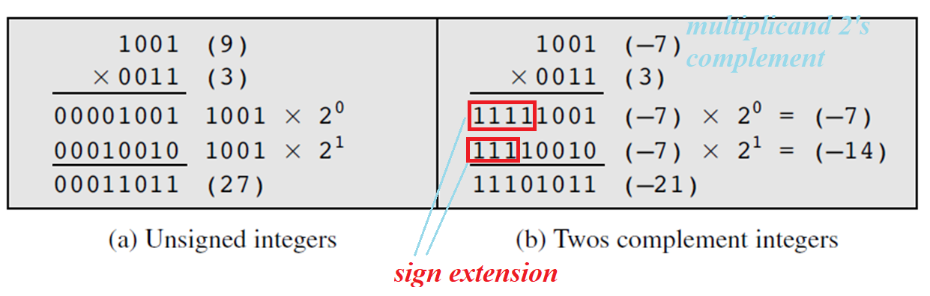
MULTIPLICATION OF SIGNED and UNSIGNED NUMBERS
Straightforward multiplication will not work
DIFFERENT…..If multiplier is Negative, will method (b) work?

Slide 10
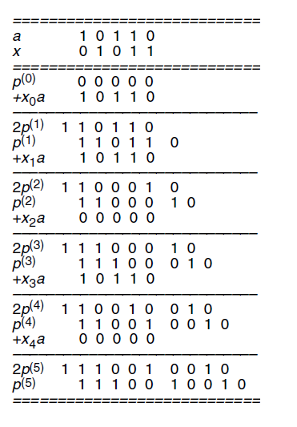
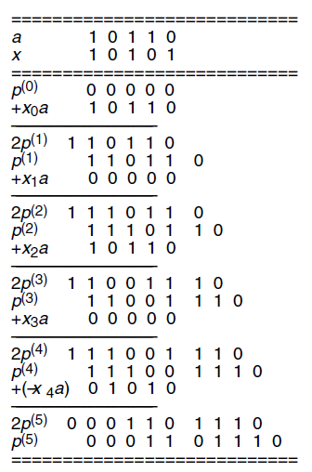
Sequential multiplication of 2’s-complement numbers with right-shifts (positive multiplier)
Sequential multiplication of 2’s-complement numbers with right-shifts (negative multiplier)

Slide 11
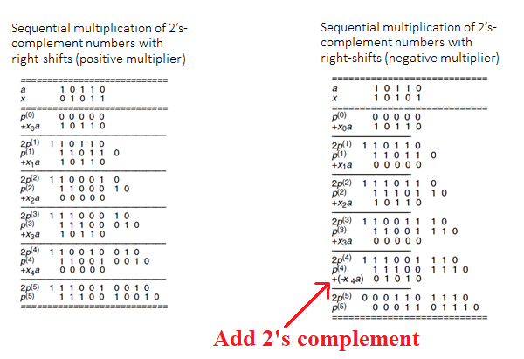

Slide 12
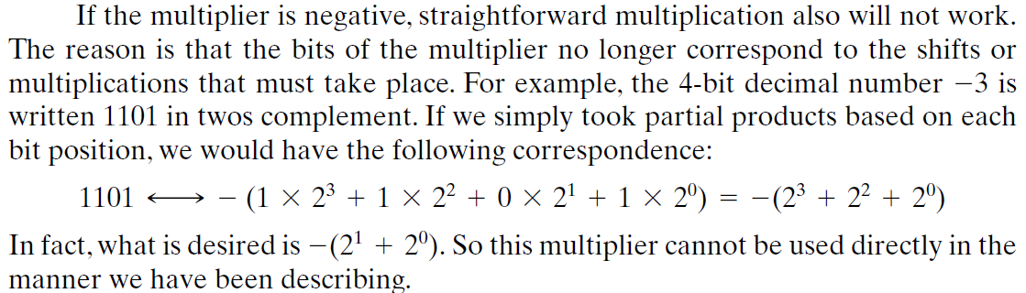
Convert both multiplier and multiplicand to positive numbers, perform the multiplication, and then take the twos complement of the result if and only if the sign of the two original numbers differed.
Implementers have preferred to use techniques that do not require this final transformation step.

Slide 13
Multiplication of negative numbers
Convert both multiplier and multiplicand to positive numbers, perform the multiplication, and then take the twos complement of the result if and only if the sign of the two original numbers differed.
Implementers have preferred to use techniques that do not require this final transformation step.

Slide 14
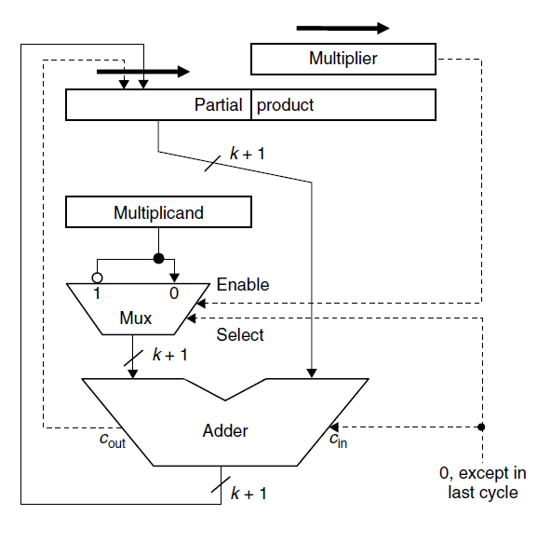
2’s-complement sequential hardware multiplier
Multiplicand must be sign-extended by k bits. We thus have a more complex adder as well as slower additions. With right shifts, on the other hand, sign extension occurs incrementally; thus the adder needs to be only 1 bit wider.
Alternatively, a k-bit adder can be augmented with special logic to handle the extra bit at the left.

Slide 15
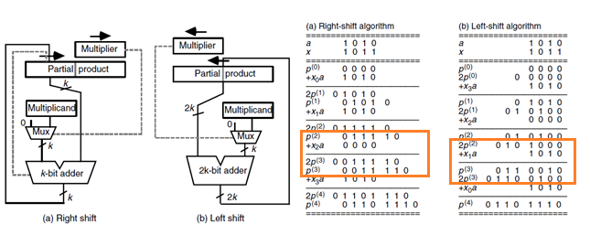
Adding zeros….. Could this be avoided?

Slide 16
Shifting alone is faster than addition followed by shifting, and one may take advantage of this fact to reduce the multiplication time on the average. The resulting algorithm or its associated hardware implementation will have variable delay depending on the multiplier value: the more 1s there are in the binary representation of x, the slower the multiplication.

Slide 17

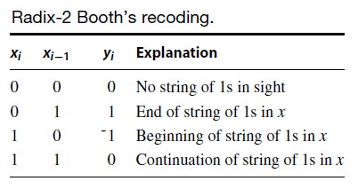
Booth’s algorithm
Booth observed that whenever there are a large number of consecutive 1s in x, multiplication can be speeded up by replacing the corresponding sequence of additions with a subtraction at the least-significant end and an addition in the position immediately to the left of its most-significant end. In other words
The longer the sequence of 1s, the larger the savings achieved.
The effect of this transformation is to change the binary number x with digit set [0, 1] to the binary signed digit number y using the digit set [−1, 1].

Slide 18
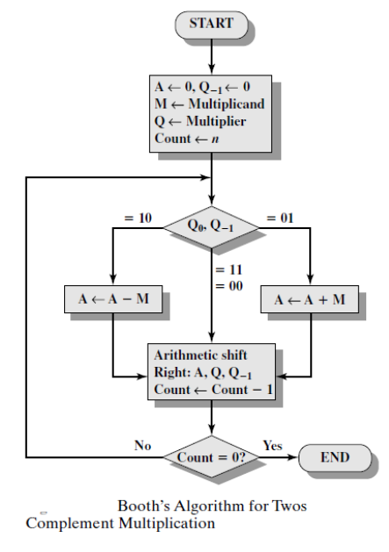
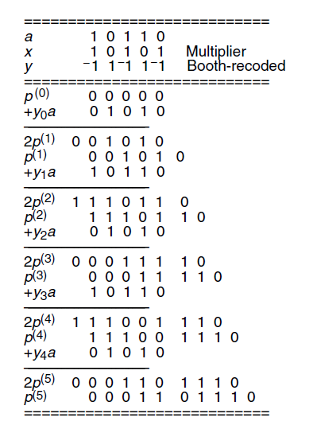
Booth’s algorithm

Slide 19
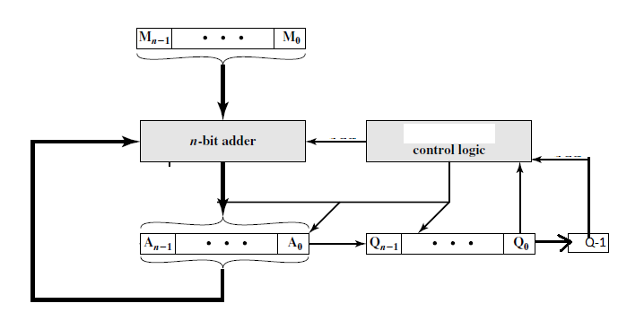
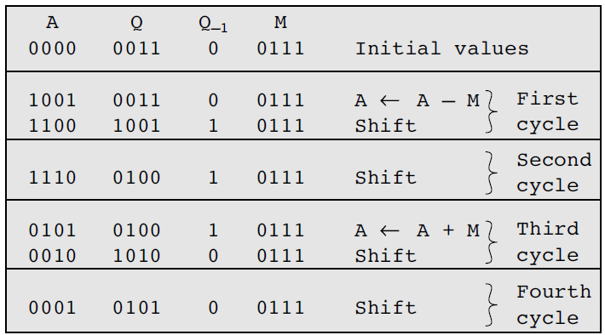
Booth’s Algorithm
Example: 7 X 3

Slide 20
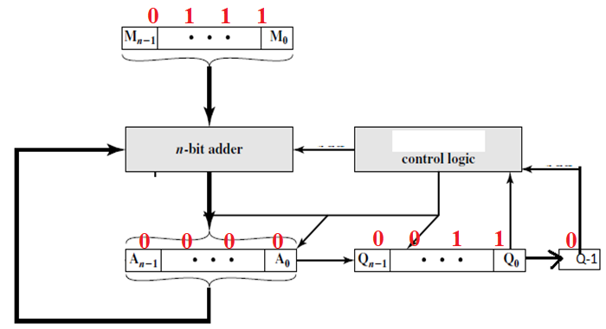

Slide 21
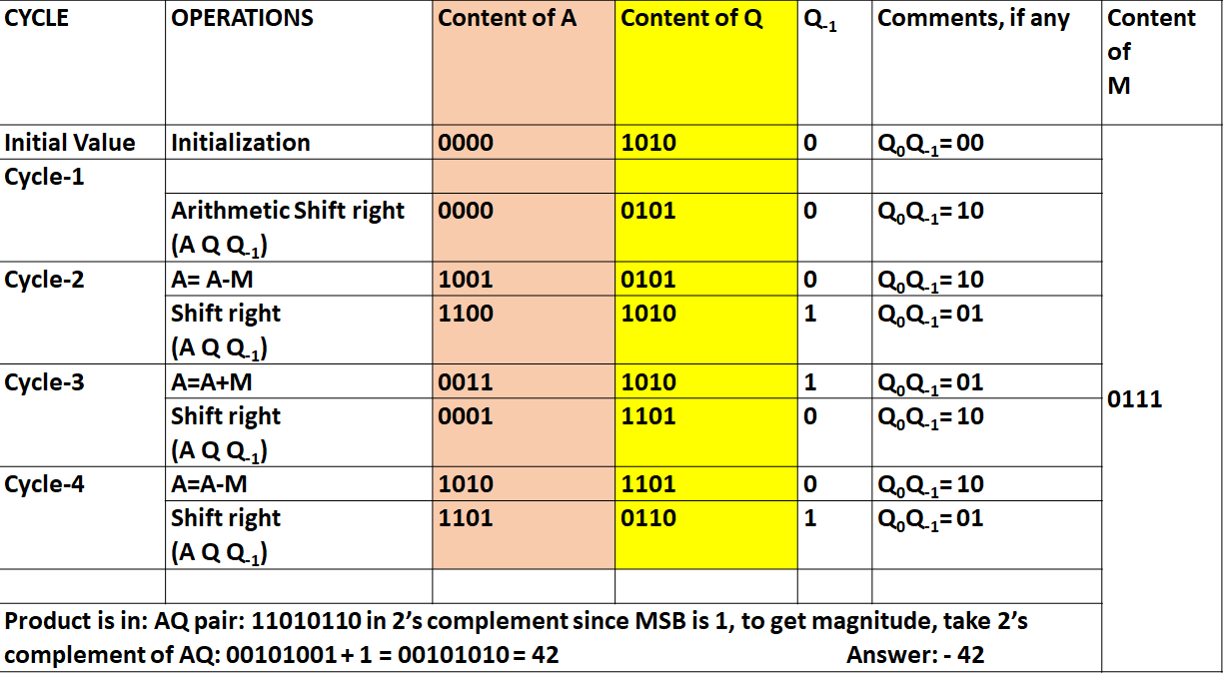
Signed Binary Multiplication
Example: 7 x (-6)

Slide 22
CYCLE | OPERATIONS | Content of A | Content of Q | Q₋₁ | Comments, if any | Content of M
Initial Value | Initialization | 0000 | 1010 | 0 | Q₀Q₋₁= 00 | 0111
Cycle-1
 | Arithmetic Shift right (A Q Q₋₁) | 0000 | 0101 | 0 | Q₀Q₋₁= 10
Cycle-2 | A= A-M | 1001 | 0101 | 0 | Q₀Q₋₁= 10
 | Shift right (A Q Q₋₁) | 1100 | 1010 | 1 | Q₀Q₋₁= 01
Cycle-3 | A=A+M | 0011 | 1010 | 1 | Q₀Q₋₁= 01
 | Shift right (A Q Q₋₁) | 0001 | 1101 | 0 | Q₀Q₋₁= 10
Cycle-4 | A=A-M | 1010 | 1101 | 0 | Q₀Q₋₁= 10
 | Shift right (A Q Q₋₁) | 1101 | 0110 | 1 | Q₀Q₋₁= 01
Product is in: AQ pair: 11010110 in 2’s complement since MSB is 1, to get magnitude, take 2’s complement of AQ: 00101001 + 1 = 00101010 = 42 Answer: - 42

Slide 23
Division

Slide 24
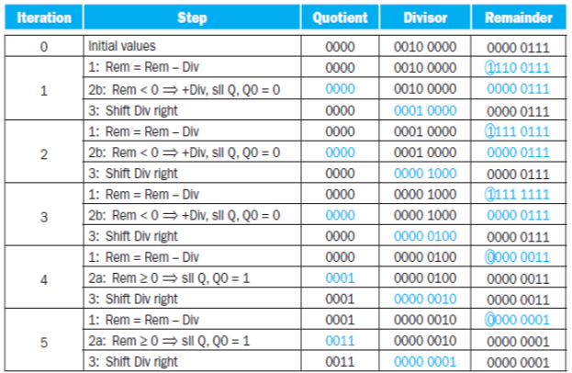
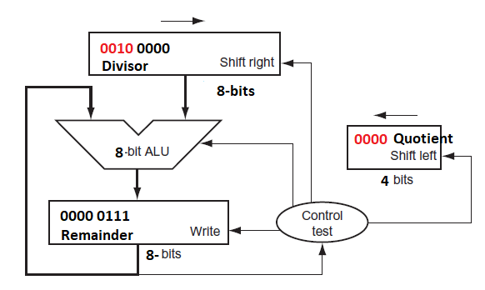
Example: Divide 7 by 2
07= 0111 (Dividend) 2 = 0010 (Divisor)
first subtract the divisor in step 1;
If the result is positive, the divisor was smaller or equal to the dividend, so we generate a 1 in the quotient
If the result is negative, the next step is to restore the original value by adding the divisor back to the remainder and generate a 0 in the quotient
The divisor is shifted right and then we iterate again.
The remainder and quotient will be found in their namesake registers after the iterations are complete.
Quotient register set to 0.
Place the divisor in the left half of Divisor Register
Remainder register is initialized with the dividend.
In each iteration of the algorithm
Move the divisor to the right one digit

Slide 25
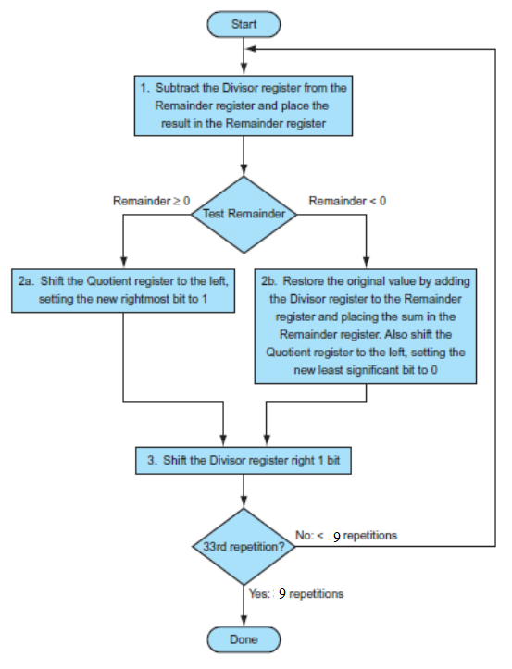
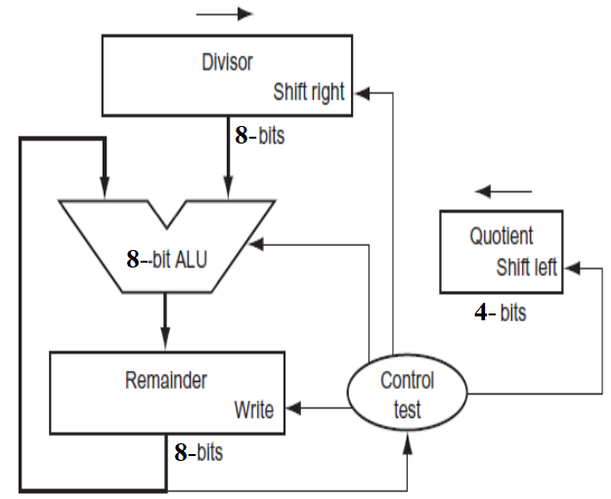

Slide 26
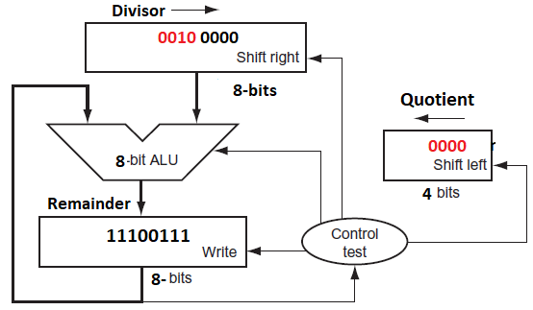
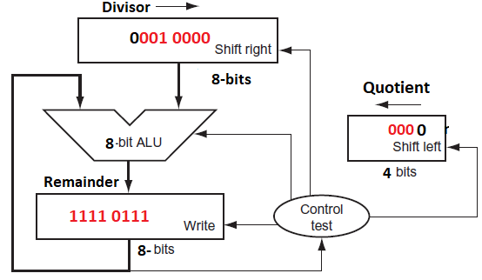
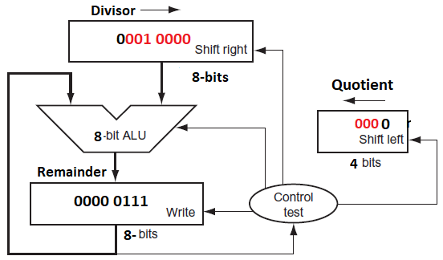
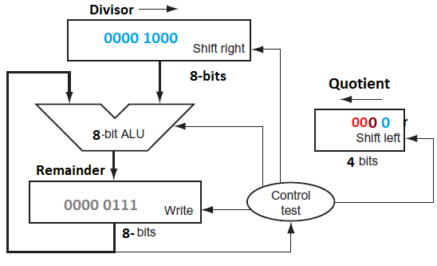

Slide 28
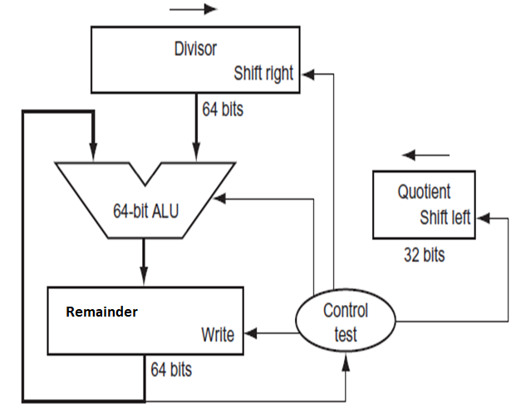
Quotient register set to 0.
Place the divisor in the left half of Divisor Register
Remainder register is initialized with the dividend.
In each iteration of the algorithm
Move the divisor to the right one digit
first subtract the divisor in step 1;
If the result is positive, the divisor was smaller or equal to the dividend, so we generate a 1 in the quotient
If the result is negative, the next step is to restore the original value by adding the divisor back to the remainder and generate a 0 in the quotient
The divisor is shifted right and then we iterate again.
The remainder and quotient will be found in their namesake registers after the iterations are complete.

Slide 31
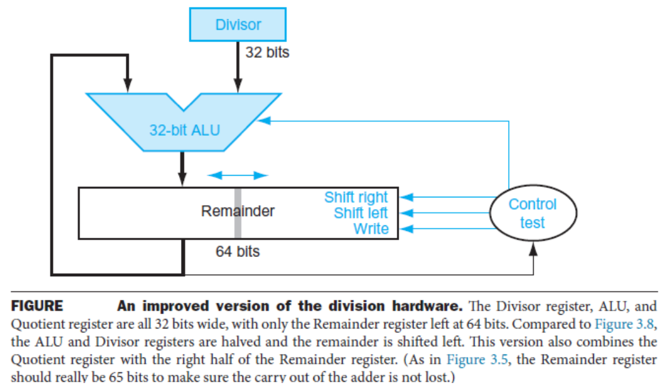

Slide 32
Floating Point Representation

Slide 34
0 00000000 00000000000000000000000 = 0
1 00000000 00000000000000000000000 = -0
0 11111111 00000000000000000000000 = Infinity
1 11111111 00000000000000000000000 = -Infinity

Slide 35



Slide 43
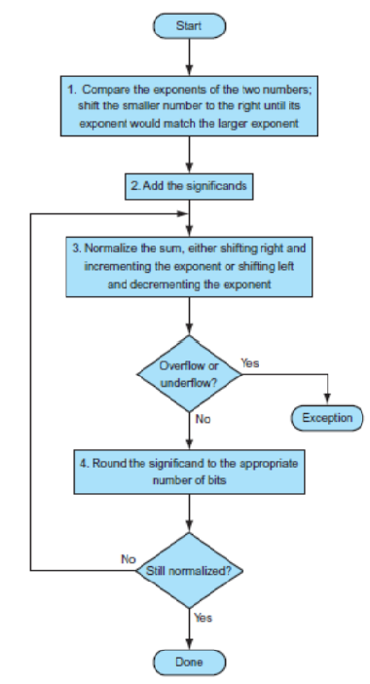

Slide 44
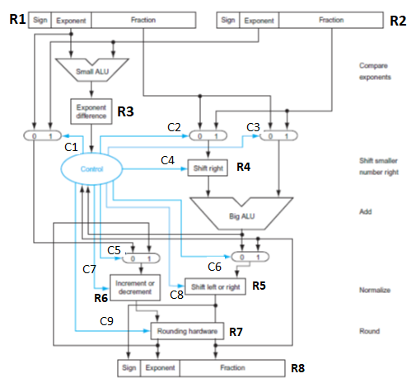
Question Using the hardware given to the right, show the addition of two numbers in steps as it would take place. A = 8.625, B = - 7.125 Show the steps in detail. Also show the contents of different registers (R1, .. R8) and control bits (C1, .. C9). It is noted that Control bits (C1, .. C9) could be either 1 or 0 and you can assign the logic levels for particular operations. You must present your answer in a Table, given below. (Increase no of columns and rows as required)

Slide 48

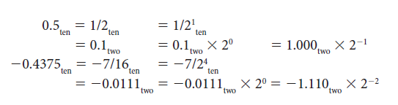
Example: FLOATING POINT ADDITION

Slide 49
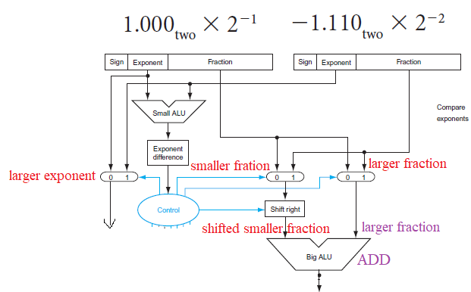

Slide 50
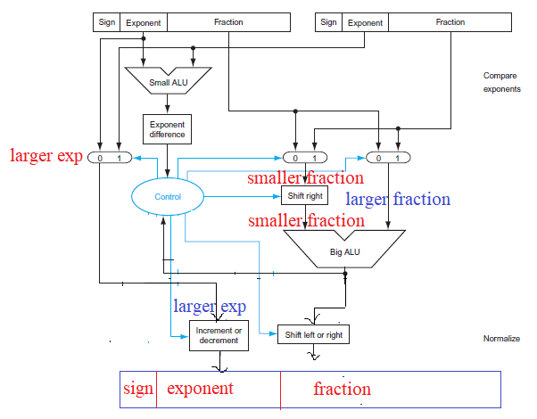

Slide 51
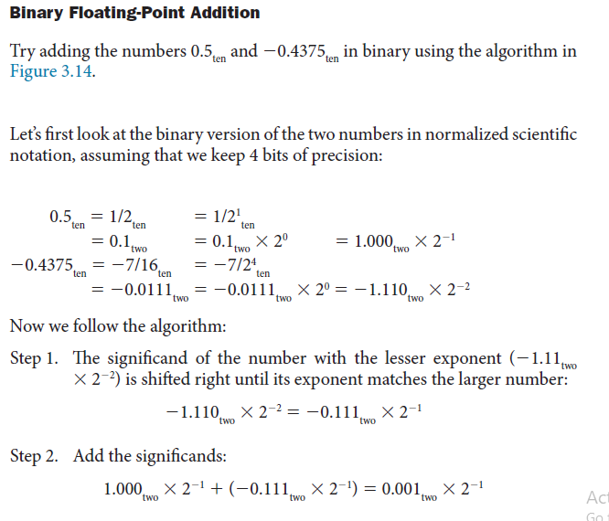

Slide 52
