Slide 1
Key Questions
How to measure performance of a CPU & a computer?
What are the performance measures used?
Which is the most acceptable/reliable performance measure? Why?

Slide 2
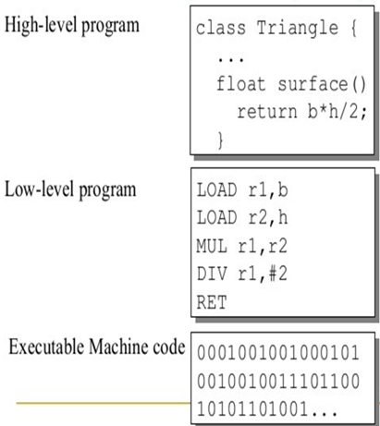
Factors deciding Performance
Algorithm
  Determines number of operations executed
Programming language, compiler, architecture
  Determine number of machine instructions executed per operation
Processor and memory system
  Determine how fast instructions are executed
I/O system (including OS)
  Determines how fast I/O operations are executed
Notes:
Morgan Kaufmann Publishers
Chapter 1 — Computer Abstractions and Technology

Slide 3
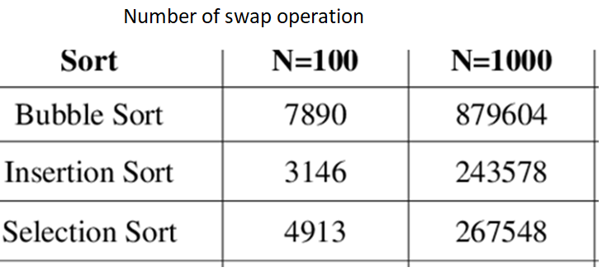
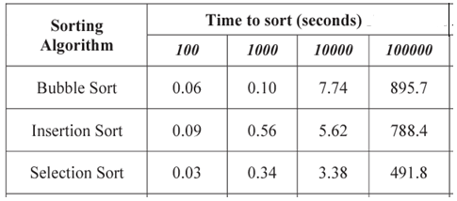
Algorithms

Slide 4
Performance Measures
Processing time of a single instruction in second
Processing time of a single instruction in CPU Clock Cycles
CPU Clock Cycles per Instruction
CPU Clock Cycles of a Program
Average CPU Clock Cycles
Number of Instructions per second
Processing time of a program
Processing time of a standard program
Performance
Speed-up Factor

Slide 5
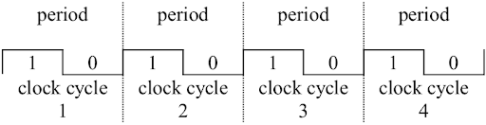
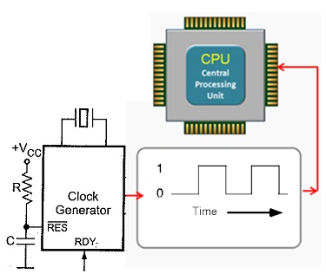
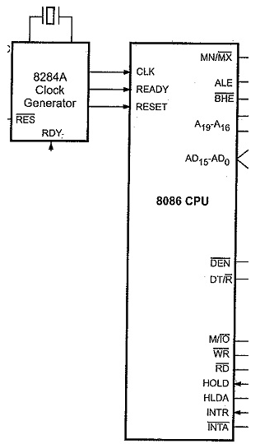
CPU CLOCK: A Timing Signal
CPU CLOCK: An Electronic Signal used to initiate any basic operation. Also used to sequence next operation. Synchronize all operations

Slide 6
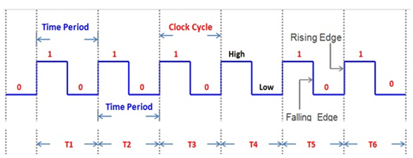
CPU Clocking
Each CPU/Microprocessor requires a highly precise square wave like electronic signal as input, called Clock signal
This signal is often generated by an external IC and input to processor
Operation of CPU and computer hardware are strictly controlled by this signal.
CPU/Computers use this electronic signal to determine when events take place within hardware
Basic operations and execution of any instruction are controlled by this signal.
Run time of any instruction or of a program also depend on this electronic signal
Clock signal is defined by two parameters
Clock period: duration of a clock cycle
Measured in Sec, milli-sec, micro-sec, nano-sec, pico-sec etc
Clock rate or clock frequency: clock cycles per second (inverse of clock cycle time)
Clock frequency: cycles per second
Measured in Hz, Kilo-Hz(KHz), Mega-Hz(MHz), Giga-Hz(GHz) etc
Notes:
Morgan Kaufmann Publishers
Chapter 1 — Computer Abstractions and Technology

Slide 7
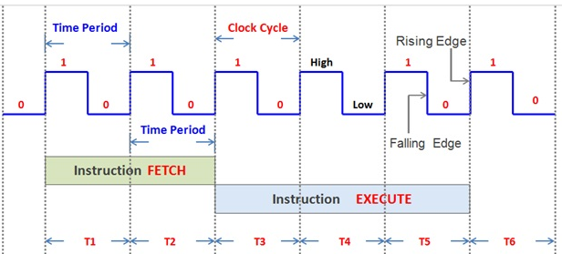
CPU Clocking
If T = 1 Sec ; Clock Frequency = 1/1sec = 1Hz
If T = 1 milli-sec ; Clock Frequency = 1/10 ⁻ ³ sec = 1000 Hz = 1KHz
If T = 1 micro-sec ; Clock Frequency = 1/10 ⁻ ⁶ sec = 10⁶ Hz = 1MHz
If T = 1 nano-sec ; Clock Frequency = 1/10 ⁻ ⁹ sec = 10⁹ Hz = 1GHz
Example: 3 GigaHertz clock rate means
clock cycle time = 1/(3x10⁹) seconds
= 333 picoseconds (ps)

Slide 8
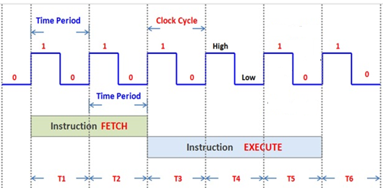
CPU Time for an Instruction
Time period: 1ns = 1×10^{–9} s
Frequency: 1 GHz
Addition Operation
Example: Addition Operation
CPU Time = 3ns = 3×10^{–9} s
CPU Time = 3 Cycles per Addition = 3 CPI for Addition
CPU Time = CPI x Time period of Clock signal = 3 x 1ns = 3ns
Notes:
Morgan Kaufmann Publishers
Chapter 1 — Computer Abstractions and Technology

Slide 9
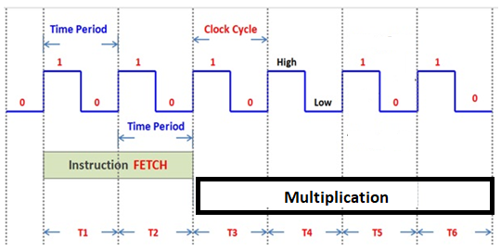

CPU Time for an Instruction
Clock period: 1ns = 1×10^{–9} s
Clock frequency: 1 GHz
Example: Multiplication Operation
Time = 4ns = 4×10^{–9} s
Time: 4 CPU Clock cycles = 4 CPI for Multiplication
Time = CPI x Clock period = 4 x 1ns = 4ns
Notes:
Morgan Kaufmann Publishers
Chapter 1 — Computer Abstractions and Technology

Slide 10
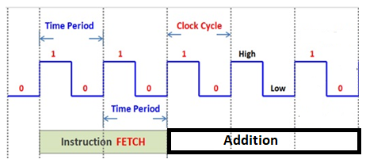
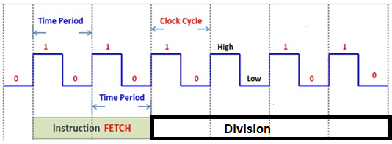
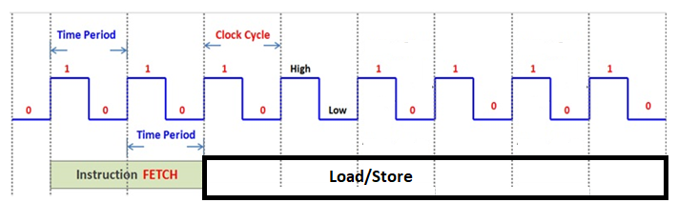
CPI for different Instructions

Slide 11
Example: Cycles Per Instruction (CPI)
Clock cycle
cycle 1
cycle 2
cycle 3
CPU Clock rate, f =1MHz; Clock Cycle, C = 1 micro second
If CPU takes 1 micro second to complete an Instruction, then CPI =1 for that Instruction.
If CPU takes 3 micro seconds to complete another Instruction, then CPI =3 for that Instruction.
If CPU Clock rate, f =2MHz; Clock Cycle, C = 0.5 micro second
If CPU takes 1 micro second to complete an Instruction, then CPI =2 for that Instruction.
If CPU takes 3 micro seconds to complete another Instruction, then CPI =6 for that Instruction.

Slide 12
Can we find CPI of a Program?
A program contains different types of instructions having different CPI values.
Types of Instruction: Arithmetic, Logical, Data Transfer, Branch etc
Given the number of instruction of different types, we can calculate the Average CPI of a program.
Program in Assembly language
LOAD R1, A
ADD R1, B
ADD R1, C
MOV R2, R1
OUT 25, R2

Slide 13
Average CPI
For a given program executed on a given CPU
Avg CPI = Total CPU Clock cycles for all instruction of program
Instructions count in the program
Example: A program contains following instructions. CPI for different types of instructions are indicated. Calculate the Average CPI of the CPU for the program.
Instruction type | Instruction Count | CPI
ALU | 500 | 2
Load | 200 | 4
Store | 200 | 4
Branch | 100 | 6
Answer: Avg CPI = (500x2 + 200x4 + 200x4 + 100x6)/1000

Slide 14
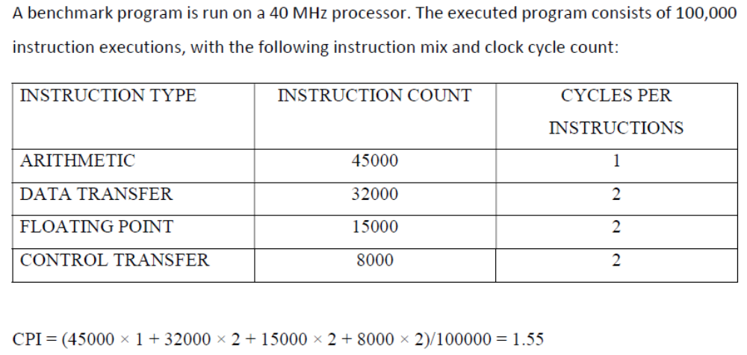
Example: Average CPI

Slide 15
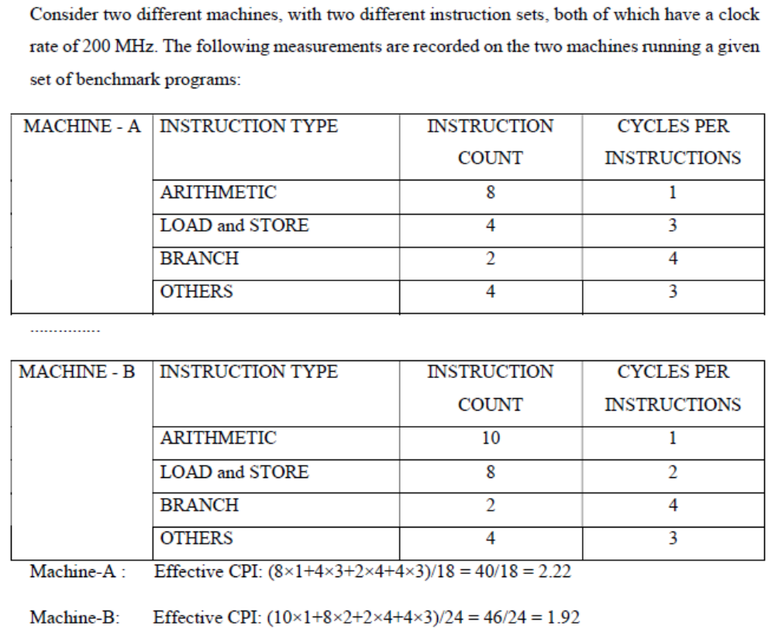
Example: Average CPI

Slide 16
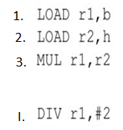
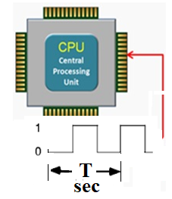
CPU Execution Time: The CPU Equation
A program is comprised of a I number of instructions
Total number of Instructions = I
The average number of clock cycles per instruction= CPI
CPU has a fixed clock cycle time, T = 1/clock frequency
CPU time = Seconds = Instructions x Cycles x Seconds
Program Program Instruction Cycle
CPU Time = I x CPI x T
execution Time
per program in seconds
Number of
instructions executed
Average CPI for program
CPU Clock Period

Slide 17
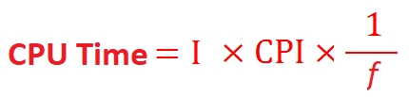
CPU Performance Equation
For a given program:
CPU Time = I x CPI x T

Slide 18
CPU Execution Time: Example
A Program is running on a CPU with the following parameters:
  Total instruction in program = 10,000,000
  Average CPI for the program, CPI = 2.5
  CPU clock frequency, f = 200 MHz.
  (Time Period, T = 1/f = 5x10⁻⁹ seconds)
What is the execution time for this program:
CPU time = Instruction count x CPI x Clock period
= 10,000,000 x 2.5 x 1 / frequency
= 10,000,000 x 2.5 x 5x10⁻⁹
= 0.125 seconds
CPU time = Seconds = Instructions x Cycles x Seconds
Program Program Instruction Cycle

Slide 19
Components That Affect
Performance Factors
Component (HW/SW) | Factors Affected
Algorithm | Total Instruction Count, CPI
Programming Language | Total Instruction Count, CPI
Compiler | Total Instruction Count, CPI
Instruction Set Architecture | Total Instruction Count, CPI, Clock frequency
Component (HW/SW) | Perf Factors Affected
Algorithm
Programming Language
Compiler
Instruction Set Architecture
Notes:
Algorithm
[Instruction count, possibly CPI]
The algorithm determines the number of source program instructions executed and hence the number of processor instructions executed. The algorithm may also affect the CPI, by favoring slower or faster instructions. For example, if the algorithm uses more floating-point operations, it will tend to have a higher CPI.
Programming language
[Instruction count, CPI]
The programming language certainly affects the instruction count, since statements in the language are translated to processor instructions, which determine instruction count. The language may also affect the CPI because of its features; for example, a language with heavy support for data abstraction (e.g., Java) will require indirect calls, which will use higher CPI instructions.
Compiler
[Instruction count, CPI]
The efficiency of the compiler affects both the instruction count and average cycles per instruction, since the compiler determines the translation of the source language instructions into computer instructions. The compiler’s role can be very complex and affect the CPI in complex ways.
Instruction set architecture
[Instruction count, clock rate, CPI]
The instruction set architecture affects all three aspects of CPU performance, since it affects the instructions needed for a function, the cost in cycles of each instruction, and the overall clock rate of the processor

Slide 20
CPU Time = Total Instruction x CPI x Clock period
Depends on:
Program Used
Compiler
ISA
Instruction Count I
Depends on:
Program Used
Compiler
ISA
CPU Organization
Depends on:
CPU Organization
Technology (VLSI)
CPI
Time
Period
of clock
T
(Average
CPI)

Slide 21
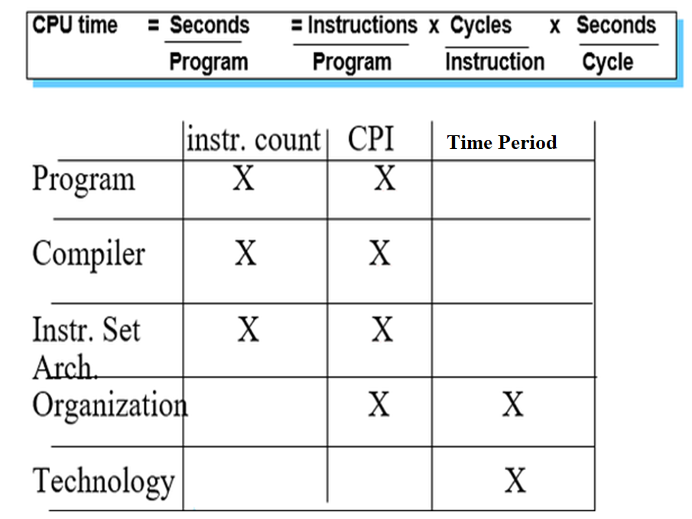

Slide 22
Computer Performance Measures: Program Execution Time
How can one measure the performance of CPU running a program?
  CPU is said to be faster or has better performance running this program if the total execution time is shorter.
  Thus the inverse of the total measured program execution time is a possible performance measure or metric:
  Performance = 1 /Execution Time

Slide 23
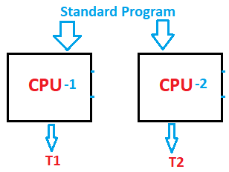


Measuring CPU Performance
Execution time
  Time to complete one task
Throughput
  Tasks completed per unit time
CPU-1 runs N times faster than CPU-2
Notes:
CS252 S05

Slide 24
Comparing Computer Performance Using Execution Time
To compare the performance of two CPUs “A”, “B” running a given specific program:
Performance_{A} = 1 / Execution Time_{A}
Performance_{B} = 1 / Execution Time_{B}
CPU A is n times faster than machine B means (or slower? if n < 1) :
Example:
For a given program:
  CPU time on A = 1 second
  CPU time on B = 10 seconds
  Performance_{A} / Performance_{B} = 10 / 1 = 10
  The performance of CPU A is 10 times the performance of CPU B
Performance_{A}
Execution Time_{B}
Speedup = n = =
Performance_{B}
Execution Time_{A}
Speedup =

Slide 25
Performance Comparison
A Program is running on a specific machine (CPU) with the following parameters:
  Total instruction count, I = 10,000,000 instructions
  Average CPI for the program = 2.5 cycles/instruction.
  Clock Frequency = 200 MHz.
Using the same program with these changes:
  A new compiler used: New instruction count, I = 9,500,000
  New CPI: 3.0
  Faster CPU implementation: New clock frequency = 300 MHz
What is the speedup with the changes?
Speedup = (10,000,000 x 2.5 x 5x10⁻⁹) / (9,500,000 x 3 x 3.33x10⁻⁹ )
= 0.125 / 0.095 = 1.32
T(old) = 1/(200x10⁶)= 5x10⁻⁹ seconds
T(new)= 1/(300x10⁶)= 3.33x10⁻⁹ seconds
Speedup = Old Execution Time = I_{old} x CPI_{old} x T_{old}
New Execution Time I_{new} x CPI_{new} x T_{new}

Slide 26
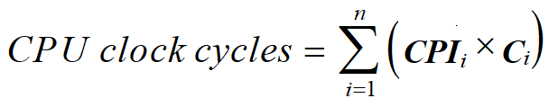
Instruction Types & CPI
Given a program with n types or classes of instructions executed on a given CPU with the following characteristics:
  C_{i} = Count of instructions of type_{i} executed
  CPI_{i} = Cycles per instruction for type_{i}
Then:
CPI = CPU Clock Cycles / Instruction Count I
  Where:
  Executed Instruction Count I = Σ C_{i}
i = 1, 2, …. n
Depends on CPU Design
i.e average or effective CPI
Executed

Slide 27
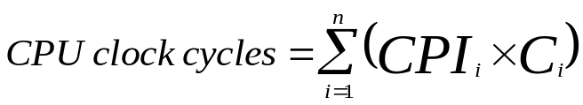
Instruction Types & CPI: An Example
An instruction set has three instruction classes:
Two code sequences have the following instruction counts:
CPU cycles for sequence 1 = 2 x 1 + 1 x 2 + 2 x 3 = 10 cycles
CPI for sequence 1 = clock cycles / instruction count
= 10 /5 = 2
CPU cycles for sequence 2 = 4 x 1 + 1 x 2 + 1 x 3 = 9 cycles
CPI for sequence 2 = 9 / 6 = 1.5
Instruction class CPI
A 1
B 2
C 3
For a specific
CPU design
Instruction counts for instruction class
Code Sequence A B C
1 2 1 2
2 4 1 1
i.e average or effective CPI
CPI = CPU Cycles / I

Slide 28
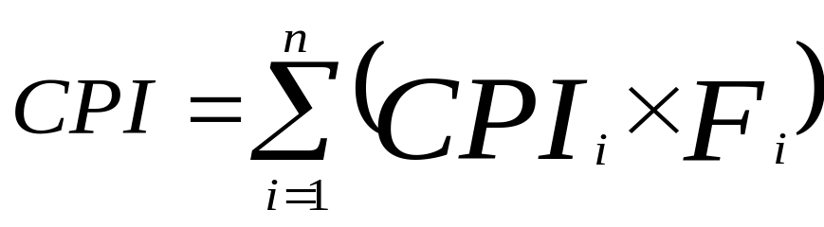
Instruction Frequency & CPI
Given a program with n types or classes of instructions with the following characteristics:
  C_{i} = Count of instructions of type_{i} executed
  CPI_{i} = Average cycles per instruction of type_{i}
  F_{i} = Frequency or fraction of instruction type_{i} executed
  = C_{i}/ total executed instruction count = C_{i}/ I
  Then:
i = 1, 2, …. n
Where: Executed Instruction Count I = Σ C_{i}
i.e average or effective CPI
CPI_{i} x F_{i}
Fraction of total execution time for instructions of type i =
CPI
T = I x CPI x C

Slide 29
Instruction Type Frequency & CPI:
A RISC Example
CPI_{i} x F_{i}
Program Profile or Executed Instructions Mix
CPI
Depends on CPU Design
Base Machine (Reg / Reg)
Op Freq, F_{i} CPI_{i} CPI_{i} x F_{i} % Time
ALU 50% 1 .5 23% = .5/2.2
Load 20% 5 1.0 45% = 1/2.2
Store 10% 3 .3 14% = .3/2.2
Branch 20% 2 .4 18% = .4/2.2
Given
Sum = 2.2
Typical Mix
i.e average or effective CPI
CPI = .5 x 1 + .2 x 5 + .1 x 3 + .2 x 2 = 2.2
= .5 + 1 + .3 + .4
T = I x CPI x C

Slide 30
MIPS (Million Instructions Per Second) Rating
For a specific program running on a specific CPU the MIPS rating is a measure of how many millions of instructions are executed per second:
MIPS Rating = Instruction count / (Execution Time x 10⁶)
= Instruction count / (CPU clocks x Cycle time x 10⁶)
= (Instruction count x Clock rate) / (Instruction count x CPI x 10⁶)
= Clock rate / (CPI x 10⁶)
Major problem with MIPS rating: As shown above the MIPS rating does not account for the count of instructions executed (I).
  A higher MIPS rating in many cases may not mean higher performance or better execution time. i.e. due to compiler design variations.
In addition the MIPS rating:
  Does not account for the instruction set architecture (ISA) used.
    Thus it cannot be used to compare computers/CPUs with different instruction sets.
  Easy to abuse: Program used to get the MIPS rating is often omitted.
    Often the Peak MIPS rating is provided for a given CPU which is obtained using a program comprised entirely of instructions with the lowest CPI for the given CPU design which does not represent real programs.

Slide 31
MIPS (Million Instructions Per Second) Rating
Under what conditions can the MIPS rating be used to compare performance of different CPUs?
The MIPS rating is only valid to compare the performance of different CPUs provided that the following conditions are satisfied:
  The same program is used
  (actually this applies to all performance metrics)
  The same ISA is used
  The same compiler is used
    (Thus the resulting programs used to run on the CPUs and
    obtain the MIPS rating are identical at the machine code level including the same instruction count)
(binary)

Slide 32
Compiler Variations, MIPS & Performance:
An Example
For a machine (CPU) with instruction classes:
For a given high-level language program, two compilers produced the following executed instruction counts:
The machine is assumed to run at a clock rate of 100 MHz.
Instruction class CPI
A 1
B 2
C 3
Instruction counts (in millions)
for each instruction class
Code from: A B C
Compiler 1 5 1 1
Compiler 2 10 1 1

Slide 33
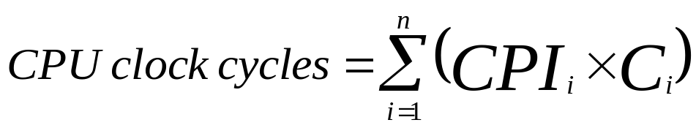
Compiler Variations, MIPS & Performance:
An Example (Continued)
MIPS = Clock rate / (CPI x 10⁶) = 100 MHz / (CPI x 10⁶)
CPI = CPU execution cycles / Instructions count
CPU time = Instruction count x CPI / Clock rate
For compiler 1:
  CPI₁ = (5 x 1 + 1 x 2 + 1 x 3) / (5 + 1 + 1) = 10 / 7 = 1.43
  MIPS Rating₁ = 100 / (1.428 x 10⁶) = 70.0 MIPS
  CPU time₁ = ((5 + 1 + 1) x 10⁶ x 1.43) / (100 x 10⁶) = 0.10 seconds
For compiler 2:
  CPI₂ = (10 x 1 + 1 x 2 + 1 x 3) / (10 + 1 + 1) = 15 / 12 = 1.25
  MIPS Rating₂ = 100 / (1.25 x 10⁶) = 80.0 MIPS
  CPU time₂ = ((10 + 1 + 1) x 10⁶ x 1.25) / (100 x 10⁶) = 0.15 seconds
MIPS rating indicates that compiler 2 is better
while in reality the code produced by compiler 1 is faster

Slide 34
MFLOPS (Million FLOating-Point Operations Per Second)
A floating-point operation is an addition, subtraction, multiplication, or division operation applied to numbers represented by a single or a double precision floating-point representation.
MFLOPS, for a specific program running on a specific computer, is a measure of millions of floating point-operation (megaflops) per second:
MFLOPS = Number of floating-point operations / (Execution time x 10⁶ )
MFLOPS rating is a better comparison measure between different machines (applies even if ISAs are different) than the MIPS rating.
  Applicable even if ISAs are different
Program-dependent: Different programs have different percentages of floating-point operations present. i.e compilers have no floating- point operations and yield a MFLOPS rating of zero.
Dependent on the type of floating-point operations present in the program.
  Peak MFLOPS rating for a CPU: Obtained using a program comprised entirely of the simplest floating point instructions (with the lowest CPI) for the given CPU design which does not represent real floating point programs.

