Slide 1
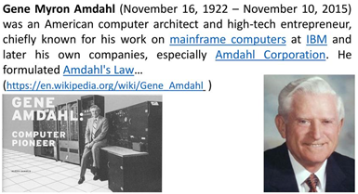
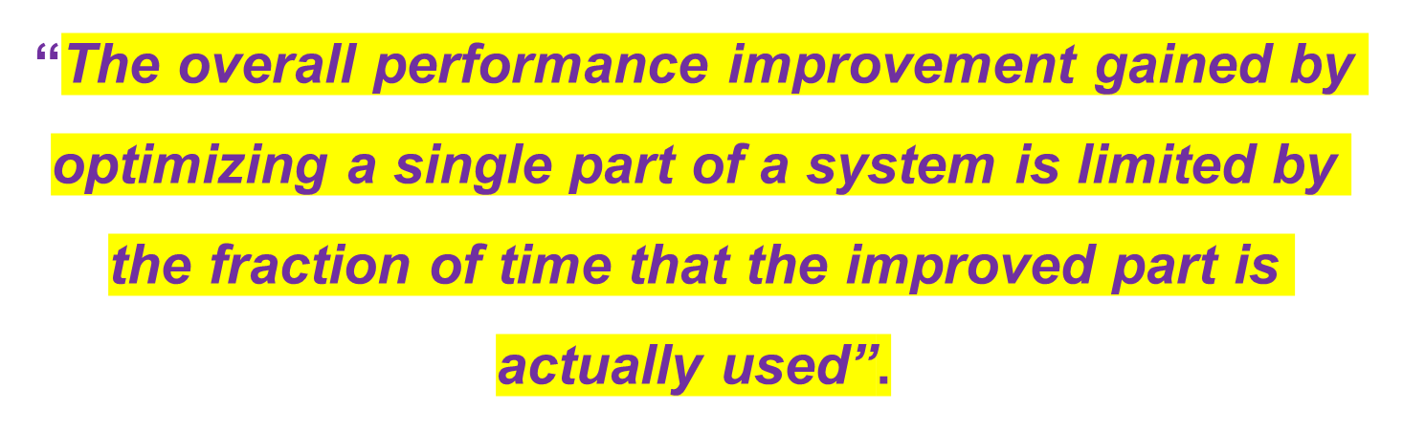
Amdahl's law

Slide 2
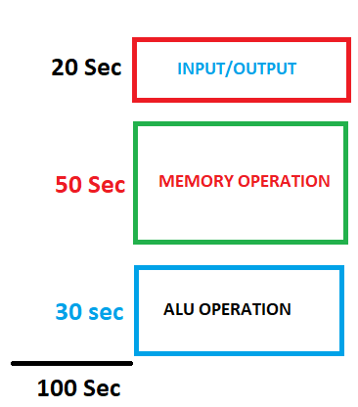
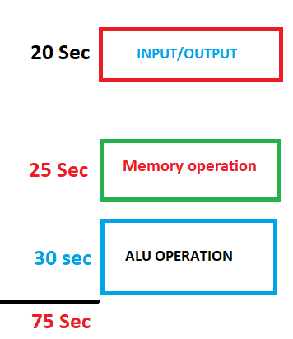

Speed up
New system
(Memory upgraded only)
Old system
= 100/75 = 1.33

Slide 3
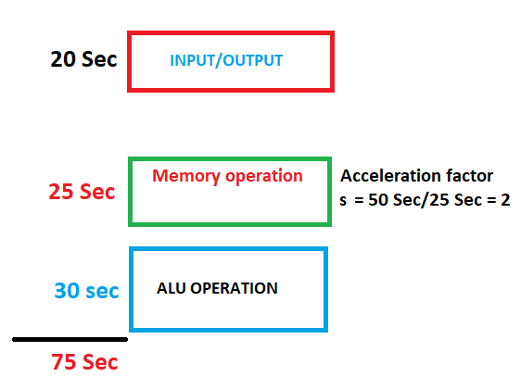
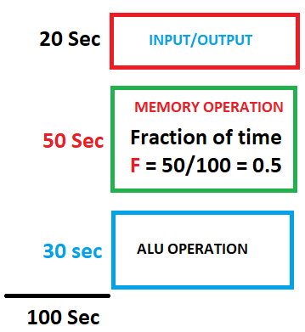

Old system
New system(Memory upgraded only)
Normalized Rum time = 1
Amdahl’s law
= 100/75 = 1.33

Slide 4
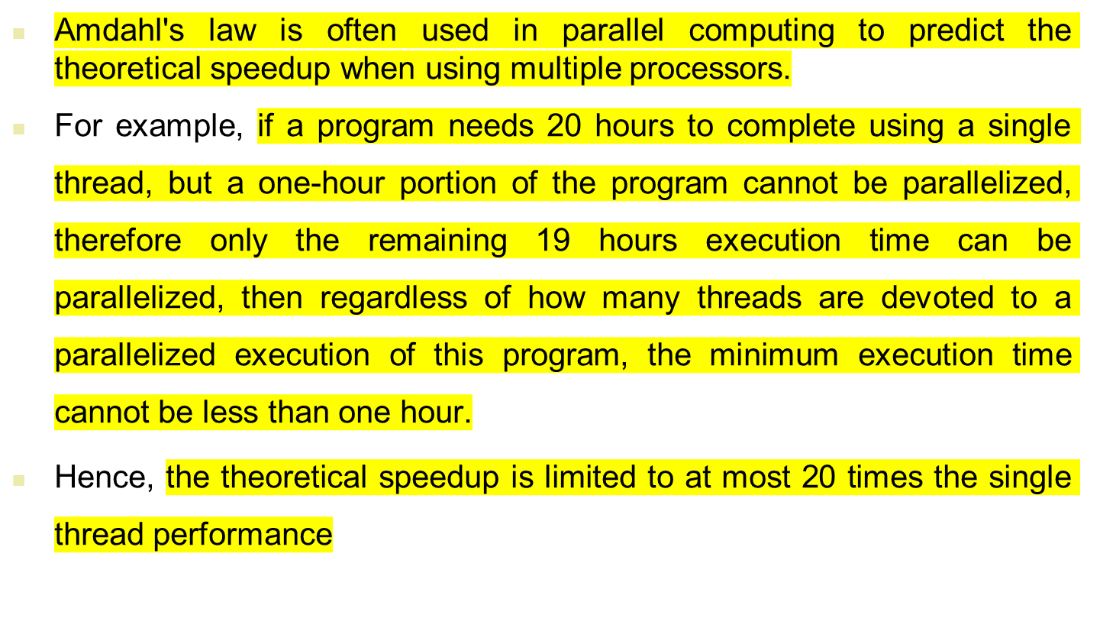
Amdahl's law

Slide 5
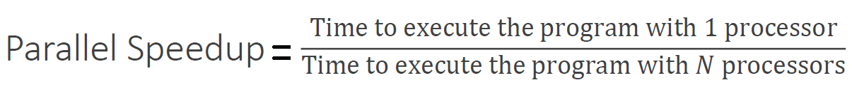
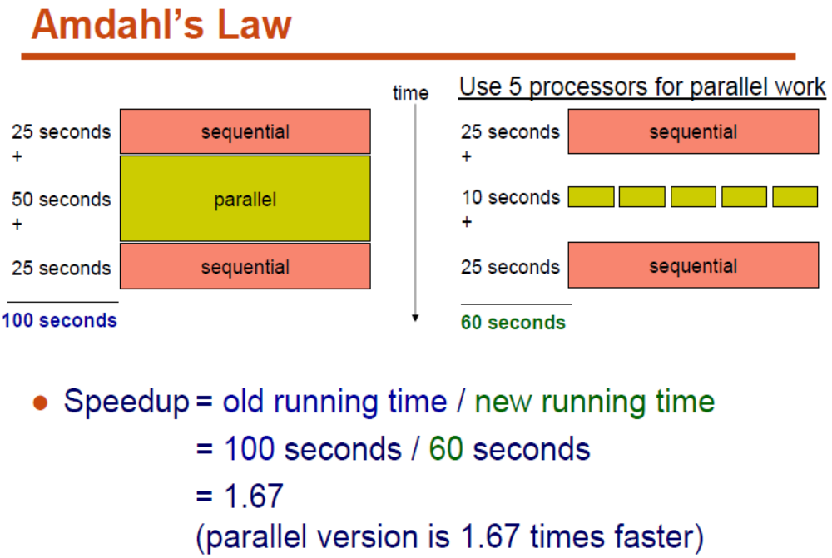
Parallel Architecture

Slide 6
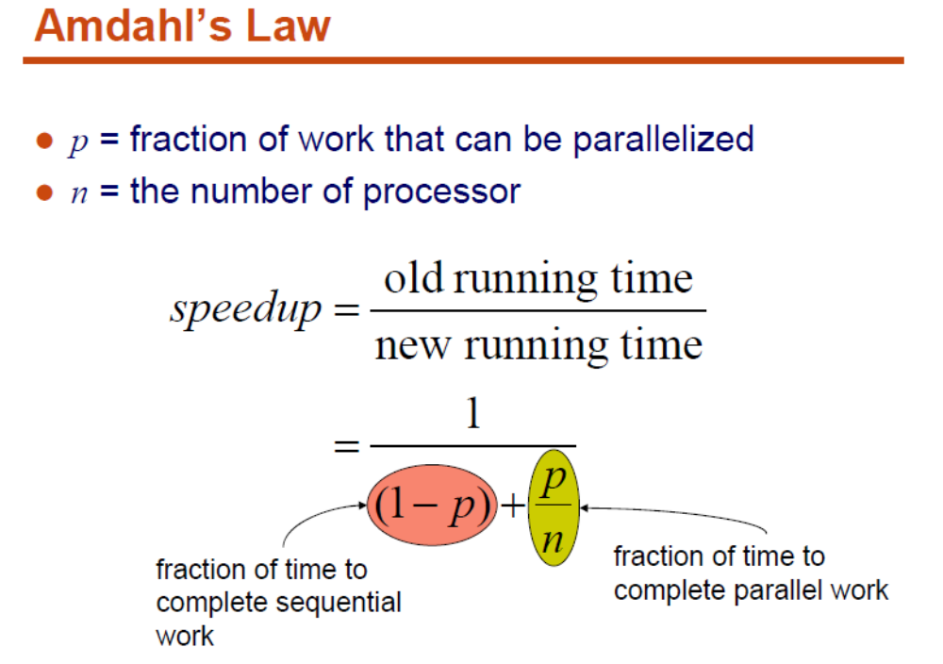

Slide 7
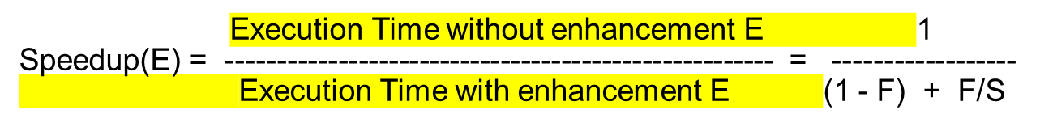
Amdahl’s Law
Before:
Execution Time without enhancement E: (Before enhancement is applied)
shown normalized to 1 = (1-F) + F =1
Unaffected fraction: (1- F)
Affected fraction: F
Unchanged
Unaffected fraction: (1- F)
F/S
After:
Execution Time with enhancement E:
What if the fraction given is
after the enhancement has been applied?
How would you solve the problem?
(i.e find expression for speedup)

Slide 8
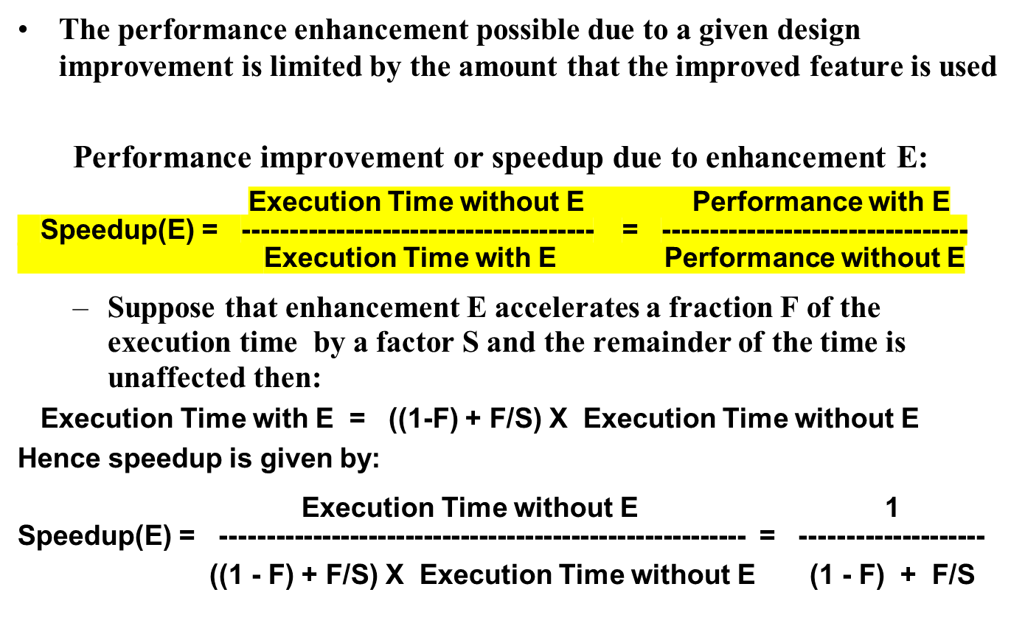
Amdahl's Law
original

Slide 9
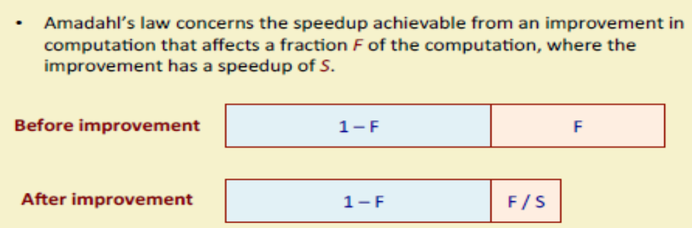
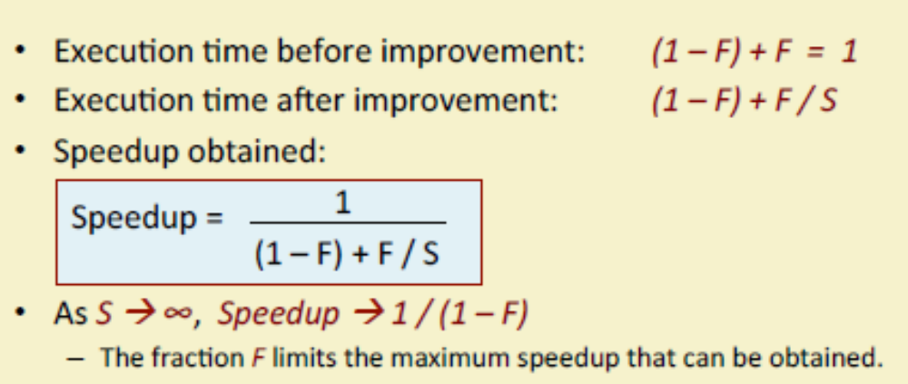
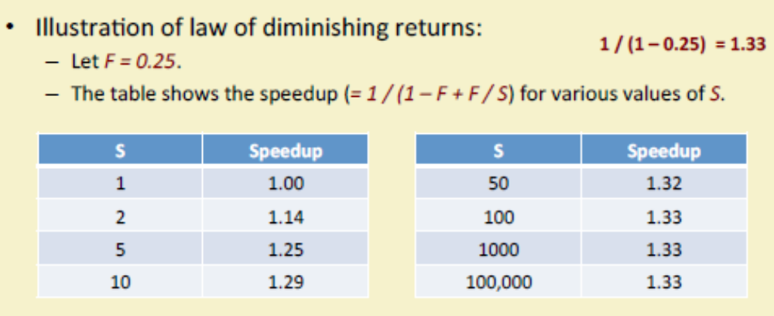

Slide 10
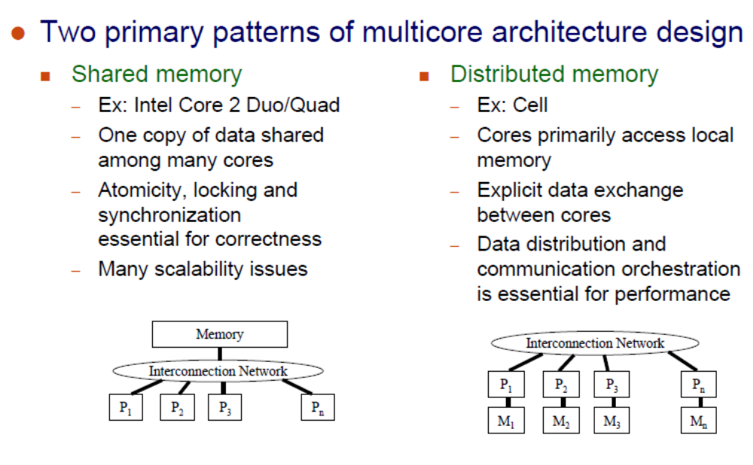

Slide 11
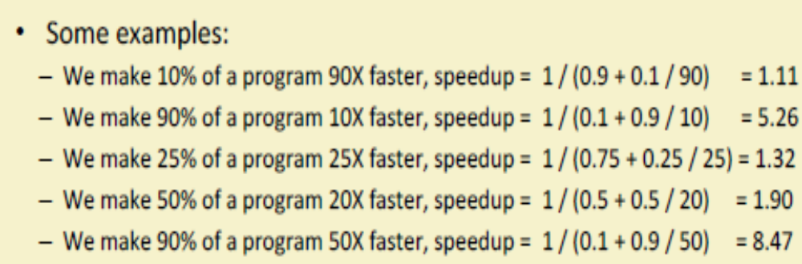

Slide 12
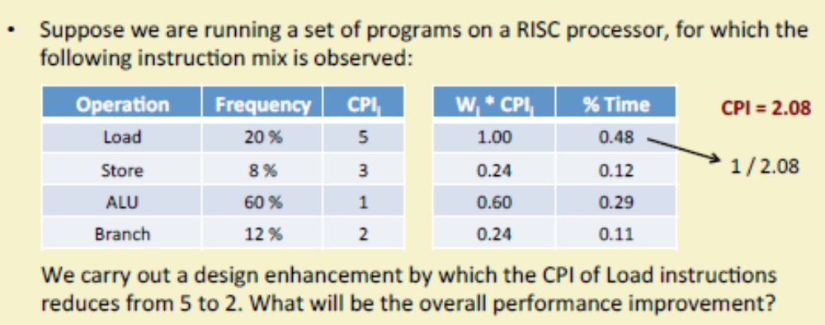
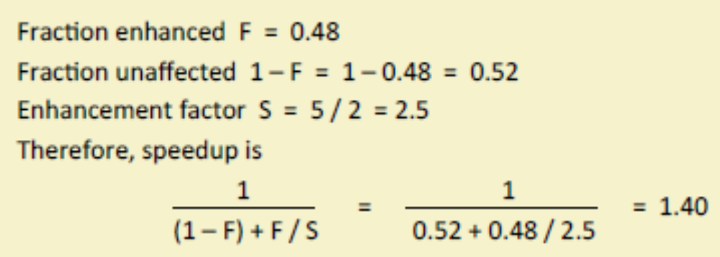
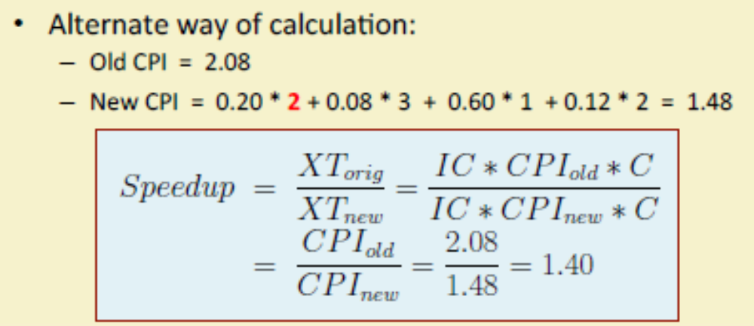

Slide 13
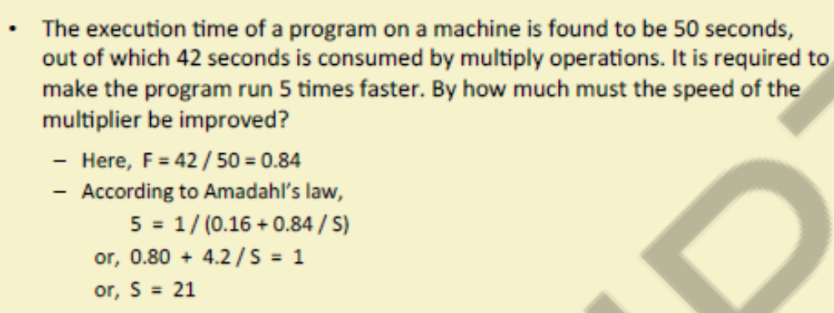
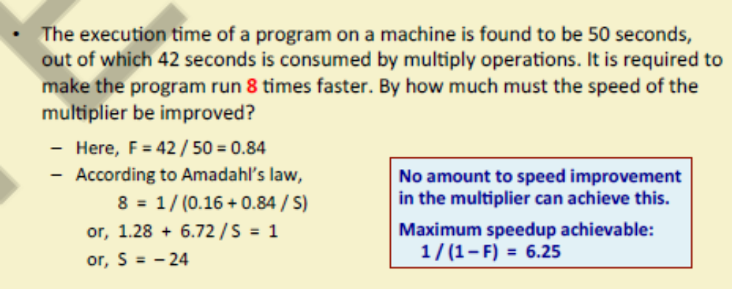

Slide 14
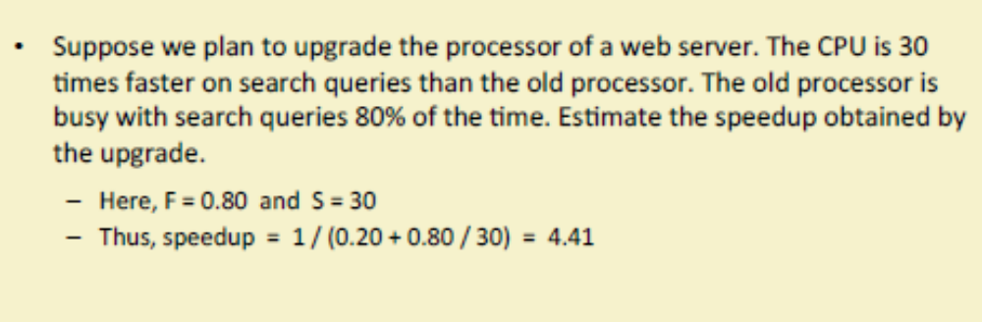

Slide 15
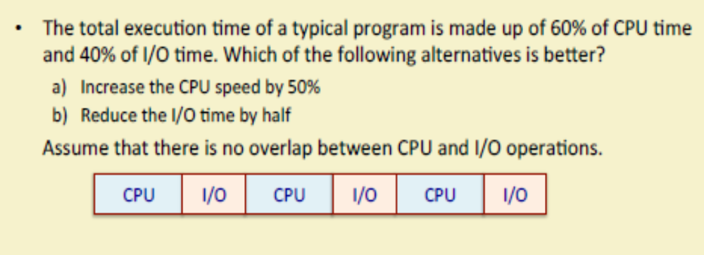
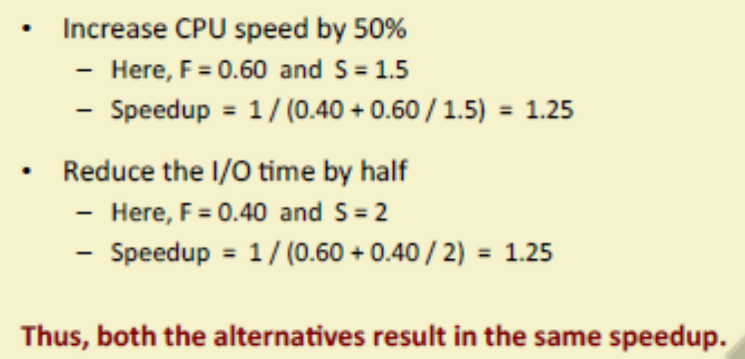

Slide 16
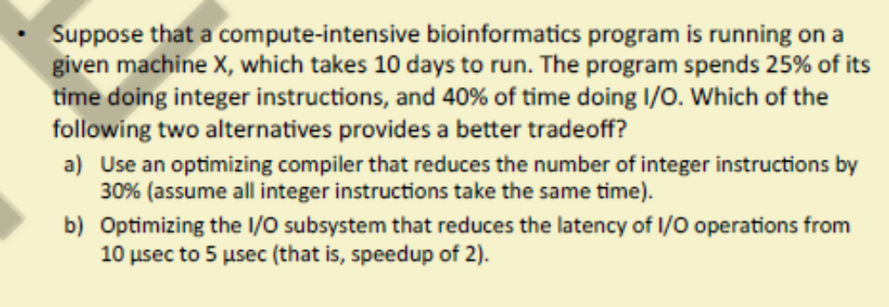
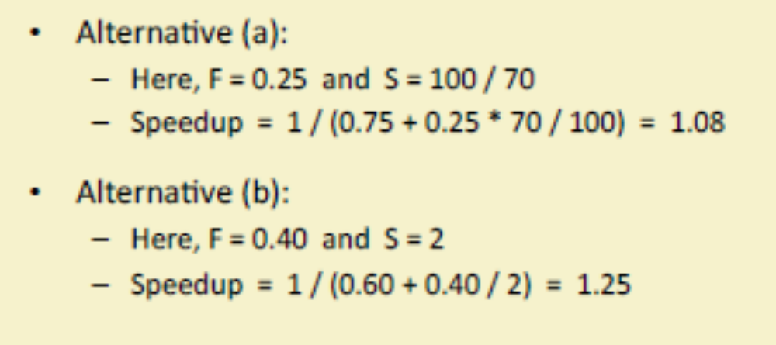

Slide 17
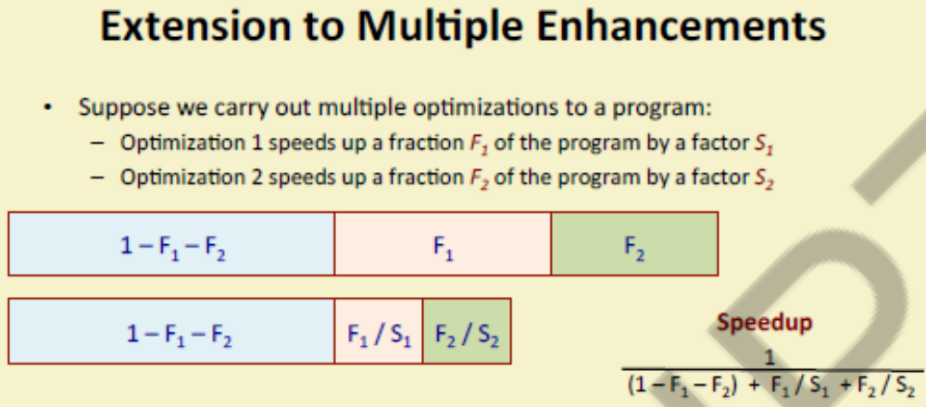
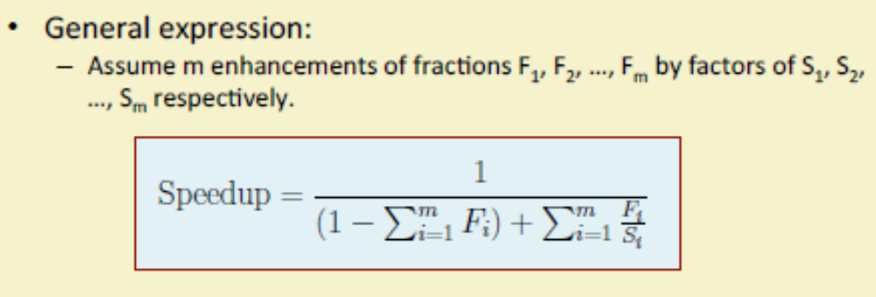

Slide 18
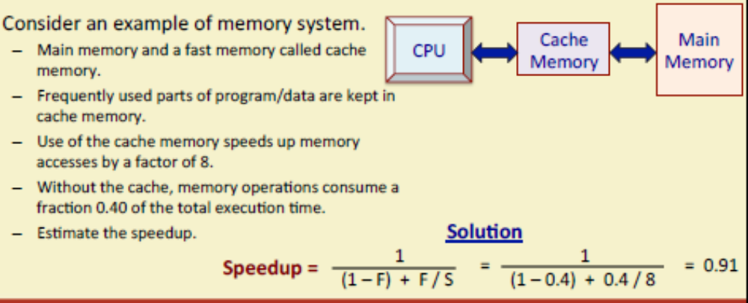
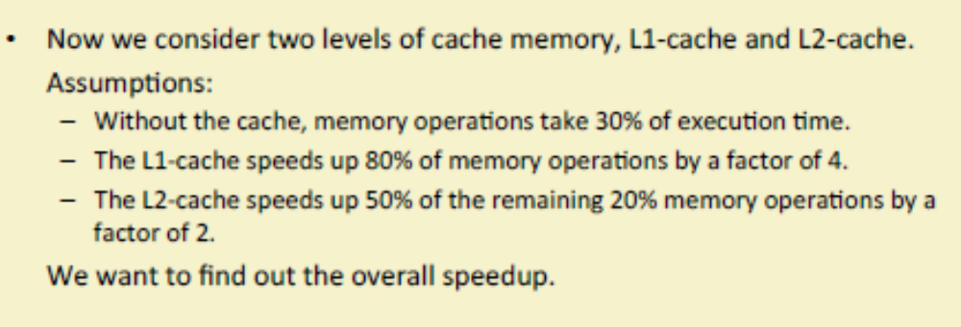
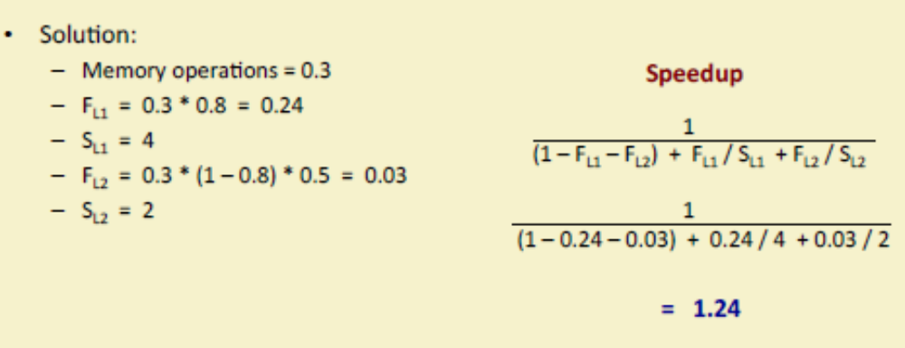

Slide 19
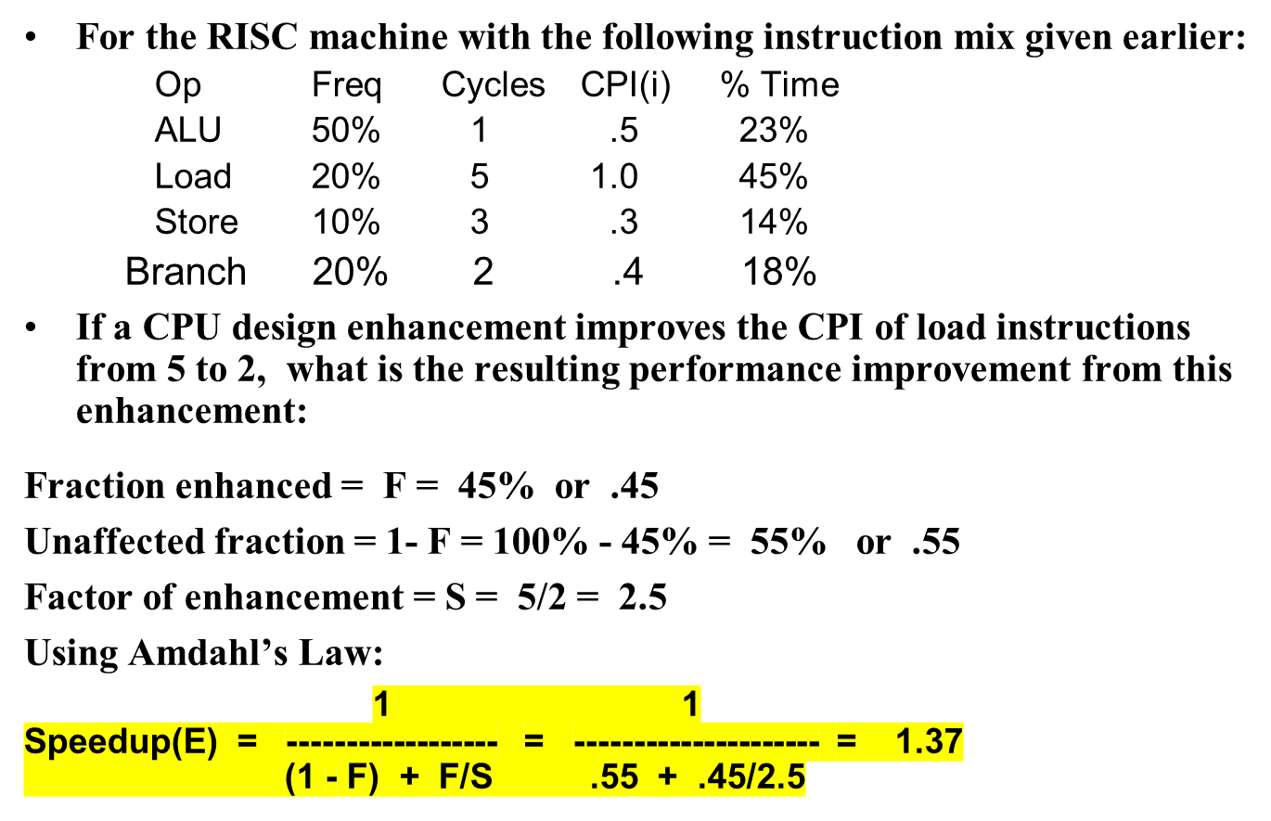
Performance Enhancement Example
CPI = 2.2

Slide 20
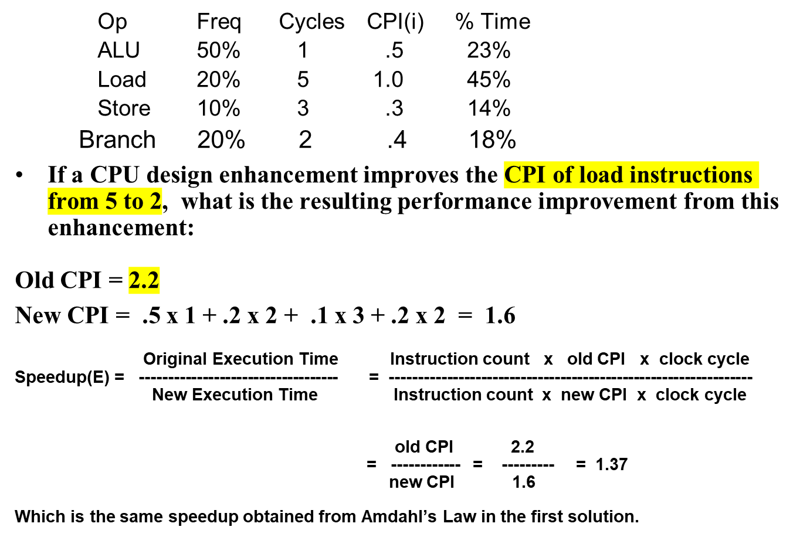
An Alternative Solution Using CPU Equation
CPI = 2.2
New CPI of load is now 2 instead of 5
T = I x CPI x C

Slide 21
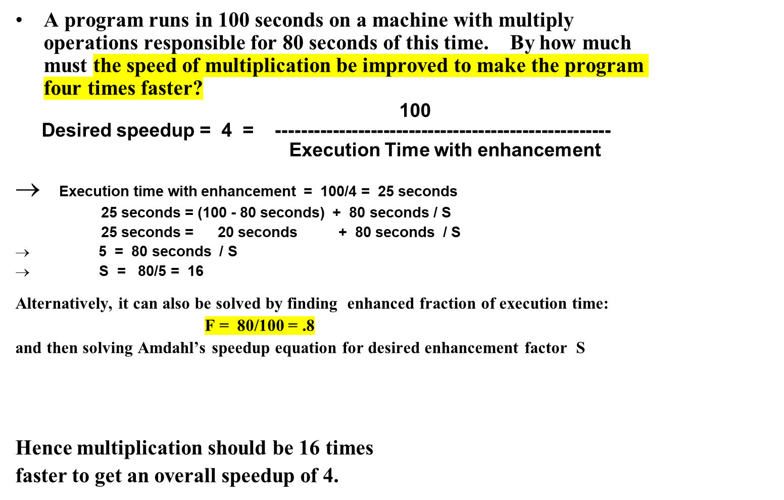

Performance Enhancement Example
1 1 1
Speedup(E) = ------------------ = 4 = ----------------- = ---------------
(1 - F) + F/S (1 - .8) + .8/S .2 + .8/s
Machine = CPU

Slide 22
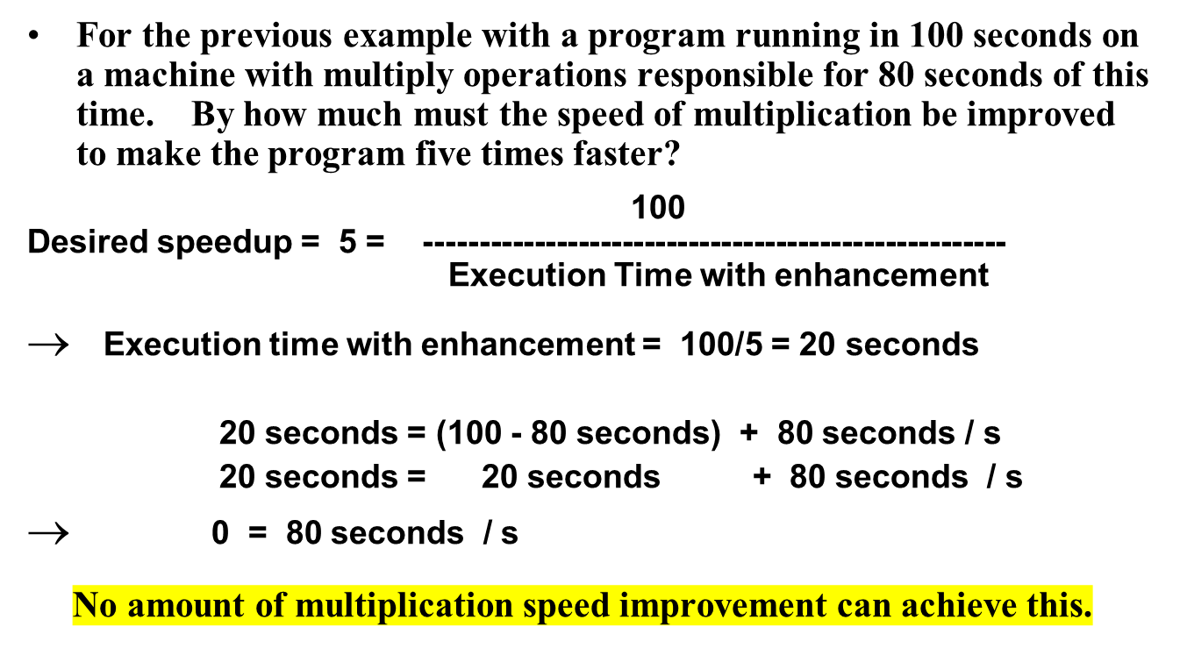
Performance Enhancement Example

Slide 23
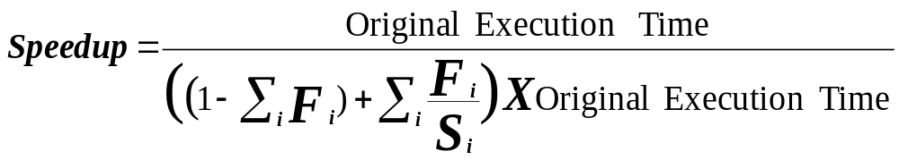
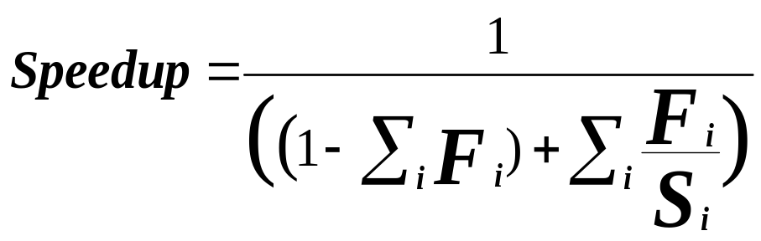
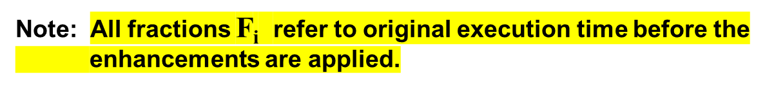
Extending Amdahl's Law To Multiple Enhancements
n enhancements each affecting a different portion of execution time
Suppose that enhancement E_{i} accelerates a fraction F_{i} of the original execution time by a factor S_{i} and the remainder of the time is unaffected then:
i = 1, 2, …. n
Unaffected fraction
What if the fractions given are
after the enhancements were applied?
How would you solve the problem?
(i.e find expression for speedup)

Slide 24
Amdahl's Law With Multiple Enhancements: Example
Three CPU performance enhancements are proposed with the following speedups and percentage of the code execution time affected:
Speedup₁ = S₁ = 10 Percentage₁ = F₁ = 20%
Speedup₂ = S₂ = 15 Percentage₁ = F₂ = 15%
Speedup₃ = S₃ = 30 Percentage₁ = F₃ = 10%
While all three enhancements are in place in the new design, each enhancement affects a different portion of the code and only one enhancement can be used at a time.
What is the resulting overall speedup?
Speedup = 1 / [(1 - .2 - .15 - .1) + .2/10 + .15/15 + .1/30)]
= 1 / [ .55 + .0333 ]
= 1 / .5833 = 1.71

Slide 25

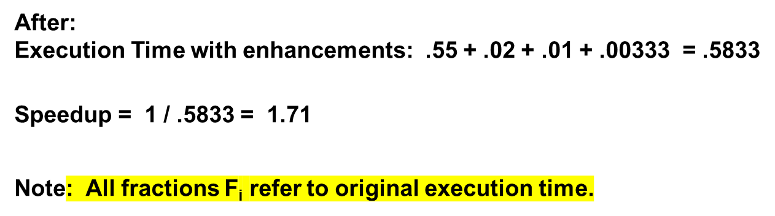
Pictorial Depiction of Example
Before:
Execution Time with no enhancements: 1
i.e normalized to 1
S₁ = 10
S₂ = 15
S₃ = 30
F₁ = .2
F₂ = .15
F₃ = .1
/ 10
/ 15
/ 30
Unchanged
Unaffected, fraction: .55
What if the fractions given are
after the enhancements were applied?
How would you solve the problem?

Slide 26
http://www.eecs.harvard.edu/cs146-246/

