Slide 1
Key Questions
How to measure performance of a CPU & a computer?
What are the performance measures used?
Which is the most acceptable/reliable performance measure? Why?

Slide 2
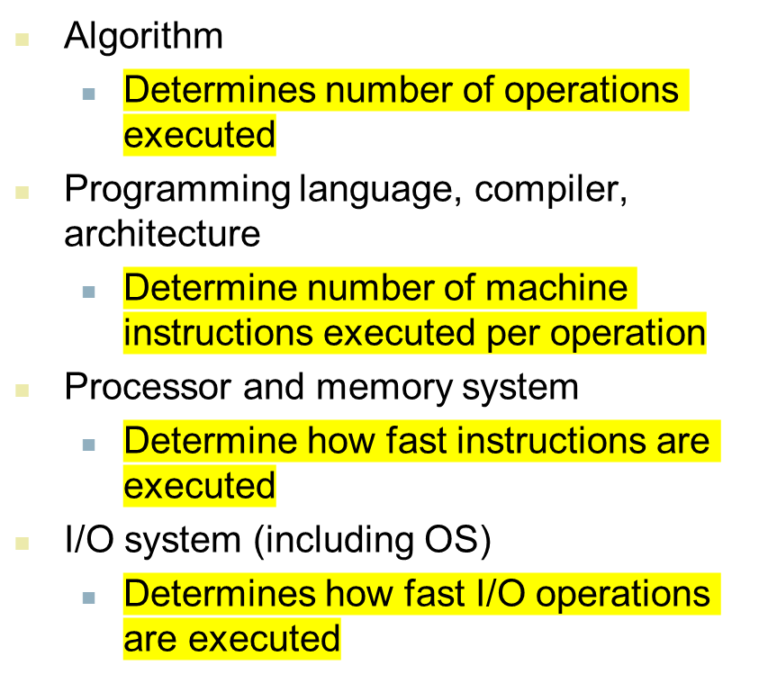
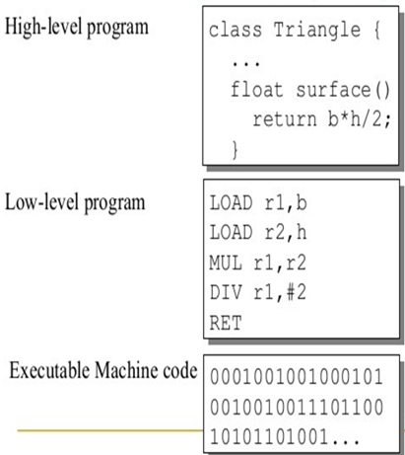
Factors deciding Performance
Notes:
Morgan Kaufmann Publishers
Chapter 1 — Computer Abstractions and Technology

Slide 3
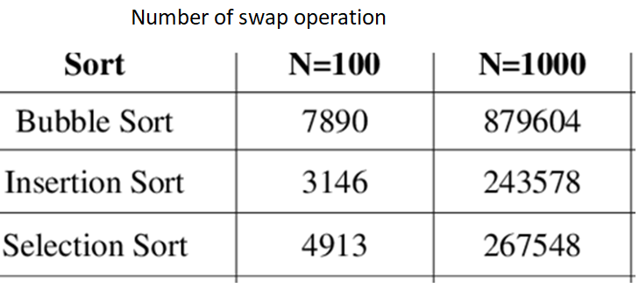
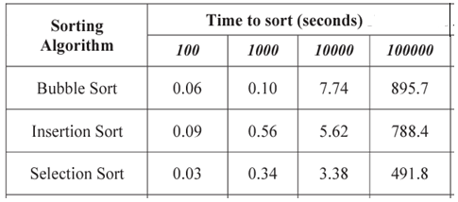
Algorithms

Slide 4
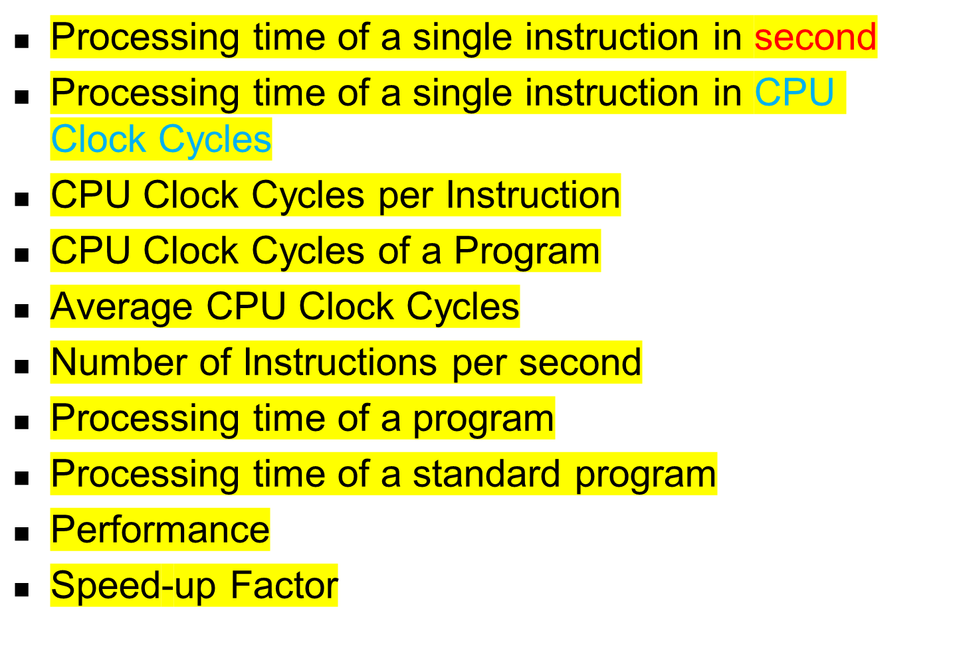
Performance Measures

Slide 5
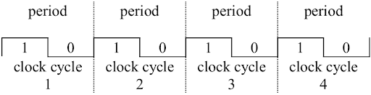
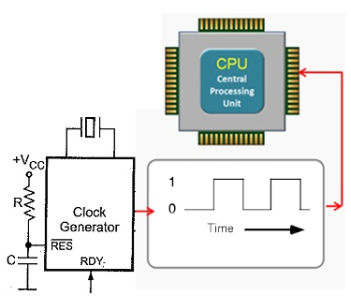
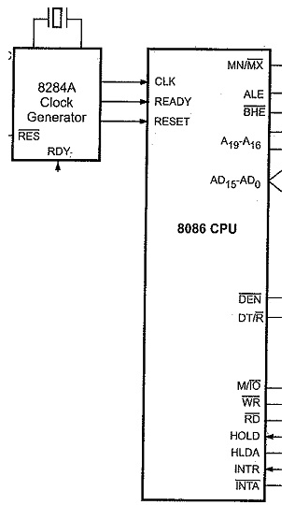
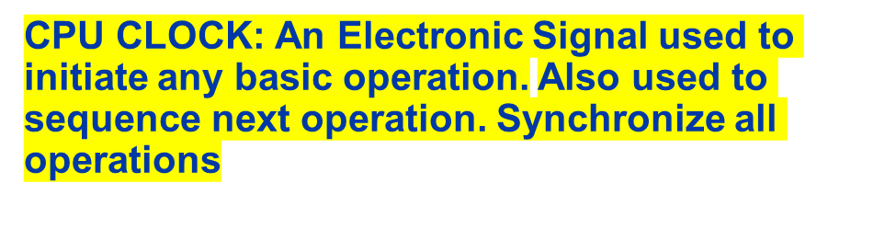
CPU CLOCK: A Timing Signal

Slide 6

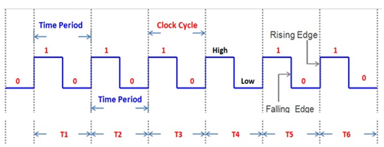
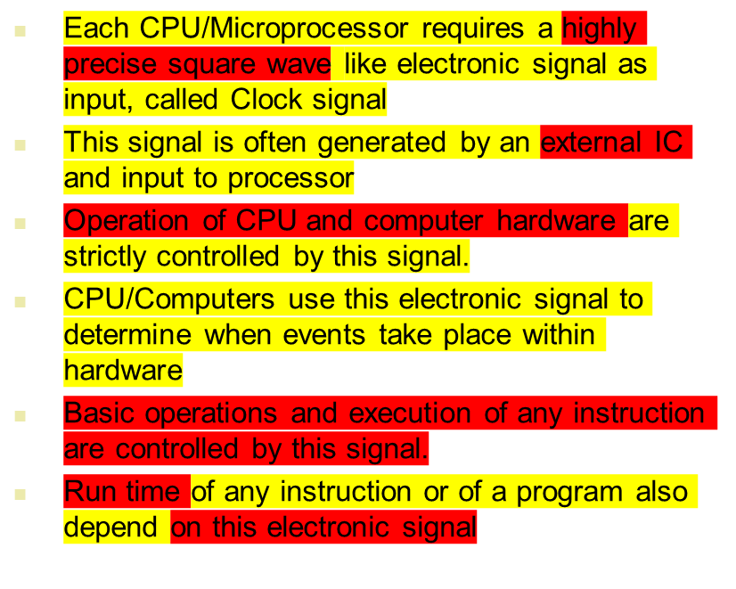
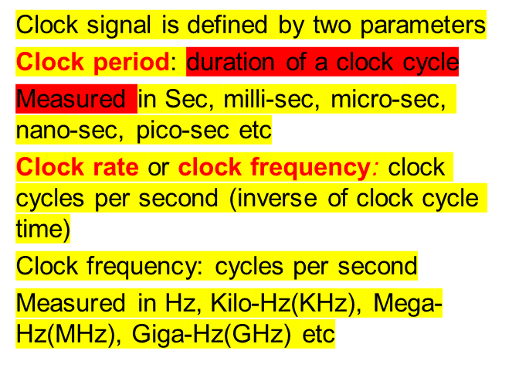
Notes:
Morgan Kaufmann Publishers
Chapter 1 — Computer Abstractions and Technology

Slide 7
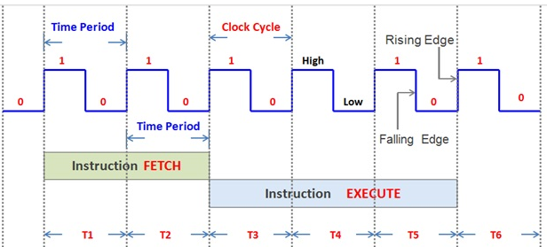
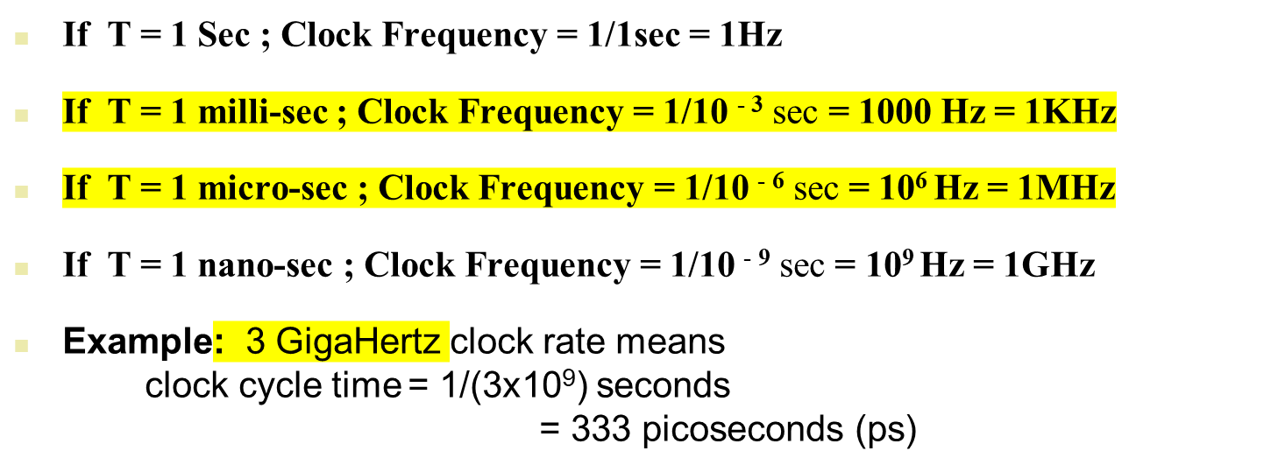
CPU Clocking

Slide 8
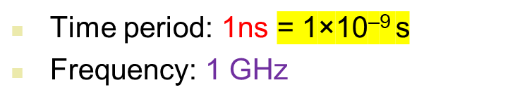
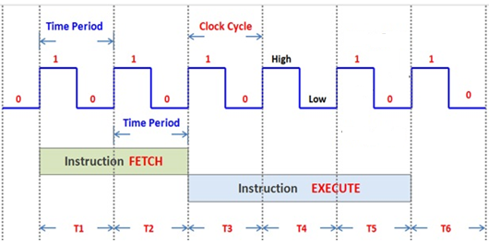
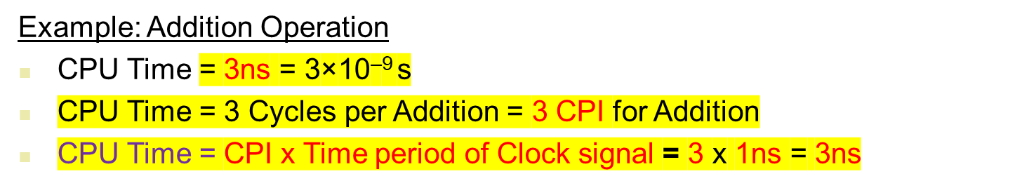
CPU Time for an Instruction
Addition Operation
Notes:
Morgan Kaufmann Publishers
Chapter 1 — Computer Abstractions and Technology

Slide 9
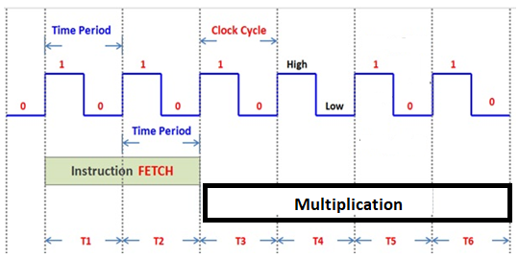
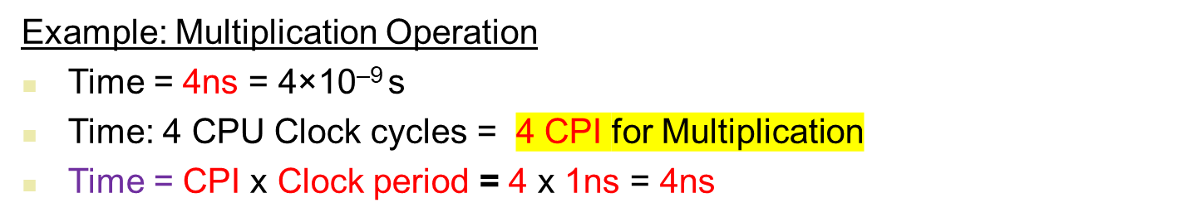

CPU Time for an Instruction
Clock period: 1ns = 1×10^{–9} s
Clock frequency: 1 GHz
Notes:
Morgan Kaufmann Publishers
Chapter 1 — Computer Abstractions and Technology

Slide 10
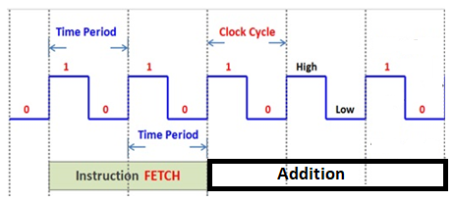
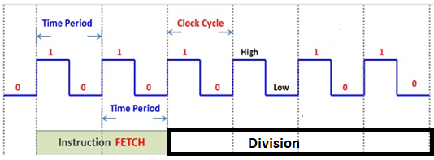
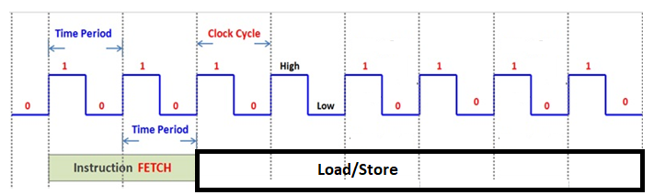
CPI for different Instructions

Slide 11
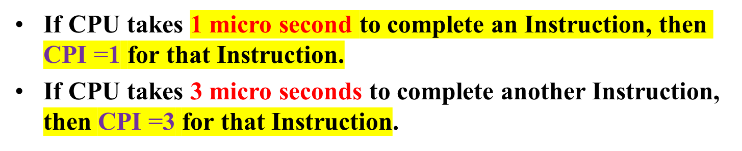
Example: Cycles Per Instruction (CPI)
Clock cycle
cycle 1
cycle 2
cycle 3
If CPU Clock rate, f =2MHz; Clock Cycle, C = 0.5 micro second
If CPU takes 1 micro second to complete an Instruction, then CPI =2 for that Instruction.
If CPU takes 3 micro seconds to complete another Instruction, then CPI =6 for that Instruction.

Slide 12
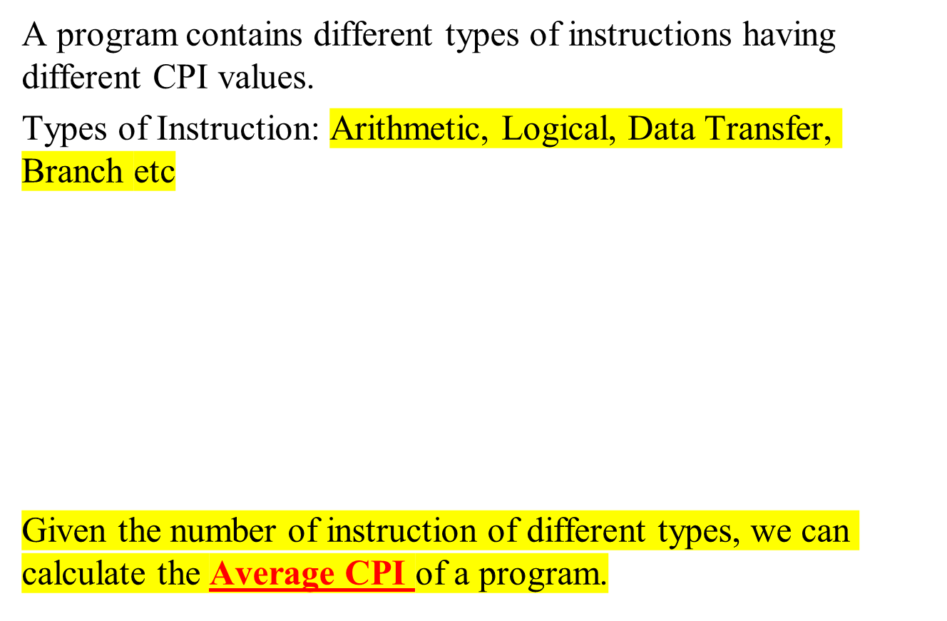
Can we find CPI of a Program?
Program in Assembly language
LOAD R1, A
ADD R1, B
ADD R1, C
MOV R2, R1
OUT 25, R2

Slide 13
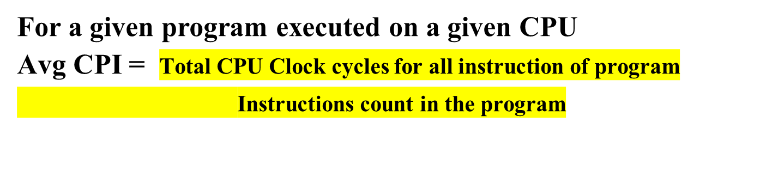
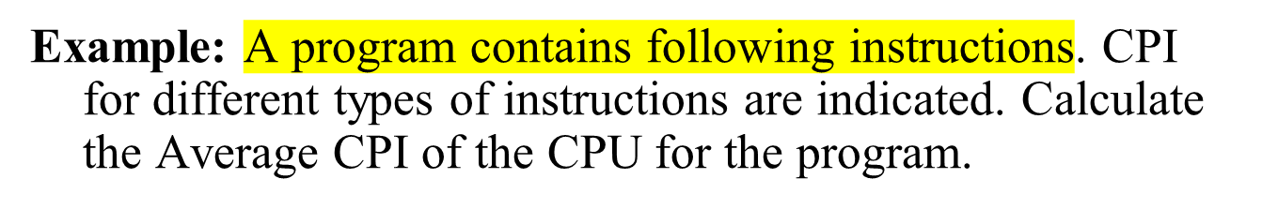
Average CPI
Instruction type | Instruction Count | CPI
ALU | 500 | 2
Load | 200 | 4
Store | 200 | 4
Branch | 100 | 6
Answer: Avg CPI = (500x2 + 200x4 + 200x4 + 100x6)/1000

Slide 14
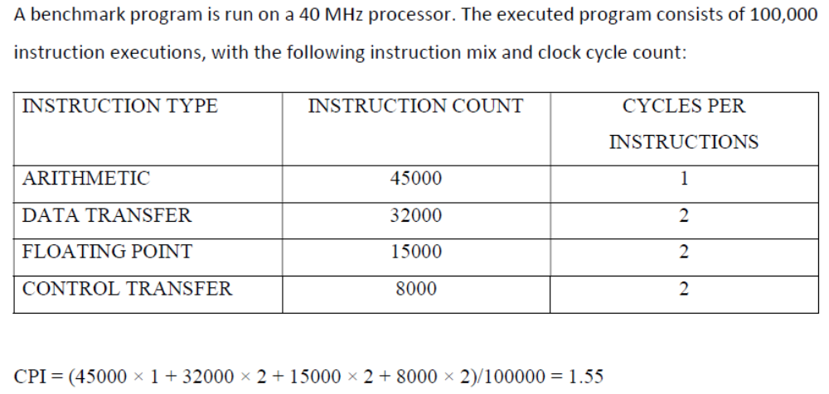
Example: Average CPI

Slide 15
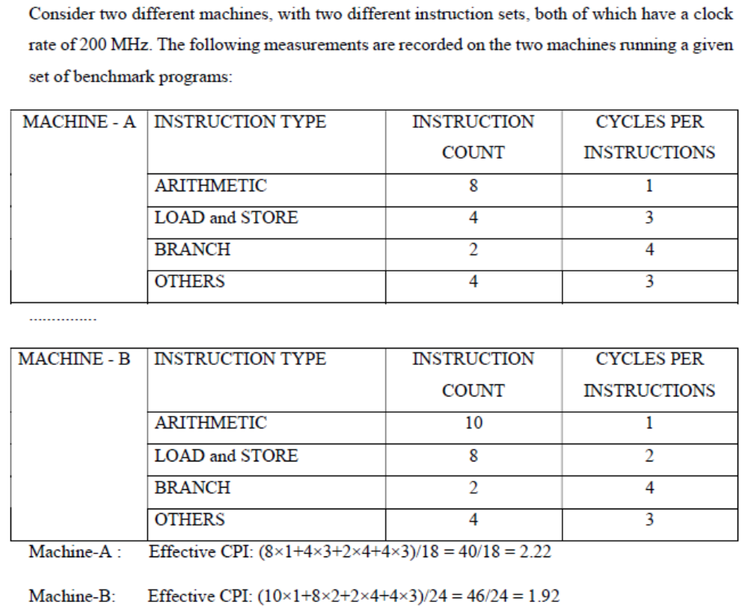
Example: Average CPI

Slide 16
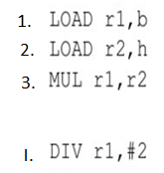
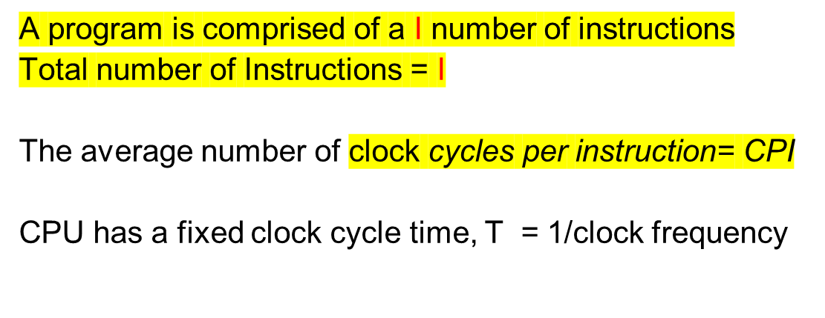
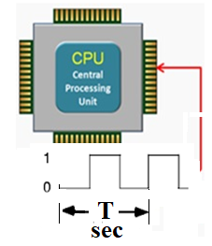

CPU Execution Time: The CPU Equation
CPU time = Seconds = Instructions x Cycles x Seconds
Program Program Instruction Cycle
execution Time
per program in seconds
Number of
instructions executed
Average CPI for program
CPU Clock Period

Slide 17

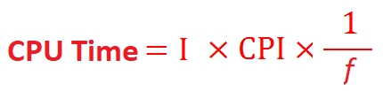
For a given program:
CPU Time = I x CPI x T

Slide 18
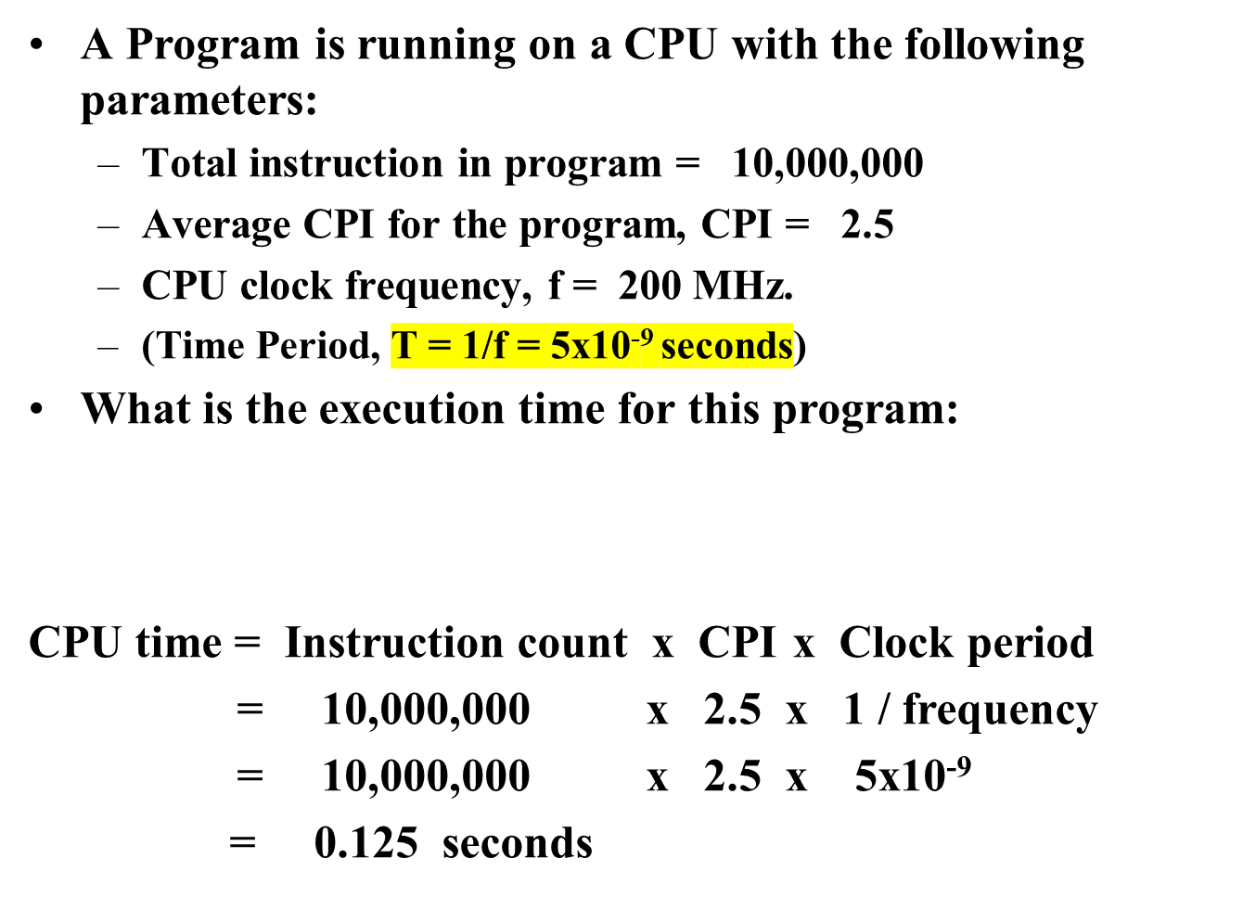
CPU Execution Time: Example
CPU time = Seconds = Instructions x Cycles x Seconds
Program Program Instruction Cycle

Slide 19

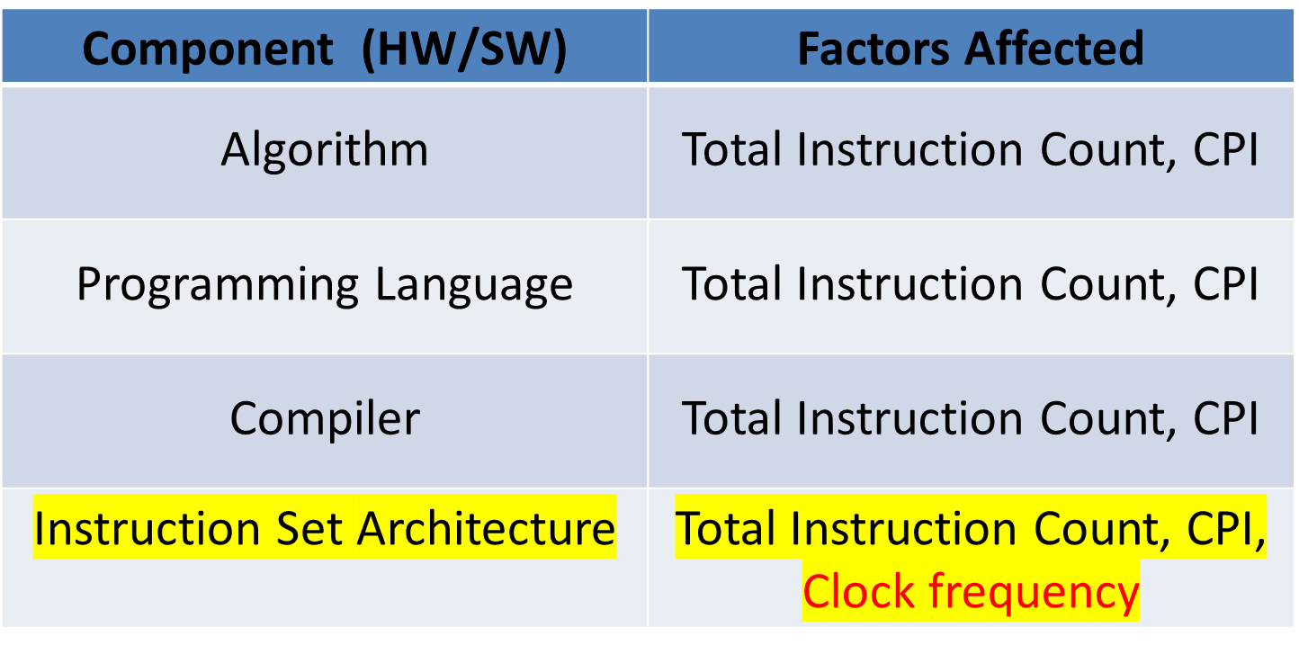
Component (HW/SW) | Perf Factors Affected
Algorithm
Programming Language
Compiler
Instruction Set Architecture
Notes:
Algorithm
[Instruction count, possibly CPI]
The algorithm determines the number of source program instructions executed and hence the number of processor instructions executed. The algorithm may also affect the CPI, by favoring slower or faster instructions. For example, if the algorithm uses more floating-point operations, it will tend to have a higher CPI.
Programming language
[Instruction count, CPI]
The programming language certainly affects the instruction count, since statements in the language are translated to processor instructions, which determine instruction count. The language may also affect the CPI because of its features; for example, a language with heavy support for data abstraction (e.g., Java) will require indirect calls, which will use higher CPI instructions.
Compiler
[Instruction count, CPI]
The efficiency of the compiler affects both the instruction count and average cycles per instruction, since the compiler determines the translation of the source language instructions into computer instructions. The compiler’s role can be very complex and affect the CPI in complex ways.
Instruction set architecture
[Instruction count, clock rate, CPI]
The instruction set architecture affects all three aspects of CPU performance, since it affects the instructions needed for a function, the cost in cycles of each instruction, and the overall clock rate of the processor

Slide 20
Depends on:
Program Used
Compiler
ISA
Instruction Count I
Depends on:
Program Used
Compiler
ISA
CPU Organization
Depends on:
CPU Organization
Technology (VLSI)
CPI
Time
Period
of clock
T
(Average
CPI)

Slide 21
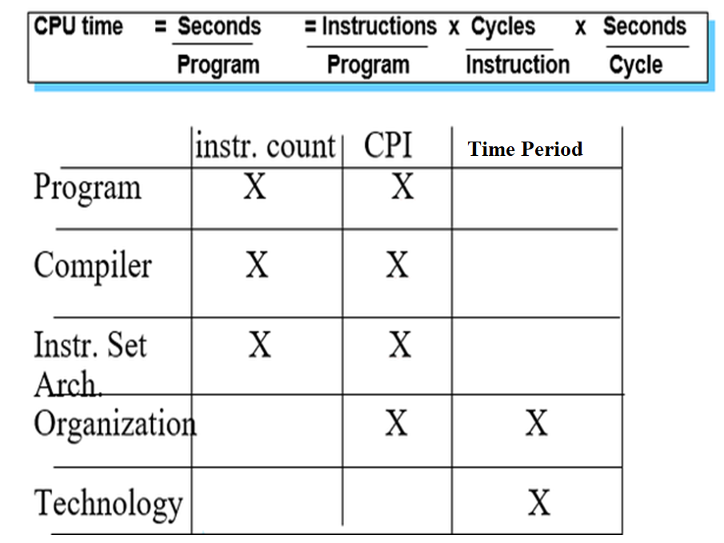

Slide 22
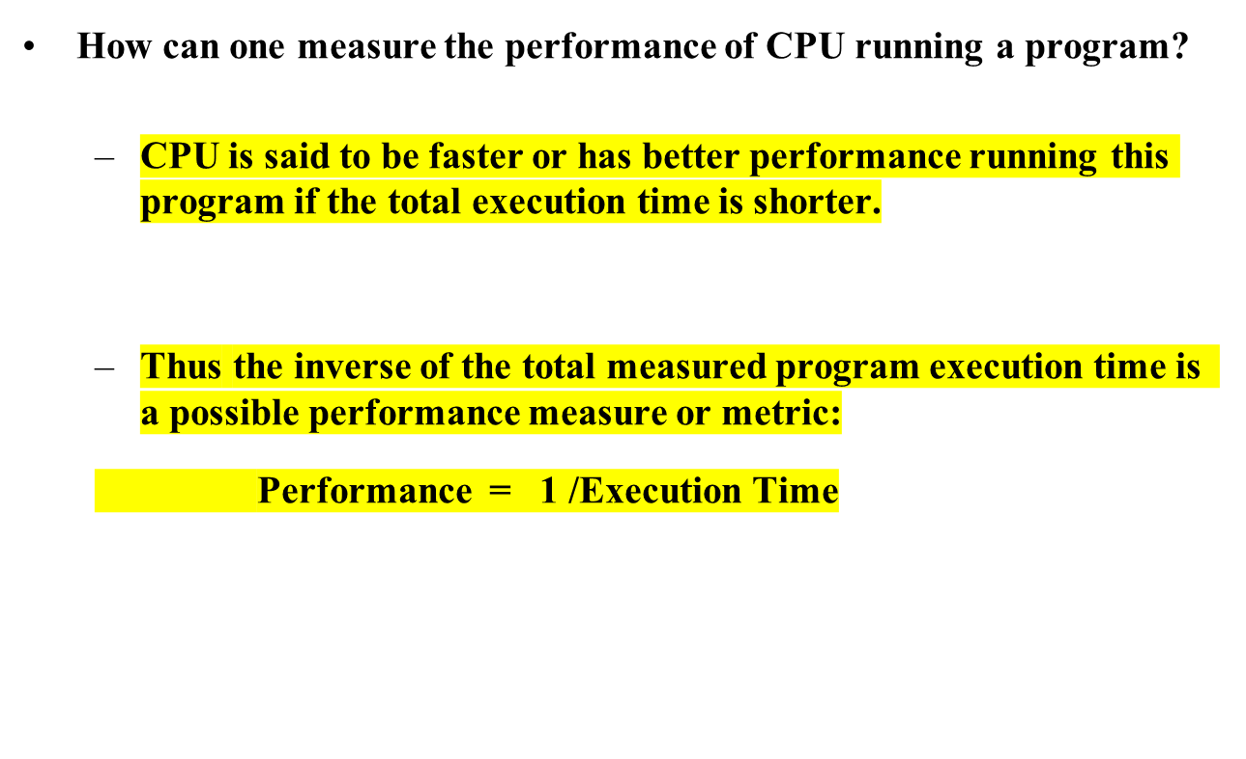

Slide 23
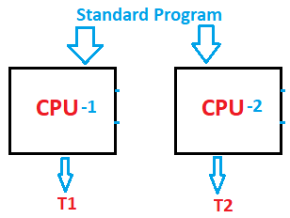
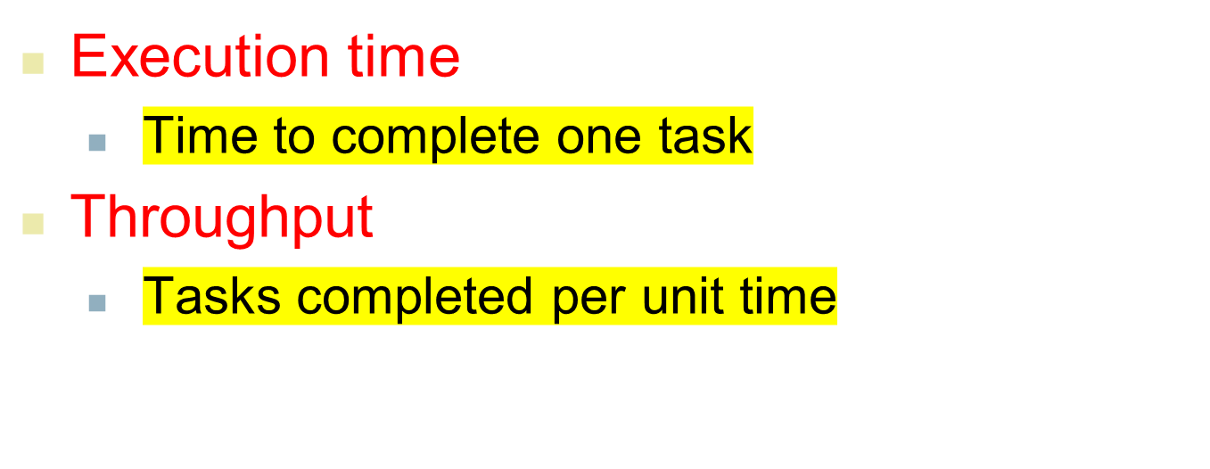


Measuring CPU Performance
CPU-1 runs N times faster than CPU-2
Notes:
CS252 S05

Slide 24
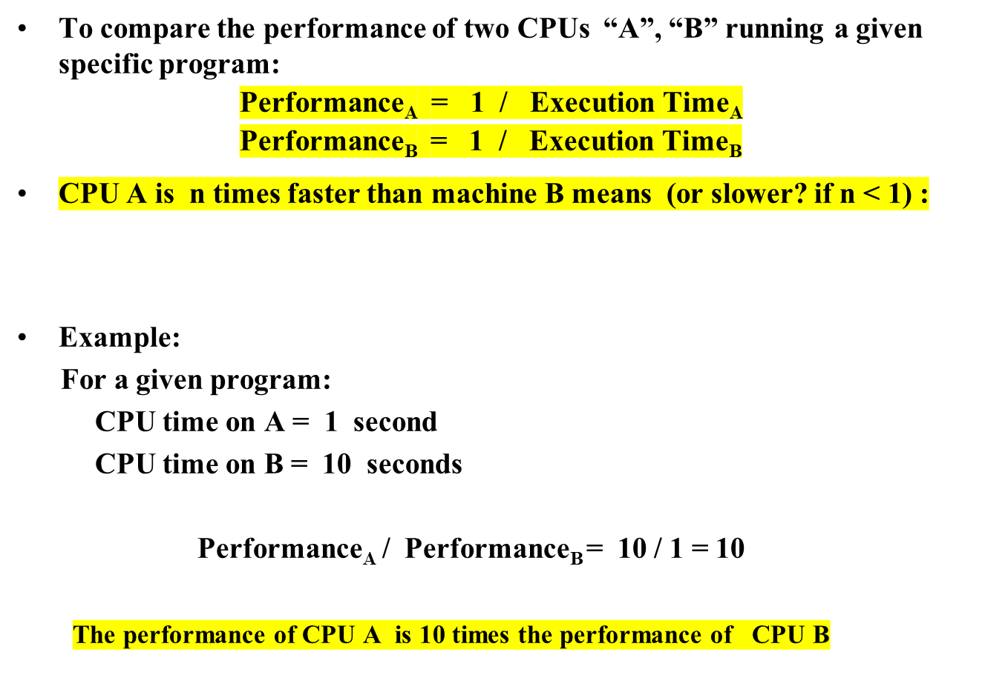
Comparing Computer Performance Using Execution Time
Performance_{A}
Execution Time_{B}
Speedup = n = =
Performance_{B}
Execution Time_{A}
Speedup =

Slide 25
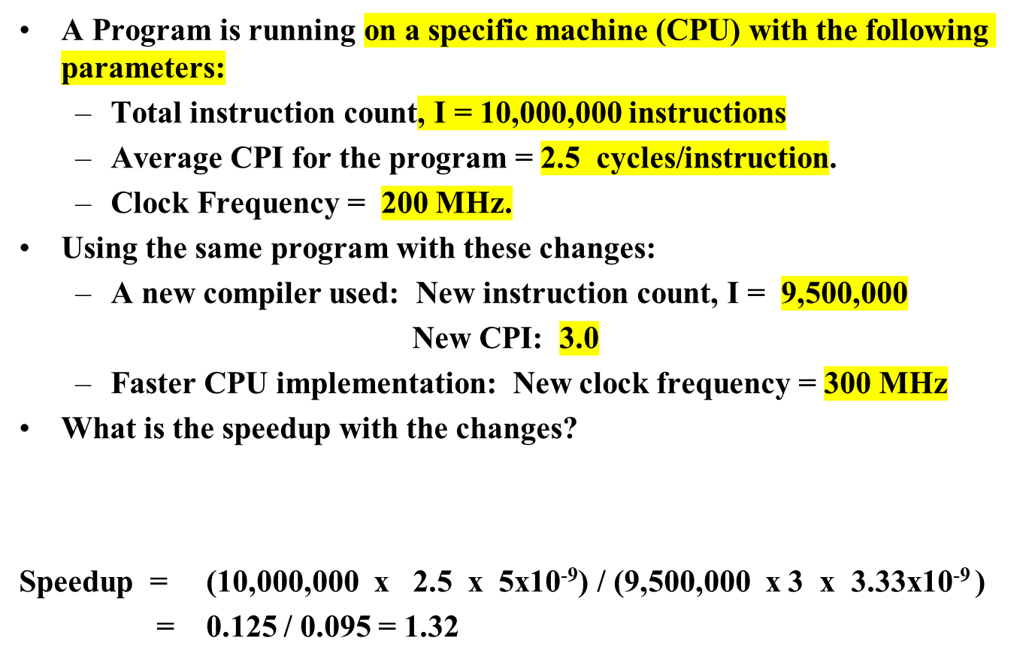

Performance Comparison
T(old) = 1/(200x10⁶)= 5x10⁻⁹ seconds
Speedup = Old Execution Time = I_{old} x CPI_{old} x T_{old}
New Execution Time I_{new} x CPI_{new} x T_{new}

Slide 26
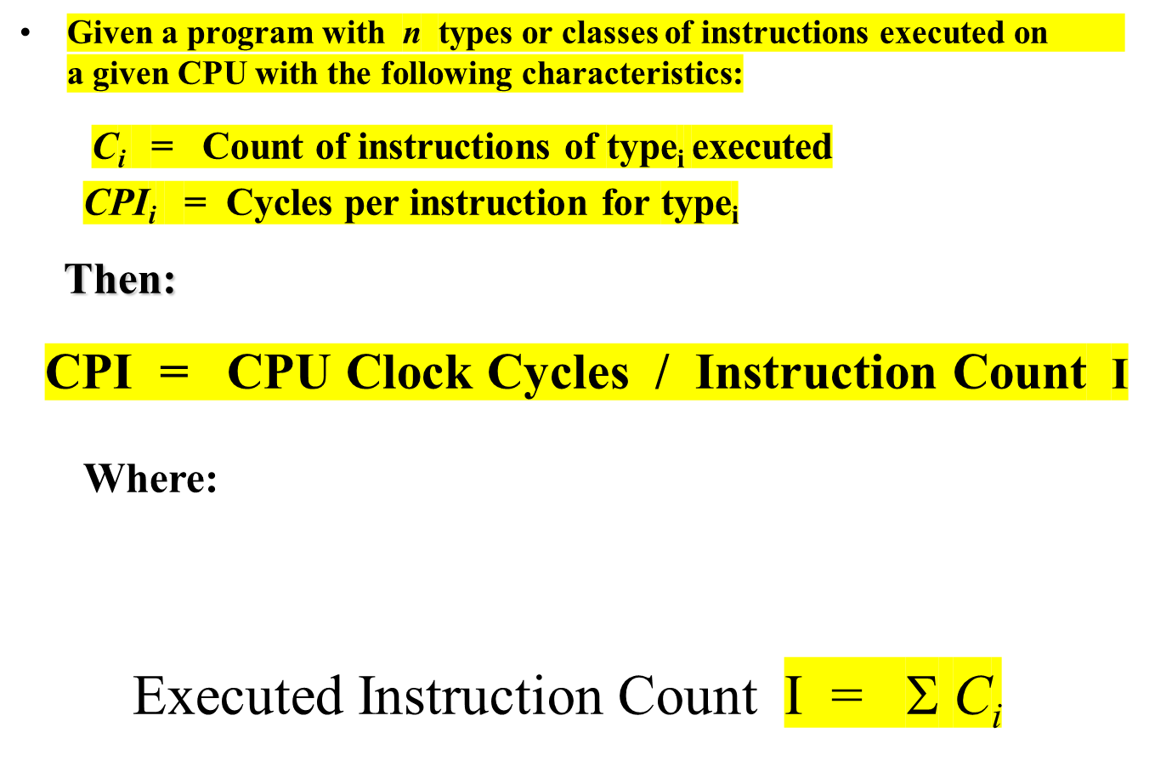
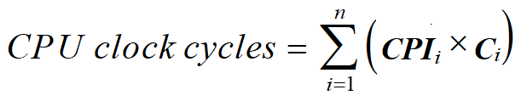
Instruction Types & CPI
i = 1, 2, …. n
Depends on CPU Design
i.e average or effective CPI
Executed

Slide 27
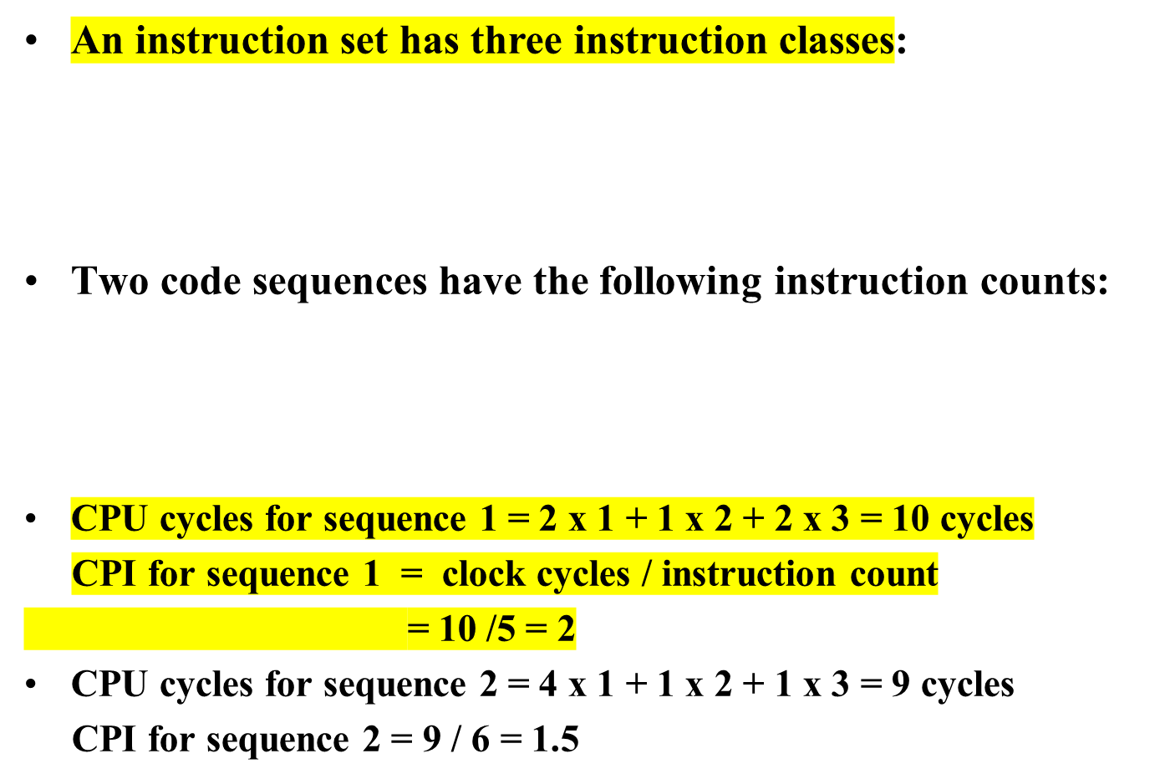
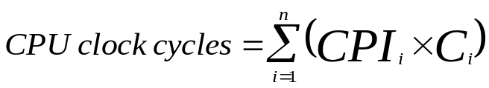
Instruction Types & CPI: An Example
Instruction class CPI
A 1
B 2
C 3
For a specific
CPU design
Instruction counts for instruction class
Code Sequence A B C
1 2 1 2
2 4 1 1
i.e average or effective CPI
CPI = CPU Cycles / I

Slide 28
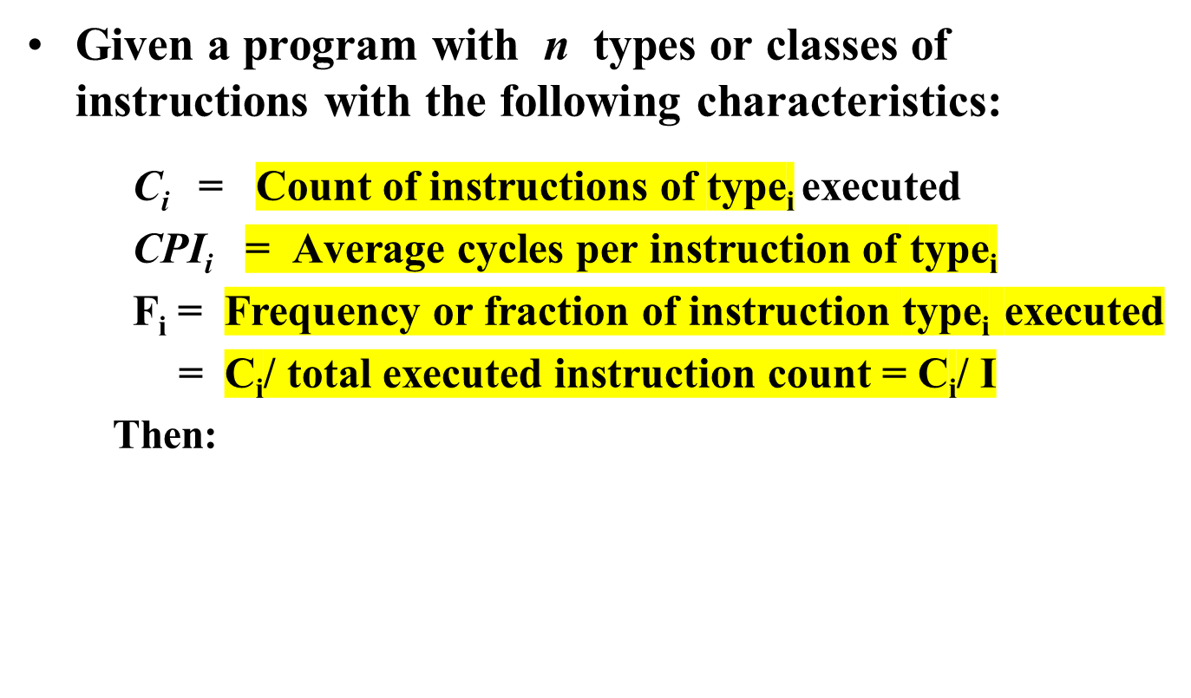
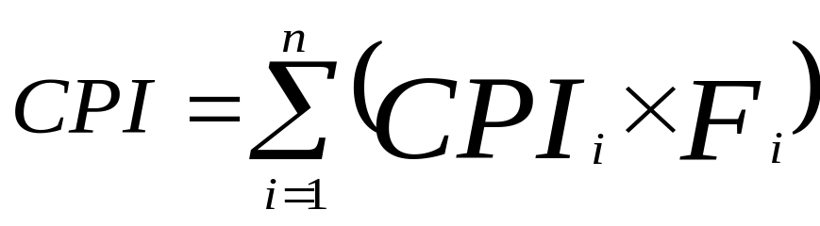
Instruction Frequency & CPI
i = 1, 2, …. n
Where: Executed Instruction Count I = Σ C_{i}
i.e average or effective CPI
CPI_{i} x F_{i}
Fraction of total execution time for instructions of type i =
CPI
T = I x CPI x C

Slide 29
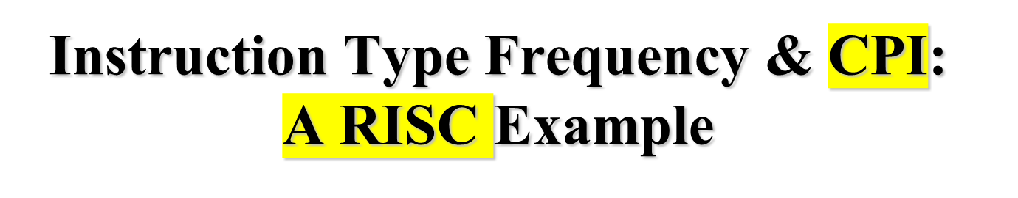

CPI_{i} x F_{i}
Program Profile or Executed Instructions Mix
CPI
Depends on CPU Design
Base Machine (Reg / Reg)
Op Freq, F_{i} CPI_{i} CPI_{i} x F_{i} % Time
ALU 50% 1 .5 23% = .5/2.2
Load 20% 5 1.0 45% = 1/2.2
Store 10% 3 .3 14% = .3/2.2
Branch 20% 2 .4 18% = .4/2.2
Given
Sum = 2.2
Typical Mix
i.e average or effective CPI
CPI = .5 x 1 + .2 x 5 + .1 x 3 + .2 x 2 = 2.2
= .5 + 1 + .3 + .4

Slide 30
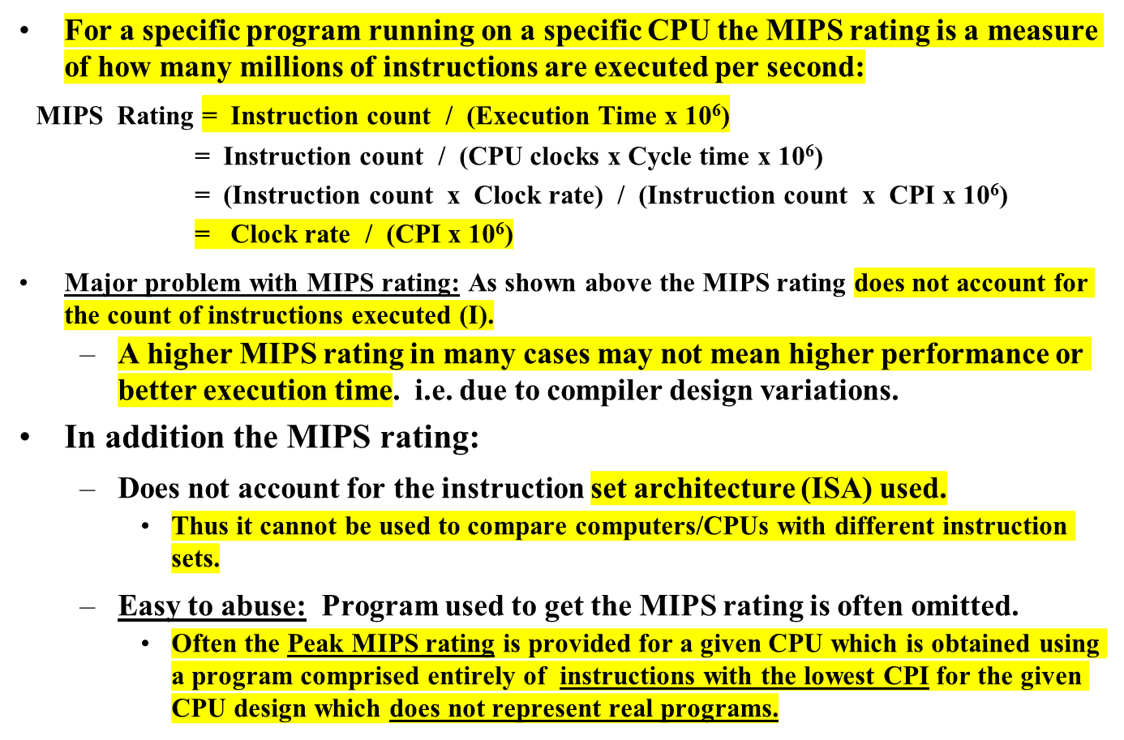
MIPS (Million Instructions Per Second) Rating

Slide 31
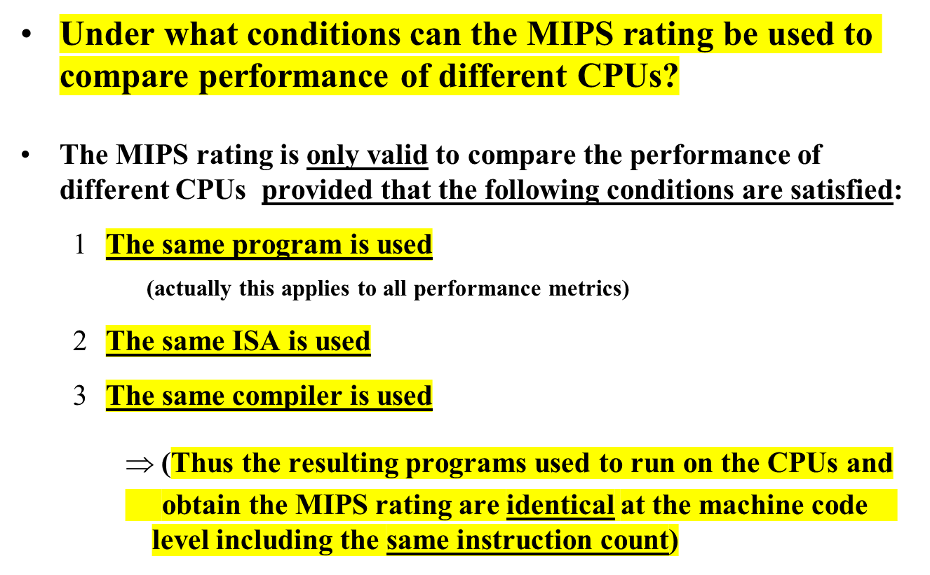
MIPS (Million Instructions Per Second) Rating
(binary)

Slide 32
Compiler Variations, MIPS & Performance:
An Example
For a machine (CPU) with instruction classes:
For a given high-level language program, two compilers produced the following executed instruction counts:
The machine is assumed to run at a clock rate of 100 MHz.
Instruction class CPI
A 1
B 2
C 3
Instruction counts (in millions)
for each instruction class
Code from: A B C
Compiler 1 5 1 1
Compiler 2 10 1 1

Slide 33
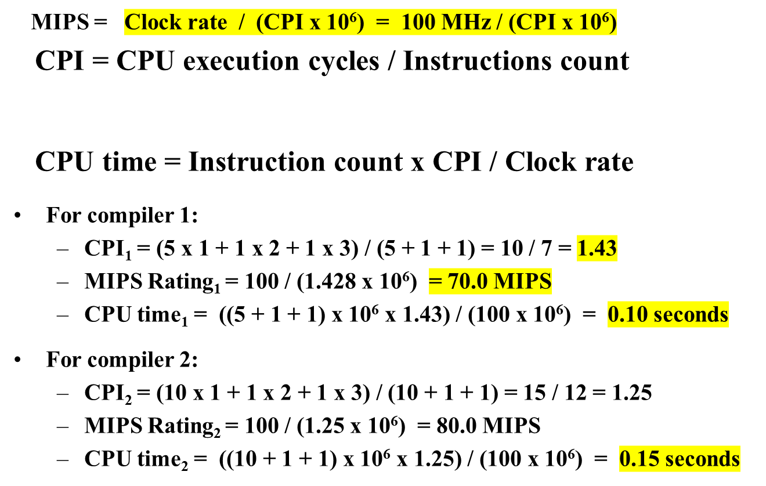

Compiler Variations, MIPS & Performance:
An Example (Continued)
MIPS rating indicates that compiler 2 is better
while in reality the code produced by compiler 1 is faster

Slide 34

MFLOPS (Million FLOating-Point Operations Per Second)

