Slide 1

TRIPS EDA
BY MARK MAGED AND AHMED RABIE

Slide 2
Table of contents
01
Heatmaps and distibutions
02
Fare amount analysis
03
Box plots and histograms

Slide 3
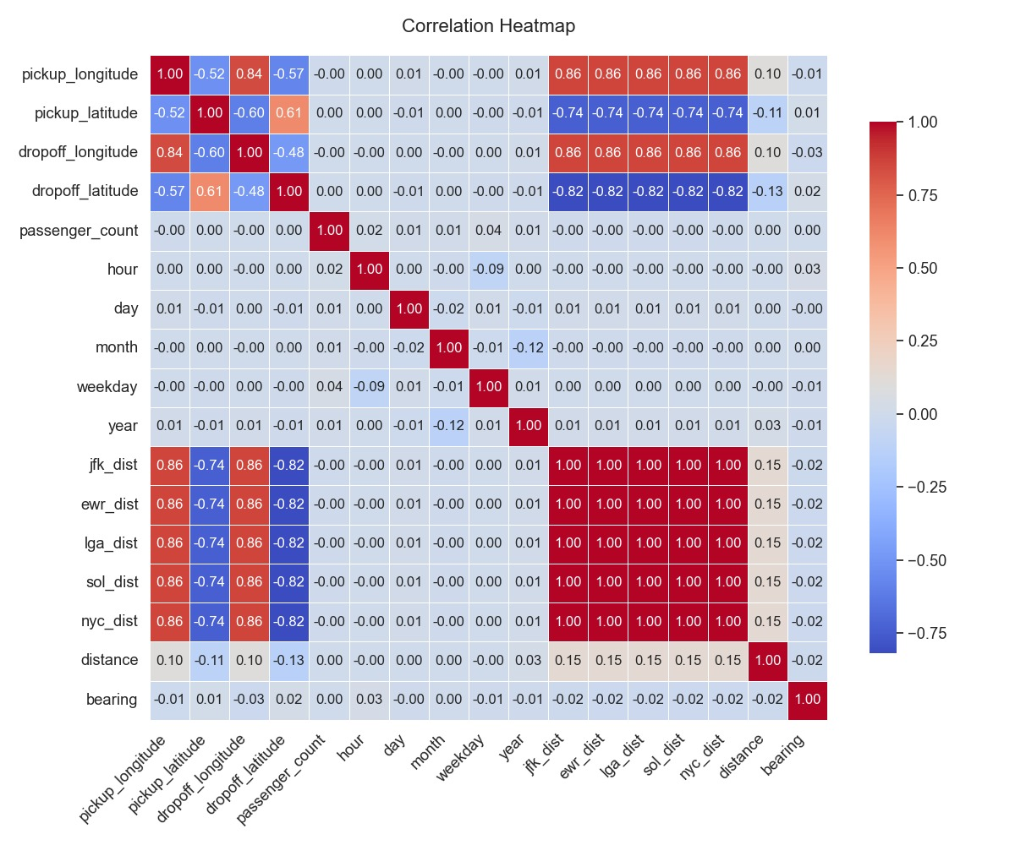
Correlation heatmap between numerical features

Slide 4
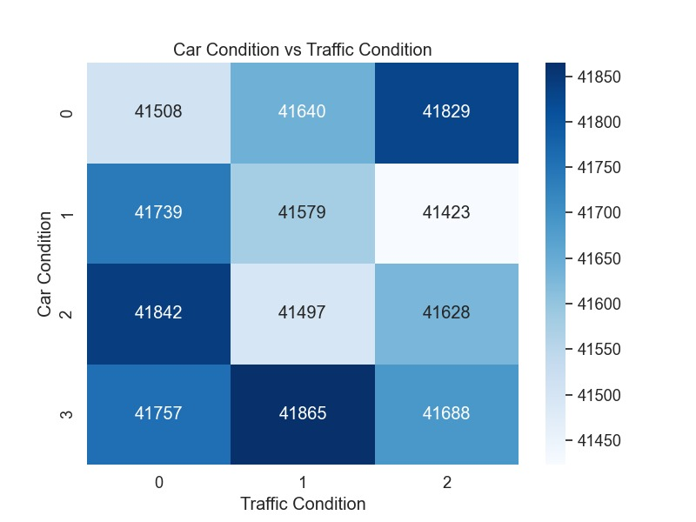
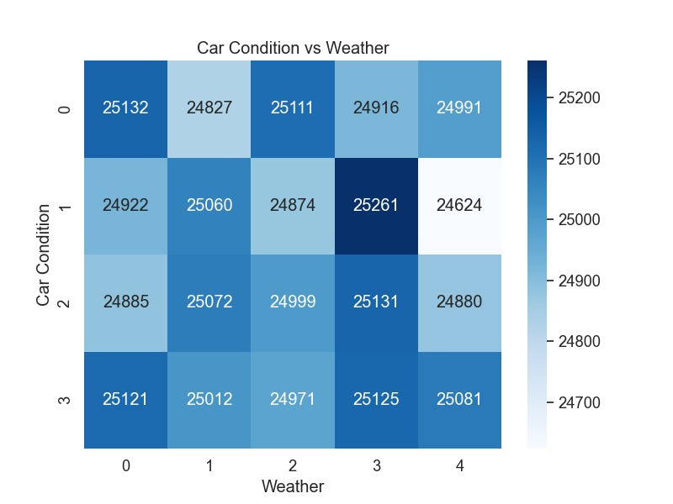
Car condition vs. traffic condition and weather

Slide 5
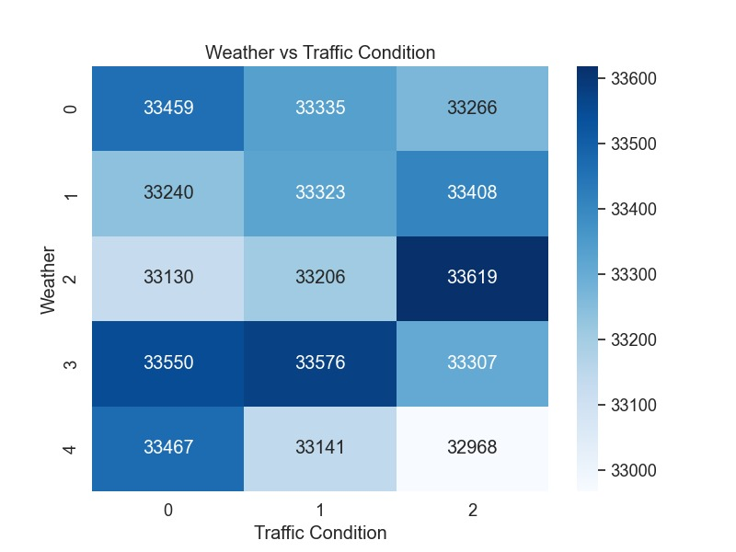
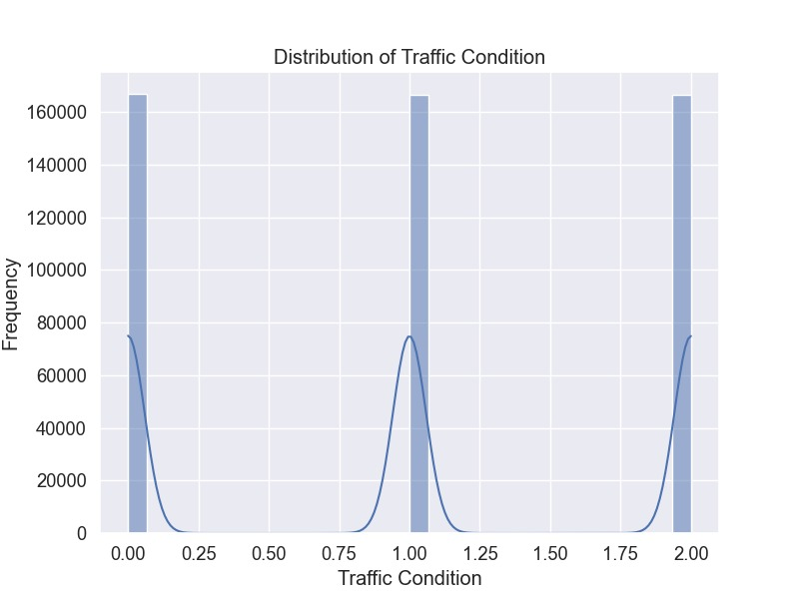
Traffic condition analysis

Slide 6
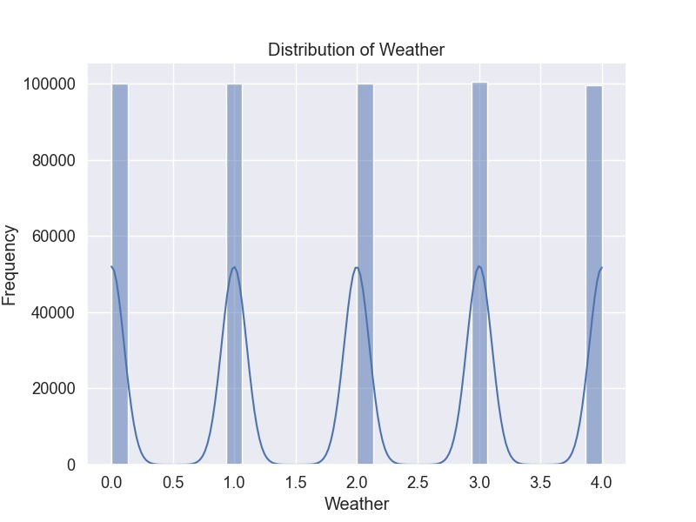
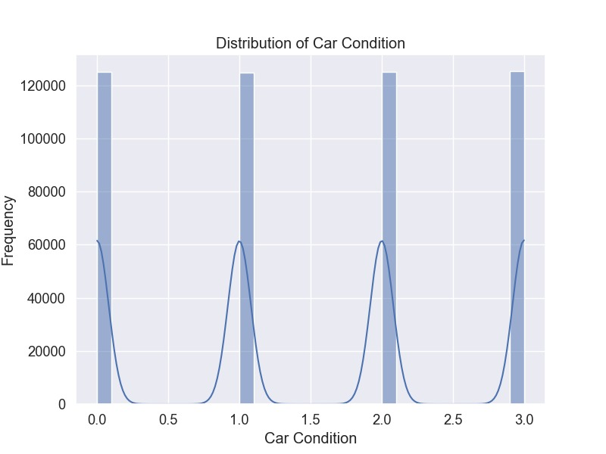
Distribution of weather and car condition

Slide 7
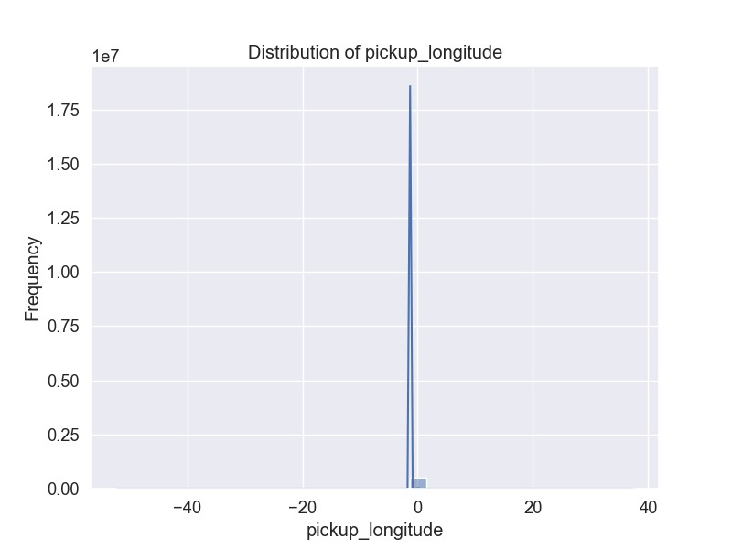
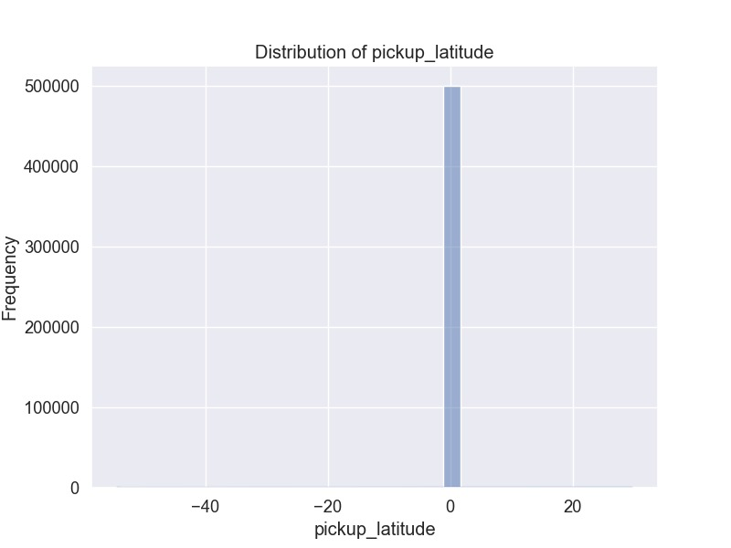
Distribution of pickup longitude and latitude

Slide 8
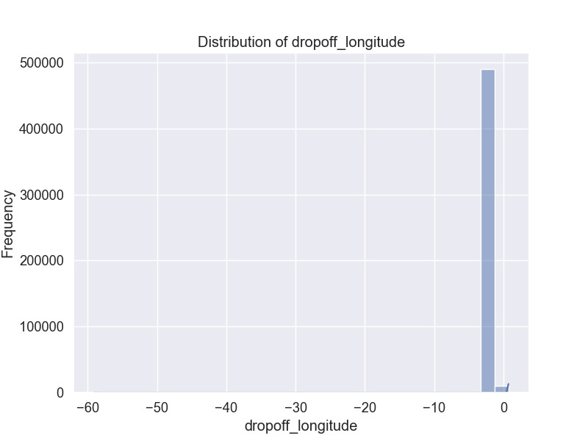
Distribution of dropoff longitude and latitude

Slide 9
Entry Errors
5 trips that had null dropoff longitude and latitude, distances and bearing were dropped
01
Trips having fare amounts less than zero were dropped along with trips with passenger counts equal to zero
02
Trips with distances more than 1000 kilo meters were dropped along with fare amounts bigger than 100 for trips that started in NYC
03

Slide 10
Fare Amount Analysis

Slide 11
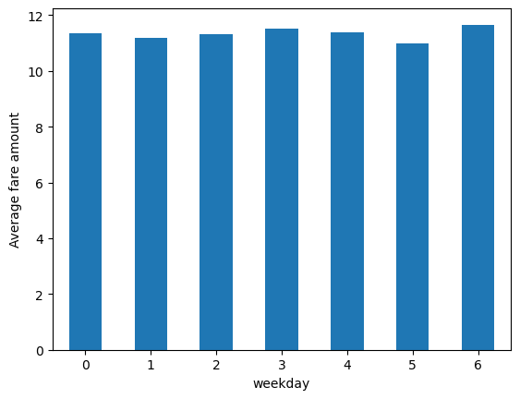
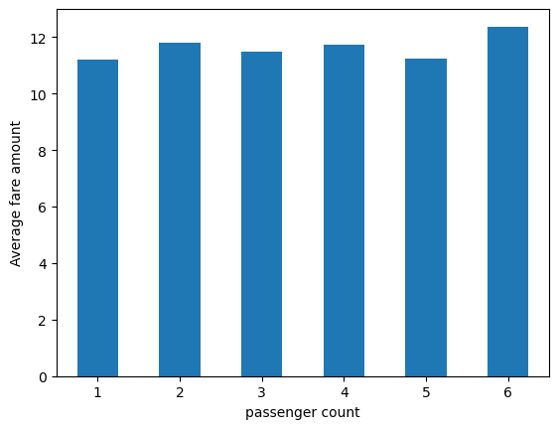
Average fare amount vs. weekday and passenger count

Slide 12
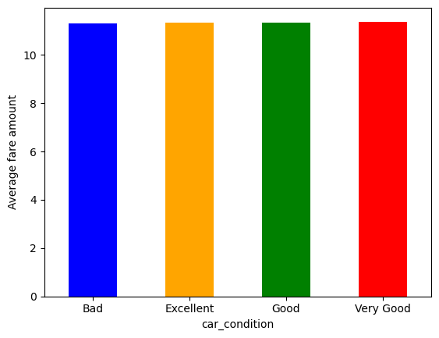
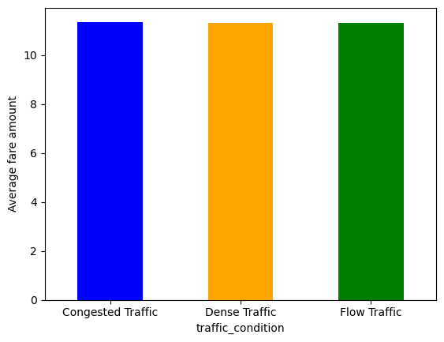
Average fare amount vs. car and traffic condition

Slide 13
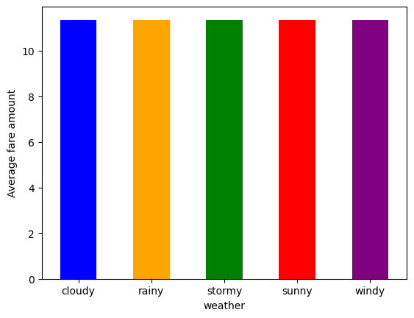
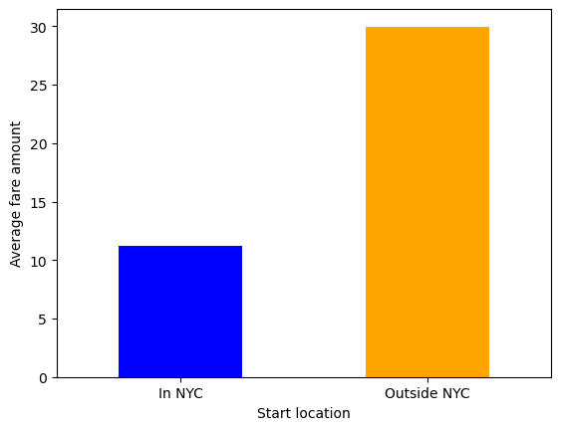
Average fare amount vs. weather and start location

Slide 14
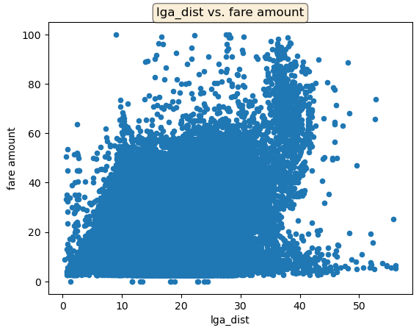
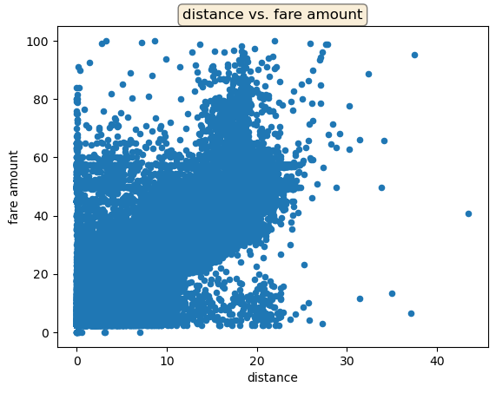
Positive correlation between fare amount and distances

Slide 15
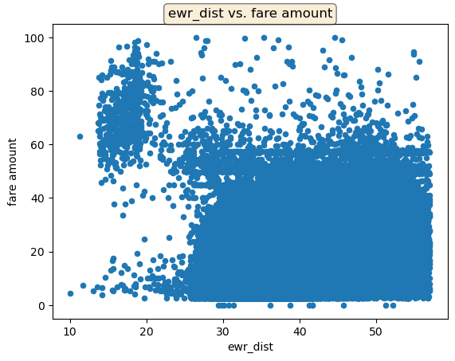
negative correlation between fare amount and distances

Slide 16
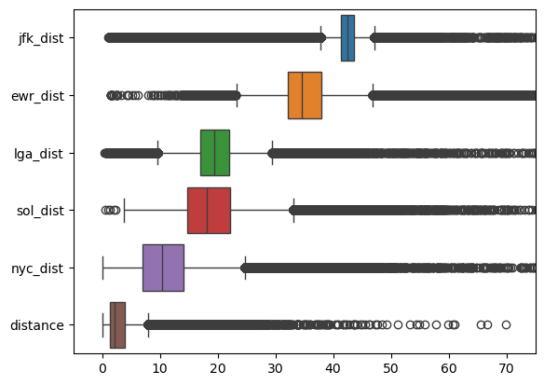
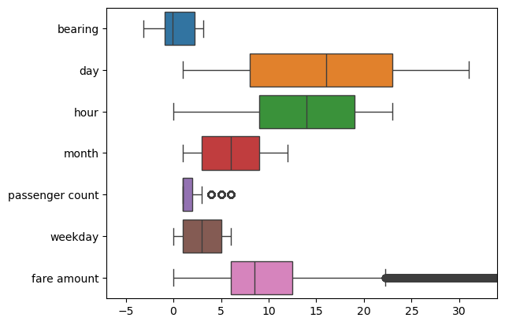
Box Plots

Slide 17
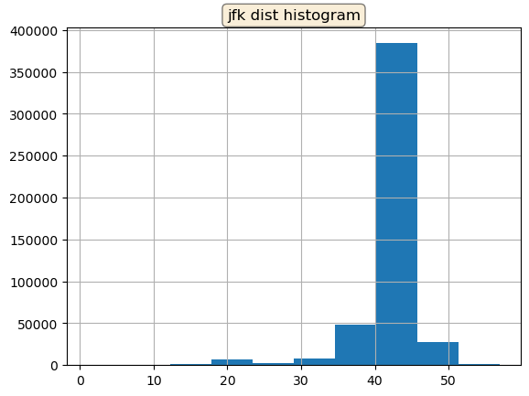
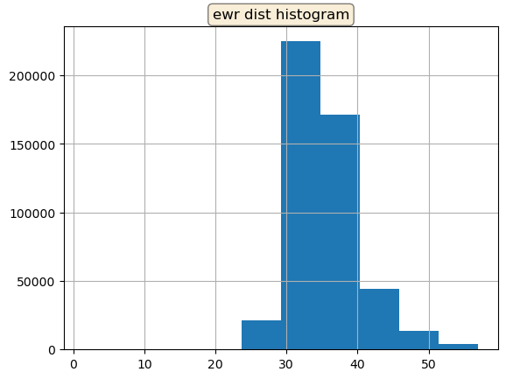
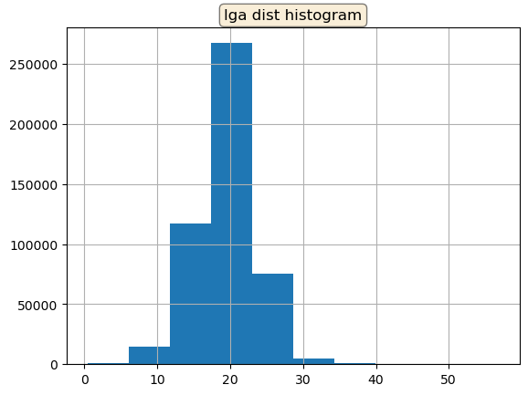
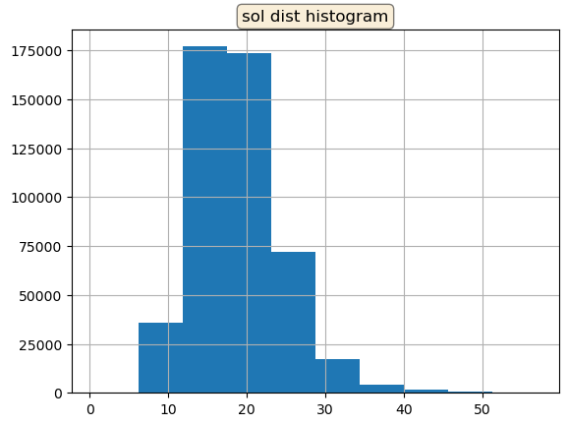
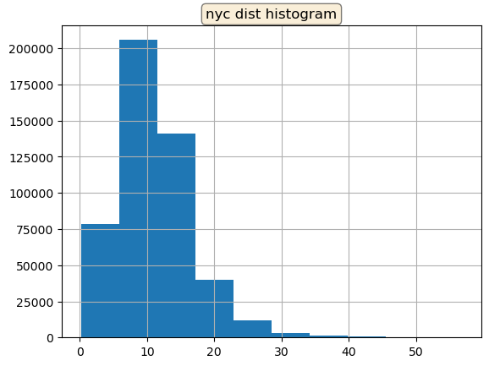
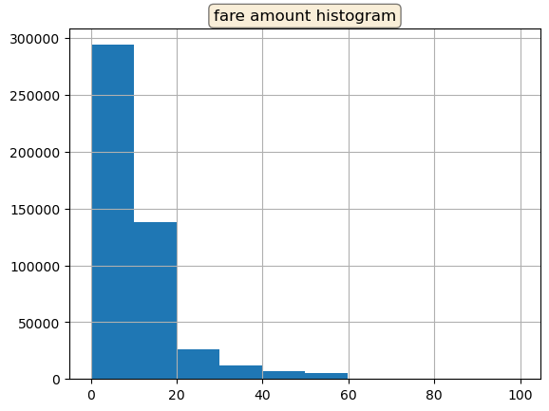

Slide 18

THANK YOU

