Slide 1
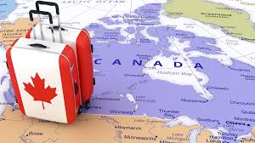

ass2
Data Science
Using python
13 Slide

Slide 2
PRESENTATION
Content List
01 Data Overview
02 Data Description
03 Data Visualization

Slide 3
01
Data Overview
Immigration to Canada from 1980 to 2013
The dataset contains annual data on the flows of international immigrants as recorded by the countries of destination.
The data presents both inflows and outflows according to the place of birth, citizenship or place of previous / next residence both for foreigners and nationals.
In this project, we will focus on the Canadian immigration data.

Slide 4
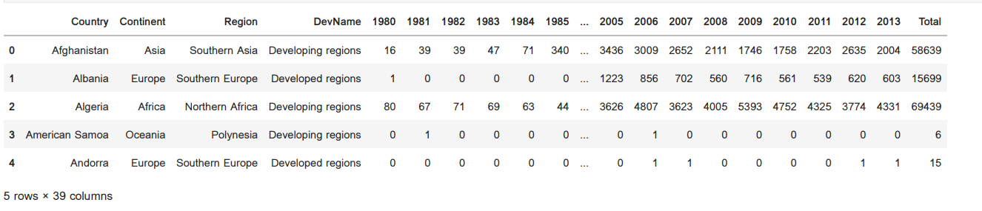
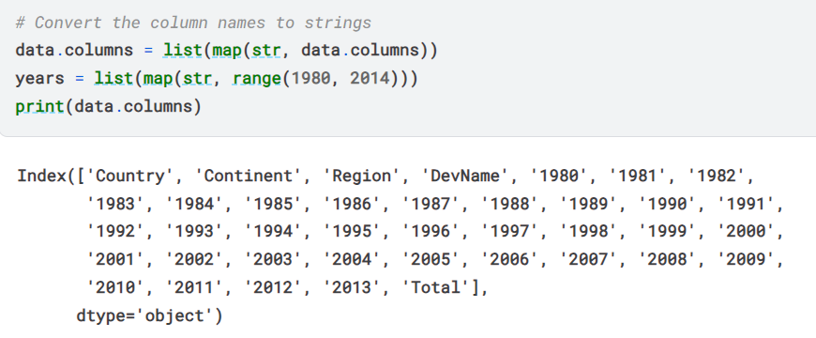
02
Data Description
01
Dataset Source: International migration flows to and from selected countries - The 2015 revision.
06
02
This dataset consists of immigrants record from 150+ countries to Canada between 1980 to 2013.
Canada
05
03
This dataset consist of 39 feature(immigration from 1980 to 2013 – country-continent-region-devName and total).
04
This dataset is clean not have null values or duplicates values

Slide 5
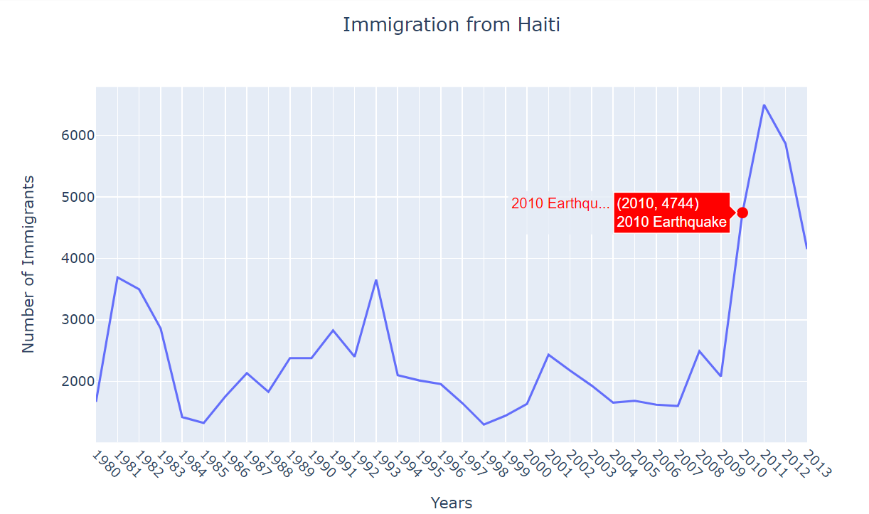
03
Data Visualization
In 2010, Haiti suffered a catastrophic magnitude 7.0 earthquake. The quake caused widespread devastation and loss of life and about three million people were affected by this natural disaster. As part of Canada's humanitarian effort, the Government of Canada stepped up its effort in accepting refugees from Haiti. We can quickly visualize this effort using a Line plot:

Slide 6
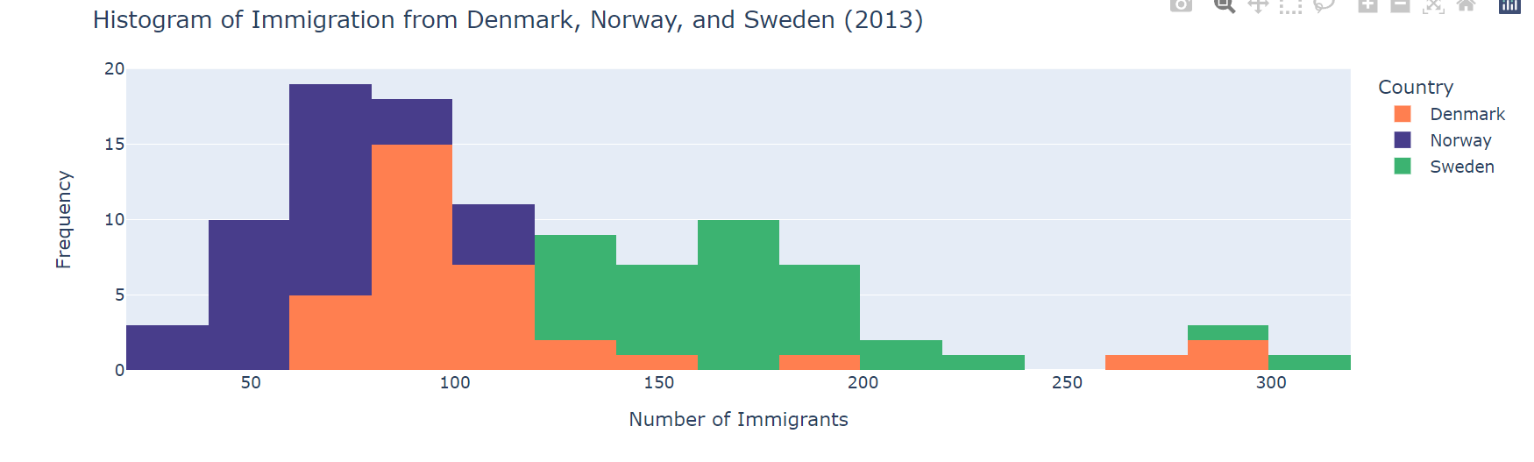
03
Data Visualization

Slide 7
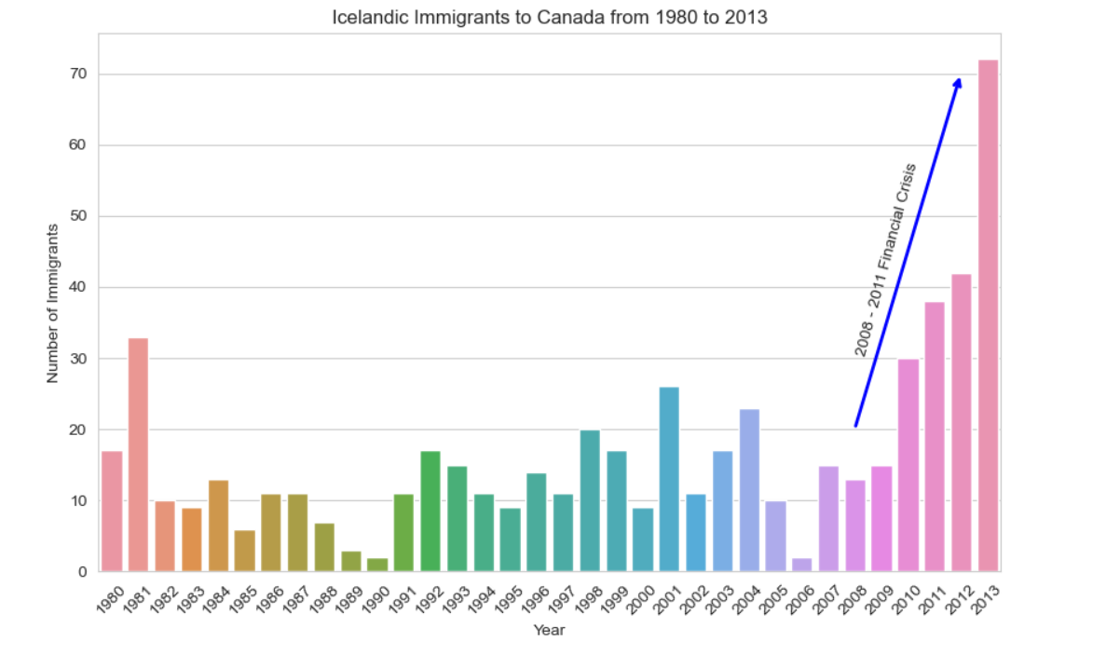
03
Data Visualization
The 2008 - 2011 Icelandic Financial Crisis was a major economic and political event in Iceland. Relative to the size of its economy, Iceland's systemic banking collapse was the largest experienced by any country in economic history. The crisis led to a severe economic depression in 2008 - 2011 and significant political unrest.
Question: Let's compare the number of Icelandic immigrants (country = 'Iceland') to Canada from year 1980 to 2013.

Slide 8
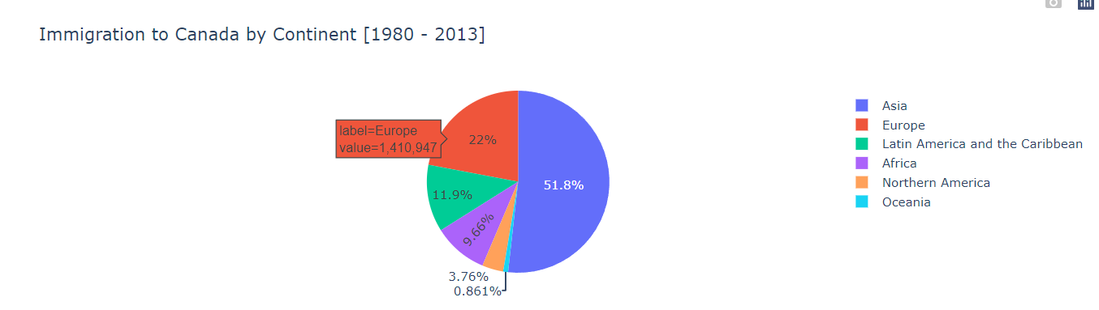
03
Data Visualization
From the visualization we can predict that the most immigration are from Africa

Slide 9
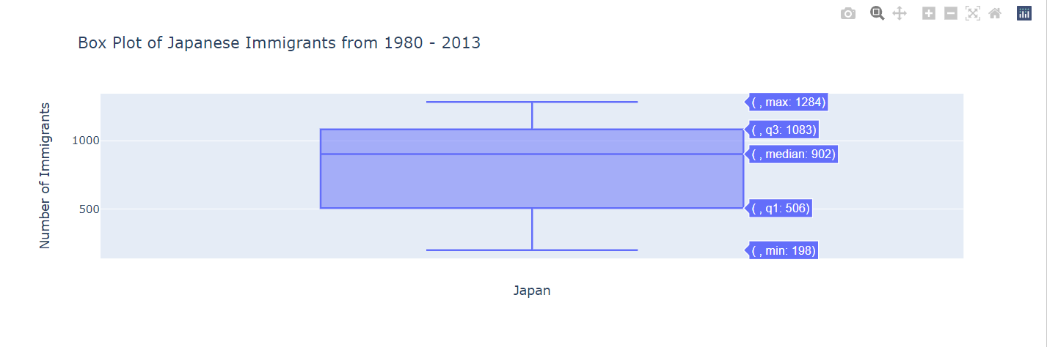
03
Data Visualization
The minimum number of immigrants is around 200 (min), maximum number is around 1300 (max), and median number of immigrants is around 900 (median).
25% of the years for period 1980 - 2013 had an annual immigrant count of ~500 or fewer (First quartile).
75% of the years for period 1980 - 2013 had an annual immigrant count of ~1100 or fewer (Third quartile).

Slide 10
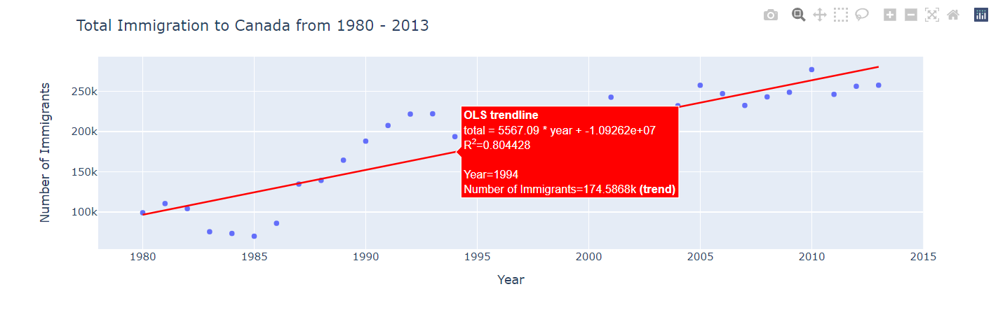
03
Data Visualization
- The data in a scatter plot is considered to express a trend. With further analysis using tools like regression, we can mathematically calculate this relationship and use it to predict trends outside the dataset.
- visualize the trend of total immigration to Canada (all countries combined) for the years 1980 - 2013.
- So let's plot a linear line of best fit, and use it to predict the number of immigrants in 2015.
- Step 1: Get the equation of line of best fit. We will use Numpy's polyfit() method by passing in the following:
- x: x-coordinates of the data.
- y: y-coordinates of the data.
- deg: Degree of fitting polynomial. 1 = linear, 2 = quadratic, and so on.

Slide 11
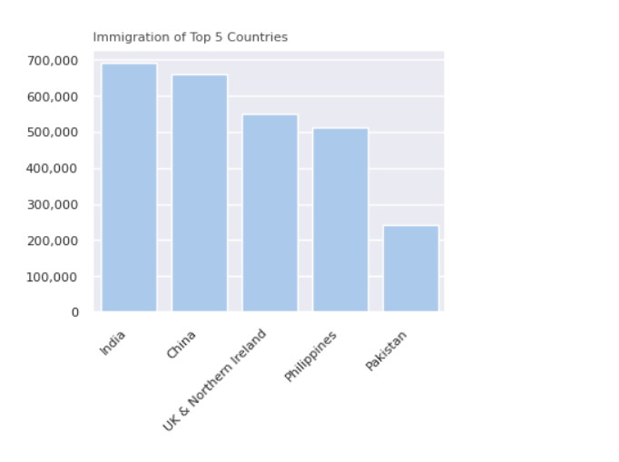
03
Data Visualization
Which countries have the highest immigration to Canada?

Slide 12
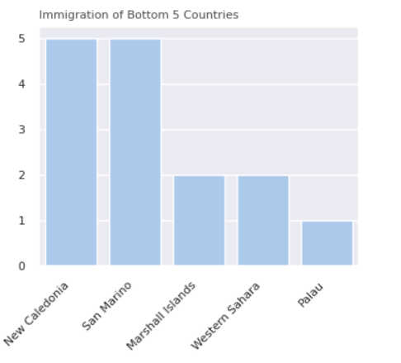
03
Data Visualization
Which countries have the lowest immigration to Canada?

Slide 13

Medical Care
Thank You…!
End

